Slide 1
Section 10.4
Applications

Slide 2
Objectives
Solve applied problems using quadratic equations.

Slide 3
Example 1: The Pythagorean Theorem
The length of a rectangle is 7 feet longer than the width. If one diagonal measures 13 feet, what are the dimensions of the rectangle?
Solution:
Draw a diagram for problems involving geometric figures whenever possible.
Let x = width of the rectangle
and x + 7 = length of the rectangle.

Slide 4
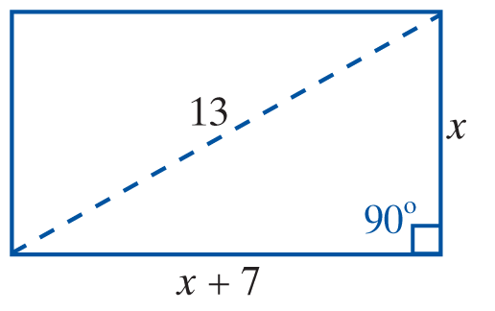
Example 1: The Pythagorean Theorem (cont.)
Then, by the Pythagorean Theorem:

Slide 5
Example 1: The Pythagorean Theorem (cont.)
A negative number does not fit the conditions of the problem.

Slide 6
Example 2: Work
Working for a janitorial service, a woman and her daughter can clean a building in 5 hours. If the daughter were to do the job by herself, she would take 24 hours longer than her mother would take. How long would it take her mother to clean the building without the daughter’s help?
(Note: For reference, this problem is similar to those discussed in Section 8.6 on work. The difference is that in this section the resulting equations are quadratic.)

Slide 7
Example 2: Work (cont.)
Solution: Let x = time for mother alone
and x + 24 = time for daughter alone.

Slide 8
Example 2: Work (cont.)

Slide 9
Example 2: Work (cont.)
The mother could do the job alone in 6 hours.

Slide 10
Example 3: Distance-Rate-Time
A small plane travels at a speed of 200 mph in still air. Flying with a tailwind, the plane is clocked over a distance of 960 miles. Flying against a headwind, it takes 2 hours more time to complete the return trip. What was the wind velocity?
Solution:
The basic formula is d = rt (distance = rate ∙ time).

Slide 11
Example 3: Distance-Rate-Time (cont.)
Let x = wind velocity.
Then 200 + x = speed of airplane going with the wind (tailwind),
200 − x = speed of airplane returning against the wind (headwind),
and 960 = distance each way.

Slide 12
Example 3: Distance-Rate-Time (cont.)
We know distance and can represent rate (or speed), so
the formula is used for representing time.

Slide 13
Example 3: Distance-Rate-Time (cont.)

Slide 14
Example 3: Distance-Rate-Time (cont.)
The wind velocity was 40 mph.

Slide 15
Example 3: Distance-Rate-Time (cont.)

Slide 16
Example 4: Geometry
a. A square piece of cardboard has a small square, 2 in. by 2 in., cut from each corner. The edges are then folded up to form a box with a volume of 5000 in.³ What are the dimensions of the box? (Hint: The volume is the product of the length, width, and height: V = lwh.)
Solution:
Draw a diagram illustrating the information.

Slide 17
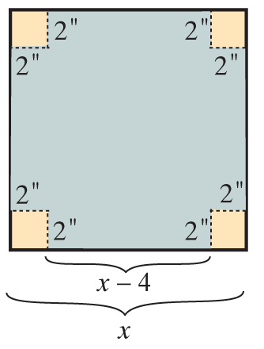
Example 4: Geometry (cont.)
Let x = one side of the square.

Slide 18
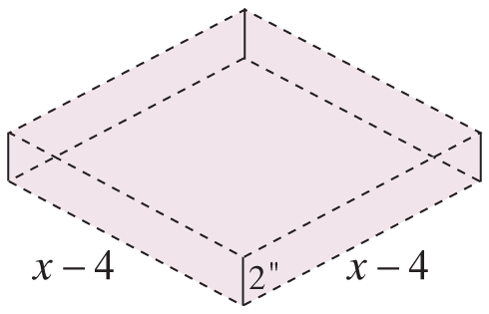
Example 4: Geometry (cont.)
The dimensions of the box are 50 in. by 50 in. by 2 in.

Slide 19
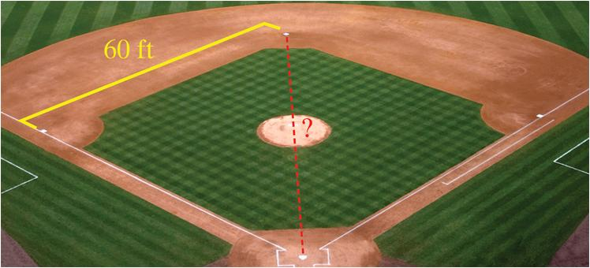
Example 4: Geometry (cont.)
b. A little league baseball field is in the shape of a square with sides of 60 feet. What is the distance (to the nearest tenth of a foot) the catcher must throw from home plate to second base?

Slide 20
Example 4: Geometry (cont.)
Solution: Since the distance from home plate to second base is the hypotenuse of a right triangle with sides of length 60 feet, we can use the Pythagorean Theorem as follows:
The catcher must throw about 84.9 feet.

