Slide 1
Section 10.5
Quadratic Functions:
y = ax² + bx + c

Slide 2
Objectives
Graph quadratic functions.
Find the vertex and the line of symmetry of a parabola.
Find maximum and minimum values of quadratic functions.

Slide 3
Quadratic Functions
Quadratic Function
A quadratic function is a function of the form
where a, b, and c are real constants and a ≠ 0.

Slide 4
Quadratic Functions
General Information on Quadratic Functions
For the quadratic function y = ax² + bx + c:
1. If a > 0, the parabola “opens upward.”
2. If a < 0, the parabola “opens downward.”
3. is the line of symmetry.

Slide 5
Quadratic Functions
General Information on Quadratic Functions (cont.)
4. The vertex (turning point) occurs where
Substitute this value for x in the function and find the y-value of the vertex. The vertex is the lowest point on the curve if the parabola opens upward or it is the highest point on the curve if the parabola opens downward.

Slide 6
Example 1: Graphing a Quadratic Function (b = 0)
For the quadratic function y = x² − 1, find (a) its vertex, (b) its line of symmetry, and (c) its x-intercepts. Plot a few specific points and graph the parabola.
Solution: For y = x² − 1, we have a = 1, b = 0, and c = −1.
(a) The vertex is at
Substituting 0 for x gives y = 0² − 1 = −1.
The vertex is the point (0, −1).
(b) The line of symmetry is

Slide 7
Example 1: Graphing a Quadratic Function (b = 0) (cont.)
(c) The x-intercepts can be found by setting y = 0 and solving the resulting quadratic equation. Thus

Slide 8
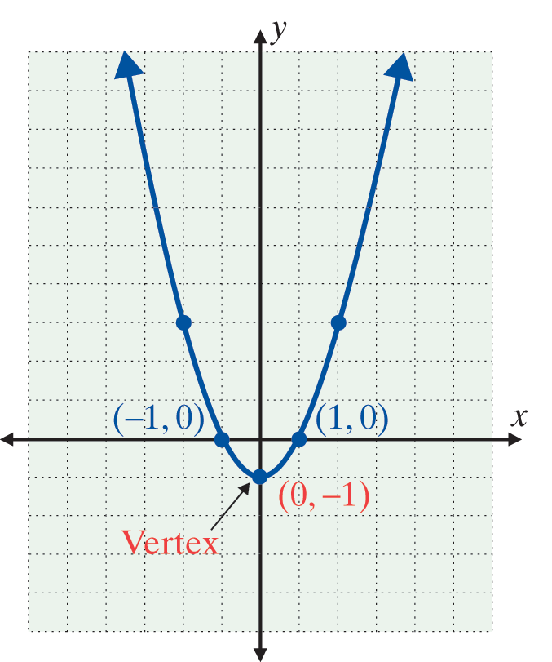
Example 1: Graphing a Quadratic Function
(b = 0) (cont.)
Thus the graph crosses the x-axis at the points (1, 0) and (−1, 0). These points and others can be found as shown in the table.
x | x² − 1 = y
−2 | (−2)² − 1 = 3
−1 | (−1)² − 1 = 0
0 | (0)² − 1 = −1
1 | (1)² − 1 = 0
2 | (2)² − 1 = 3
−1 is called the minimum value of the quadratic function.

Slide 9
Example 2: Graphing a Quadratic Function
For the quadratic function f(x) = x² − 6x + 1, find (a) its vertex, (b) its line of symmetry, and (c) its x-intercepts. Plot a few specific points and graph the parabola.
Solution: For f(x) = x² − 6x + 1, a = 1, b = −6, and c = 1.
(a) The vertex is at Substituting 3 for x
gives y = 3² − 6 ⋅ 3 + 1 = −8. The vertex is the point
(3, −8).
(b) The line of symmetry is

Slide 10
Example 2: Graphing a Quadratic Function (cont.)
(c) The x-intercepts can be found by setting y = 0 and solving the resulting quadratic equation. Thus, using the quadratic formula, we have
The x-intercepts are at
Estimating these values with a calculator gives the
x-­intercepts at about (5.83, 0) and (0.17, 0).

Slide 11
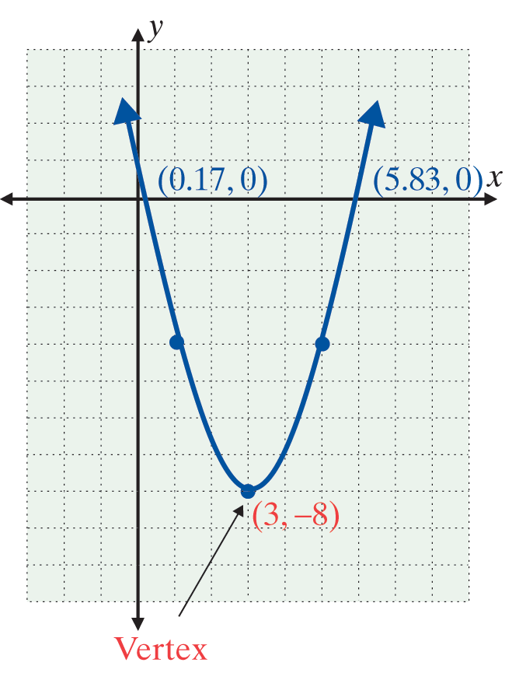
Example 2: Graphing a Quadratic Function (cont.)
Thus the graph crosses the x-axis at about (5.83, 0) and (0.17, 0). Other points can be found as shown in the table.
x | x² − 6x + 1 = y
1 | (1)² − 6(1) + 1 = −4
3 | (3)² − 6(3) + 1 = −8
5 | (5)² − 6(5) + 1 = −4
−8 is the minimum value of the quadratic function.

Slide 12
Example 3: Graphing a Quadratic Function (c = 0)
For the quadratic function y = −2x² + 4x, find (a) its vertex, (b) its line of symmetry, and (c) its x-intercepts. Plot a few specific points and graph the parabola.
Solution: For y = −2x² + 4x, a = −2, b = 4, and c = 0.
(a) The vertex is at
Substituting 1 for x gives
The vertex is the point (1, 2).

Slide 13
Example 3: Graphing a Quadratic Function (c = 0) (cont.)
(b) The line of symmetry is
(c) The x-intercepts can be found by setting y = 0 and solving the resulting quadratic equation. Thus, by factoring, we have
The x-intercepts are at (0, 0) and (2, 0). Thus the graph crosses the x-axis at the points (0, 0) and (2, 0).

Slide 14
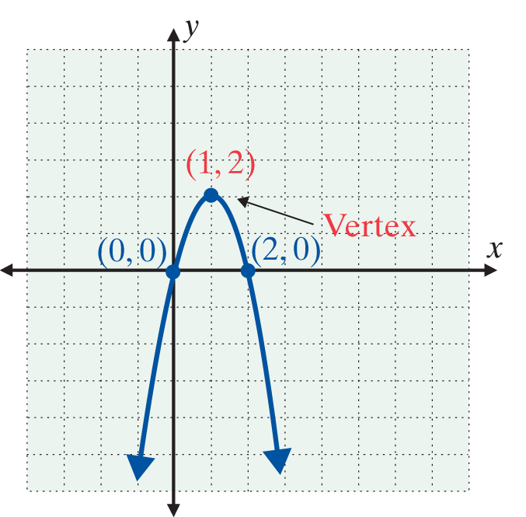
Example 3: Graphing a Quadratic Function
(c = 0) (cont.)
These points, along with others points can be found as shown in the table.
x | −2x² + 4x = y
0 | −2(0)² + 4(0) = 0
1 | −2(1)² + 4(1) = 2
2 | −2(2)² + 4(2) = 0
2 is called the maximum value of the quadratic function.

Slide 15
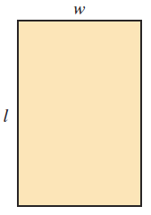
Example 4: Quadratic Function Application
Find the dimensions of the rectangle with maximum area if the perimeter is 40 meters.
Solution: Let A = area
l = length
w = width.

Slide 16
Example 4: Quadratic Function Application
So, substituting for w,
This is a quadratic function with a = −1, b = 20, and c = 0. The maximum area occurs at the vertex of the corresponding parabola where

Slide 17
Example 4: Quadratic Function Application
Thus the maximum occurs when l = 10 m and w = 10 m. (The rectangle is, in fact, a square and the area = 100 m².)

Slide 18

Example 5: Graphing with a Calculator
Use your graphing calculator to graph the quadratic function y = 2x² − x − 15. Then use the trace key to estimate the location of three points on the graph. (As shown in the following diagrams, set the WINDOW so that xmin = −10, xmax = 10, ymin = −20 and
ymax = 10.)
Solution: Step 1: Press the key marked .
Step 2: Enter the function to be graphed:
\Y₁ = 2X² − X − 15.

Slide 19

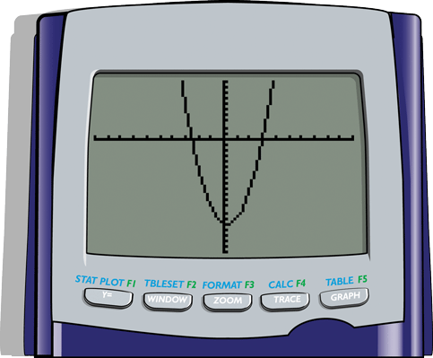
Example 5: Graphing with a Calculator
Step 3: Press in the upper right hand corner of the keyboard.
The graph of the parabola should appear on the display as shown here.

Slide 20

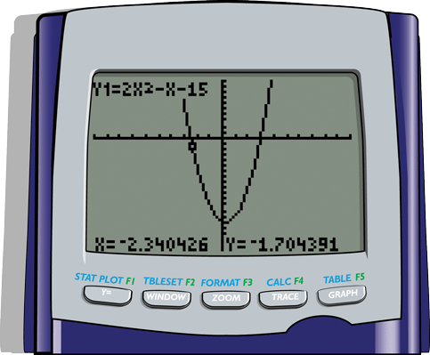
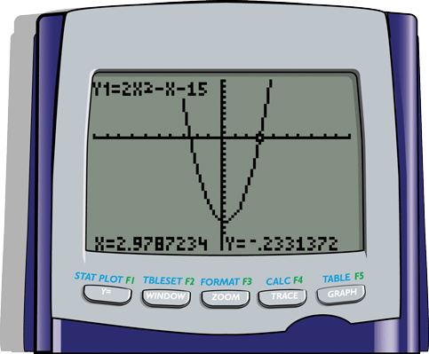
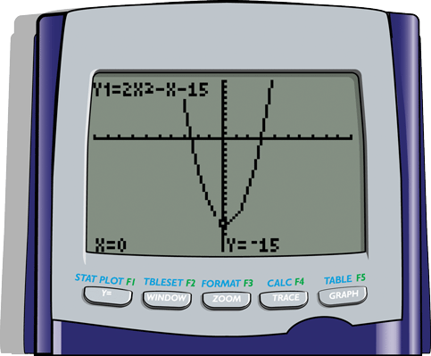
Example 5: Graphing with a Calculator
Now, press the key and move the cursor around to estimate the location of points. Three such locations are shown here.

