Slide 1
Section 2.2
Multiplication and Division with Fractions

Slide 2
Objectives
Reduce fractions to lowest terms.
Write fractions as equivalent fractions with specified denominators.
Multiply and divide fractions.

Slide 3
Rational Numbers Defined
Rational Number
A rational number is a number that can be written in the form where a and b are integers and b ≠ 0.

Slide 4
Rational Numbers Defined
Notes
There are fractions that cannot be written with the numerator and denominator as integers. For example,
is a fraction (very useful in trigonometry) but also an irrational number.

Slide 5
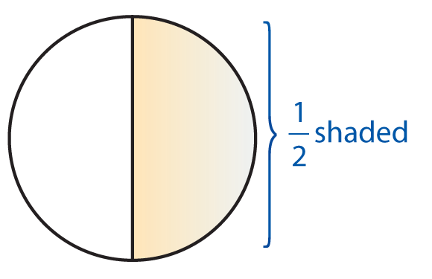
Example 1: Fractions
a. can mean 1 of 2 equal parts.
If you read of a book, then you can view this as
having read one of two equal parts of the book. If the
book has 50 pages, then you read 25 pages, since, as
we will see,

Slide 6
Example 1: Fractions (cont.)

Slide 7
Rational Numbers Defined
Rules for the Placement of Negative Signs in Fractions
If a and b are real numbers, and b ≠ 0, then
For example:

Slide 8
Example 2: Negative Signs in Fractions

Slide 9
Multiplication
Multiplication with Fractions
To multiply two fractions, multiply the numerators and multiply the denominators.
For example:

Slide 10
Multiplication
The Fundamental Principle of Fractions

Slide 11
Multiplication
To Build a Fraction to Higher Terms
To build a fraction to higher terms, use the Fundamental Principle and multiply both the numerator and denominator by the same nonzero number.

Slide 12
Multiplication
To Reduce a Fraction
To reduce a fraction, factor both the numerator and denominator and use the Fundamental Principle to “divide out” any common factors. If the numerator and the denominator have no common prime factors, the fraction has been reduced to lowest terms.

Slide 13
Example 3: Fundamental Principal of Fractions
a. Build to higher terms with denominator of 16a.
Solution:
Because we know that 8 · 2a = 16a, use k = 2a and

Slide 14
Example 3: Fundamental Principal of Fractions (cont.)
b. Write in the form of an equivalent fraction with
denominator 28.
Solution:
Because we know that 7 · 4 = 28, use k = 4 and

Slide 15
Example 3: Fundamental Principal of Fractions (cont.)
c. Reduce to lowest terms by using prime
factorization.
(Note: Section R.1 of the Review Chapter provides a thorough discussion of prime numbers.)
Solution:
Note that the negative sign can be with the same numerator or in front of the fraction. We seldom use the negative sign in the denominator.

Slide 16
Example 3: Fundamental Principal of Fractions (cont.)
d. Find the product in lowest terms. (Do not
find the product directly. Factor and reduce as you multiply. Treat the variables as you would numbers.)
Solution:

Slide 17
Example 3: Fundamental Principal of Fractions (cont.)
e. Find the product in lowest terms. (Note that
the number 1 is implied to be a factor even if it is not written.)
Solution:
Remember that if all factors are divided out (in the numerator or denominator), you must use 1 even if it is not written.

Slide 18
Division
Reciprocal
If a ≠ 0 and b ≠ 0, the reciprocal of
Remember that 0 has no reciprocal. That is, is undefined.

Slide 19
Division
Division
To divide by a nonzero fraction, multiply by its reciprocal:

Slide 20
Example 4: Dividing Fractions with Negative Numbers
Solution:
Note that, just as with integers, the product of two negative fractions is positive.

Slide 21
Example 4: Dividing Fractions with Negative Numbers (cont.)
In algebra, an improper fraction (a fraction with the numerator greater than the denominator), is preferred to the mixed number
Improper fractions are perfectly acceptable as long as they are reduced, meaning the numerator and denominator have no common prime factors. We will discuss mixed numbers in more detail in the next section.

Slide 22
Example 5: Dividing Fractions with Variables
Solution:

Slide 23
Example 6: Multiplication and Division of Fractions

Slide 24
Example 7: Multiplication and Division of Fractions
If of a number is 99, what is the number?
Solution:
Because we know the product, 99, the missing number
can be found by dividing the product by
The other number is 264. That is of 264 is 99.

Slide 25
Example 7: Multiplication and Division of Fractions (cont.)
(Note: As we will see in Chapter 3, this problem can be approached algebraically with a variable.)

Slide 26
Division
Notes
Important note about expressions involving fractions in algebra.
An expression with a fraction as the coefficient can be
written in two different forms. For example,
have the same meaning. That is, for all values of x, we
have

