Slide 1
Section 2.4
Decimal Numbers and Fractions

Slide 2
Objectives
Operate with decimal numbers.
Change fractions to decimal form.
Change decimals to fraction form.

Slide 3
Multiplication and Division with Decimals (Review)
Multiplying Two Decimal Numbers
1. Multiply the two numbers as if they were whole numbers.
2. Count the total number of places to the right of the decimal points in both numbers being multiplied.
3. Place the decimal point in the product so that the number of places to the right is the same as that found in step 2.

Slide 4
Example 1: Multiplication with Decimals
Find the products.
Solution:
Solution:

Slide 5
Multiplication and Division with Decimals (Review)
Dividing Two Decimal Numbers
To find the quotient of two decimal numbers:
1. Move the decimal point in the divisor to the right to get a whole number,
2. Move the decimal point in the dividend the same number of places,
3. Place the decimal point in the quotient above the new place in the dividend, then
4. Divide as with whole numbers.

Slide 6
Example 2: Division with Decimals
Solution:
Decimal point in quotient.
We are actually multiplying both the divisor
and dividend by 10:

Slide 7
Example 2: Division with Decimals (cont.)

Slide 8
Example 3: Fraction to Decimal Form, Terminating Decimal
Solution:
so we divide. With a calculator
Or, we can write
Long division will give the same result.

Slide 9
Example 4: Fraction to Decimal Form,
Infinite Repeating Decimal
Write the fraction in decimal form as an infinite repeating decimal. Round the decimal to the nearest ten-thousandth (four decimal places).
Solution:
By dividing with long division (or using a calculator) we will find that
This notation with the bar over the six digits 142857 indicates that they repeat indefinitely and in that order.

Slide 10
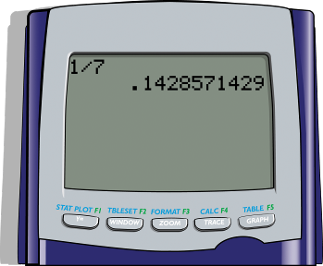
Example 4: Fraction to Decimal Form,
Infinite Repeating Decimal
Thus to four decimal places we have
With a TI-84 Plus calculator you will find the following:

Slide 11
Changing Decimals to Fraction Form
Changing Decimals to Fraction Form
To write a decimal in fraction form:
1. Write the fraction part of the decimal in the numerator and the position (place value) in the denominator.
2. Reduce the fraction to lowest terms.

Slide 12
Example 5: Decimal to Fraction Form
Write the decimal number 0.56 in fraction form, reduced.
Solution:

Slide 13
Example 6: Calculating Average Speed
During three school days in one week, Matilde drove her mother’s car to school and noted that her top speed each day was 25 mph, 35 mph, and 55 mph. When her mother asked what her average top speed was, what was her answer (to the nearest tenth)?
Solution: Matilde had taken this class and knew to add the numbers and divide by 3:
25 + 35 + 55 = 115
115 ÷ 3 = 38.3 mph (to the nearest tenth)
Her average speed was 38.3 mph.

Slide 14
Using Calculators
Graphing Calculators and Fractions
The TI-84 Plus Graphing Calculator has commands that will:
1. Change decimal numbers into fraction form.
2. Change fractions into decimal form (done by division).
3. Add two fractions with different denominators and find the result with a common denominator.

Slide 15
Example 7: Evaluating Fractions with a Calculator
Use a TI-84 Plus calculator (or other graphing calculator) to perform the following:
a. Change the decimal number 0.82 into fraction form.
b. Change the fraction into decimal form.
c. Find the sum in fraction form.

Slide 16

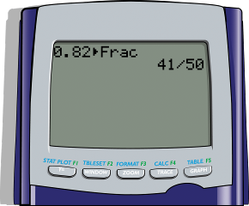

Example 7: Evaluating Fractions with a Calculator (cont.)
Solutions:
a. Proceed as follows:
Enter the numbers 0.82 (or just .82).
Press .
Select >Frac by pressing .
Press again.
The screen will display:
Note that the fraction is reduced.

Slide 17
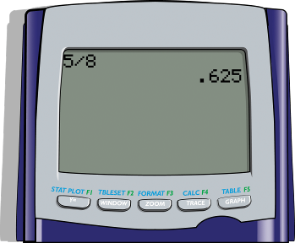
Example 7: Evaluating Fractions with a Calculator (cont.)
b. Proceed as follows:
Enter the fraction by entering 5 ÷ 8.
Press .
The calculator will automatically give the answer in decimal form and the screen will appear as follows:

Slide 18
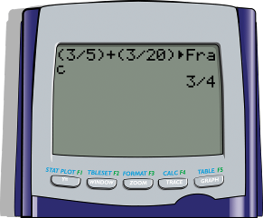
Example 7: Evaluating Fractions with a Calculator (cont.)
c. Proceed as follows:
Enter the sum of the fractions as (3 ÷ 5)+ (3 ÷ 20).
Press .
Select >Frac by pressing .
Press .
The display on the screen will appear as follows:
Note that the fraction is reduced.

Slide 19
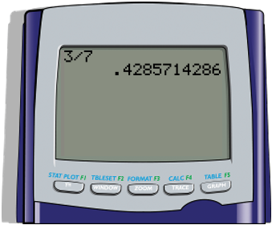
Example 8: Converting Fractions to
Infinite Repeating Decimals
Write the fraction in decimal form as an infinite
repeating decimal. Then round the decimal to the nearest ten-thousandth (four decimal places).
Solution:
We can divide by using long division as in or use a calculator as in 3 ÷ 7 = 0.428571428571 (accurate to ten decimal places on a TI-84 Plus).

Slide 20
Example 8: Converting Fractions to
Infinite Repeating Decimals (cont.)
The calculator has automatically rounded the last digit. In fact the pattern of digits is an infinite pattern:
Or, we can put a bar over the pattern (indicating that the pattern repeats indefinitely):

