Slide 1
Section 2.5
Order of Operations with Negative Numbers and Fractions

Slide 2
Objectives
Evaluate integer, fractional, and decimal expressions using the rules for order of operations.

Slide 3
Order of Operations
Rules for Order of Operations
1. Simplify within grouping symbols, such as parentheses ( ), brackets [ ], and braces { }, working from the inner most grouping outward.
2. Find any powers indicated by exponents.
3. Moving from left to right, perform any multiplications or divisions in the order they appear.
4. Moving from left to right, perform any additions or subtractions in the order they appear.

Slide 4
Order of Operations
Notes
Other grouping symbols are the absolute value bars
(such as ), the fraction bar (as in ), and the
square root symbol (such as ).

Slide 5
Order of Operations
Note
Even though the mnemonic PEMDAS is helpful, remember that multiplication and division are performed as they appear, left to right. Also, addition and subtraction are performed as they appear, left to right.

Slide 6
Example 1: Order of Operations with Integers
Use the rules for order of operations to evaluate each of the following expressions.
a. 36 ÷ 4 − 6 ⋅ 2² b. 2( 3² − 1 ) − 3 ⋅ 2³
c. 9 − 2[ ( 3 ⋅ 5 − 7² ) ÷ 2 + 2² ]
Solutions:

Slide 7
Example 1: Order of Operations with Integers (cont.)

Slide 8
Example 1: Order of Operations with Integers (cont.)
Note: Because of the rules for order of operations at no time did we even subtract 9 − 2.

Slide 9
Example 2: Order of Operations with Fractions
Use the rules for order of operations to evaluate each of the following expressions.

Slide 10
Example 2: Order of Operations with Fractions (cont.)
Solutions:

Slide 11
Example 2: Order of Operations with Fractions (cont.)

Slide 12
Example 2: Order of Operations with Fractions (cont.)

Slide 13
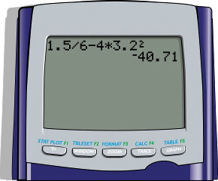
Example 3: Order of Operations with Decimals (using Calculators)
Calculators are programmed to use the rules for order of operations. Use your TI-84 Plus graphing calculator to find the value of each of the following expressions.
Solutions:
a.

Slide 14
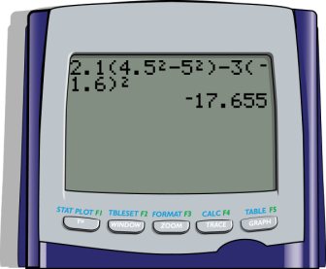
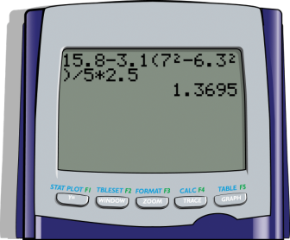
Example 3: Order of Operations with Decimals (using Calculators) (cont.)
b. c.

Slide 15
Practice Problems
Use the rules for order of operations to evaluate each expression.

Slide 16
Practice Problems (cont.)
Simplify.

Slide 17
Practice Problem Answers

