Slide 1
Section 3.7
Applications: Percent Problems (Discount, Taxes, Commission, Profit, and Others)

Slide 2
Objectives
Change decimals to percents.
Change percents to decimals.
Find percents of numbers.
Find fractional parts of numbers.
Solve word problems involving decimals, fractions, and percents.

Slide 3
The Basic Percent Formula R ⋅ B = A
The Basic Formula R ⋅ B = A
R = RATE or percent (as a decimal or fraction)
B = BASE (number we are finding the percent of)
A = AMOUNT or percentage (a part of the base)
“of” means to multiply.
“is” means equal (=).
The relationship among R, B, and A is given in the formula

Slide 4
Example 1: Percent of a Number
a. What is 72% of 800?
Solution:
R = 0.72 and B = 800 and A is unknown.
So, 576 is 72% of 800.

Slide 5
Example 1: Percent of a Number (cont.)
b. 57% of what number is 163.191?
Solution:
R = 0.57 and B is unknown and A is 163.191.
So, 57% of 286.3 is 163.191.

Slide 6
Example 1: Percent of a Number (cont.)
c. What percent of 180 is 45?
Solution:
R is the unknown and B is 180 and A is 45.
So, 25% of 180 is 45.

Slide 7
Example 2: Applications
A bicycle was purchased at a discount of 25% of its original price of $1600. If 6% sales tax was added to the purchase price, what was the total paid for the bicycle?
Solution:
There are two ways to approach this problem. One way is to find the discount and then subtract this amount from $1600. Another way is to subtract 25% from 100% to get 75% and then find 75% of $1600. In either case, the sales tax must be calculated on the sale price and added to the sale price.

Slide 8
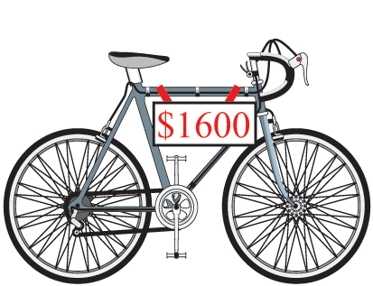
Example 2: Applications (cont.)
Here, we will calculate the discount and then subtract from the original price.

Slide 9
Example 2: Applications (cont.)
Original Price − Discount
= $1600 − $400 = $1200 Sale Price
Sales Tax = 6% of Sale Price = 0.06 ⋅ $1200 = $72
Total Paid = Sale Price + Sales Tax
= $1200 + $72 = $1272
The total paid for the bicycle, including sales tax, was $1272.

Slide 10
Example 3: Commission
A saleswoman earns a salary of $1200 a month plus a commission of 8% on whatever she sells after she has sold $8000 in furniture. What did she earn the month she sold $25,000 worth of furniture?
Solution:
First subtract $8000 from $25,000 to find the amount on which the commission is based.
$25,000 − $8000 = $17,000

Slide 11
Example 3: Commission (cont.)
Now, find the amount of the commission.
Now, add the commission to her salary to find what she earned that month.
$1200 + $1360 = $2560 earned for the month

Slide 12
Example 4: Percent of Profit
Calculate the percent of profit for both a and b and tell which is the better investment.
a. $300 profit on an investment of $2400.
b. $500 profit on an investment of $5000.
Solution:
Set up ratios and find the corresponding percents.

Slide 13
Example 4: Percent of Profit (cont.)
Clearly, $500 is more than $300, but 12.5% is greater than 10% and investment a. is the better investment.

Slide 14
Practice Problems
1. Write 0.3 as a percent.
2. Write 6.4% as a decimal.
3. Write as a percent.
4. Find 12% of 200.
5. Find the percent of profit if $400 is made on an investment of $1500.

Slide 15
Practice Problem Answers
1. 30%
2. 0.064
3. 20%
4. 24
5. 26.67%

