Slide 1
Section 3.8
Formulas in Geometry

Slide 2
Objectives
Recognize and use appropriate geometric formulas for computations.

Slide 3
Perimeter
Terminology and Notation Related to Circles
Term | Notation | Definition
1. Circumference 2. Radius | C r | The perimeter of a circle is called its circumference. The distance from the center of a circle to any point on the circle is called its radius.

Slide 4
Perimeter
Terminology and Notation Related to Circles (cont.)
Term | Notation | Definition
3. Diameter | d | The distance from one point on a circle to another point on The circle measured through Its center is called its diameter. (Note: The diameter is twice the radius: d = 2r.)

Slide 5
Perimeter
Terminology and Notation Related to Circles (cont.)
Term | Notation | Definition
4. Pi | π | π is a Greek letter used for the constant 3.1415926535… (π is an irrational number.)

Slide 6
Example 1: Perimeter
a. Find the perimeter of a rectangle with a length of
10 feet and a width of 8 feet.
Solution:
i. Sketch the figure.
ii.
The perimeter is 36 feet.

Slide 7
Example 1: Perimeter (cont.)
b. Find the circumference of a circle with a diameter of 3 centimeters.
Solution 1:
i. Sketch the figure.
ii.

Slide 8
Example 1: Perimeter (cont.)
Solution 2:
i. Sketch the figure.
ii.
Note that the result is the same with either formula. The circumference is approximately 9.42 centimeters.

Slide 9
Example 1: Perimeter (cont.)
c. Find the perimeter of the triangle with sides labeled as in the figure.
Solution:
The perimeter is 17.3 inches.

Slide 10
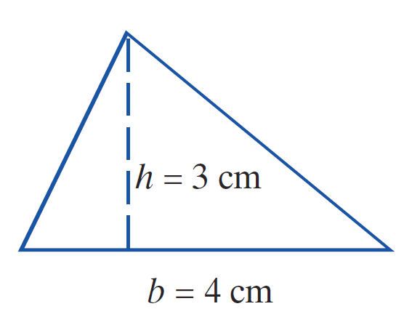
Example 2: Area
a. Find the area of a triangle with a height of 3 centimeters and a base of 4 centimeters.
Solution:
i. Sketch the figure.
ii.
The area is 6 square centimeters.

Slide 11
Example 2: Area (cont.)
b. Find the area of a circle with a radius of 6 inches. (Use π = 3.14.)
Solution:
i. Sketch the figure.
ii.
The area is approximately 113.04 square inches.

Slide 12
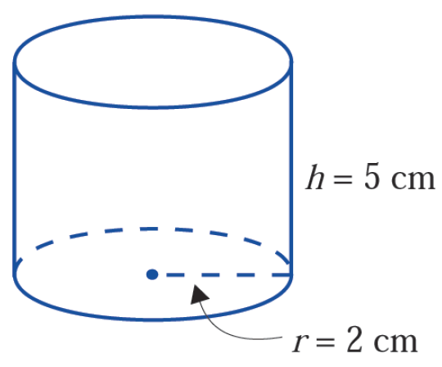
Example 3: Volume
a. Find the volume of a right circular cylinder with a radius of 2 centimeters and a height of 5 centimeters.
Solution:
i. Sketch the figure.
ii.
The volume is approximately 62.80 cubic centimeters.

Slide 13
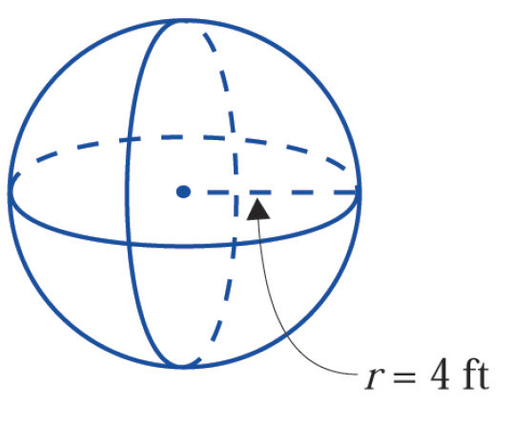
Example 3: Volume (cont.)
b. Find the volume of a sphere with a radius of 4 feet.
Solution:
i. Sketch the figure.
ii.
The volume is approximately 267.95 cubic feet.

Slide 14
Practice Problems
1. Find the area of a square with sides 4 cm long.
2. Find the area of a circle with a diameter 6 in.
3. Find the perimeter of a rectangle 3.5 m long and 1.6 m wide.
4. Find the volume of a rectangular solid with a length of 16 ft, a width of 10 ft, and a height of 1.4 ft.

Slide 15
Practice Problem Answers
1. 16 cm²
2. 28.26 in.² (or exactly 9π in.²)
3. 10.2 m
4. 224 ft³

