Slide 1
Section 4.2
Graphing Linear Equations in Two Variables: Ax + By = C

Slide 2
Objectives
Plot points that satisfy a linear equation and draw the graph of the corresponding line.
Recognize the standard form of a linear equation in two variables: Ax + By = C
Find the x-intercept and y-intercept of a line and graph the corresponding line.
Recognize equations of the form x = a and y = b as the forms for vertical and horizontal lines, respectively.

Slide 3
The Standard Form: Ax + By = C
Notes
Note that in the standard form Ax + By = C, A and B may be positive, negative, or 0, but A and B cannot both be 0.

Slide 4
Example 1: Graph by Plotting Points
a. Draw the graph of the linear equation x + 3y = 6.
Solution:

Slide 5
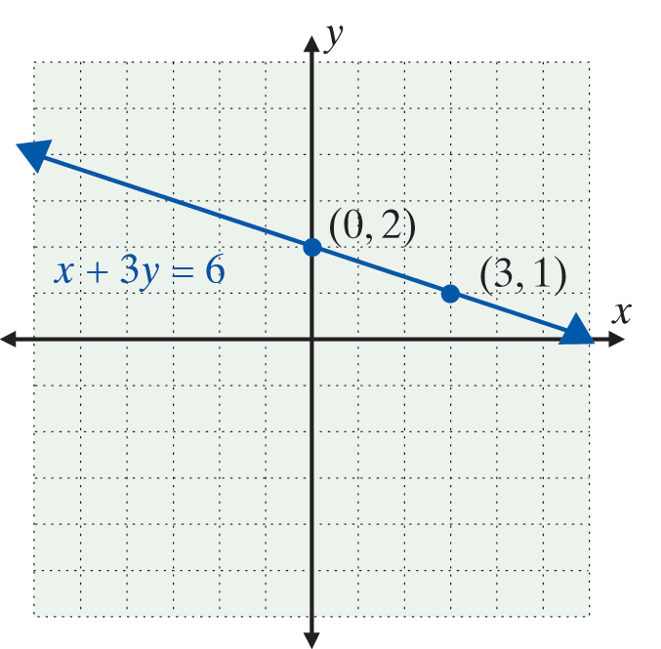
Example 1: Graph by Plotting Points (cont.)
Two points on the graph are (0, 2) and (3, 1). You may have chosen two other values for x and calculated the corresponding y-values. You would still get the same straight line as the graph. For accuracy in graphing, avoid choosing two points close together.

Slide 6
Example 1: Graph by Plotting Points (cont.)
b. Draw the graph of the linear equation 2x − 5y = 10.
Solution:

Slide 7
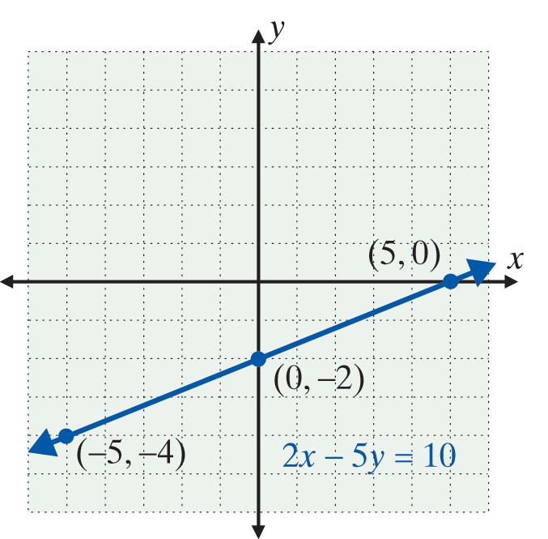
Example 1: Graph by Plotting Points (cont.)
Graphing three points is a good idea, if only to be sure the graph is in the right position and no error has been made in the calculations for the other points.

Slide 8
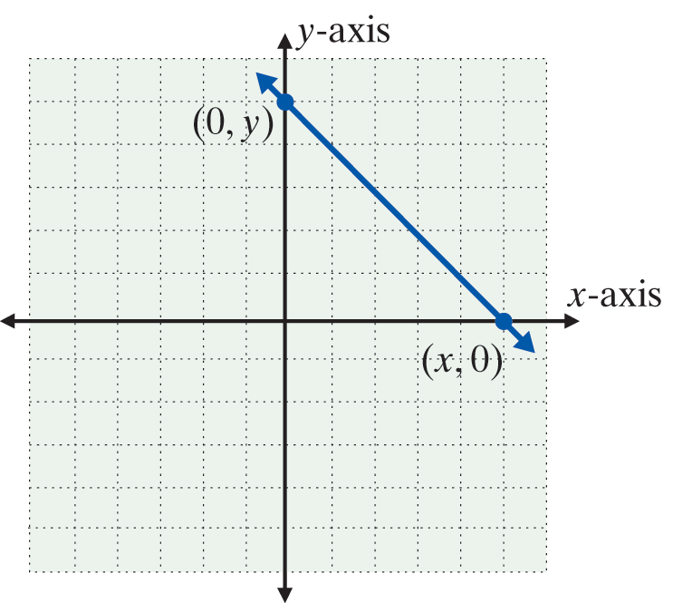
y-intercept and x-intercept
Intercepts
1. To find the y-intercept (where
the line crosses the y-axis),
substitute x = 0 and solve for y.
2. To find the x-intercept (where
the line crosses the x-axis),
substitute y = 0 and solve for x.

Slide 9
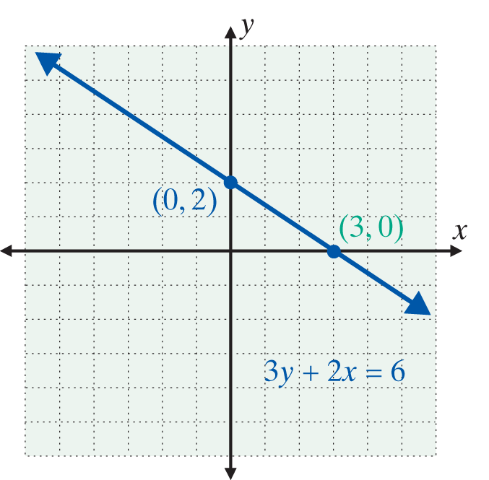
Example 2: Graph Using the y-and x-Intercepts
Graph the following linear equations by locating the y-intercepts and the x-intercepts.
a. 3y + 2x = 6
Solution:
(0, 2) is the y-intercept
(3, 0) is the x-intercept

Slide 10
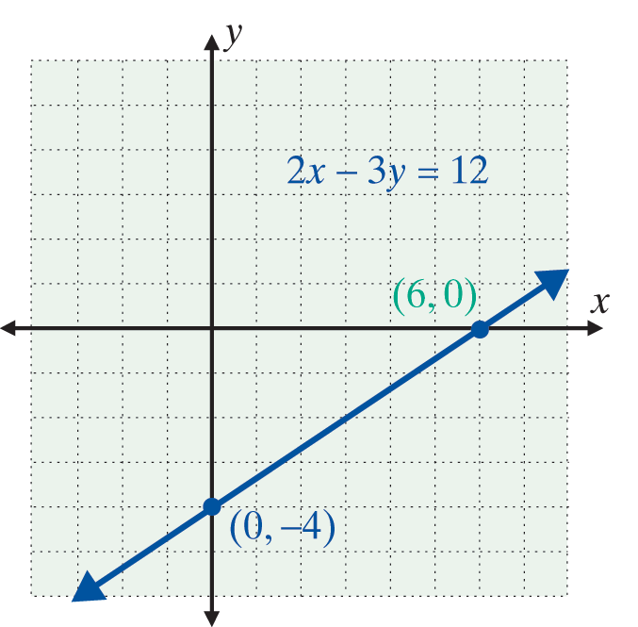
Example 2: Graph Using the y-and x-Intercepts (cont.)
b. 2x − 3y = 12
Solution:
(0, −4) is the y-intercept
(6, 0) is the x-intercept

Slide 11
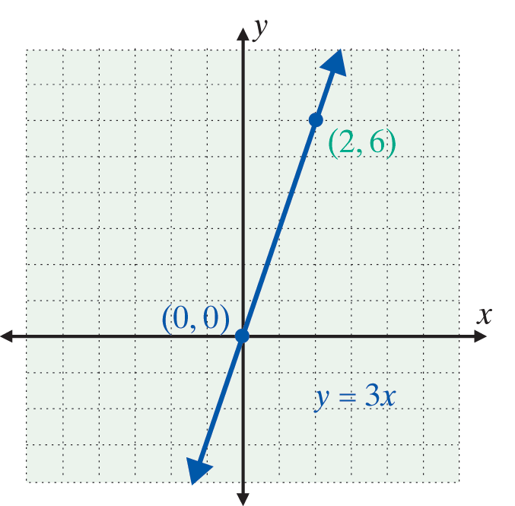
Example 3: Lines that Contain the Origin
Graph the linear equation y = 3x.
Solution:
Locate two points on the graph.

Slide 12
Horizontal and Vertical Lines
Horizontal and Vertical Lines
We can make the following two statements about horizontal and vertical lines:
1. The graph of any equation of the form y = b is a horizontal line.
2. The graph of any equation of the form x = a is a vertical line.

Slide 13
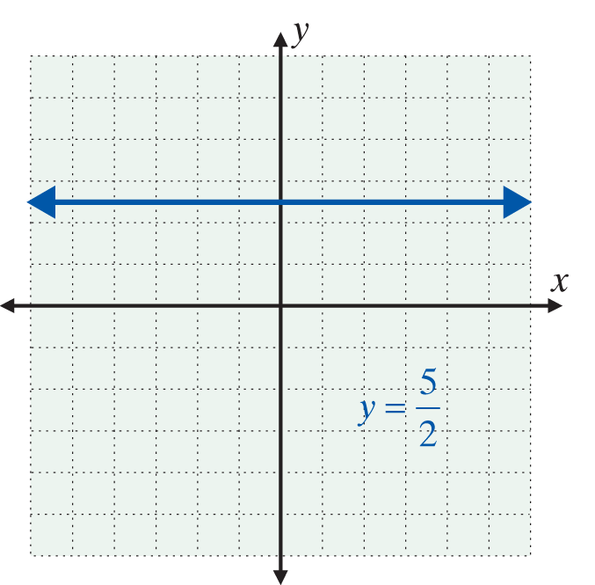
Example 4: Horizontal and Vertical Lines
Graph each of the following linear equations.
a. 2y = 5
Solution:
Solving for y:

Slide 14
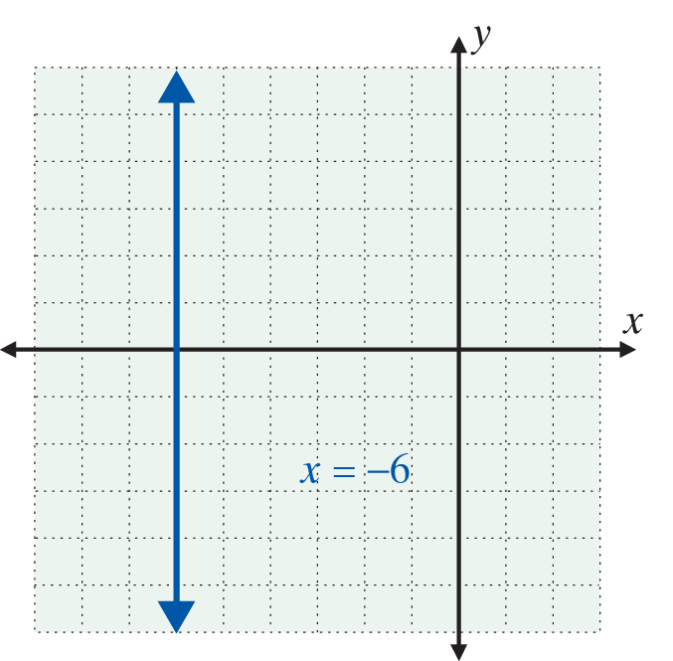
Example 4: Horizontal and Vertical Lines (cont.)
b. x + 6 = 0
Solution:
Solving for x:

