Slide 1
Section 4.3
The Slope-Intercept Form:
y = mx + b

Slide 2
Objectives
Find the slopes of lines given two points.
Write the equations of lines given the slopes and
y-intercepts.
Graph lines given the slopes and y-intercepts.
Find the slopes and y-intercepts of lines.
Find the slopes of horizontal and vertical lines.

Slide 3
The Meaning of Slope
Slope

Slide 4
Calculating the Slope
To Calculate the Slope of a Line
1. Locate any two points on the line.
2. Find the difference in the y-values and divide by the difference in the x-values.
3. This ratio (of rise divided by run) is the slope of the line.

Slide 5
Calculating the Slope
Notes
In the notation P₁, 1 is called a subscript and P₁ is read “P sub 1”. Similarly, P₂ is read “P sub 2” and P₃ is read “P sub 3.”

Slide 6
Calculating the Slope
Notes
All lines with the same slope are parallel.

Slide 7
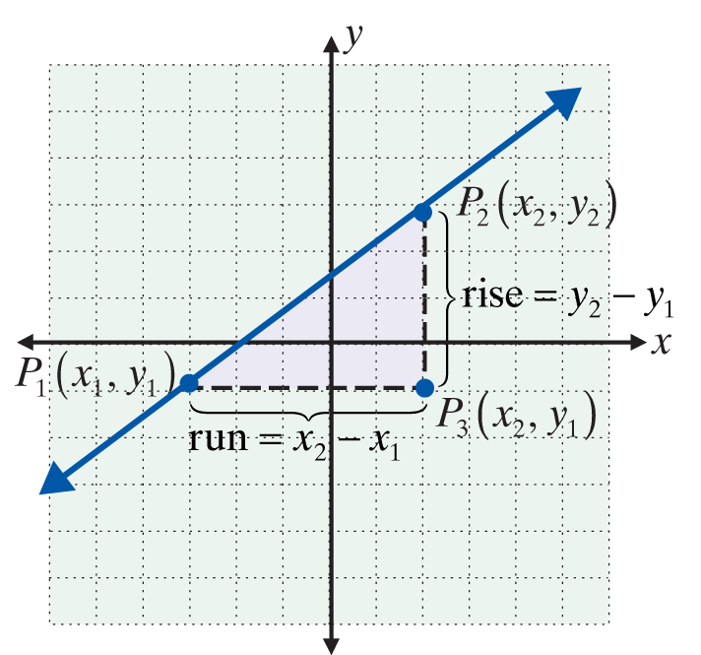
Calculating the Slope
Slope
Let P₁(x₁, y₁) and P₂(x₂, y₂) be two points on a line. Then P₃(x₂, y₁) is at the right angle shown in Figure, and the slope can be calculated as follows.

Slide 8
Example 1: Finding the Slope of a Line
a. Using the formula for slope, find the slope of the line 2x + 3y = 6.
Solution:

Slide 9
Example 1: Finding the Slope of a Line (cont.)
b. Suppose that the order of the points in Example 1a is changed. That is, (x₁, y₁) = (−3, 4) and (x₂, y₂) = (0, 2). Will this make a difference in the slope?
Solution:
Thus, the slope is the same even if the order of the points is reversed.

Slide 10
Calculating the Slope
Note
Lines with positive slope go up as we move along the line from left to right.
Lines with negative slope go down as we move along the line from left to right.

Slide 11
Slopes of Horizontal and Vertical Lines
Horizontal and Vertical Lines
The following two general statements are true for horizontal and vertical lines:
1. For horizontal lines (of the form y = b), the slope is 0.
2. For vertical lines (of the form x = a), the slope is undefined.

Slide 12
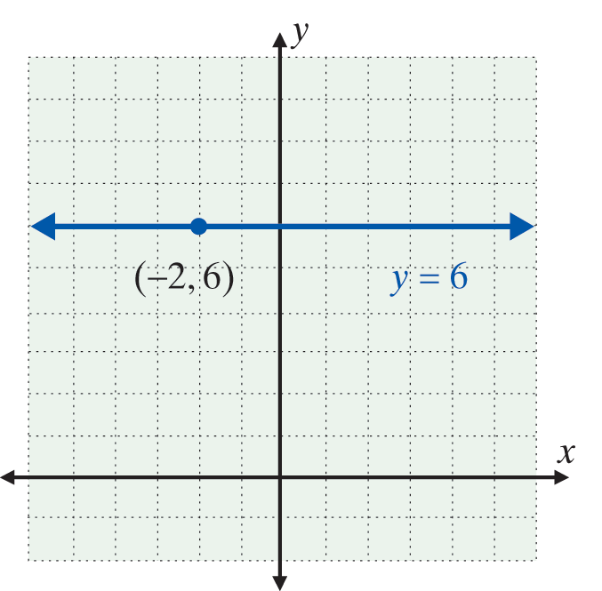
Example 2: Slopes of Vertical and Horizontal Lines
a. Find the equation and slope of the horizontal line through the point (−2, 6).
Solution:
The equation is y = 6 and the slope is 0.

Slide 13
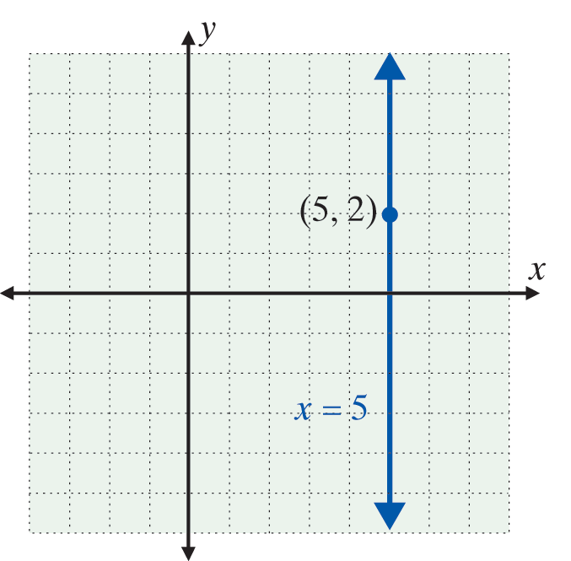
Example 2: Slopes of Vertical and Horizontal Lines (cont.)
b. Find the equation and slope of the vertical line through the point (5, 2).
Solution:
The equation is x = 5 and the slope is undefined .

Slide 14
Slopes of Horizontal and Vertical Lines
Special Note About Slopes of Lines
All lines that slant downward to the right have negative slopes.
All lines that slant upward to the right have positive slopes.
All horizontal lines have slope 0.
All vertical lines have slope undefined.

Slide 15
The Slope-Intercept Form: y = mx + b
For y = mx + b, m is the slope
Statement: Given an equation in the form y = mx + b, then m is the slope.
Proof: Suppose that the equation is solved for y and
y = mx + b. Let (x₁, y₁) and (x₂, y₂) be two points on the line where x₁ ≠ x₂. Then y₁ = mx₁ + b and y₂ = mx₂+ b so the slope can be calculated as follows:

Slide 16
The Slope-Intercept Form: y = mx + b
For y = mx + b, m is the slope (cont.)
Therefore, for an equation in the form y = mx + b, the slope of the line is m.

Slide 17
The Slope-Intercept Form: y = mx + b
Slope-Intercept Form
y = mx + b is called the slope-intercept form for the equation of a line. m is the slope and b is the y-intercept.

Slide 18
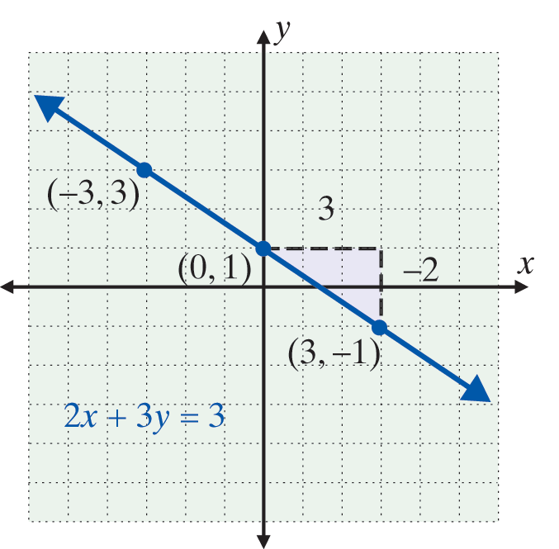
Example 3: Using the Form y = mx + b
a. Find the slope and y-intercept of 2x + 3y = 3 and graph the line.
Solution:

Slide 19
Example 3: Using the Form y = mx + b (cont.)
As shown in the figure, if we first “run” 3 units to the right and “rise” 2 units down from the y-intercept (0, 1), we locate another point (3, –1). The line can be drawn through these two points.

Slide 20
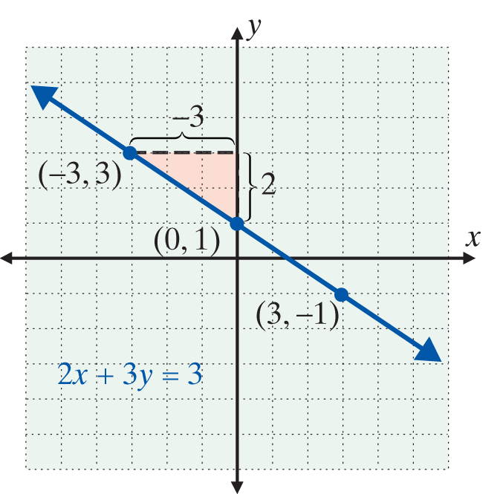
Example 3: Using the Form y = mx + b (cont.)
Note: We could also first “rise” 2 units up and “run” 3 units to the left from (0, 1) and locate another point on the graph, (−3, 3).

Slide 21
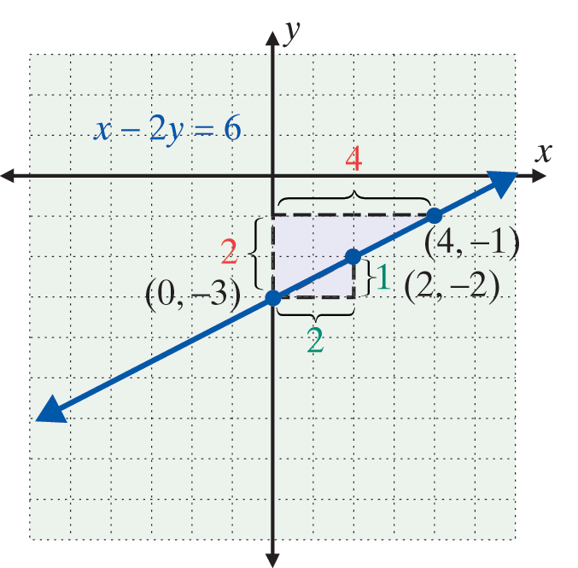
Example 3: Using the Form y = mx + b (cont.)
b. Find the slope and y-intercept of x − 2y = 6 and graph the line.
Solution:

Slide 22
Example 3: Using the Form y = mx + b (cont.)
Because and the y-intercept is (0, –3), we can
locate another point by moving first [from (0, –3)] a “run” of 2 units right and a “rise” of 1 unit up. This gives the point (2, –2) and we can draw the line through these two points.

Slide 23
Example 3: Using the Form y = mx + b (cont.)
Or, we can first move a “rise” of 2 units up and a “run” of 4 units right and locate the point (4, –1). [Note: The ratio of the rise to run must be 1 to 2, which is the
slope of the line:

Slide 24
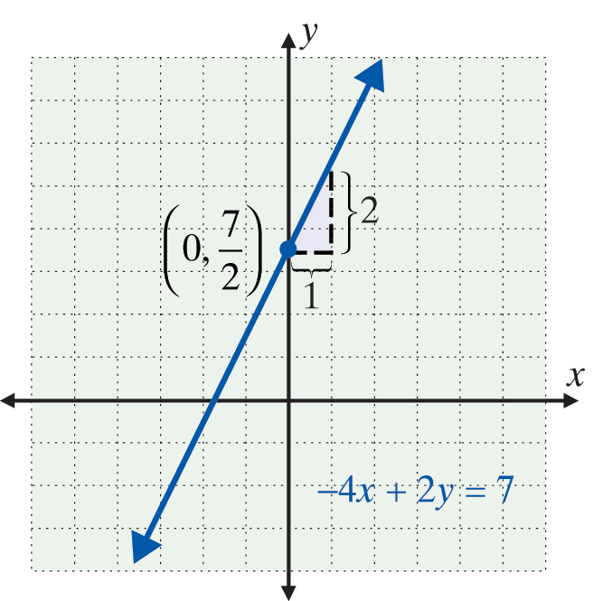
Example 3: Using the Form y = mx + b (cont.)
c. Find the slope and y-intercept of −4x + 2y = 7 and graph the line.
Solution:

Slide 25
Example 3: Using the Form y = mx + b (cont.)
(Note that the whole number 2 is written as a ratio
(fraction), because we must have two numbers, one
for the rise and one for the run, in analyzing the slope.)

Slide 26
Example 4: Finding the Equation of a Line
Find the equation of the line with y-intercept (0, −2)
and slope
Solution:
In this case, we can substitute directly into the slope-
intercept form y = mx + b with b = −2 and

Slide 27
Example 4: Finding the Equation of a Line (cont.)
In standard form, 3x − 4y = 8. Note that
is also in standard form. For convenience, we multiply by 4 so that the coefficients are integers. Both forms are correct and either form is an acceptable answer.

Slide 28
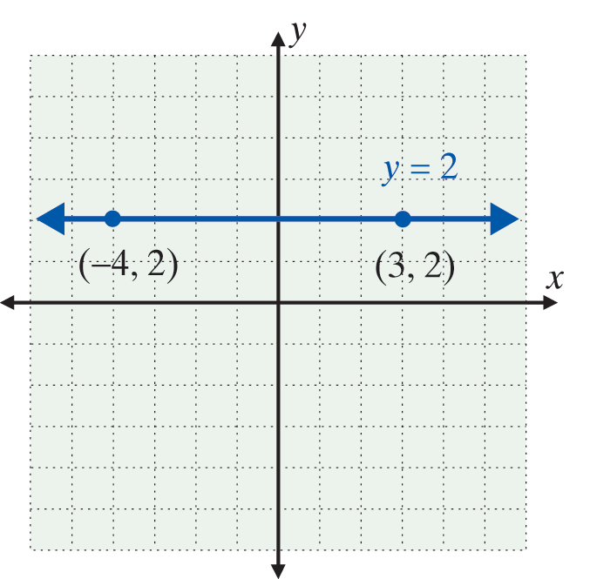
Example 5: Graphing Horizontal and Vertical Lines
a. Graph the horizontal line y = 2.
Solution:
Two points with y-value 2 are (−4, 2) and (3, 2). The line can be drawn through these two points.
Note that the slope m = 0 and the y-intercept is (0, 2).

Slide 29
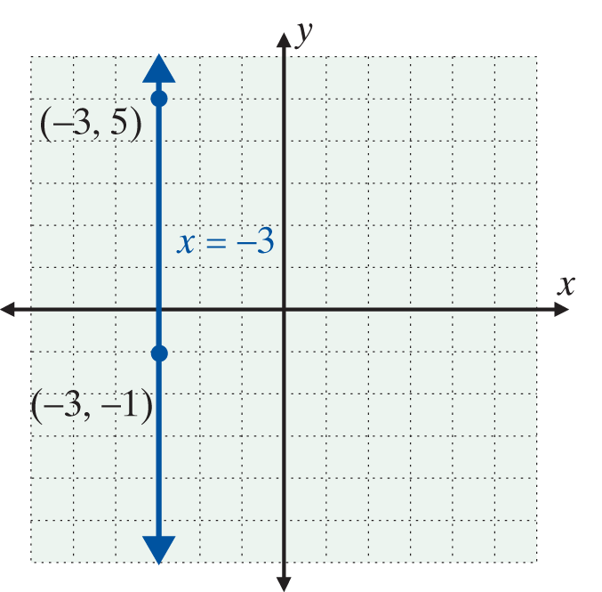
Example 5: Graphing Horizontal and Vertical Lines (cont.)
b. Graph the vertical line x = −3.
Solution:
Two points with x-value −3 are (−3, 5) and (−3, −1). The line can be drawn through these two points.
Note that the slope m is undefined and there is no y­-intercept.

Slide 30
Practice Problems
1. Find the slope of the line determined by the points (1, 5) and (2, −2).
2. Find the equation of the line through the point (0, 3)
with slope
3. Find the slope, m, and y-intercept, b, for the equation 2x + 3y = 6.
4. Write an equation for the horizontal line through the point (−2, 3).
5. Write an equation for the vertical line through the point (−1, −2).

Slide 31
Practice Problem Answers

