Slide 1
Section 4.4
Point-Slope Form:

Slide 2
Objectives
Graph lines given the slope and one point on each line.
Write the equations of lines given the slope and one point on each line.
Write the equations of lines given two points on each line.
Write linear equations from information given in applied problems.

Slide 3
Example 1: Graphing a Line Given a
Point and a Slope
a. Graph the line with slope which passes through the point (4, 5).
Solution:
Start from the point (4, 5) and locate another point on
the line using the slope as We can proceed in
either of the following ways:
1. Move 3 units up (rise) and 4 units right (run), or
2. Move 4 units right (run) and 3 units up (rise).

Slide 4
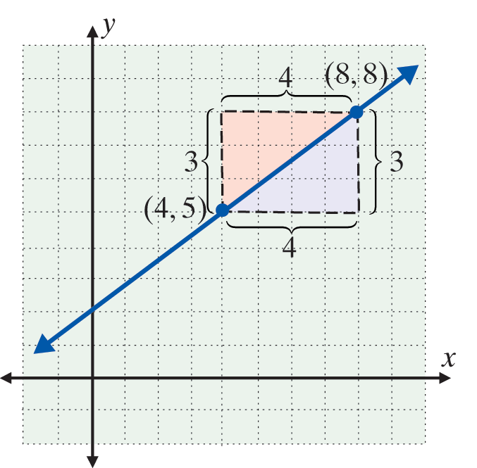
Example 1: Graphing a Line Given a
Point and a Slope (cont.)
Either way we arrive at the same point (8, 8).
(Note: any numbers in the ratio of 3 to 4 can be used for the moves, such as 6 to 8 or 9 to 12.)

Slide 5
Example 1: Graphing a Line Given a
Point and a Slope (cont.)
b. Graph the line with slope which passes through the point (−1, 4).
Solution:
Start from the point (−1, 4) and locate another point on the line using the slope as There are four ways to proceed. Here are two:
1. Move 2 units down and 5 units right, or
2. Move 5 units right and 2 units down.

Slide 6
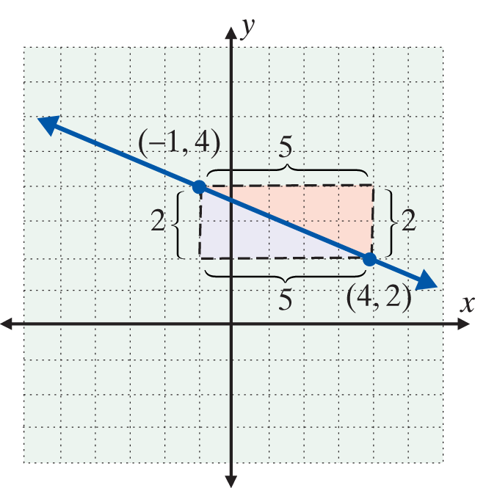
Example 1: Graphing a Line Given a
Point and a Slope (cont.)
Either way we arrive at the same point (4, 2).
What this means is that we can move from the given point with the rise first and then the run or run first and then the rise.

Slide 7
The Point-Slope Form
Point-Slope Form
is called the point-slope form for the equation of a line. m is the slope, and is a given point on the line.

Slide 8
Example 2: Using the Point-Slope Form
a. Find an equation of the line that has slope and passes through the point (1, 5).
Solution:
Substitute into the point-slope form
The Point-Slope Form.

Slide 9
Example 2: Using the Point-Slope Form (cont.)
This same equation can be written in the slope-intercept form and in standard form.
Slope-intercept form

Slide 10
Example 2: Using the Point-Slope Form (cont.)
Or multiplying each term by 3 gives
Standard form
or

Slide 11
Example 2: Using the Point-Slope Form (cont.)
b. Find three forms for the equation of the line with slope that contains the point (6, −1).
Solution: Use the point-slope form:

Slide 12
Example 2: Using the Point-Slope Form (cont.)

Slide 13
Finding the Equations of Lines Given Two Points
Finding the Equation of a Line
If two points are given,
1. Use the formula to find the slope.
2. Use this slope, m, and either point in the point- slope formula

Slide 14
Example 3: Using Two Points to
Find the Equation of Line
a. Find an equation of the line passing through the two
points (−1, −3) and (5, −2).
Solution:
Find m using the formula for slope.
Using the point-slope form [either point (−1, −3) or point (5, −2) will give the same result] yields

Slide 15
Example 3: Using Two Points to Find the Equation of Line (cont.)
Use (5, −2).
Point-slope form
Slope-intercept form
Multiply both sides by 6.
Standard form Ax + By = C

Slide 16
Example 3: Using Two Points to Find the Equation of Line (cont.)
b. Find an equation of the line that contains the points (−2, 3) and (5, 1).
Solution:

Slide 17
Example 3: Using Two Points to Find the Equation of Line (cont.)
Using (−2, 3) in the point-slope form gives
Slope-intercept form

Slide 18
Example 3: Using Two Points to Find the Equation of Line (cont.)
Or, using (5, 1) in the point-slope form gives

Slide 19
Example 3: Using Two Points to Find the Equation of Line (cont.)
Thus we see that using either point yields the same equation. The equation may be written in standard form 2x + 7y = 17.

Slide 20
Example 4: Finding the Equations of
Parallel Lines
Find the equation of the line through the point (2, −4) and parallel to the line y = 3x − 1.
Solution:
Because we know that the line y = 3x − 1 has slope
m = 3, we can use the point (2, −4) as and go directly to the form This gives the desired equation:
Point-slope form

Slide 21
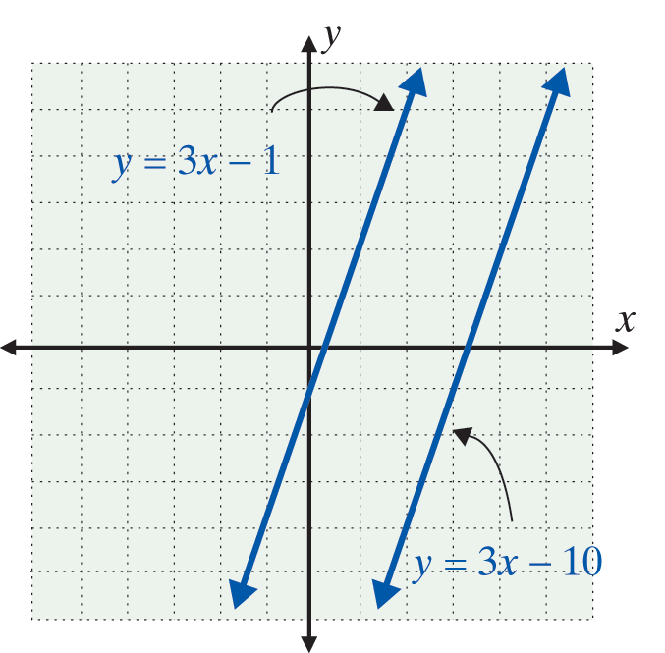
Example 4: Finding the Equations of
Parallel Lines (cont.)
or, simplifying

Slide 22
Example 5: Finding the Equations of
Perpendicular Lines
Find the equation of the line perpendicular to the line 3x + y = 7 and passing through the point (5, −2).
Solution:
For the equation 3x + y = 7, we solve for y and get y = −3x + 7.
This line has slope m = −3. Therefore, any line perpendicular to this line will have slope

Slide 23
Example 5: Finding the Equations of
Perpendicular Lines (cont.)
Now using the point slope form gives:
Simplifying gives:

Slide 24
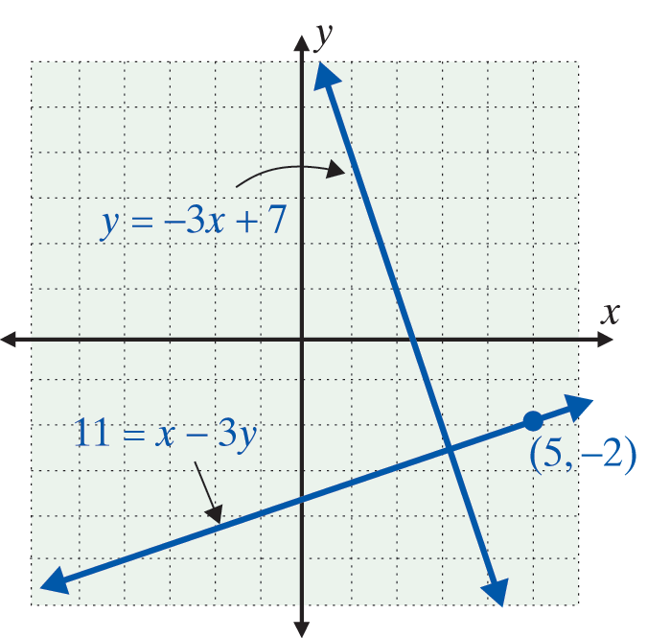
Example 5: Finding the Equations of
Perpendicular Lines (cont.)
Thus the line x − 3y = 11 passes through the point
(5, −2) and is perpendicular to the line 3x + y = 7. Both lines are graphed.

Slide 25
Practice Problems
1. Write an equation in standard form for the line with slope that contains the point (2, −2).
2. Write an equation in standard form for the line
passing through the two points (6, 2) and (−3, 1).
3. Write an equation in slope-intercept form for the line passing through the point (−5, 2) and parallel to the line 3x + y = 8. (Remember, parallel lines have the same slope.)

Slide 26
Practice Problem Answers

