Slide 1
Section 4.5
Introduction to Functions and Function Notation

Slide 2
Objectives
Determine whether a relation is or is not a function.
Find the domain and range of a relation or a function.
Use the vertical line test to determine whether a graph is or is not the graph of a function.
Use function notation.

Slide 3
Introduction to Functions
Relation
A relation is a set of ordered pairs.
The domain, D, of a relation is the set of all first coordinates in the relation.
The range, R, of a relation is the set of all second coordinates in the relation.

Slide 4
Example 1: Finding the Domain and Range
Find the domain and range for each of the following relations.
Solution:
Note that 6 is listed only once in the domain even though it appears in two ordered pairs. The numbers may be listed in any order in both the domain and range. We have listed them in order here for convenience only.

Slide 5
Example 1: Finding the Domain and Range (cont.)

Slide 6
Introduction to Functions
Function
A function is a relation in which each domain element has exactly one corresponding range element.
OR
A function is a relation in which each domain element occurs only once.

Slide 7
Example 2: Determining Functions
Determine whether each of the following relations is or is not a function.
Solution:
r is not a function. The first coordinate 2 appears more than once.
Solution:
s is a function. Each first coordinate has only one corresponding second coordinate.

Slide 8
Example 2: Determining Functions (cont.)
Solution:
t is a function. Each first coordinate appears only once. The fact that the second coordinates are all the same has no relevance in the definition of a function.

Slide 9
The Vertical Line Test
Vertical Line Test
If any vertical line intersects a graph of a relation in more than one point, then the relation graphed is not a function.

Slide 10
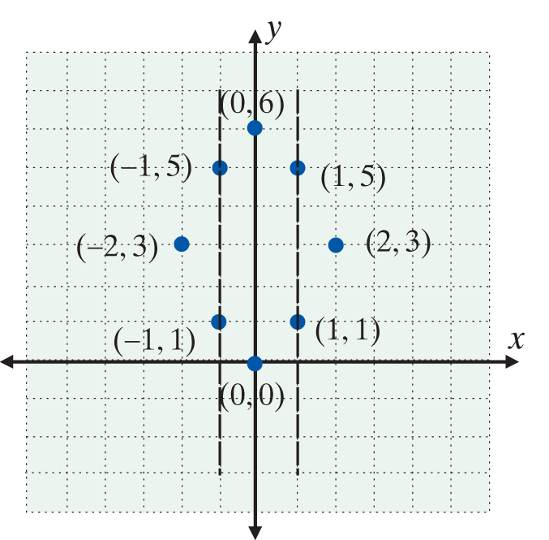
Example 3: Vertical Line Test
Use the vertical line test to determine whether each of the following graphs does or does not represent a function.
a.

Slide 11
Example 3: Vertical Line Test (cont.)
Solution:
Not a function. At least one vertical line intersects the graph in more than one point. Listing the ordered pairs shows that several x-coordinates are repeated:

Slide 12
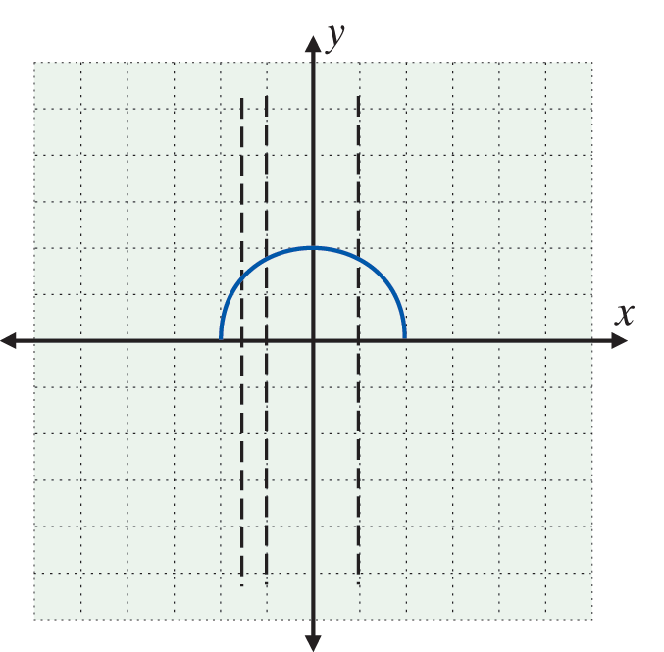
Example 3: Vertical Line Test (cont.)
b.
Solution:
A function. No vertical line will intersect the graph in more than one point. Several vertical lines are drawn to illustrate this fact.

Slide 13
Example 3: Vertical Line Test (cont.)
Furthermore, the domain and range can be determined by investigating the graph. We see that the domain and range consist of an infinite number of real values and are intervals of real numbers:

Slide 14
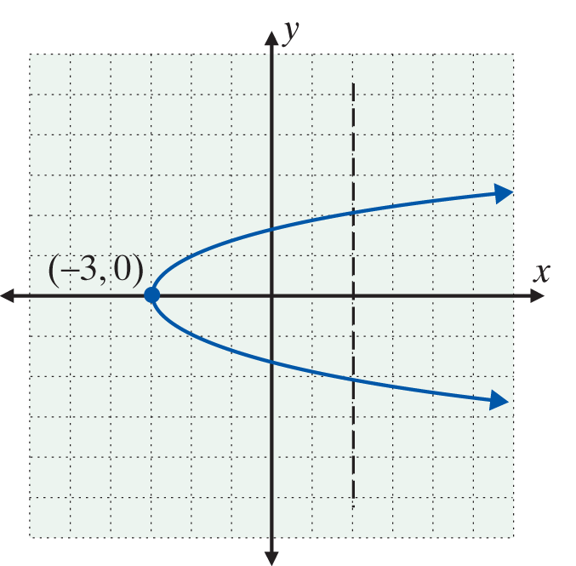
Example 3: Vertical Line Test (cont.)
c.
Solution:
Not a function. A vertical line intersects the graph in more than one point.

Slide 15
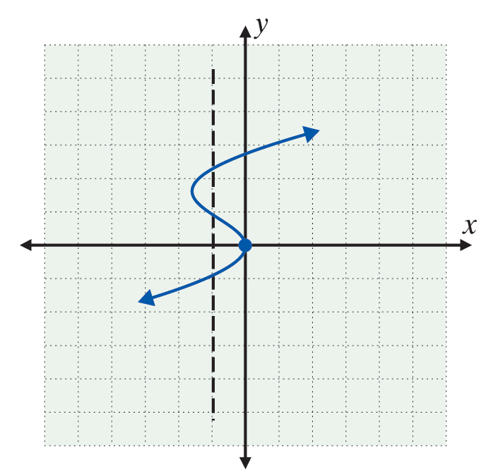
Example 3: Vertical Line Test (cont.)
d.
Solution:
Not a function. A vertical line intersects the graph in more than one point.

Slide 16
Example 4: Function Evaluation
For the function g(x) = 4x + 3, find
Solution:

Slide 17
Example 5: Nonlinear Function Evaluation
For the function find
Solution:

Slide 18
Example 6: Nonlinear Function Evaluation
For the function find
Solution:

Slide 19
Example 7: Nonlinear Function Evaluation
Given the function with restricted domain D = {−1, 0, 2, 3}, write the function as a set of ordered pairs.
Solution: For each x-value in D, find the corresponding y-value by substituting into f(x).

Slide 20
Example 7: Nonlinear Function Evaluation (cont.)
So the function can be written as the following set of ordered pairs:

Slide 21
Practice Problems
1. State the domain and range of the relation { (1, 2), (3, 4), (5, 6) }. Is the relation a function?
2. Write the function as a set of ordered pairs given f(x) = 2x − 5 and D = { −4, 0, 2, 3 }.

Slide 22
Practice Problem Answers

