Slide 1
Section 4.6
Graphing Linear Inequalities:
y < mx + b

Slide 2
Objectives
Understand the concept of a half-plane.
Graph linear inequalities.

Slide 3
Graphing Linear Inequalities: y < mx + b
Concepts Related to Straight Lines
In summary, we have discussed the following concepts related to straight lines:

Slide 4
Graphing Linear Inequalities: y < mx + b
Concepts Related to Straight Lines (cont.)
x = a represents a vertical line
y = b represents a horizontal line
Parallel lines have the same slope.
Perpendicular lines have slopes that are negative (or opposite) reciprocals of each other.
Graphing calculators can be used to graph straight lines that are not vertical.

Slide 5
Graphing Linear Inequalities: y < mx + b
Two Methods for Graphing Linear Inequalities
First, graph the boundary line (dashed if the inequality is < or >, solid if the inequality is ≤ or ≥).
Method 1
a. Test any one point obviously on one side of the line.
b. If the test-point satisfies the inequality, shade the half-plane on that side of the line. Otherwise, shade the other half-plane.

Slide 6
Graphing Linear Inequalities: y < mx + b
Two Methods for Graphing Linear Inequalities (cont.)
Method 2
a. Solve the inequality for y (assuming that the line is not vertical).
b. If the solution shows y < or y ≤ , then shade the half-plane below the line.
c. If the solution shows y > or y ≥, then shade the half-plane above the line.
(Note: If the boundary line is vertical, then it is of the form x = a and Method 1 should be used.)

Slide 7
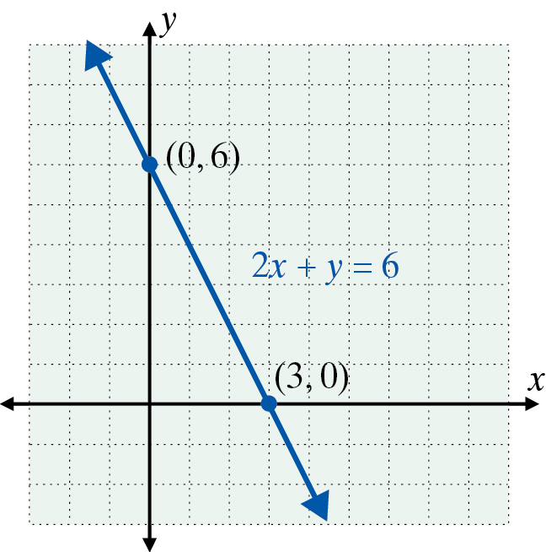
Example 1: Graphing Linear Inequalities
Graph the following inequalities.
a. Graph the half-plane that satisfies the inequality
Solution:
Method 1 is used in this example.
Step 1: Graph the line 2x + y = 6
as a solid line.

Slide 8
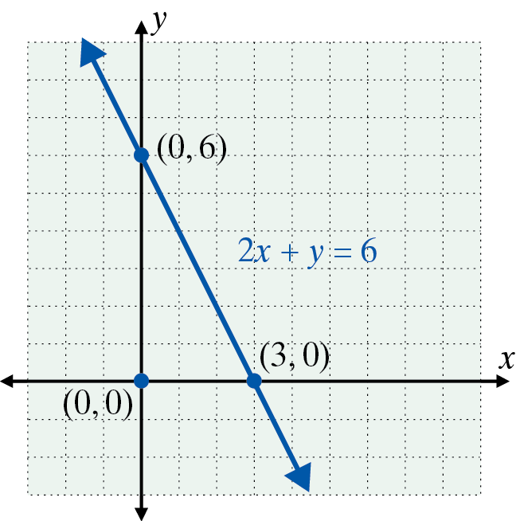
Example 1: Graphing Linear Inequalities (cont.)
Step 2: Test any point on one side of the line.
In this example, we have chosen (0, 0).
This is a true statement.

Slide 9
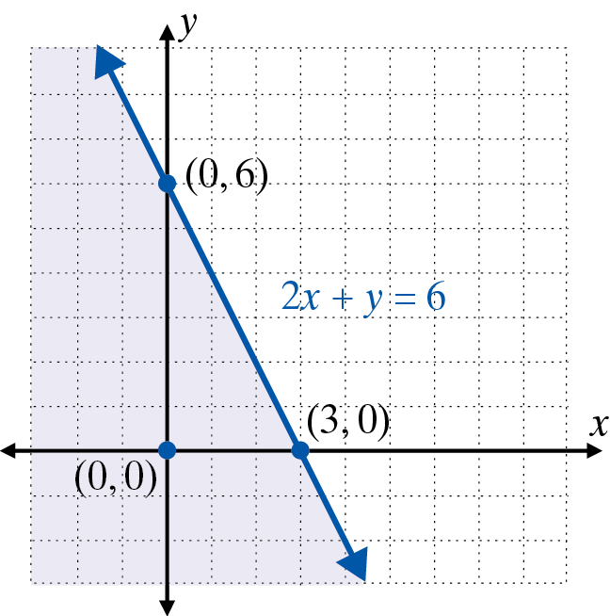
Example 1: Graphing Linear Inequalities (cont.)
Step 3:
Shade the points on the same side as the point (0, 0).

Slide 10
Example 1: Graphing Linear Inequalities (cont.)
b. Graph the solution set to the inequality y > 2x.
Solution:
Since the inequality is already solved for y, Method 2 is easy to apply.
Step 1:
Graph the line y = 2x as a dashed line.

Slide 11
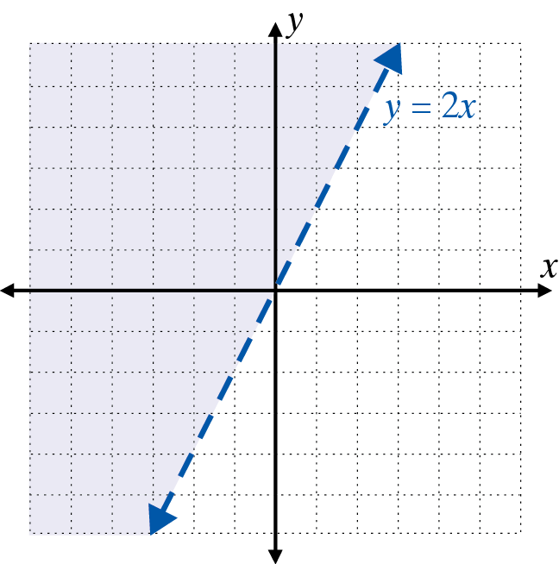
Example 1: Graphing Linear Inequalities (cont.)
Step 2: By Method 2, the graph consists of those points above the line. Shade the half-plane above the line.

Slide 12
Example 1: Graphing Linear Inequalities (cont.)
c. Graph the half-plane that satisfies the inequality y > 1.
Solution:
Again, the inequality is already solved for y and Method 2 is used.
Step 1:
Graph the horizontal line y = 1 as a dashed line.

Slide 13
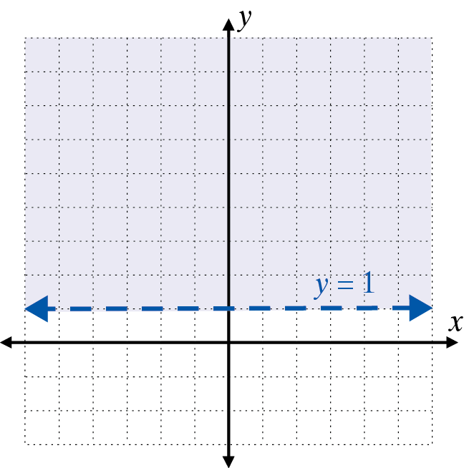
Example 1: Graphing Linear Inequalities (cont.)
Step 2: By Method 2, shade the half-plane above the line.

Slide 14
Example 1: Graphing Linear Inequalities (cont.)
d. Graph the solution set to the inequality x ≤ 0.
Solution:
The boundary line is a vertical line and Method 1 is used.
Step 1: Graph the line x = 0 as a solid line.
Note that this is the y-axis.
Step 2: Test the point (2, 1).
2 ≤ 0
This statement is false.

Slide 15
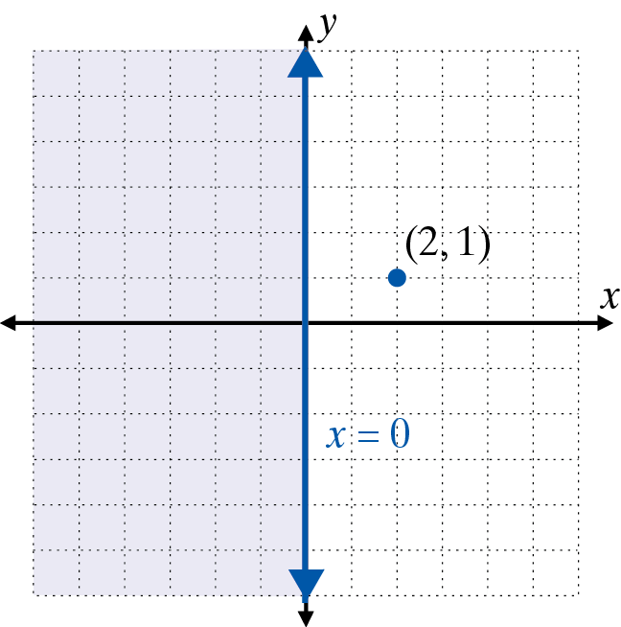
Example 1: Graphing Linear Inequalities (cont.)
Step 3: Shade the half-plane on the opposite side of the line as ( 2, 1 ). This half-plane consists of the points with x-coordinate 0 or negative.

Slide 16
Example 2: Graphing Using a TI-84 Plus (cont.)
a. Graph the linear inequality
Solution:
Step 1:
Solving the inequality for y gives:
Step 2:
Press the key and enter the function:

Slide 17

Example 2: Graphing Using a TI-84 Plus (cont.)
Step 3:
Go to the \ and hit two times so that the display
appears as follows:

Slide 18

Example 2: Graphing Using a TI-84 Plus (cont.)
Step 4:
Press and (assuming that the window includes part of the line) the following graph should appear on the display.

Slide 19
Example 2: Graphing Using a TI-84 Plus (cont.)
b. Graph the linear inequality −3x + 2y < −4
Solution:
Step 1: Solving the inequality for y gives:
Step 2:
Press the key and enter the function:

Slide 20

Example 2: Graphing Using a TI-84 Plus (cont.)
Step 3:
Go to the \ and hit three times so that the display appears as follows:

Slide 21
Example 2: Graphing Using a TI-84 Plus (cont.)
Step 4:
Press and (assuming that the window is okay) the following graph should appear on the display.

Slide 22
Practice Problems
1. Which of the following points satisfy the inequality
x + y < 3?
2. Which of the following points satisfy the inequality
x − 2y ≥ 0?

Slide 23
Practice Problems
3. Which of the following points satisfy the inequality
x < 3?

Slide 24
Practice Problem Answers

