Slide 1
Section 5.1
Systems of Equations: Solutions by Graphing

Slide 2
Objectives
Determine if given points lie on both lines in specified systems of equations.
Determine, by graphing, if systems of linear equations are consistent, inconsistent, or dependent.
Estimate, by graphing, the coordinates of the intersections of consistent systems of linear equations.

Slide 3
Example 1: Solution of a System
Show that (2, 1) is a solution to the system
Solution:
Substitute x = 2 and y = 1 into both equations.
In the first equation:

Slide 4
Example 1: Solution of a System (cont.)
In the second equation:
Because (2, 1) satisfies both equations, (2, 1) is a solution to the system.

Slide 5
Example 2: Not a Solution of a System
Show that (0, 4) is not a solution to the system
Solution:
Substitute x = 0 and y = 4 into both equations.
In the first equation:

Slide 6
Example 2: Not a Solution of a System (cont.)
In the second equation:
Because (0, 4) does not satisfy both equations, (0, 4) is NOT a solution to the system.

Slide 7
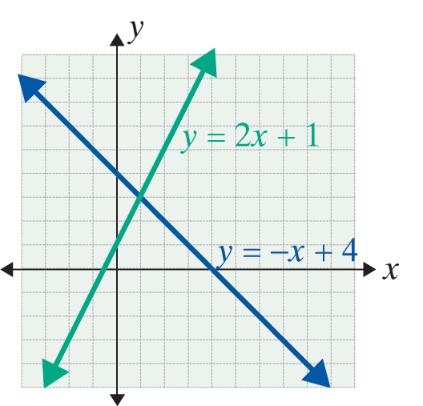
Solutions by Graphing
Solutions By Graphing
System | Graph | Intersection | Terms
 |  | One point: (1, 3) The point (1, 3) is the solution to the system. | Consistent

Slide 8
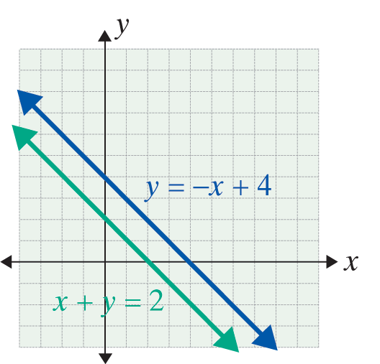
Solutions by Graphing
Solutions By Graphing (cont.)
System | Graph | Intersection | Terms
 |  | No points; lines are parallel. There is no solution to the system. | Inconsistent

Slide 9
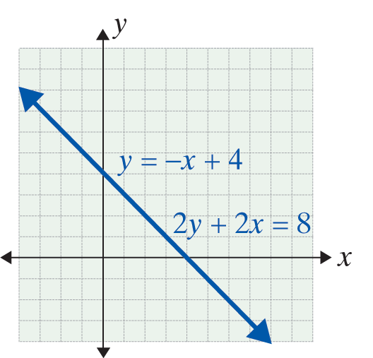
Solutions by Graphing
Solutions By Graphing (cont.)
System | Graph | Intersection | Terms
 |  | Lines coincide. The solution is an infinite set of points of the form (x, −x + 4). | Dependent

Slide 10
Solutions by Graphing
Notes
The graphing method of solving a system of linear equations shows the geometric relationship between the two lines. However, determining the exact point of intersection on a graph can be difficult or impossible. In particular, when the solution of a system involves fractions or roots, the point of intersection can only be estimated. Algebraic methods, which give exact solutions, will be discussed in Sections 5.2 and 5.3.

Slide 11
Example 3: Solving by Graphing
Solve the following systems graphically and state whether the systems are consistent, inconsistent, or dependent.

Slide 12
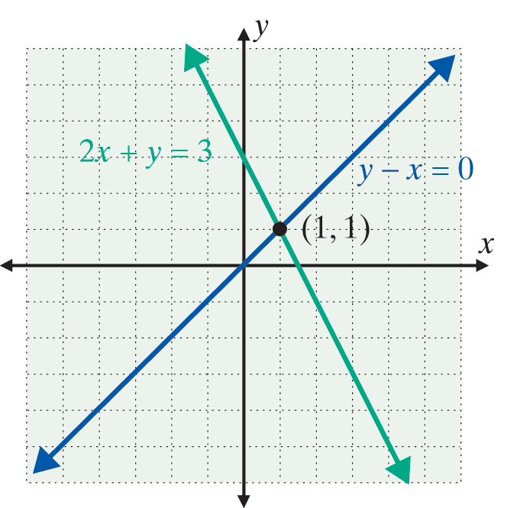
Example 3: Solving by Graphing (cont.)
Solutions:
a. The system is consistent.
The point of intersection
is (1, 1). That is, (1,1) is the
solution of the system.

Slide 13
Example 3: Solving by Graphing (cont.)
Check:
Substitute x = 1 and y = 1 into both equations.
For y − x = 0, we have 1 − 1 = 0.
For 2x + y = 3,
we have 2 ⋅ 1 + 1 = 3.

Slide 14
Example 3: Solving by Graphing (cont.)
b. The system is consistent, but the point of intersection can be only estimated. This example points out the main weakness in solving a system graphically. In such cases, any reasonable estimate will be acceptable. For example, if you estimated
or some such point, your
answer is acceptable.

Slide 15
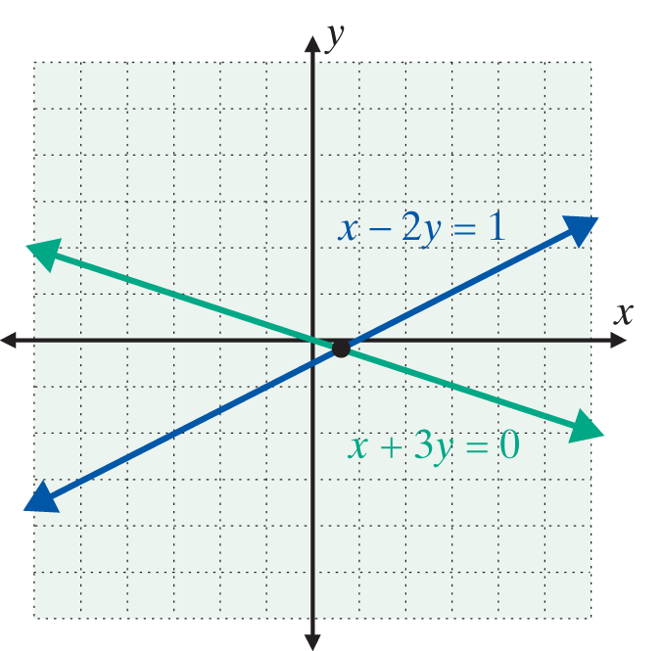
Example 3: Solving by Graphing (cont.)
The actual point of intersection (and the solution
to the system) is
We will be able to locate this point precisely using the techniques of the next section.

Slide 16
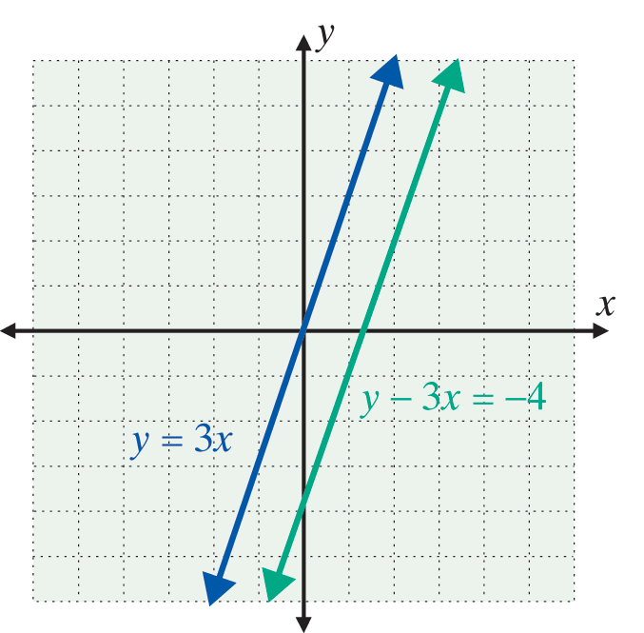
Example 3: Solving by Graphing (cont.)
c. The system is inconsistent. The lines are parallel with the same slope, 3, and there are no points of intersection. There is no solution to the system.

Slide 17
Example 3: Solving by Graphing (cont.)
d. The system is dependent. All points that lie on one line also lie on the other line. For example, (4, 1) is a point on the line x + 2y = 6 since 4 + 2( 1 ) = 6. The
point (4, 1) is also on the line since
Therefore, the solution can be stated
as all of the points that satisfy the equation x + 2y = 6. The solution is the set of all points of the form
an infinite set of solutions.

Slide 18
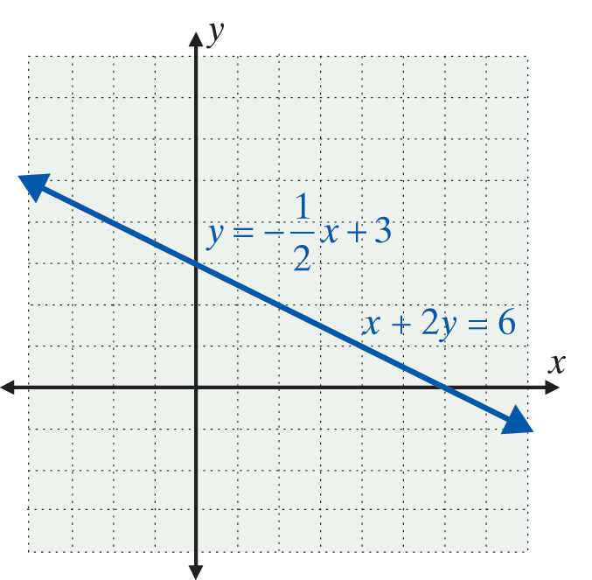
Example 3: Solving by Graphing (cont.)

Slide 19
Solutions by Graphing
Remember:
1. To use the graphing method, graph the lines as accurately as you can.
2. Be sure to check your solution by substituting back into both of the original equations. (Of course, fractional estimates may not check exactly.)

Slide 20

Example 4: Using a Graphing Calculator
Consider the system and proceed as follows:
Step1: Solve each equation for y. For this system
Step 2: Press and enter the two expressions for y.

Slide 21

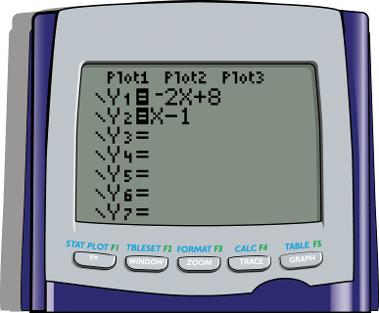
Example 4: Using a Graphing Calculator (cont.)
To get the variable X, press the key .
The display screen will appear as follows:

Slide 22




Example 4: Using a Graphing Calculator (cont.)
Step 3: Press .
(Both lines should appear. If not, you may need to adjust the .)
Step 4: Press and CALC. Select 5: intersect.
The cursor will appear on one of the lines. Use the right or left arrow to get near the point of intersection and press . Then move the up or down arrow to get to the other line. Move on this line closer to the point of intersection and press . Follow the directions for Guess? by moving the cursor to the point of intersection and pressing .

Slide 23
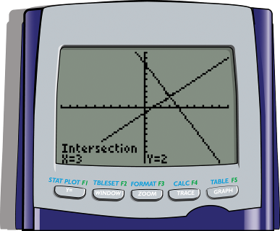
Example 4: Using a Graphing Calculator (cont.)
Step 5: The answer x = 3 and y = 2 will appear at the bottom of the display screen

Slide 24
Example 4: Using a Graphing Calculator (cont.)
Note: Step 4 may seem somewhat complicated, but TRY IT. IT IS FUN and accurate!
Also, if the lines are parallel (an inconsistent system) the calculator will give an error message.

