Slide 1
Section 5.4
Applications: Distance-Rate-Time, Number Problems, Amounts and Costs

Slide 2
Objectives
Solve applied problems related to distance, rate, and time by using systems of linear equations.
Solve applied problems related to numbers by using systems of linear equations.
Solve applied problems related to amounts and costs by using systems of linear equations.

Slide 3
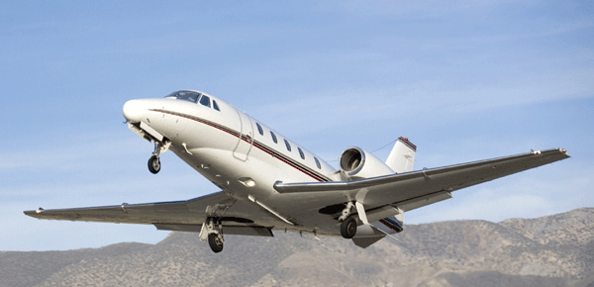
Example 1: Distance-Rate-Time (Rates Unknown)
A small plane flew 300 miles in 2 hours flying with the wind. Then on the return trip, flying against the wind, it traveled only 200 miles in 2 hours. What were the wind velocity and the speed of the plane? (Note: The “speed of the plane” means how fast the plane would be flying with no wind.)
Solution: Let s = speed of plane
and w = wind velocity

Slide 4
Example 1: Distance-Rate-Time (Rates Unknown)
When flying with the wind, the plane’s actual rate will increase to s + w. When flying against the wind, the plane’s actual rate will decrease to s − w. (Note: If the wind had been strong enough, the plane could actually have been flying backward, away from its destination.)
Rate × Time = Distance
With the wind | s + w | 2 | 2( s + w )
Against the wind | s − w | 2 | 2( s − w )

Slide 5
Example 1: Distance-Rate-Time (Rates Unknown)
The system of linear equations is
  with the wind
against the wind

Slide 6
Example 1: Distance-Rate-Time (Rates Unknown)
Substitute s = 125 into one of the original equations.
The speed of the plane was 125 mph, and the wind velocity was 25 mph.

Slide 7

Example 2: Distance-Rate-Time (Times Unknown)
Two buses leave Eureka traveling in opposite directions. One leaves at noon and the second leaves at 1 P.M. The first one travels at an average speed of 55 mph and the second one at an average speed of 59 mph. At what time will the buses be 226 miles apart?

Slide 8
Example 2: Distance-Rate-Time (Times Unknown) (cont.)
Solution: Let x = time of travel for first bus
and y = time of travel for second bus
The system of linear equations is
Rate × Time = Distance
Bus 1 | 55 | x | 55x
Bus 2 | 59 | y | 59y

Slide 9
Example 2: Distance-Rate-Time (Times Unknown) (cont.)
Substitution gives
        This gives x = 1.5 + 1 = 2.5.
Thus the first bus travels 2.5 hours and the second bus travels 1.5 hours. Therefore, the buses will be 226 miles apart at 2:30 P.M.

Slide 10
Example 3: Number Problem
The sum of two numbers is 80 and their difference is 10. What are the two numbers?
Solution: Let x = one number
and y = the other number.
The system of linear equations is

Slide 11
Example 3: Number Problem (cont.)
Solving by addition gives
        Substituting 45 for x in the first equation gives:
        The two numbers are 45 and 35.
Check: 45 + 35 = 80 and 45 − 35 = 10

Slide 12
Example 4: Counting Coins
Mike has $1.05 worth of change in nickels and quarters. If he has twice as many nickels as quarters, how many of each type of coin does he have?
Solution:
We use two equations – one relating the number of coins and the other relating the value of the coins. The value of each nickel is 5 cents and the value of each quarter is 25 cents.

Slide 13
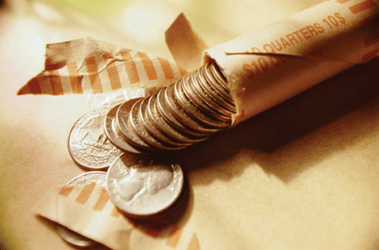
Example 4: Counting Coins (cont.)
Let n = number of nickels
and q = number of quarters.
Coins | # of Coins | Value | Total Value
Nickel | n | 0.05 | 0.05n
Quarters | q | 0.25 | 0.25q

Slide 14
Example 4: Counting Coins (cont.)
The system of linear equations is
Note carefully that in the first equation q is multiplied by 2 because the number of nickels is twice the number of quarters. Therefore, n is bigger.

Slide 15
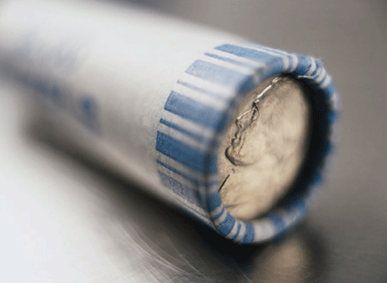
Example 4: Counting Coins (cont.)
The first equation is already solved for n, so substitution into the second equation gives
Mike has 3 quarters and 6 nickels.

Slide 16
Example 5: Calculating Age
Pat is 6 years older than her sister Sue. In 3 years, she will be twice as old as Sue. How old is each girl now?
Solution: We use two equations – one relating their ages now and the other relating their ages in 3 years.
Let P = Pat’s age now
and S = Sue’s age now
Then the system of linear equations is

Slide 17
Example 5: Calculating Age (cont.)
Rewrite the second equation in standard form and solve by addition.

Slide 18
Example 5: Calculating Age (cont.)
Substitute S = 3 into one of the original equations.
Pat is 9 years old; Sue is 3 years old.

Slide 19
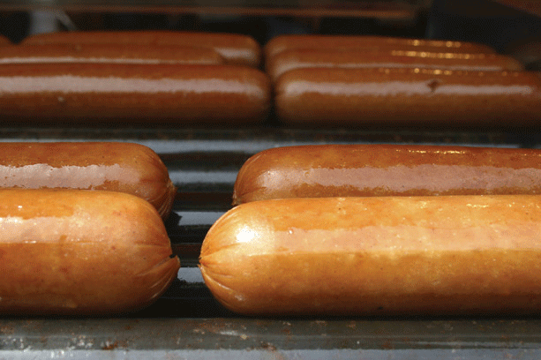
Example 6: Amounts and Costs
Three hot dogs and two orders of French fries cost $10.30. Four hot dogs and four orders of fries cost $15.60. What is the cost of a hot dog? What is the cost of an order of fries?
Solution: Let x = cost of one hot dog
and y = cost of one order of fries.
Then the system of linear equations is

Slide 20
Example 6: Amounts and Costs
Both equations are in standard form. Solve using the addition method.

Slide 21
Example 6: Amounts and Costs
Substitute x = 2.50 into one of the original equations.
One hot dog costs $2.50 and one order of fries costs $1.40.

Slide 22
Applications
Notes
You should consider making tables similar to those illustrated in Examples 1, 2, and 4 when working with applications. These tables can help you organize the information in a more understandable form.

