Slide 1
Section 5.5
Applications: Interest and Mixture

Slide 2
Objectives
Solve applied problems related to interest by using systems of linear equations.
Solve applied problems related to mixture by using systems of linear equations

Slide 3
Example 1: Interest
James has two investment accounts, one pays 6% interest and the other pays 10% interest. He has $1000 more in the 10% account than he has in the 6% account. The interest from the 10% account exceeds the interest from the 6% account by $260 each year. How much does he have in each account?
Solution:
Careful reading indicates two types of information:
1. He has two accounts.
2. He earns two amounts of interest.

Slide 4
Example 1: Interest (cont.)
Let x = amount (principal) invested at 6%
y = amount (principal) invested at 10%,
then 0.06x = interest earned on first account
0.10y = interest earned on second account.
Now set up two equations.

Slide 5
Example 1: Interest (cont.)
Because the first equation is already solved for y, we use the substitution method and substitute for y in the second equation:

Slide 6
Example 1: Interest (cont.)
Substitute x = 4000 into one of the original equations to find y.
James has $4000 invested at 6% and $5000 invested at 10%.

Slide 7
Example 2: Interest
Lila has $7000 to invest. She decides to separate her funds into two accounts. One yields interest at the rate of 7% and the other at 12%. If she wants a total annual income from both accounts to be $690, how should she split the money? (Note: The higher interest account is considered more risky. Otherwise, she would put the entire $7000 into that account.)
Solution:
Again, careful reading indicates two types of information:
1. She has two accounts.
2. She earns two amounts of interest.

Slide 8
Example 2: Interest (cont.)
Let x = amount (principal) invested at 7%
y = amount (principal) invested at 12%,
Then 0.07x = interest earned on first account
0.12y = interest earned on second account.
Now set up two equations.

Slide 9
Example 2: Interest (cont.)
Both equations are in standard form. Solve by addition. Multiply the first equation by −7 and the second by 100 to get opposite coefficients for x as follows:

Slide 10
Example 2: Interest (cont.)
Substitute y = 4000 into one of the original equations.
She should invest $3000 at 7% and $4000 at 12%.

Slide 11
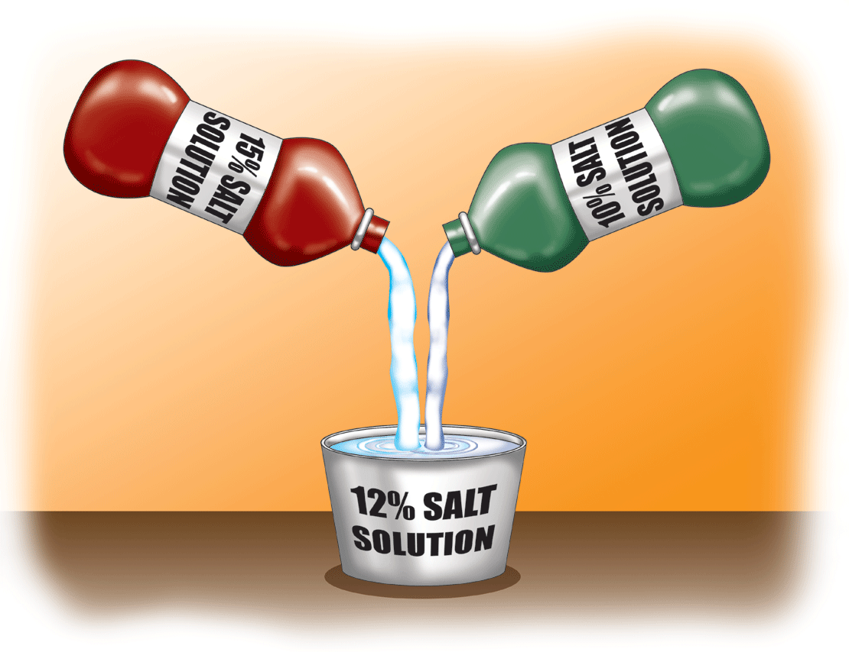
Example 3: Mixture
How many ounces each of a 10% salt solution and a 15% salt solution must be used to produce 50 ounces of a 12% salt solution?
Solution:
Let x = amount of 10% solution
and y = amount of 15% solution.

Slide 12
Example 3: Mixture (cont.)
10% solution | x | 0.10 | 0.10x
15% solution | y | 0.15 | 0.15y
12% solution | 50 | 0.12 | 0.12(50)
Amount of solution
Percent of salt
Amount of salt
×
=
Then the system of linear equations is

Slide 13
Example 3: Mixture (cont.)
Multiplying the first equation by −10 and the second by 100 gives

Slide 14
Example 3: Mixture (cont.)
Substitute y = 20 into one of the original equations.
Use 30 ounces of the 10% solution and 20 ounces of the 15% solution.

Slide 15
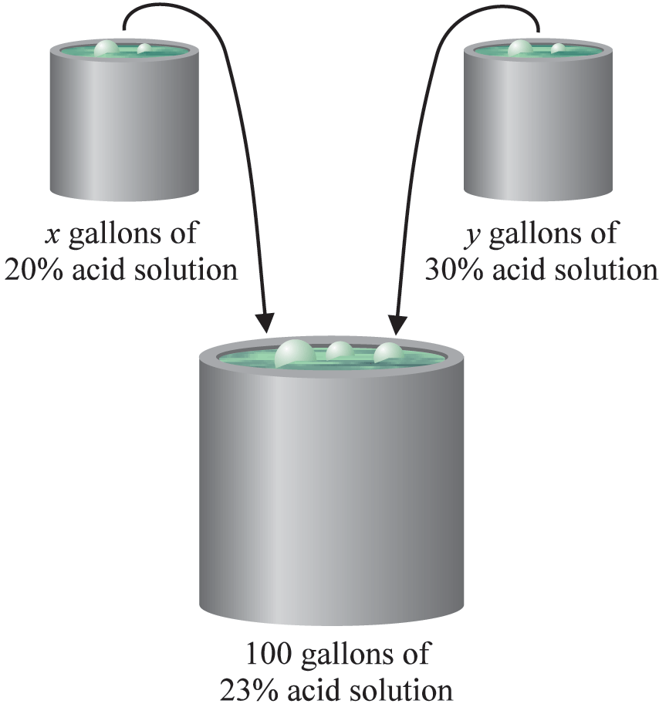
Example 4: Mixture
How many gallons of a 20% acid solution should be mixed with a 30% acid solution to produce 100 gallons of a 23% solution?
Solution:
Let x = amount of 20% solution
and y = amount of 30% solution.

Slide 16
Example 4: Mixture (cont.)
Then the system of linear equations is
×
20% solution | x | 0.20 | 0.20x
35% solution | y | 0.30 | 0.30y
23% solution | 100 | 0.23 | 0.23(100)
Amount of solution
Percent of acid
Amount of acid
=

Slide 17
Example 4: Mixture (cont.)
Multiplying the first equation by −20 and the second by 100 gives

Slide 18
Example 4: Mixture (cont.)
Substitute y = 30 into one of the original equations.
Seventy gallons of the 20% solution should be added to 30 gallons of the 30% solution. This will produce 100 gallons of a 23% solution.

