Slide 1
Section 5.6
Graphing Systems of Linear Inequalities

Slide 2
Objectives
Solve systems of linear inequalities graphically

Slide 3
Solving a System of Linear Inequalities
To Solve a System of Two Linear Inequalities
1. Graph both half-planes.
2. Shade the region that is common to both of these half-planes.
(This region is called the intersection of the two half-planes.)
3. To check, pick one test-point in the intersection and verify that it satisfies both inequalities.
(Note: If there is no intersection, then the system is inconsistent and has no solution.)

Slide 4
Example 1: Solving a System of Linear Inequalities
Graph the points that satisfy the system of linear inequalities
Solution:
Step 1: For x ≤ 2, the points are to the left of and on the line x = 2.
Step 2: For y ≥ −x + 1, the points are above and on the line y = −x + 1.

Slide 5
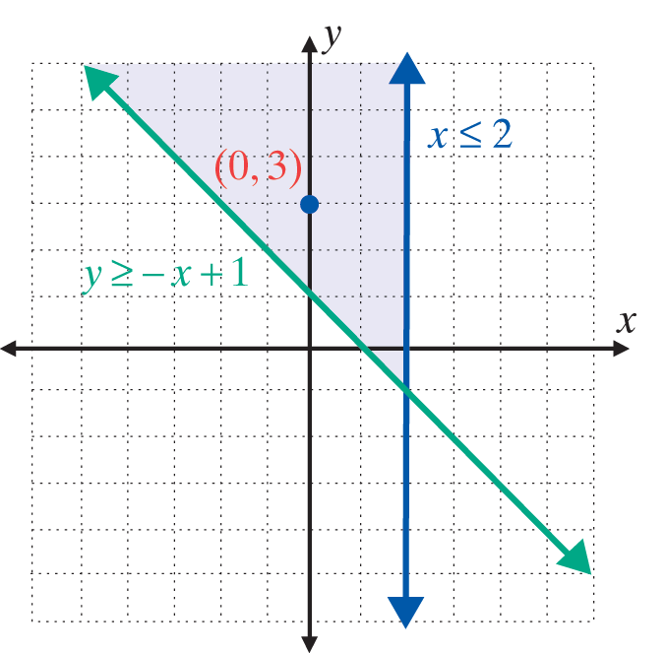
Example 1: Solving a System of Linear Inequalities (cont.)
Step 3: Shade only the region with points that satisfy both inequalities. In this case, we test the point (0, 3).
0 ≤ 2 A true statement
3 ≥ −0 + 1 A true statement

Slide 6
Example 2: Solving a System of Linear Inequalities
Solve the system of linear inequalities graphically:
Solution:
Step 1: Solve each inequality for y:
Step 2: For y ≤ −2x + 6, the points are below and on the line y = −2x + 6.
Step 3: For y < −x + 4, the points are below but not on the line y = −x + 4.

Slide 7
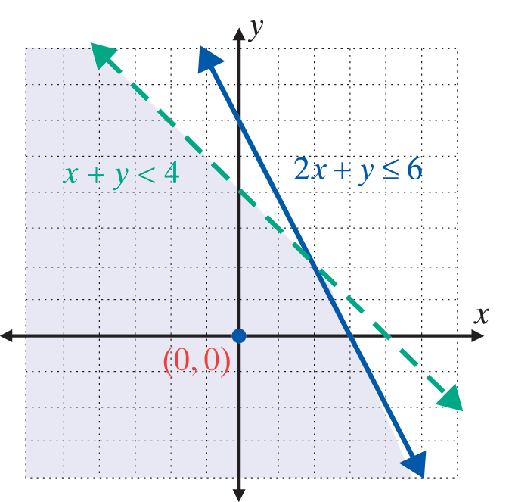
Example 2: Solving a System of Linear Inequalities (cont.)
Step 4: Shade only the region with points that satisfy both inequalities.
Note that the line y = −x + 4 is dashed.
In this case, we test the point (0, 0).
2 . 0 + 0 ≤ 6 A true statement
0 + 0 < 4 A true statement

Slide 8
Example 3: Using a Graphing Calculator to Solve a System of Linear Inequalities
Use a TI-84 Plus graphing calculator to graph the following system of linear inequalities:
Solution:
Step 1: Solve each inequality for y:
(Note: Solving 2x − y ≤ 0 for y can be written as 2x ≤ y and then as y ≥ 2x.)

Slide 9

Example 3: Using a Graphing Calculator to Solve a System of Linear Inequalities
Steps 2 and 3: Press the key and enter both functions and the corresponding symbols as they appear here:

Slide 10

Example 3: Using a Graphing Calculator to Solve a System of Linear Inequalities
Step 4: Press . The display should appear as follows. The solution is the cross-hatched region.

