Slide 1
Section 6.2
Exponents and Scientific Notation

Slide 2
Objectives
Simplify powers of expressions by using the properties of integer exponents.
Write a decimal number in scientific notation.
Operate with decimal numbers by using scientific notation.

Slide 3
Exponents
Summary of the Rules for Exponents
For any nonzero real number a and integers m and n:

Slide 4
Power Rule
Power Rule for Exponents
If a is a nonzero real number and m and n are integers, then
In words, the value of a power raised to a power can be found by multiplying the exponents and keeping the base.

Slide 5
Example 1: Power Rule for Exponents
Simplify each expression using the power rule for exponents.

Slide 6
Example 1: Power Rule for Exponents (cont.)

Slide 7
Example 1: Power Rule for Exponents (cont.)
Another approach, because we have a numerical base, would be
We see that while the base and exponent may be different, the value is the same.

Slide 8
Rule for Power of a Product
Power of a Product
If a and b are nonzero real numbers and n is an integer then
(ab)^{n} = a^{n}b^{n}.
In words, a power of a product is found by raising each factor to that power.

Slide 9
Example 2: Rule for Power of a Product
Simplify each expression using the rule for power of a product.

Slide 10
Example 2: Rule for Power of a Product (cont.)
or, using the rule of negative exponents first and then the rule for the power of a product,

Slide 11
Example 2: Rule for Power of a Product (cont.)

Slide 12
Rule for Power of a Product
Notes
Special Note about Negative Numbers and Exponents:
In an expression such as −x², we know that −1 is understood to be the coefficient of x². That is,
−x² = −1 · x².
The same is true for expressions with numbers such as −7². That is,
−7² = −1 · 7² = −1 · 49 = −49.

Slide 13
Rule for Power of a Product
Notes (cont.)
We see that the exponent refers to 7 and not to −7. For the exponent to refer to −7 as the base, −7 must be in parentheses as follows:
( −7 )² = ( −7 ) · ( −7 ) = +49.
As another example,
−2⁰ = −1 · 2⁰ = −1 · 1 = −1 and ( −2 )⁰ = 1.

Slide 14
Rule for Power of a Quotient
Rule for the Power of a Quotient
If a and b are nonzero real numbers and n is an integer, then
In words, a power of a quotient (in fraction form) is found by raising both the numerator and the denominator to that power.

Slide 15
Example 3: Rule for the Power of a Quotient
Simplify each expression using the rule for the power of a quotient.

Slide 16
Example 4: Applying Combinations of Rules for Exponents
Simplify each expression by using the appropriate rules for exponents.

Slide 17
Example 4: Applying Combinations of Rules for Exponents (cont.)
Solution:
Option 1: Simplify inside the parentheses first

Slide 18
Example 4: Applying Combinations of Rules for Exponents (cont.)
Option 2: Apply the Power Rule first
Note that the answer is the same even though the rules were applied in a different order.

Slide 19
Example 5: Two Approaches with Fractional Expressions and Negative Exponents

Slide 20
Example 6: A More Complex Example
This example involves the application of a variety of steps. Study it carefully and see if you can get the same result by following a different sequence of steps.

Slide 21
Example 6: A More Complex Example (cont.)

Slide 22
Using Combinations of Rules for Exponents
Summary of the Rules for Exponents
If a and b are nonzero real numbers and m and n are integers:

Slide 23
Using Combinations of Rules for Exponents
Summary of the Rules for Exponents (cont.)

Slide 24
Scientific Notation and Calculators
Scientific Notation
If N is a decimal number, then in scientific notation

Slide 25

Example 7: Decimals in Scientific Notation
Write the following decimal numbers in scientific notation.
a. 8,720,000 b. 0.000 000 376
Solutions:
a. 8,720,000
To check, move the decimal point 6 places to the right and get the original number:
8.72 × 10⁶
= 8.72 × 10⁶ 8.72 is between 1 and 10
= 8. 7 2 0 0 0 0 .
= 8,720,000.

Slide 26

Example 7: Decimals in Scientific Notation (cont.)
b. 0.000 000 376
To check, move the decimal point 7 places to the left and get the original number:
3.76 × 10⁻⁷
= 3.76 × 10⁻⁷ 3.76 is between 1 and 10
= 0. 0 0 0 0 0 0 3 . 7 6
= 0.000000376.

Slide 27
Example 8: Properties of Exponents
Simplify the following expressions by first writing the decimal numbers in scientific notation and then using the properties of exponents.

Slide 28
Example 8: Properties of Exponents (cont.)

Slide 29
Example 8: Properties of Exponents (cont.)

Slide 30
Example 8: Properties of Exponents (cont.)
c. Light travels approximately 3 × 10⁸ meters per second. How many meters per minute does light travel?
Solution:
Since there are 60 seconds in one minute, multiply by 60.
Thus light travels 1.8 × 10¹⁰ meters per minute.

Slide 31


Example 9: Scientific Notation and Calculators
a. Use a TI-84 Plus graphing calculator to evaluate the
expression Leave the answer in
scientific notation.
(Note: The caret key is used to indicate an
exponent. Also, you can press the key and
select SCI on the first line to have all decimal calculations in scientific notation.)

Slide 32
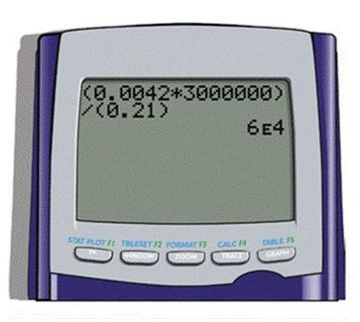
Example 9: Scientific Notation and Calculators (cont.)
Solution:
With a TI-84 Plus calculator (set in scientific notation mode) the display should appear as shown below:

Slide 33
Example 9: Scientific Notation and Calculators (cont.)
b. A light-year is the distance light travels in one year. Use a TI-84 Plus calculator to find the length of a light-year in scientific notation if light travels 186,000 miles per second.
Solution: 60 sec = 1 minute
60 min = 1 hour
24 hr = 1 day
365 days = 1 year
Multiplication gives the following display on your calculator.

Slide 34
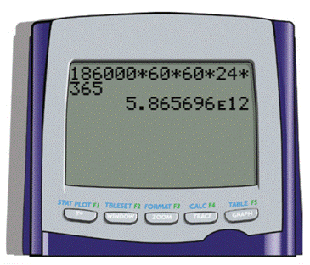
Example 9: Scientific Notation and Calculators (cont.)
(Note that the E in the display indicates an exponent with base 10.)
Thus a light-year is 5,865,696,000,000 miles.

Slide 35
Practice Problems
Simplify each expression.
5. Write the number in scientific notation: 186,000 miles per second (speed of light in miles per second).

Slide 36
Practice Problem Answers

