Slide 1
Section 7.6
Applications of Quadratic Equations

Slide 2
Objectives
Solve word problems by writing quadratic equations that can be factored and solved.

Slide 3
Applications
Attack Plan for Word Problems
1. Read the problem carefully at least twice.
2. Decide what is asked for and assign a variable or variable expression to the unknown quantities.
3. Organize a chart, table, or diagram relating all the information provided.
4. Form an equation. (A formula of some type may be necessary.)

Slide 4
Applications
Attack Plan for Word Problems (cont.)
5. Solve the equation.
6. Check your solution with the wording of the problem to be sure it makes sense.

Slide 5
Example 1: Applications of Quadratic Functions
a. One number is four more than another and the sum of their squares is 296. What are the numbers?
Solution:
Let x = smaller number. Then x + 4 = larger number.

Slide 6
Example 1: Applications of Quadratic Functions (cont.)
There are two sets of answers to the problem: 10 and 14 or −14 and −10.

Slide 7
Example 1: Applications of Quadratic Functions (cont.)
b. In an orange grove, there are 10 more trees in each row than there are rows. How many rows are there if there are 96 trees in the grove?
Solution:
Let r = number of rows.
Then r + 10 = number of trees per row.
Set up the equation and solve.

Slide 8
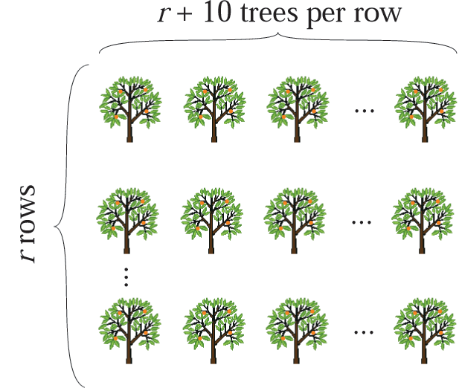
Example 1: Applications of Quadratic Functions (cont.)
There are 6 rows in the grove (6 · 16 = 96 trees).
Note: While −16 is a solution to the equation, −16 does not fit the conditions of the problem and is discarded. You cannot have −16 rows.

Slide 9
Example 1: Applications of Quadratic Functions (cont.)
c. A rectangle has an area of 135 square meters and perimeter of 48 meters. What are the dimensions of the rectangle?
Solution: The area of a rectangle is the product of its length and width (A = lw).
The perimeter of a rectangle is given by P = 2l + 2w.
Since the perimeter is 48 meters, then the length plus the width must be 24 meters (one-half of the perimeter).

Slide 10
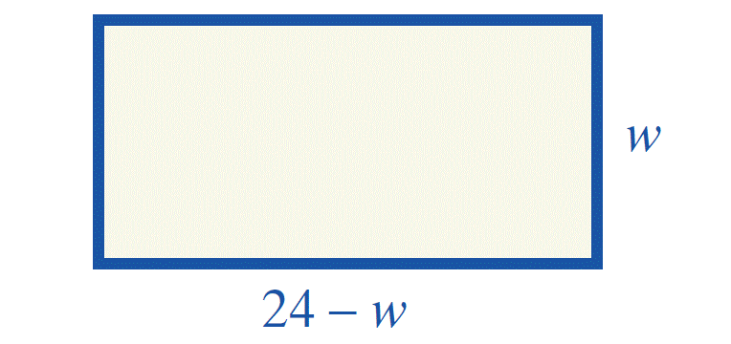
Example 1: Applications of Quadratic Functions (cont.)
Let w = width. Then 24 − w = length.
Set up the equation and solve.
Area = lw = length times width.
Note: 0 can be on either side of the equation.

Slide 11
Example 1: Applications of Quadratic Functions (cont.)
Note the solution because generally length is greater than width.
The width is 9 meters and the length is 15 meters (9 · 15 = 135).

Slide 12
Example 1: Applications of Quadratic Functions (cont.)
d. A man wants to build a block wall shaped like a rectangle along three sides of his property. If 180 feet of fencing is needed and the area of the lot is 4000 square feet, what are the dimensions of the lot?
Solution:
Let x = one of two equal sides.
Then 180 − 2x = third side.

Slide 13
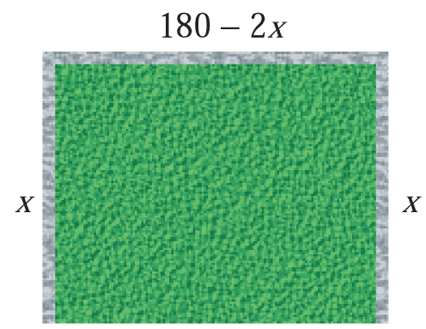
Example 1: Applications of Quadratic Functions (cont.)
Set up the equation and solve.

Slide 14
Example 1: Applications of Quadratic Functions (cont.)
From this information there are two possible answers: the lot is 50 ft by 80 ft or the lot is 40 ft by 100 ft.

Slide 15
Example 1: Applications of Quadratic Functions (cont.)
e. The sum of the squares of two consecutive positive odd integers is 202. Find the integers.
Solution:
Let n = first odd integer. Then n + 2 = next consecutive odd integer.
Set up the equation and solve.

Slide 16
Example 1: Applications of Quadratic Functions (cont.)
Since the problem asked for positive integers, −11 is discarded.
The first integer is 9 and the next consecutive odd integer is 11.
Checking:

