Slide 1
Section 8.6
Applications

Slide 2
Objectives
Solve word problems using proportions.
Solve word problems related to distance, rate, and time.
Solve word problems related to the time it takes to complete a job.

Slide 3
Example 1: Solving Proportions
a. The sum of two integers is 104 and they are in the ratio of 8 to 5. Find the two numbers.
Solution:
Here we know the total sum of the two numbers is 104. So let n = one number and 104 − n = second number.
Then set up a proportion using the ratio 8 to 5.

Slide 4
Example 1: Solving Proportions (cont.)
The two numbers are 64 and 40.
(Checking, we get the sum 64 + 40 = 104 and the ratio

Slide 5
Example 1: Solving Proportions (cont.)
b. Suppose that an artist expects that for every 9 special brushes he orders, 7 will be good and 2 will be defective. If he orders 45 brushes, how many will he expect to be defective?
Solution:
Let n = number of defective brushes
and 45 − n = number of good brushes ( Total − n ).

Slide 6

Example 1: Solving Proportions (cont.)
Then, using the ratio of good to defective,
He expects 10 defective brushes.

Slide 7
Example 2: Determining Rate Using Proportions
a. Janice can run 32 kilometers (about 20 miles) in the same amount of time that her twin sister, Jill, can run 24 kilometers. If Janice runs 2 kilometers per hour faster than Jill, how fast does each girl run?
Solution:
Let r = Jill’s rate
and r + 2 = Janice’s rate ( She runs faster than Jill. )

Slide 8
Example 2: Determining Rate Using Proportions (cont.)
Using the formula and the fact that their times
are equal, we can write the equation:

Slide 9
Example 2: Determining Rate Using Proportions (cont.)
So, Jill's rate = r = 6 kph and Janice's rate = r + 2 = 8 kph.

Slide 10
Example 2: Determining Rate Using Proportions (cont.)
b. A small plane can fly at 120 mph in still air. If it can fly 490 miles with a tailwind in the same time that it can fly 350 miles against a headwind, what is the speed of the wind? (Note: A tailwind is a wind that blows in the same direction that the plane is flying and, therefore increases the speed of the plane. A headwind is a wind that blows from the opposite direction the plane is flying and therefore decreases the speed of the plane.)

Slide 11
Example 2: Determining Rate Using Proportions (cont.)
Solution:
Using the formula and the fact that the times are
equal, the equation is
Let w = speed of the wind.

Slide 12
Example 2: Determining Rate Using Proportions (cont.)
The speed of the wind is 20 mph.

Slide 13
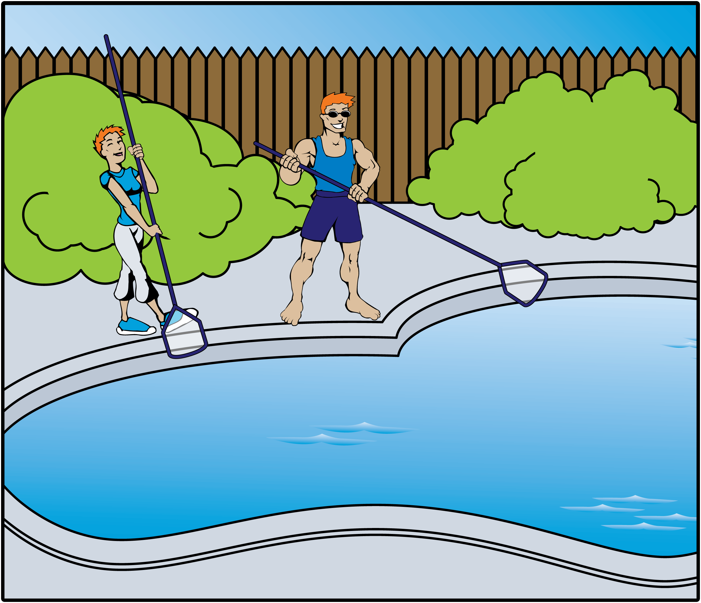
Example 3: Calculating Work Using Proportions
a. Mike can clean his family’s pool in 2 hours. His younger sister, Stacey, can do it in 3 hours. If they work together, how long will it take them to clean the pool?

Slide 14
Example 3: Calculating Work Using Proportions (cont.)
Solution:
Let x = number of hours working together. Then

Slide 15
Example 3: Calculating Work Using Proportions (cont.)
Multiply each term on both sides of the equation by 6x, the LCM of the denominators.

Slide 16
Example 3: Calculating Work Using Proportions (cont.)
Together they can clean the pool in hours, or 1 hour,
12 minutes. (Note that this answer seems reasonable since it is less time than either person would take working alone.)

Slide 17
Example 3: Calculating Work Using Proportions (cont.)
b. A man was told that his new Jacuzzi® pool would fill through an inlet valve in 3 hours. He knew something was wrong when the pool took 8 hours to fill. He found he had left the drain valve open. How long will it take to drain the pool once it is filled and only the drain valve is open?
Solution:
Let t = time to drain pool. (Note: We use the information gained when the pool was filled with both valves open. In that situation, the inlet and outlet valves worked against each other.)

Slide 18
Example 3: Calculating Work Using Proportions (cont.)

Slide 19
Example 3: Calculating Work Using Proportions (cont.)

Slide 20
Example 3: Calculating Work Using Proportions (cont.)
The pool will drain in hours, or 4 hours, 48 minutes.
(Note that this is more time than the inlet valve would take to fill the pool. If the outlet valve worked faster than the inlet valve, then the pool would never have filled in the first place.)

