Slide 1
Section 8.7
Additional Applications: Variation

Slide 2
Objectives
Understand direct and inverse variation.
Solve applied problems.

Slide 3
Direct Variation
Direct Variation
A variable quantity y varies directly as (or is directly proportional to) a variable x if there is a constant k such that
The constant k is called the constant of variation.

Slide 4
Example 1: Direct Variation
The length, s, that a hanging spring stretches varies directly as the weight placed at the end of the spring. If a weight of 5 mg stretches a certain spring 3 cm, how far will the spring stretch with a weight of 6 mg?
(Note: We assume that the weight is not so great as to break the spring.)
Solution:
Since the two variables are directly proportional, they are related as

Slide 5
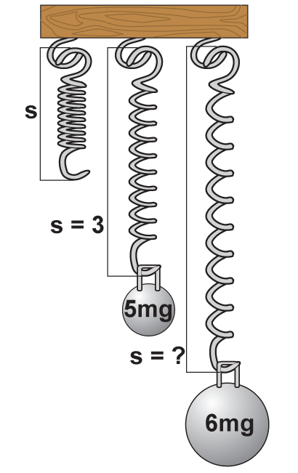
Example 1: Direct Variation (cont.)
s = kw where s is the distance the spring stretches and w is the weight placed at the end of the spring.
First substitute the given information to
find the value for k. (The value for k will
depend on the particular spring. Springs
made of different material or which are
wound tighter will have different values
for k.)

Slide 6
Example 1: Direct Variation (cont.)
So, substitute for k in the equation. Thus, for this spring

Slide 7
Example 1: Direct Variation (cont.)
Now, for w = 6 mg,
s = 0.6(6) = 3.6.
The spring will stretch 3.6 cm if a weight of 6 mg is placed at its end.

Slide 8
Inverse Variation
Inverse Variation
A variable quantity y varies inversely as (or is inversely proportional to) a variable x if there is a constant k such that
The constant k is called the constant of variation.

Slide 9
Example 2: Inverse Variation
The volume of propane in a container varies inversely to the pressure on the gas. If the propane has a volume of 200 in.³ under a pressure of 4 lbs per in.², what will be its volume if the pressure is increased to 5 lbs per in.²?
Solution:

Slide 10
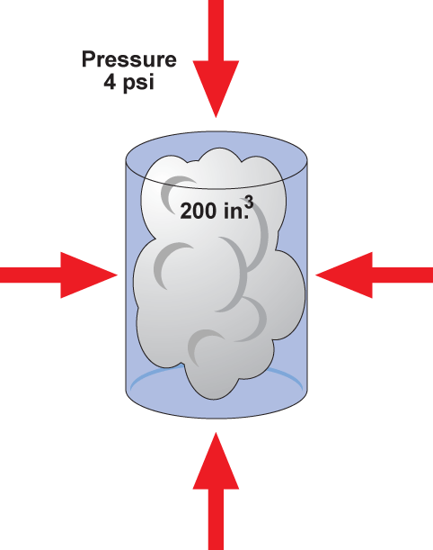
Example 2: Inverse Variation (cont.)
Now, substitute 800 for k in the equation.
The volume will be 160 in³.

