Slide 1
Section 9.1
Real Numbers and Evaluating Radicals

Slide 2
Objectives
Determine if a real number is rational or irrational.
Understand the meaning of radical expressions.
Use a TI-84 Plus calculator to evaluate radical expressions.

Slide 3
Real Numbers
Integers
Integers are the whole numbers and their opposites.
..., −4, −3, −2, −1, 0, 1, 2, 3, 4, …

Slide 4
Real Numbers
Rational Numbers
A rational number is any number that can be written in
the form where a and b are integers and b ≠ 0.

Slide 5
Perfect Squares and Square Roots
Squares of integers from 1 to 20 (Perfect Squares)

Slide 6
Perfect Squares and Square Roots
Terminology of Radicals
The symbol is called a radical sign.
The number under the radical sign is called the radicand.
The complete expression, such as is called a radical or radical expression.

Slide 7
Perfect Squares and Square Roots
Square Root
If b is a nonnegative real number and a is a real number such that
then a is called a square root of b. If a is nonnegative, then we write

Slide 8
Example 1: Square Roots

Slide 9
Example 1: Square Roots
has two square roots, one positive and one negative. The sign is understood to represent the positive square root or the principal square root. Therefore,
d. 49
The negative square root must have a “−” sign in front of the radical sign.

Slide 10
Perfect Squares and Square Roots
Notes
The square roots of negative real numbers are not real numbers. (There is no real number whose square is negative.) Thus is not a real number and is not a real number. Such numbers are called imaginary numbers or nonreal complex numbers. These numbers and their properties will be studied in later courses in mathematics.

Slide 11
Cube Roots
Table 1: Cubes of integers from 1 to 10 (Perfect Cubes)

Slide 12
Cube Roots
Cube Root
If a and b are real numbers such that
then a is called the cube root of b. We write

Slide 13
Example 2: Cube Roots
Note that the cube root of a negative number is negative.

Slide 14
Irrational Numbers
Irrational Numbers
Irrational numbers are real numbers that are not rational numbers. Written in decimal form, irrational numbers are infinite, nonrepeating decimals.

Slide 15
Example 3: Irrational Numbers
The following numbers are all irrational numbers. Your calculator will show them rounded to nine or more decimal places; however, the digits continue without end and there is no pattern to the digits.
See “Did You Know?” at the beginning of this chapter for a formal proof of the fact that is irrational.

Slide 16
Example 3: Irrational Numbers (cont.)
π is the ratio of the circumference to the diameter of any circle.
e is the base of natural logarithms and will be studied in detail in later courses.

Slide 17
Example 4: Find the Square
Use the definition of square root to find the square of each radical expression.
Solution:
Solution:
Solution:
The square of a negative number is positive.

Slide 18
Summary of Square Roots of Integers
The Fundamental Principle of Rational Expressions
In general, if a is a positive real number, then
1. is a real number.
2. is nonreal.
Note: is rational if a is a perfect square or the quotient of perfect squares. Otherwise, is irrational.

Slide 19

Example 5: Evaluating Radical Expressions with a Calculator
Use a TI-84 Plus graphing calculator to evaluate each of the following radical expressions. In each example the steps (or keys to press) are shown. The TI-84 Plus gives answers accurate up to nine decimal places. You (and your instructor) may choose to round these answers to fewer than nine places.
Solution: Press the keys in the following sequence:

Slide 20

Example 5: Evaluating Radical Expressions with a Calculator (cont.)
Note: To get the square root symbol on the TI-84 Plus, press 2nd then the key. When the symbol appears, it will appear with a left hand parenthesis. You should press the right-hand parenthesis to close the square root operation.

Slide 21
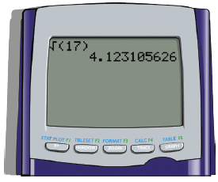
Example 5: Evaluating Radical Expressions with a Calculator (cont.)
The display will appear as follows:

Slide 22
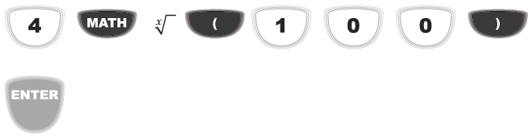
Example 5: Evaluating Radical Expressions with a Calculator (cont.)
Solution: Press the keys in the following sequence:
Note: The 4 followed by the indicates the 4th root to the calculator. That is, the 4 takes the place of x in the expression
Note: This expression represents the 4th root of 100.

Slide 23
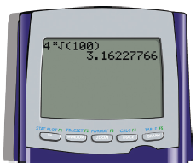
Example 5: Evaluating Radical Expressions with a Calculator (cont.)
The display will appear as follows:

Slide 24

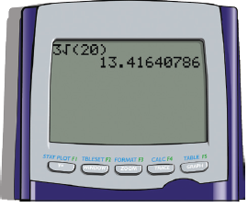
Example 5: Evaluating Radical Expressions with a Calculator (cont.)
Note: This expression represents 3 times
Solution: Press the keys in the following sequence:
The display will appear as follows:

Slide 25

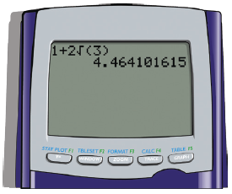
Example 5: Evaluating Radical Expressions with a Calculator (cont.)
Note: The calculator is programmed to follow the rules for order of operations.
Solution: Press the keys in the following sequence:
The display will appear as follows:

Slide 26
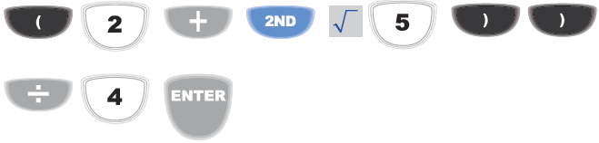
Example 5: Evaluating Radical Expressions with a Calculator (cont.)
Solution: Note: The fraction bar indicates that the numerator must be treated as a quantity.
To ensure the correct answer, we must put the entire numerator in parentheses.
Press the keys in the following sequence:

Slide 27
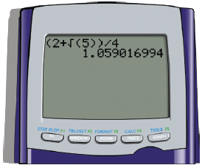
Example 5: Evaluating Radical Expressions with a Calculator (cont.)
The display will appear as follows:

