Slide 1
Section 9.7
The Pythagorean Theorem

Slide 2
Objectives
Use the distance formula to find the distance between two points.
Understand the Pythagorean Theorem.
Determine if triangles are right triangles by using the Pythagorean Theorem.
Use the distance formula to find various properties of triangles.

Slide 3
Distance Between Two Points on a Vertical or Horizontal Line
Calculating The Distance Between Two Points on a Horizontal or Vertical Line
For P₁(x₁, y₁), and P₂(x₂, y₁) on a horizontal line,
For P₁(x₁, y₁), and P₂(x₁, y₂) on a vertical line,

Slide 4
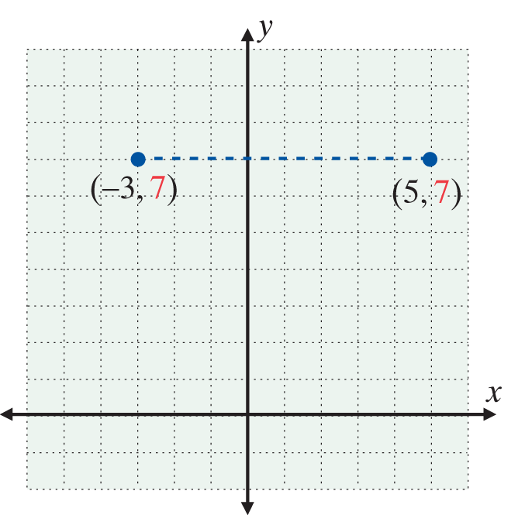
Example 1: Calculating Distance on Horizontal and Vertical Lines
a. Find the distance, d, between the two points (5, 7) and (−3, 7).
Solution: Since the points are on a horizontal line (they have the same y-coordinate), we find the absolute value of the difference between the x-coordinates.

Slide 5
Example 1: Calculating Distance on Horizontal and Vertical Lines (cont.)
b. Find the distance, d, between the two points (2, 8)
and
Solution:
Since the points are on a vertical line (they have the same x-coordinate), we find the absolute value of the difference between the y-coordinates.

Slide 6
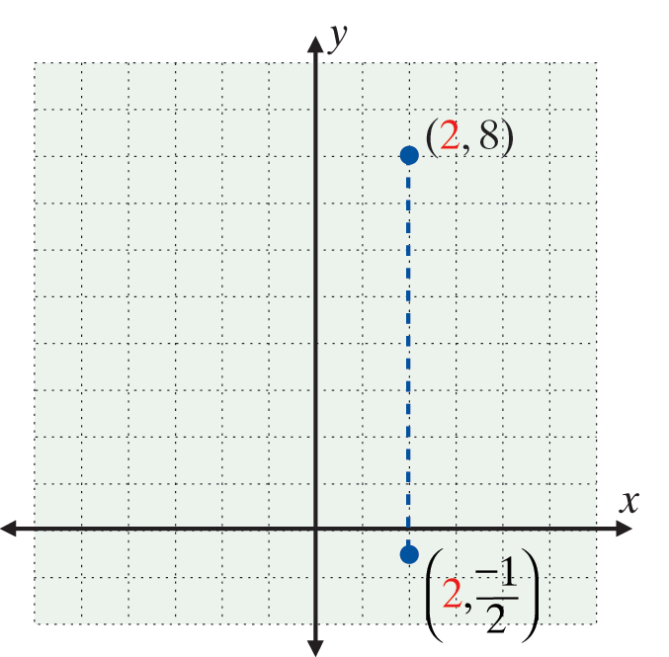
Example 1: Calculating Distance on Horizontal and Vertical Lines (cont.)

Slide 7
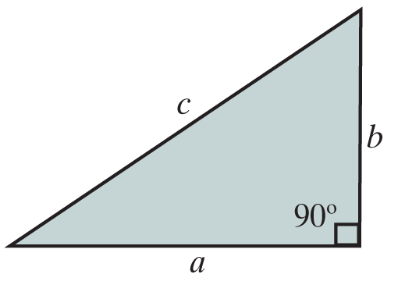
The Pythagorean Theorem: c² = a² + b²
The Pythagorean Theorem
In a right triangle, the square of the hypotenuse is equal to the sum of the squares of the two legs.

Slide 8
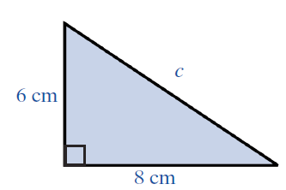
Example 2: The Pythagorean Theorem
a. What is the length of the hypotenuse of a right triangle if one leg is 8 cm long and the other leg is
6 cm long?
Solution:
By the Pythagorean Theorem,

Slide 9
Example 2: The Pythagorean Theorem (cont.)
The hypotenuse is 10 cm long. (Note that only the positive square root of 100 is used because the negative square root does not make sense as a solution to the problem.)

Slide 10
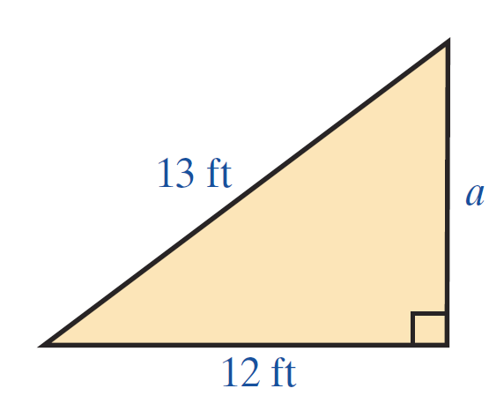
Example 2: The Pythagorean Theorem (cont.)
b. In the right triangle shown here the length of one of the legs is unknown. If the hypotenuse is 13 ft and one of the legs is 12 ft, what is the length of the other leg?
Solution: By the Pythagorean Theorem,
The leg is 5 ft long.

Slide 11
Distance Between Two Points in a Plane
Formula for the Distance Between Two Points
The formula for the distance between two points
P₁(x₁, y₁) and P₂(x₂, y₂) is

Slide 12
Distance Between Two Points in a Plane
Notes
In the actual calculation of d, be sure to add the squares before taking the square root. In general,
For example, suppose that
Then adding first gives
CORRECT

Slide 13
Distance Between Two Points in a Plane
Notes (cont.)
Taking square roots first gives the wrong result:
INCORRECT

Slide 14
Example 3: Distance Between Two Points
a. Find the distance between the two points (3, 4) and (−2, 7).
Solution:

Slide 15
Example 3: Distance Between Two Points (cont.)
b. Find the distance between the two points
Solution:

Slide 16
Example 3: Distance Between Two Points (cont.)
c. Show that the triangle determined by the points
A( −2, 1 ), B( 3, 4 ), and C( 1, −4 ) is an isosceles triangle. (An isosceles triangle has two equal sides. So, the object is to determine whether or not two sides have the same length.)
Solution:
The length of the line segment AB is the distance between the points A and B. We denote this distance by |AB|. Thus to show that the triangle ABC is isosceles, we need to show that |AB| = |AC| or that |AB| = |BC| or |AC| = |BC|.

Slide 17
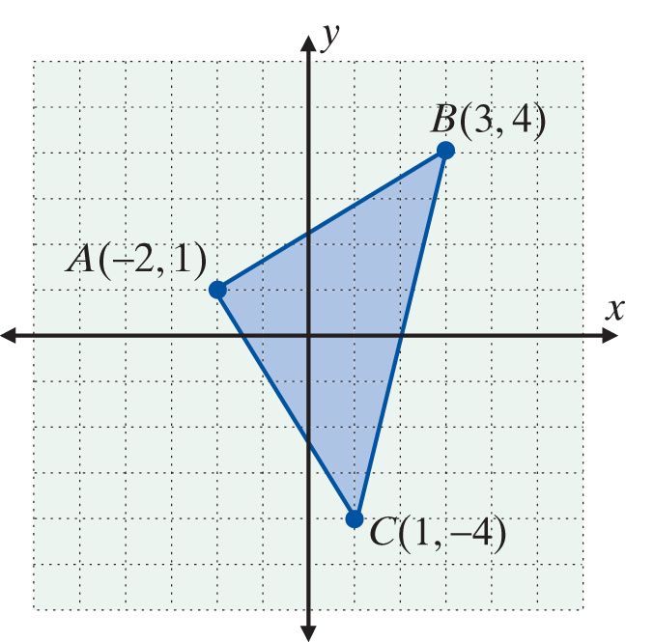
Example 3: Distance Between Two Points (cont.)
If none of these relationships are true then the triangle does not have two equal sides and is not isosceles.
Since |AB| = |AC|, the triangle is isosceles.

Slide 18
Practice Problems
Find the distance between the two given points.
4. Determine whether or not a triangle with sides of 60 ft, 11 ft, and 61 ft is a right triangle.

Slide 19
Practice Problem Answers

