Slide 1
Section R.1
Exponents and Order of Operations

Slide 2
Objectives
Understand the terms exponent, base, and power.
Evaluate expressions with exponents.
Follow the rules for order of operations to evaluate numerical expressions.

Slide 3
Exponents
Whole Numbers
The whole numbers are the natural (or counting) numbers and the number 0.
Natural numbers = ℕ = { 1, 2, 3, 4, 5, 6, 7, 8, 9, 10, 11,… }
Whole numbers = 𝕎
= { 0, 1, 2, 3, 4, 5, 6, 7, 8, 9, 10, 11,…}
Note that 0 is a whole number but not a natural number.

Slide 4
Example 1: Writing Exponents
With Repeated Multiplication With Exponents
a. 5 ⋅ 5
= 25
5²
= 25
b. 2 ⋅ 2 ⋅ 2
= 8
2³
= 8
c. 5 ⋅ 5 ⋅ 5
= 125
5³
= 125
d. 10 ⋅ 10 ⋅ 10 ⋅ 10
= 10,000
10⁴
= 10,000

Slide 5
Exponents
Notes
Variables are introduced here so that rules and definitions can be stated in a general form. Variables will be used in the examples and exercises beginning with Chapter 1.

Slide 6
Exponents
Variable
A variable is a symbol (generally a letter of the alphabet) that is used to represent an unknown number or any one of several numbers.

Slide 7
Exponents
Exponent and Base
A whole number n is an exponent if it is used to tell how many times another whole number a is used as a factor. The repeated factor a is called the base of the exponent. Symbolically,

Slide 8
Exponents
Notes
COMMON ERROR:
Do not multiply the base and the exponent.
Do multiply the base by itself.
INCORRECT
INCORRECT
CORRECT
CORRECT

Slide 9
Example 2: Translating Exponents
is read “eight squared is equal to sixty-four.”
a. 8² = 64
b. 5³ = 125
Expressions with exponents other than 2 or 3 are read as the base “to the _____ power.”
For example,
2⁵ = 32
is read “five cubed is equal to one hundred twenty-five.”
is read “two to the fifth power is equal to thirty­two.”

Slide 10


Example 3: Evaluating Exponents with a Calculator
Use a TI-84 Plus graphing calculator to find the value of each of the following exponential expressions.
a. 9⁵ b. 41³ c. 152⁰
Solutions for a TI-84 Plus Calculator
a. Step 1: Enter 9. (This is the base.)
Step 2: Press the caret key .
Step 3: Enter 5. (This is the exponent.)
Step 4: Press the key .
The display should read 59049.

Slide 11
Example 3: Evaluating Exponents with a Calculator (cont.)
b. Step 1: Enter 41.
Step 2: Press the caret key .
Step 3: Enter 3.
Step 4: Press the key .
The display should read 68921.

Slide 12
Example 3: Evaluating Exponents with a Calculator (cont.)
c. Step 1: Enter 152.
Step 2: Press the caret key .
Step 3: Enter 0.
Step 4: Press the key .
The display should read 1.

Slide 13
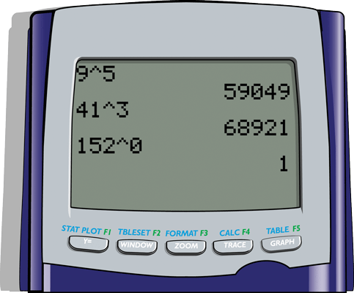
Example 3: Evaluating Exponents with a Calculator (cont.)
Here we show the display screen for all these calculations.

Slide 14
Rules for Order of Operations
Rules for Order of Operations
1. First, simplify within grouping symbols, such as parentheses ( ), brackets [ ], or braces { }. Start with the innermost grouping.
2. Second, evaluate any numbers or expressions with exponents.

Slide 15
Rules for Order of Operations
Rules for Order of Operations (cont.)
3. Third, moving from left to right, perform any multiplications or divisions in the order in which they appear.
4. Fourth, moving from left to right, perform any additions or subtractions in the order in which they appear.

Slide 16
Rules for Order of Operations
Notes
Even though the mnemonic PEMDAS is helpful, remember that multiplication and division are performed as they appear, left to right. Also, addition and subtraction are performed as they appear, left to right.

Slide 17
Example 4: Order of Operations
Evaluate the expression 24 ÷ 8 + 4 ⋅ 2 − 6.
Solution
Divide before multiplying in this case. Remember to move left to right.
Multiply before adding or subtracting.
Add before subtracting in this case.
Remember to move left to right.
Subtract.

Slide 18
Example 5: Evaluating Expressions
Evaluate the expression 5 − 18 ÷ 9 ⋅ 2 + 4(7).
Solution
Divide.
Multiply.
Multiply.
Subtract.
Add.

Slide 19
Example 6: Evaluating Expressions
Evaluate the expression 30 ÷ 10 · 2³ + 3(6 − 2).
Solution
Operate within parentheses.
Find the power.
Divide.
Multiply in each part separated
by +.
Add.

Slide 20
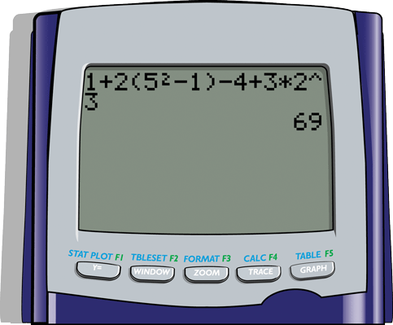
Example 7: Evaluating Expressions with a Calculator
Use your TI-84 Plus calculator to evaluate the following expression. 1 + 2(5² − 1) − 4 + 3 ⋅ 2³
Solution:
Now use pencil and paper to evaluate the expression. You should get the same answer because the calculator is programmed to use the rules for order of operations.

