Slide 1
Section R.3
Fractions (Multiplication and Division)

Slide 2
Objectives
Understand the terms numerator, denominator, and reciprocal.
Raise fractions to higher terms.
Reduce fractions to lowest terms.
Multiply and divide with fractions.

Slide 3
Introduction to Fractions
Fraction
A fraction is a number that can be written in the form
where a and b are whole numbers and b ≠ 0.

Slide 4
Introduction to Fractions
Notes
Special Note
If 0 does occur in a denominator, we say that the fraction is undefined because division by 0 is
undefined. For example, is undefined.

Slide 5
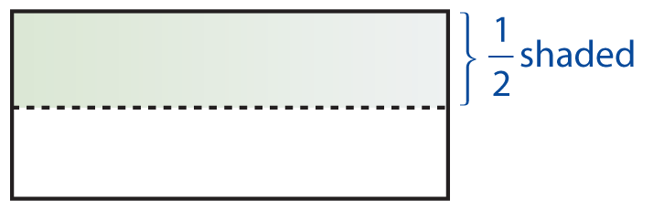
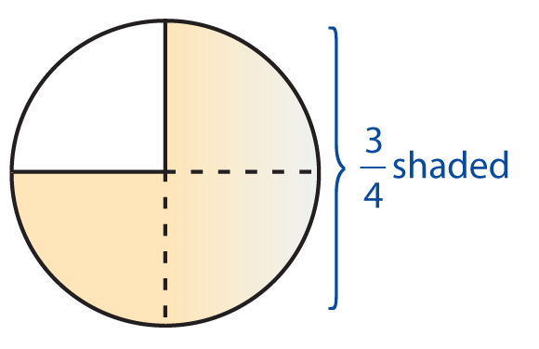
Example 1: Fractions
a. can mean 1 of 2 equal parts.
b. can mean 3 of 4 equal parts.

Slide 6
Example 1: Fractions (cont.)
c. A fraction can be used to indicate division.
For example

Slide 7
Introduction to Fractions
Proper Fraction, Improper Fraction
A proper fraction is a fraction in which the numerator is less than the denominator.
An improper fraction is a fraction in which the numerator is greater than the denominator.

Slide 8
Multiplying with Fractions
To Multiply Fractions
1. Multiply the numerators.
2. Multiply the denominators.

Slide 9
Example 2: Multiplying Fractions
Find the product of
Solution:

Slide 10
Example 3: Multiplying Fractions
Solution:

Slide 11
Example 4: Multiplying Fractions

Slide 12
Example 5: Raising Fractions to Higher Terms
Build to higher terms as indicated:
(That is, find a fraction that is equal to with denominator 36.)
Solution:
We know that so we choose and proceed as follows:
(Thus and are two forms of the same number.)

Slide 13
Example 6: Raising Fractions to Higher Terms
Build to higher terms as indicated:
Solution:
We know that so we choose and proceed as follows:

Slide 14
Example 7: Raising Fractions to Lower Terms
Reduce to lowest terms.
Solution:
Find the prime factorization of the numerator and the denominator, then “divide out” the common factors.

Slide 15
Example 8: Raising Fractions to Lower Terms
Reduce to lowest terms.
Solution:
a. Using prime factors, we have

Slide 16
Example 8: Raising Fractions to Lower Terms (cont.)
b. Larger common factors can be divided out, but we must be sure that we have the largest common factor.

Slide 17
Example 9: Multiplying and Reducing Fractions
Multiply and reduce to lowest terms.

Slide 18
Example 10: Multiplying and Reducing Fractions
Multiply and reduce to lowest terms.

Slide 19
Example 11: Multiplying and Reducing Fractions
Multiply and reduce to lowest terms.

Slide 20
Dividing with Fractions
Reciprocal
The reciprocal of (where a ≠ 0 and b ≠ 0) and

Slide 21
Dividing with Fractions
Notes
The number 0 has no reciprocal. That is has no reciprocal because is undefined.

Slide 22
Dividing with Fractions
Division
To divide by any nonzero number, multiply by its reciprocal.
In general,

Slide 23
Example 12: Dividing Fractions
Solution:
The reciprocal of 4 is so we multiply by

Slide 24
Example 13: Dividing and Reducing Fractions
Divide and reduce to lowest terms:
Solution:
The reciprocal of is Reduce by factoring.

Slide 25
Example 14: Applications: Dividing and Reducing Fractions
If you had $30 and you spent $26 to buy a computer keyboard, what fraction of your money did you spend for the keyboard? What fraction do you still have?
Solution:
a. The fraction you spent is
b. Since you still have $4, the fraction you still have is

Slide 26
Example 15: Applications: Dividing Fractions
A truck is towing 3000 pounds. This is of the truck’s towing capacity.
a. Can the truck tow more than 3000 pounds?
b. If you were to multiply times 3000, would the product be more or less than 3000?
c. What is the towing capacity of the truck?

Slide 27
Example 15: Applications: Dividing Fractions (cont.)
Solution:
a. Yes, the truck can tow more than 3000 pounds because is less than 1.
b. The product would be less than 3000.
c. To find the towing capacity divide:
The towing capacity of the truck is 4500 pounds.

