Slide 1
Section R.4
Fractions (Addition and Subtraction)

Slide 2
Objectives
Find the LCD (least common denominator) of a set of fractions.
Add fractions.
Subtract fractions.

Slide 3
Addition with Fractions
To Add Two (or More) Fractions with the Same Denominator
1. Add the numerators.
2. Keep the common denominator.
3. Reduce, if possible.

Slide 4
Example 1: Additions of Fractions

Slide 5
Example 2: Additions of Fractions

Slide 6
Addition with Fractions
To Add Fractions with Different Denominators:
1. Find the least common denominator (LCD).
2. Change each fraction into an equivalent fraction with that denominator.
3. Add the new fractions.
4. Reduce, if possible.

Slide 7
Example 3: Adding Fractions with Different Denominators
Find the sum:
Solution:
a. Find the LCD. Remember that the least common denominator (LCD) is the least common multiple (LCM) of the denominators.
Note: You might not need to use prime factorizations to find the LCD. If the denominators are numbers that are familiar to you, then you might be able to find the LCD simply by inspection.

Slide 8
Example 3: Adding Fractions with Different Denominators (cont.)

Slide 9
Example 3: Adding Fractions with Different Denominators (cont.)

Slide 10
Example 4: Adding Fractions with Different Denominators

Slide 11
Example 4: Adding Fractions with Different Denominators (cont.)
b. Steps b, c, and d from Example 3 can be written together in one step.

Slide 12
Example 4: Adding Fractions with Different Denominators (cont.)
Note that, in adding fractions, we also may choose to write them vertically. The process is the same.

Slide 13
Addition with Fractions
COMMON ERROR
The following common error must be avoided:
Find the sum
Incorrect Solution
You cannot cancel across the + sign.

Slide 14
Addition with Fractions
COMMON ERROR (cont.)
Correct Solution
Use LCD = 6.
NOW reduce.
2 is a factor in both the numerator and the denominator.

Slide 15
Subtraction with Fractions
To Subtract Two Fractions with the Same Denominator
1. Subtract the numerators.
2. Keep the common denominators.
3. Reduce if possible.

Slide 16
Example 5: Subtracting Fractions

Slide 17
Subtraction with Fractions
To Subtract Fractions with Different Denominators
1. Find the least common denominator (LCD).
2. Change each fraction to an equal fraction with that denominator.
3. Subtract the new fractions.
4. Reduce, if possible.

Slide 18
Example 6: Subtracting Fractions with Different Denominators

Slide 19
Example 6: Subtracting Fractions with Different Denominators (cont.)
b. Find equal fractions with denominator 165, subtract, and reduce.
The answer does not reduce because there are no
common prime factors in the numerator and denominator.

Slide 20
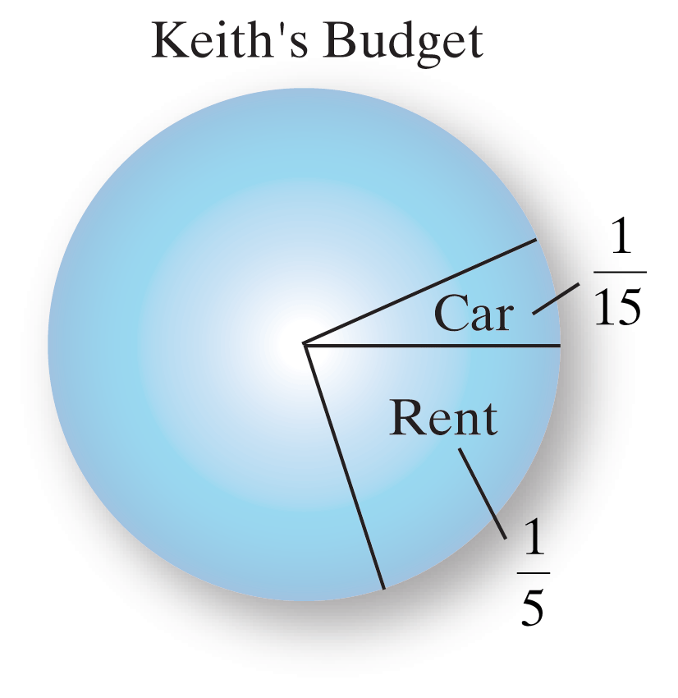
Example 7: Applications: Budget Proportions
If Keith’s total income for the year was $48,000 and he
spent of his income on rent and of his income
on his car, what total amount did he spend on these two items?

Slide 21
Example 7: Applications: Budget Proportions (cont.)
Solution:
We can add the two fractions and then multiply the sum by $48,000. (Or, we can multiply each fraction by $48,000, and then add the results. We will get the same answer either way.) The LCD is 15.

Slide 22
Example 7: Applications: Budget Proportions (cont.)
Keith spent a total of $12,800 on rent and his car.

