Slide 1
Section R.5
Decimals and Percents

Slide 2
Objectives
Read and write decimal numbers.
Operate (add, subtract, multiply, and divide) with decimal numbers.
Round decimal numbers to designated places.
Understand percents.
Change decimals and fractions to percent form.

Slide 3
Reading and Writing Decimal Numbers
To Read or Write a Decimal Number
1. Read (or write) the whole number.
2. Read (or write) "and" in place of the decimal point.
3. Read (or write) the fraction part as a whole number with the name of the place of the last digit on the right.

Slide 4
Example 1: Writing in Decimal Notation
in decimal notation
in words

Slide 5
Example 2: Writing in Decimal Notation
Write four hundred and two thousandths in decimal notation.
Solution:
400.002
Two 0’s are inserted as placeholders.
The digit 2 is in the thousandths position.

Slide 6
Example 3: Writing in Decimal Notation
Write four hundred two thousandths in decimal notation.
Solution:
0.402
Note carefully how the use of and in the phrase in Example 2 gives it a completely different meaning from the phrase in this example.

Slide 7
Addition with Decimal Numbers
To Add Decimal Numbers:
1. Write the addends in a vertical column.
2. Keep the decimal points aligned vertically.
3. Keep digits with the same position value aligned. (Zeros may be filled in as aids.)
4. Add the numbers, just as with whole numbers, keeping the decimal point in the sum aligned with the other decimal points.

Slide 8
Example 4: Adding Decimals
Find the sum: 17 + 4.88 + 50.033 + 0.6.
Solution:
Align decimal points vertically.
The decimal point is understood to be to the right of 17, as 17.0.
0’s are filled in to help keep the digits in line.
sum

Slide 9
Subtraction with Decimal Numbers
To Subtract Decimal Numbers
1. Write the numbers in a vertical column.
2. Keep the decimal points aligned vertically.
3. Keep digits with the same position value aligned. (Zeros may be filled in as aids.)
4. Subtract, just as with whole numbers, keeping the decimal point in the difference aligned with the other decimal points.

Slide 10
Example 5: Subtracting Decimals
Find the difference: 21.715 – 14.823.
Solution:

Slide 11
Example 6: Applications: Monetary Arithmetic
At the bookstore, Mrs. Gonzalez bought a text for $55, art supplies for $32.50, and computer supplies for $29.25. If tax was $9.34, how much change did she receive from a gift certificate worth $150?
Solution:
a. Find the total of her expenses including tax.
total

Slide 12
Example 6: Applications: Monetary Arithmetic
(cont.)
b. Subtract the answer in part a. from $150.
She received $23.91 in change.

Slide 13
Example 7: Adding and Subtracting Decimals with a Calculator
Use a TI-84 Plus graphing calculator to perform the following operations:
a. 4852.621 + 5443.1 b. 84.3613 − 46.98
Solution:
After entering the values and operations into the calculator, the display will be as follows:

Slide 14
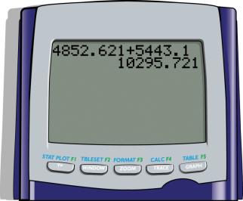
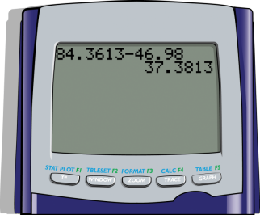
Example 7: Adding and Subtracting Decimals with a Calculator (cont.)
a. b.
The answer to part a. is 10295.721 and the answer to b. is 37.3813.

Slide 15
Multiplication with Decimal Numbers
To Multiply Positive Decimal Numbers
1. Multiply the two numbers as if they were whole numbers.
2. Count the total number of places to the right of the decimal points in both numbers being multiplied.
3. Place the decimal point in the product so that the number of places to the right is the same as that found in step 2.

Slide 16
Example 8: Multiplying Decimals
Multiply: 2.435 × 4.1.
Solution:
4 places in the product

Slide 17
Division with Decimal Numbers
To Divide Decimal Numbers
1. Move the decimal point in the divisor to the right so that the divisor is a whole number.
2. Move the decimal point in the dividend the same number of places to the right.
3. Place the decimal point in the quotient directly above the new decimal point in the dividend.
4. Divide just as with whole numbers.

Slide 18
Example 9: Dividing Decimals
Find the quotient:
Solution:
a. Write down the numbers.
b. Move both decimal points one place to the right so that the divisor becomes a whole number. Then place the decimal point in the quotient.
decimal point in quotient

Slide 19
Example 9: Dividing Decimals (cont.)
c. Proceed to divide as with whole numbers.
quotient
divisor
dividend
remainder

Slide 20
Division with Decimal Numbers
Rounding to the Right of the Decimal Point
Rounding to the right of the decimal point in a decimal number is similar to rounding with whole numbers:
1. Look one digit to the right of the desired place of accuracy.
2. If this digit is 5 or more, raise the digit in the desired place by 1. Otherwise, leave the digit as it is.
3. Drop the remaining digits.
(Note that when rounding with whole numbers these digits must be replaced by 0's)

Slide 21
Example 10: Dividing Decimals and Rounding
Find the quotient 82.3 ÷ 2.9 to the nearest tenth.
Solution:
Divide until the quotient is in hundredths (one place more than tenths); then round to tenths.

Slide 22
Example 10: Dividing Decimals and Rounding (cont.)
hundredths
read approximately
Add 0’s as needed.
accurate to the nearest tenth

Slide 23
Example 11: Applications: Calculating Price
Suppose that the price of a gallon of gas is stated as $3.15 at the pump and the station owner tells you that the taxes you are paying are figured at 0.45 times the price he is actually charging for a gallon of gas. What price (to the nearest penny) is he actually charging for a gallon of gas? (Note: As we will see on page 57, 145% = 1.45.)
Solution:
To find the actual price of a gallon of gas, before taxes, divide the total price by 1.45.

Slide 24
Example 11: Applications: Calculating Price (cont.)
So, the actual cost of the gas is about $2.17 per gallon before taxes.

Slide 25
Example 12: Multiplying and Dividing Decimals with a Calculator
Use a TI-84 Plus graphing calculator to perform the following operations and write the answer accurate to 4 decimal places:
a. 4.631(0.235)(2.3)
b. 19.36 ÷ 5.4
Solution:
After entering the values and operations into the calculator, the display will be as shown on the next slide:

Slide 26
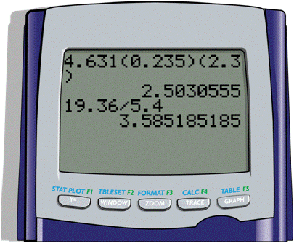
Example 12: Multiplying and Dividing Decimals with a Calculator (cont.)
The answers accurate to 4 decimal places:
a. 2.5031 b. 3.5852

Slide 27
Decimals and Percents
To Change a Decimal to a Percent:
Step 1. Move the decimal point two places to the right.
Step 2. Add the % symbol.
These two steps have the effect of multiplying by 100 and then dividing by 100. Thus the number is not changed. Just the form is changed.

Slide 28
Example 13: Converting Decimals to Percents
Change each decimal to an equivalent percent.
a. 0.254 b. 0.005
c. 1.5 d. 0.2
Solutions:
a. 0.254
= 25.4%
Decimal point moved
two places to the right
% symbol added on

Slide 29
Example 13: Converting Decimals to Percents (cont.)
b. 0.005
c. 1.5
= 0.5%
Note that this is less than 1%.
Decimal point moved
two places to the right
% symbol added on
= 150%
Note that this is more than 100%.
Decimal point moved
two places to the right
% symbol added on

Slide 30
Example 13: Converting Decimals to Percents (cont.)
d. 0.2
= 20%
Decimal point moved
two places to the right
% symbol added on

Slide 31
Decimals and Percents
To Change a Percent to a Decimal:
Step 1. Move the decimal point two places to the left.
Step 2. Delete the % symbol.

Slide 32
Example 14: Converting Percents to Decimals
Change each percent to an equivalent decimal.
a. 38% b. 16.2%
c. 100% d. 0.25%
Solutions:
a. 38%
= 0.38
% symbol deleted
Understood
decimal point
Decimal point
moved two places left

Slide 33
Example 14: Converting Percents to Decimals (cont.)
= 0.162
b. 16.2%
c. 100%
d. 0.25%
= 1.00
= 1
= 0.0025
The percent is less than 1%, and the decimal is less than 0.01.

Slide 34
Fractions and Percents
To Change a Fraction to a Percent
Step 1. Change the fraction to a decimal
(Divide the numerator by the denominator.)
Step 2. Change the decimal to a percent.

Slide 35
Example 15: Converting Fractions to Percents
Change to a percent.
Solution:
First divide 5 by 8 to get the
decimal form. (This can be
done with a calculator.)
Now change 0.625 to a percent:

Slide 36
Example 16: Calculating Percents
In the U.S. in 1900, there were about 27,000 college graduates (who received bachelor’s degrees), of which about 22,000 were men. In 2003, there were about 1,300,000 college graduates, of which about 550,000 were men. Find the percentage of college graduates that were men in each of those years.
Solution:
For each year, divide (with a calculator) the number of male graduates by the total number of graduates:

Slide 37
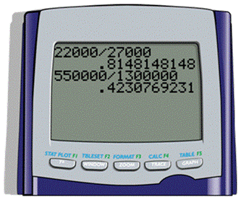
Example 16: Calculating Percents (cont.)
a. For 1900, of college
graduates were men.
b. For 2003, of college
graduates were men.

