Slide 1
Section 2.1
Cartesian Coordinate System and Linear Equations: Ax + By = C

Slide 2
Objectives
Graph and label ordered pairs of real numbers as points on a plane.
Find ordered pairs that satisfy a given linear equation.
Recognize the standard form of a linear equation: Ax + By = C.
Graph linear equations.
Locate the x-intercept and the y-intercept of a linear equation.

Slide 3
Cartesian Coordinate System
One-to-One Correspondence
There is a one-to-one correspondence between points in a plane and ordered pairs of real numbers.

Slide 4
Example 1: Graphing Ordered Pairs
Graph the set of ordered pairs
(Note: The listing of ordered pairs within the braces can be in any order.)
Solution: To locate each point, start at the origin, and:
For A(−3, 1), move 3 units left and 1 unit up.
For B(−1, −3), move 1 unit left and 3 units down.
For C(0, 2), move 2 units up (do not move any units left or right.)

Slide 5
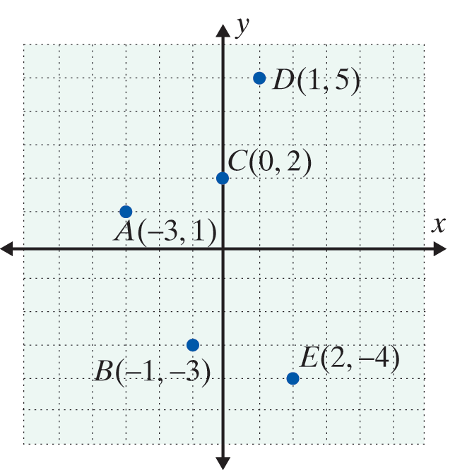
Example 1: Graphing Ordered Pairs (cont.)
For D(1, 5), move 1 unit right and 5 units up.
For E(2, −4), move 2 units right and 4 units down.

Slide 6
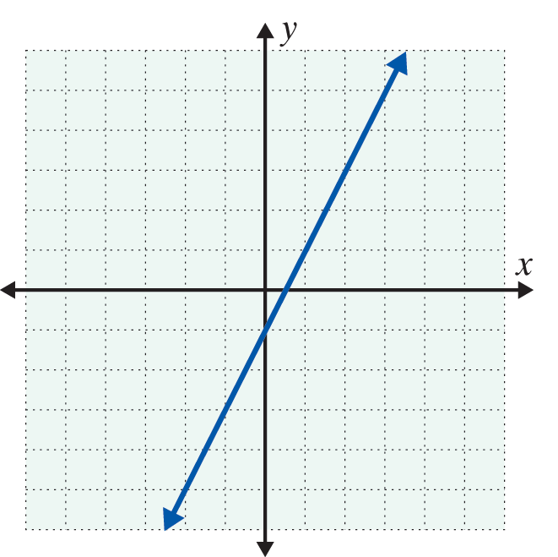
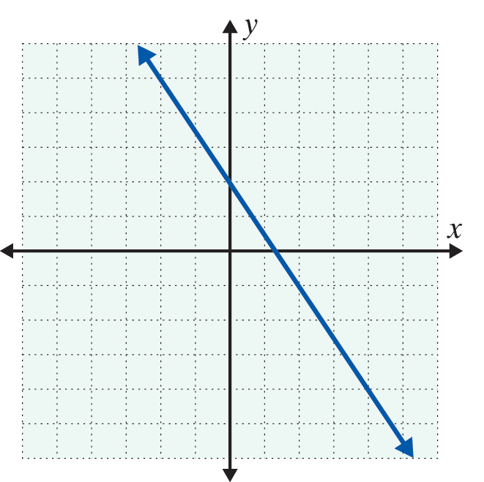
Example 2: Reading Points on a Graph
The graphs of two straight lines are given. Each line has an infinite number of points. Use the grid to help you locate (or estimate) three points on each line.
a. b.

Slide 7
Example 2: Reading Points on a Graph (cont.)

Slide 8
Graphing Straight Lines
Solution Set of an Equation in Two Variables
The solution set of an equation in two variables, x and y, consists of all ordered pairs of real numbers (x, y) that satisfy the equation.

Slide 9
Graphing Straight Lines
Standard Form of a Linear Equation
Any equation of the form
Ax + By = C,
where A, B, and C are real numbers and A and B are not both equal to 0, is called the standard form of a linear equation.

Slide 10
Graphing Straight Lines
Notes
Note that in the standard form Ax + By = C, A and B may be positive, negative, or 0, but A and B cannot both be 0.

Slide 11
Graphing Straight Lines
To Graph a Linear Equation in Two Variables
1. Locate any two points that satisfy the equation. (Choose values for x and y that lead to simple solutions. Remember that there are an infinite number of choices for either x or y. But, once a value for x or y is chosen, the corresponding value for the other variable is found by substituting into the equation.)
2. Plot these two points on a Cartesian coordinate system.

Slide 12
Graphing Straight Lines
To Graph a Linear Equation in Two Variables (cont.)
3. Draw a straight line through these two points. [Note: Every point on that line will satisfy the equation.]
4. To check: Locate a third point that satisfies the equation and check to see that it does indeed lie on the line.

Slide 13
Example 3: Graphing a Linear Equation in Two Variables
Graph each of the following linear equations.
a. 2x + 3y = 6
Solution:
Make a table with headings x and y and, whenever possible, choose values for x or y that lead to simple solutions for the other variable. In this example, we have found four ordered pairs that satisfy this equation by choosing two x values and two y values that we felt would result in simple solutions.

Slide 14
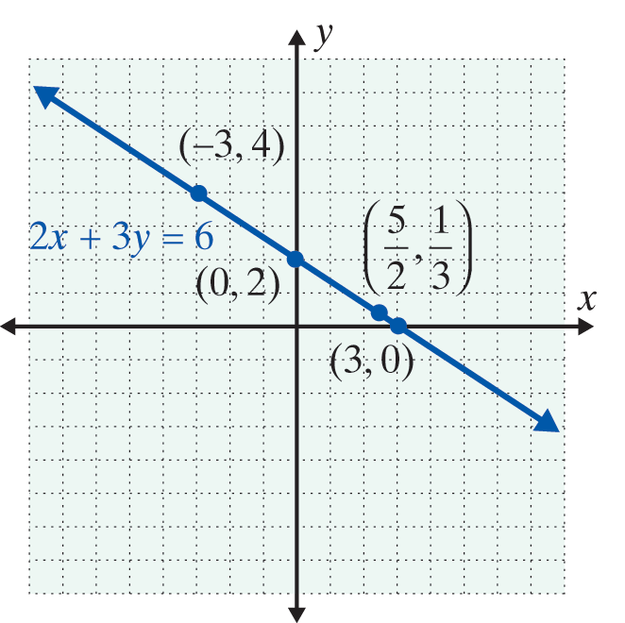
Example 3: Graphing a Linear Equation in Two Variables (cont.)
x | 2x + 3y = 6 | y

Slide 15
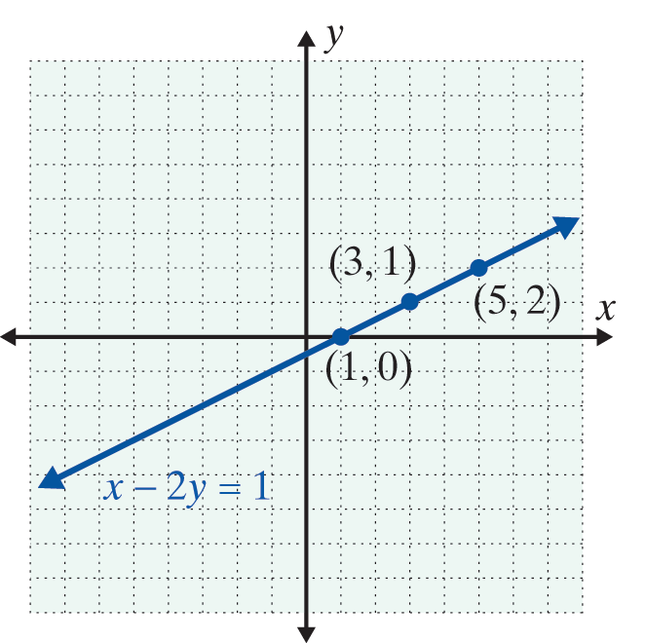
Example 3: Graphing a Linear Equation in Two Variables (cont.)
b. x − 2y = 1
Solution:
Solve for x and substitute 0, 1, and 2 for y: x = 2y + 1.
Results | Substitutions | Choices

Slide 16
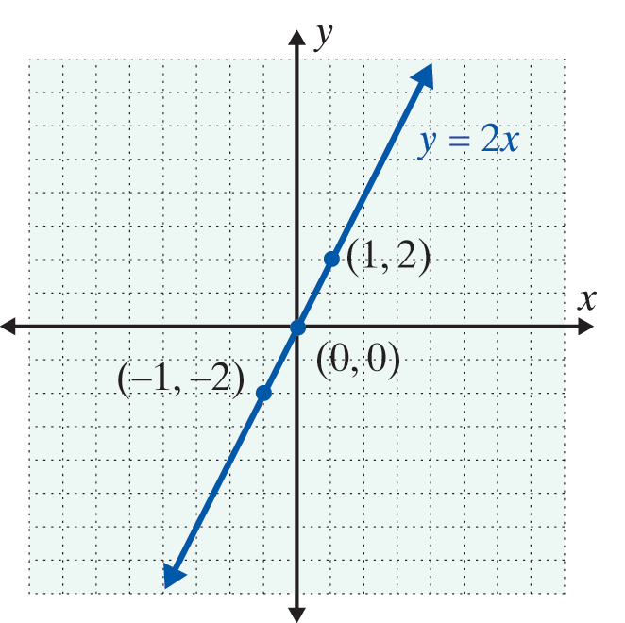
Example 3: Graphing a Linear Equation in Two Variables (cont.)
c. y = 2x
Solution: Substitute −1, 0, and 1 for x.
Results | Substitutions | Choices

Slide 17
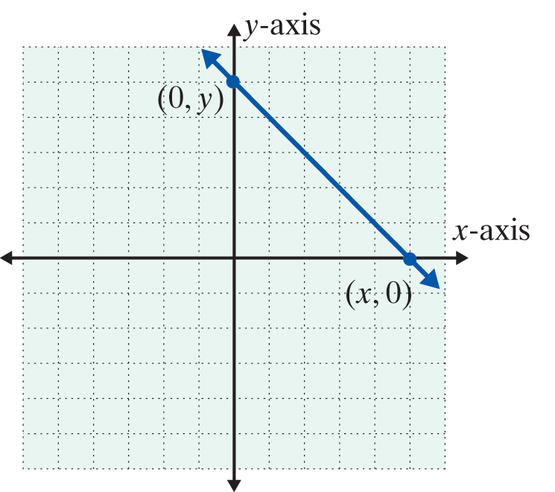
Locating the y-intercept and x-intercept
Intercepts
1. To find the y-intercept
(where the line crosses
the y-axis), substitute
x = 0 and solve for y.
2. To find the x-intercept
(where the line crosses
the x-axis), substitute
y = 0 and solve for x.

Slide 18
Example 4: x- and y-Intercepts
Graph the following linear equations by locating the y-intercept and the x-intercept.

Slide 19
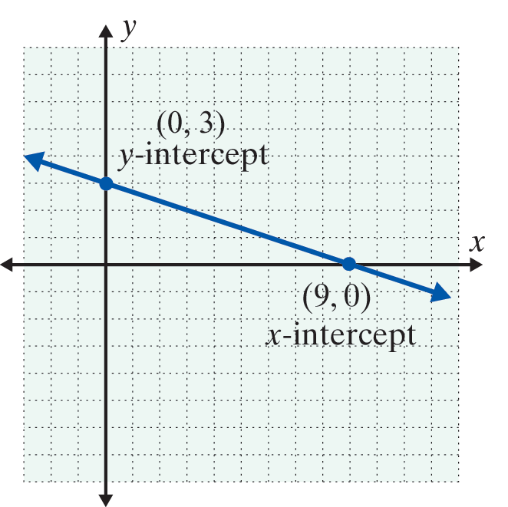
Example 4: x- and y-Intercepts (cont.)
Plot the two intercepts and
draw the line that contains
them.

Slide 20
Example 4: x- and y-Intercepts (cont.)

Slide 21
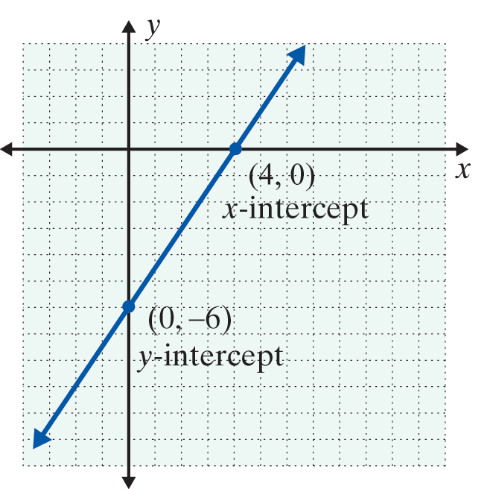
Example 4: x- and y-Intercepts (cont.)
Plot the two intercepts and draw the line that contains them.

Slide 22
Locating the y-intercept and x-intercept
Notes
In general, the intercepts are easy to find because substituting 0 for x or y leads to an easy solution for the other variable. However, when the intercepts result in a point with fractional (or decimal) coordinates and estimation is involved, then a third point that satisfies the equation should be found to verify that the line is graphed correctly.

Slide 23
Practice Problems
1. For x in the set {−1, 2, 3}, find the corresponding ordered pairs that satisfy the equation x − 2y = 3.
2. Find the missing coordinate of each ordered pair so that it belongs to the solution set of the equation 2x + y = 4:
(0, ), ( , 0), ( , 8), (−1, ).
3. Does the ordered pair satisfy the equation 3x + 2y = 6?
4. Find the x-intercept and y-intercept of the equation −3x + y = 9.

Slide 24
Practice Problem Answers
1.
2. (0, 4), (2, 0), (−2, 8), (−1, 6)
3. Yes
4. x-intercept = (−3,0), y-intercept = (0, 9)

