Slide 1
Section 2.2
Slope-Intercept Form:
y = mx + b

Slide 2
Objectives
Interpret the slope of a line as a rate of change.
Find the slopes of lines given two points.
Find the slopes of and graph horizontal and vertical lines.
Find the slopes and y-intercepts of lines and then graph the lines.
Write the equations of lines given the slopes and y-intercepts.

Slide 3
The Meaning of Slope
Slope
Let P₁(x₁, y₁) and P₂(x₂, y₂) be two points on a line. The slope can be calculated as follows:
Note: The letter m is standard notation for representing the slope of a line.

Slide 4
Example 1: Finding the Slope of a Line
Find the slope of the line that contains the points (−1, 2) and (3, 5), and then graph the line.
Solution:

Slide 5
Example 1: Finding the Slope of a Line (cont.)

Slide 6
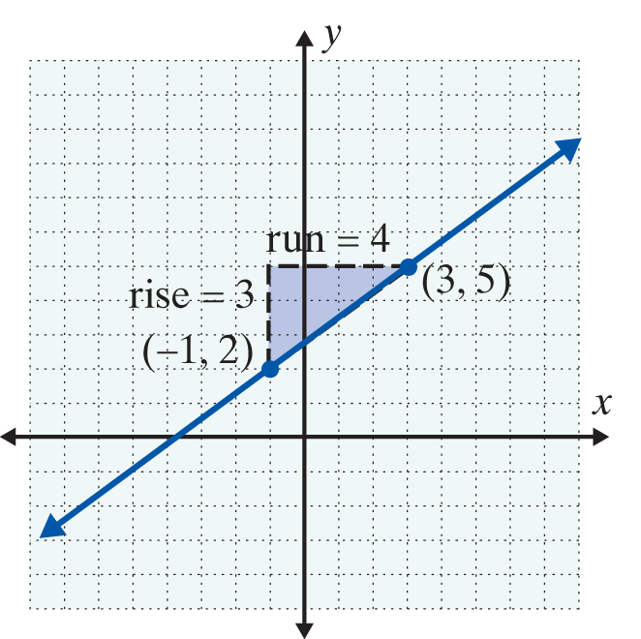
Example 1: Finding the Slope of a Line (cont.)

Slide 7
Example 2: Finding the Slope of a Line
Find the slope of the line that contains the points (1, 3) and (5, 1), and then graph the line.
Solution:

Slide 8
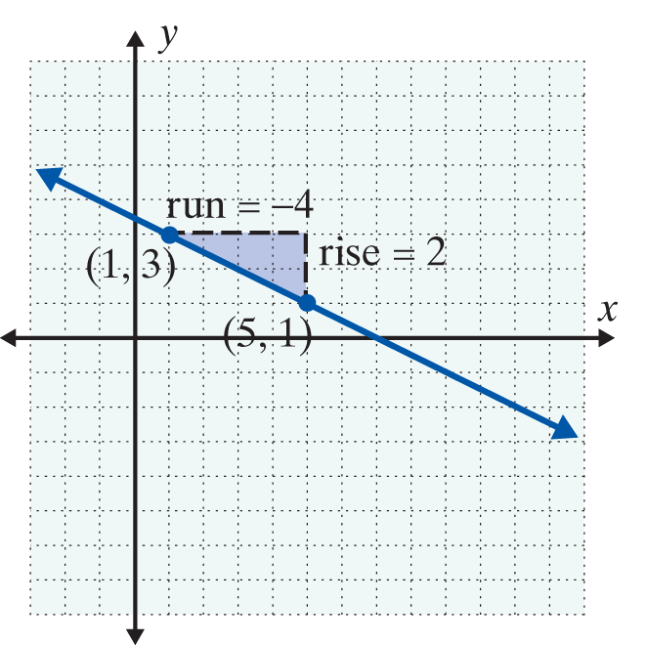
Example 2: Finding the Slope of a Line (cont.)

Slide 9
Calculating the Slope
Notes
Lines with positive slope go up as we move along the line from left to right.
Lines with negative slope go down as we move along the line from left to right.

Slide 10
Slopes of Horizontal and Vertical Lines
Horizontal and Vertical Lines
The following two general statements are true for horizontal and vertical lines:
1. For horizontal lines (of the form y = b), the slope is 0.
2. For vertical lines (of the form x = a), the slope is undefined.

Slide 11
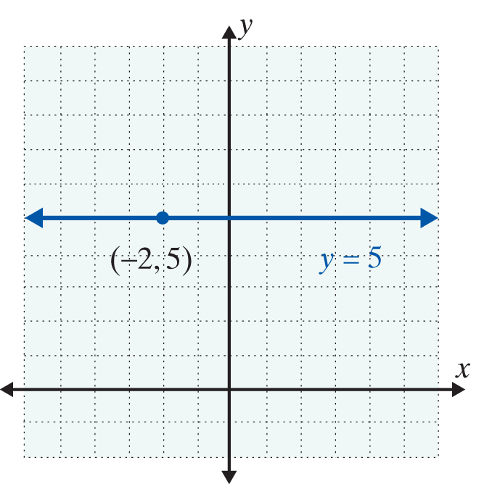
Example 3: Slopes of Horizontal and Vertical Lines
a. Find the equation and slope of the horizontal line through the point (−2, 5).
Solution: The equation is y = 5 and the slope is 0.

Slide 12
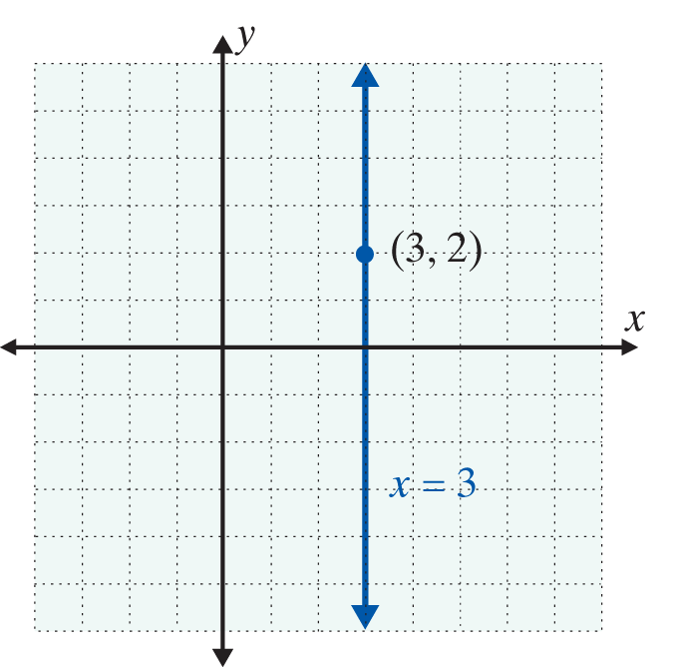
Example 3: Slopes of Horizontal and Vertical Lines (cont.)
b. Find the equation and slope of the vertical line through the point (3, 2).
Solution:
The equation is x = 3 and the slope is undefined.

Slide 13
Slope-Intercept Form: y = mx + b
For y = mx + b, m is the Slope
Statement:
Given an equation in the form y = mx + b, the slope of the line is m.
Proof:
Suppose that the equation is solved for y and y = mx + b. Let (x₁, y₁) and (x₂, y₂) be two points on the line where x₁ ≠ x₂. Then y₁ = mx₁ + b and y₂ = mx₂ + b. The slope can be calculated as follows:

Slide 14
Slope-Intercept Form: y = mx + b
For y = mx + b, m is the Slope (cont.)
Therefore, for an equation of the form y = mx + b, the slope of the line is m.

Slide 15
Slope-Intercept Form: y = mx + b
Slope-Intercept Form
y = mx + b is called the slope-intercept form for the equation of a line. m is the slope and (0, b) is the y-intercept.

Slide 16
Example 4: Using the Form y = mx + b
a. Find the slope and y-intercept of −2x + 3y = 6 and graph the line.
Solution: Solve for y.

Slide 17
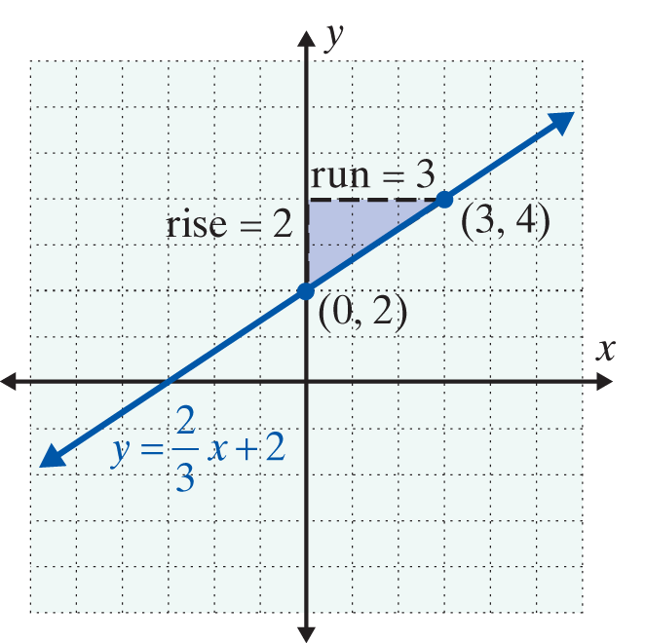
Example 4: Using the Form y = mx + b (cont.)
As shown in the graph, if we “rise” 2 units up and “run” 3 units to the right from the y-intercept (0, 2), we locate another point (3, 4). The line can be drawn through these two points.

Slide 18
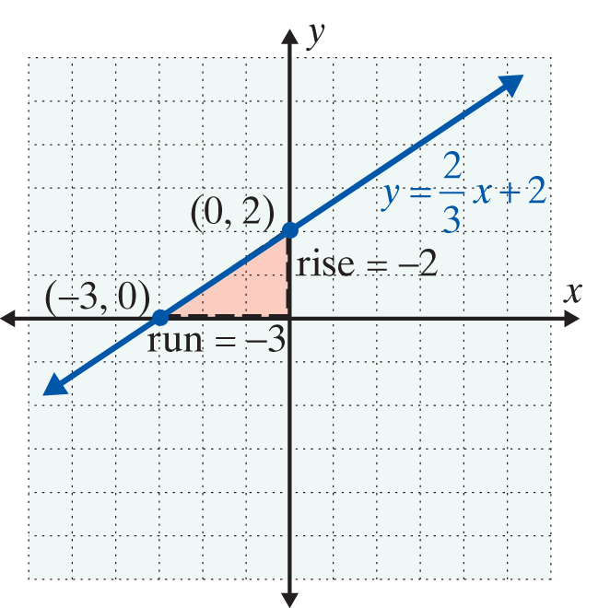
Example 4: Using the Form y = mx + b (cont.)
Note: As shown in the graph, we could also first “rise” 2 units down and “run” 3 units left from the y-intercept to locate the point (−3, 0) on the graph. That is, we can interpret the slope

Slide 19
Example 4: Using the Form y = mx + b (cont.)
b. Find the slope and y-intercept of x + 2y = −6 and graph the line.
Solution: Solve for y.

Slide 20
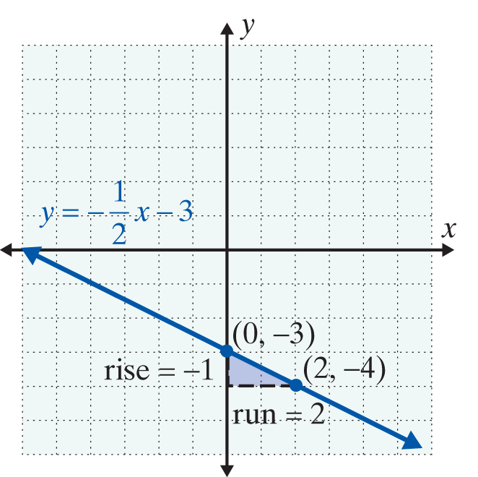
Example 4: Using the Form y = mx + b (cont.)
We can treat as
and the “rise” as −1
and the “run” as 2. Moving from (0, −3) as shown in the figure, we locate another point (2, −4) on the graph and draw the line.

Slide 21
Example 4: Using the Form y = mx + b (cont.)

Slide 22
Practice Problems
1. Find the slope of the line through the two points (1, 3) and (4, 6). Graph the line.
2. Find the equation of the line through the point (0, 5)
with slope
3. Find the slope and y-intercept for the line 2x + y = 7.
4. Write the equation for the horizontal line through the point (−1, 3). What is the slope of this line?
5. Write the equation for the vertical line through the point (−1, 3). What is the slope of this line?

Slide 23
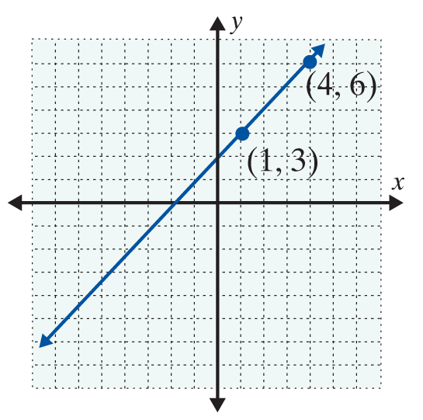
Practice Problem Answers
1. m = 1 2.
3. m = −2, y-intercept = (0, 7)
4. y = 3, slope is 0
5. x = −1, slope is undefined

