Slide 1
Section 2.3
Point-Slope Form:

Slide 2
Objectives
Graph a line given its slope and one point on the line.
Find the equation of a line given its slope and one point on the line by using the formula
Find the equation of a line given two points on the line.

Slide 3
Example 1: Graph a Line Given a Point and the Slope
Graph the line with slope which passes through the point (2, 5).
Solution: Start from the point (2, 5) and locate another point on the line by using the slope as
There are four ways to proceed. Here are two:
1. Move 4 units right and 3 units down, or
2. Move 3 units down and 4 units right.

Slide 4
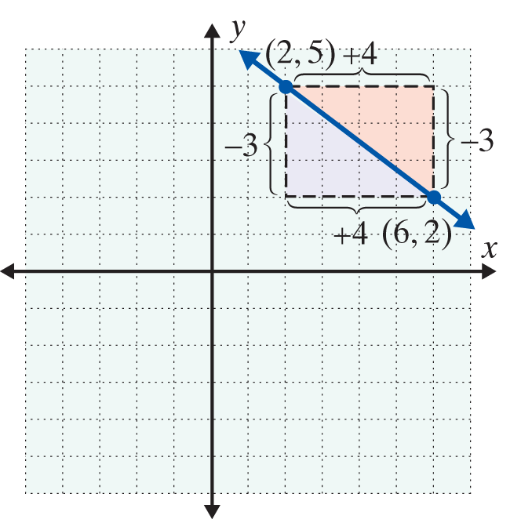
Example 1: Graph a Line Given a Point and the Slope (cont.)
Either way, you arrive at the same point (6, 2).
This means that we can move
from the given point either with
the rise first or the run first.
(Note: Any numbers in the ratio
of −3 to 4 can be used for the
moves, such as −6 to 8 or 9 to −12.)

Slide 5
Point-Slope Form:
Point-Slope Form
An equation of the form
is called the point-slope form for the equation of a line that contains the point and has slope m.

Slide 6
Example 2: Using the Point-Slope Form
Find the equation of the line with a slope of and
passing through the point (2, 3). Graph the line using the point and slope.
Solution: Substitute into the point-slope form.

Slide 7
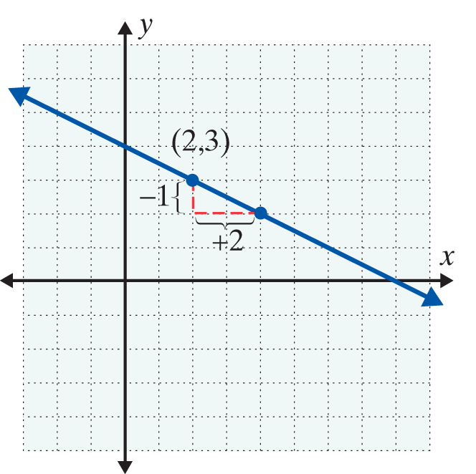
Example 2: Using the Point-Slope Form (cont.)

Slide 8
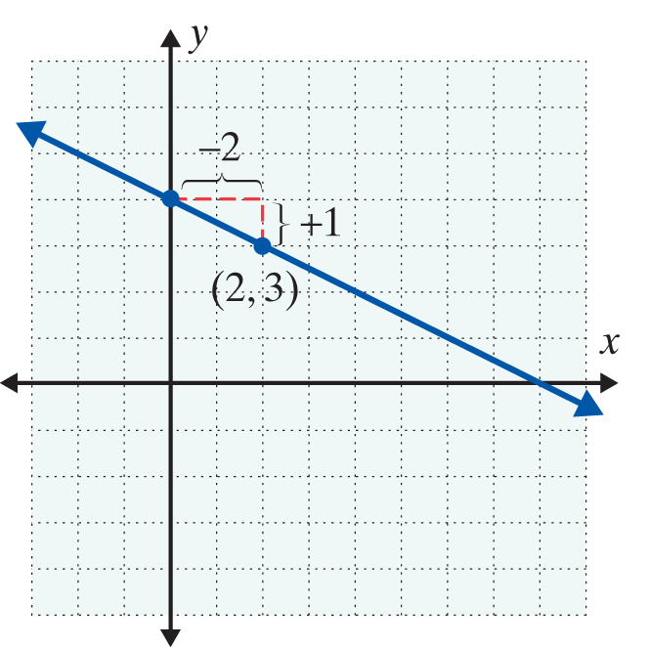
Example 2: Using the Point-Slope Form (cont.)
With a negative slope, either the rise is negative and the run is positive, or the rise is positive and the run is negative. In either case, as the previous figure and the following figure illustrate, the line is the same.

Slide 9
Finding the Equations of Lines Given Two Points
Finding the Equation of a Line
If two points are given,
1. Use the formula to find the slope.
2. Use this slope, m, and either point in the point- slope formula

Slide 10
Example 3: Using Two Points to Find the Equation of a Line
Find the equation of the line containing the two points (−1, 2) and (4, −2).
Solution: First, find the slope.

Slide 11
Example 3: Using Two Points to Find the Equation of a Line (cont.)
Now use one of the given points and the point-slope form for the equation of a line.
[(−1, 2) and (4, −2) are used here to illustrate that either point may be used.]
Using (−1, 2)
Using (4, −2)

Slide 12
Example 3: Using Two Points to Find the Equation of a Line (cont.)
or 4x + 5y = 6 4x + 5y = 6

Slide 13
Parallel Lines and Perpendicular Lines
Parallel and Perpendicular Lines
Parallel lines are lines that never intersect (cross each other) and these lines have the same slope. All vertical lines are parallel to one another.
Perpendicular lines are lines that intersect at 90° (right) angles and whose slopes are negative reciprocals of each other. Horizontal lines are perpendicular to vertical lines.

Slide 14
Example 4: Finding the Equations of Parallel Lines
Find the equation of the line through the point (2, 3) parallel to the line 5x + 3y = 1. Graph both lines.
Solution:
First, solve for y to find the slope of the given line.

Slide 15
Example 4: Finding the Equations of Parallel Lines (cont.)
Now use the point-slope form with and

Slide 16
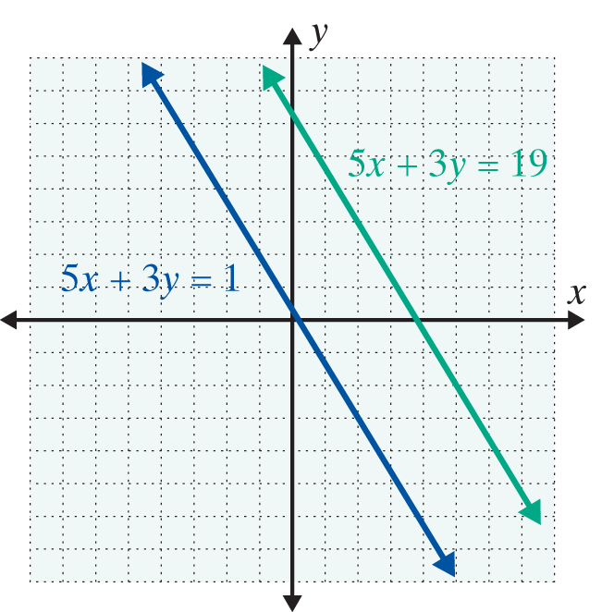
Example 4: Finding the Equations of Parallel Lines (cont.)

Slide 17
Example 5: Finding the Equation of Perpendicular Lines
Find the equation of the line through the point (2, 3) perpendicular to the line 5x + 3y = 1. Graph both lines.
Solution: We know from Example 4 that the slope of the line 5x + 3y = 1 is Thus any line perpendicular to this line must have slope
Now, using and we have

Slide 18
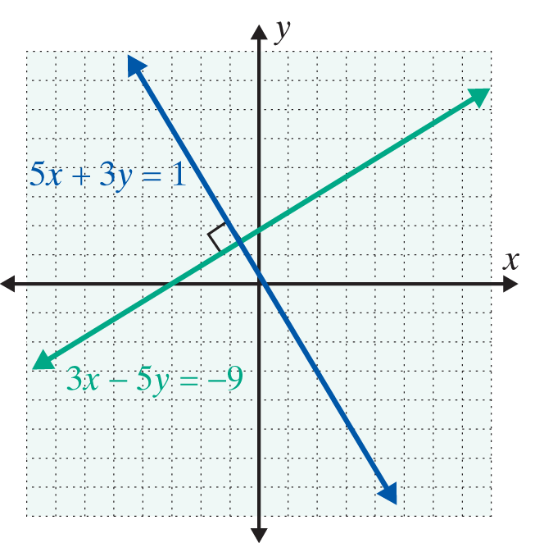
Example 5: Finding the Equation of Perpendicular Lines (cont.)

Slide 19
Parallel Lines and Perpendicular Lines
Summary of Formulas and Properties of Straight Lines
1. Ax + By = C Standard form
2. Slope of a line
3. y = mx + b Slope-intercept form
4. Point-slope form

Slide 20
Parallel Lines and Perpendicular Lines
Summary of Formulas and Properties of Straight Lines (cont.)
5. y = b Horizontal line, slope 0
6. x = a Vertical line, undefined slope
7. Parallel lines have the same slope.
8. Perpendicular lines have slopes that are negative reciprocals of each other.

Slide 21
Practice Problems
Find a linear equation in standard form that satisfies the given conditions.
1. Passes through the point (4, −1) with m = 2
2. Parallel to y = −3x + 4 and contains the point (−1, 5)
3. Perpendicular to 2x + y = 1 and passes through the origin (0, 0)
4. Contains the two points (6, −2) and (2, 0)

Slide 22
Practice Problem Answers

