Slide 1
Section 2.4
Introduction to Functions and Function Notation

Slide 2
Objectives
Find the domain and range of a relation or function.
Determine whether a relation is or is not a function.
Use the vertical line test to determine whether a graph is or is not the graph of a function.
Write functions using function notation.
Use a TI-84 Plus graphing calculator to graph functions.

Slide 3
Relations and Functions
Notes
The ordered pairs discussed in this text are ordered pairs of real numbers. However, more generally, ordered pairs might be other types of pairs such as (parent, child), (city, state), or (name, batting average).

Slide 4
Relations and Functions
Relation, Domain, and Range
A relation is a set of ordered pairs of real numbers.
The domain, D, of a relation is the set of all first coordinates in the relation.
The range, R, of a relation is the set of all second coordinates in the relation.

Slide 5
Example 1: Finding the Domain and Range
Find the domain and range for each of the following relations.
Solution:
Note that 6 is written only once in the domain and 2 is written only once in the range, even though each appears more than once in the relation.

Slide 6
Example 1: Finding the Domain and Range
Solution:

Slide 7
Relations and Functions
Function
A function is a relation in which each domain element has exactly one corresponding range element.

Slide 8
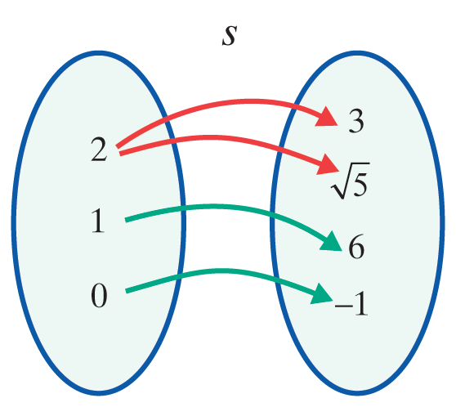
Example 2: Functions
Determine whether or not each of the following relations is a function.
Solution:
s is not a function. The number 2 appears as a first coordinate more than once.

Slide 9
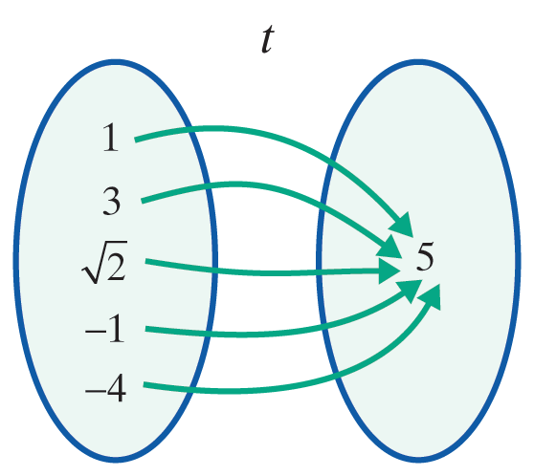
Example 2: Functions (cont.)
Solution:
t is a function. Each first coordinate appears only once. The fact that the second coordinates are all the same has no effect on the concept of a function.

Slide 10
Vertical Line Test
Vertical Line Test
If any vertical line intersects the graph of a relation at more than one point, then the relation graphed is not a function.

Slide 11
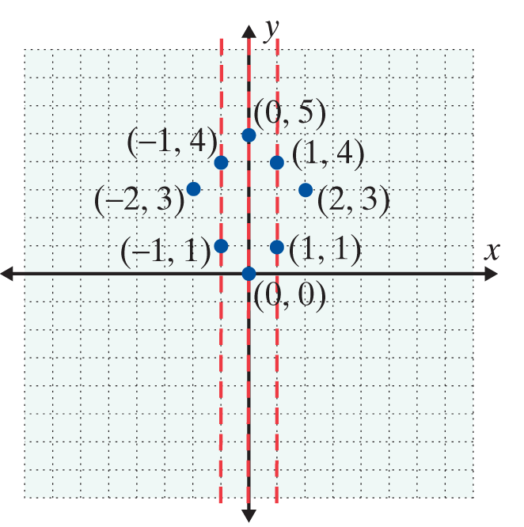
Example 3: Vertical Line Test
Use the vertical line test to determine whether or not each of the following graphs represents a function. Then list the domain and range of each graph.
a.
Solution:
The relation is not a function since a vertical line can be drawn that intersects the graph at more than one point. Listing the ordered pairs shows that several x-coordinates appear more than once.

Slide 12
Example 3: Vertical Line Test (cont.)
Here D = {−2 , −1, 0, 1, 2}
and R = {0, 1, 3, 4, 5}.

Slide 13
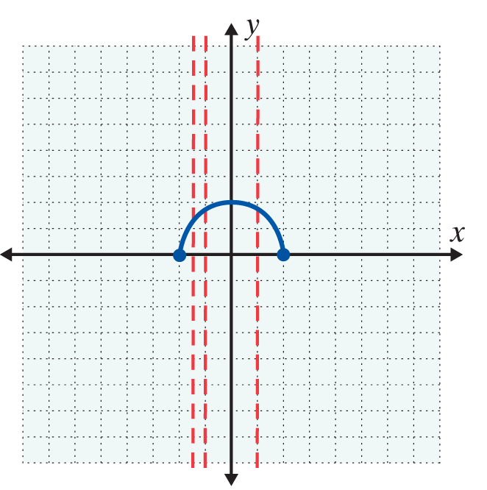
Example 3: Vertical Line Test (cont.)
b.
Solution:
The relation is a function. No vertical line will intersect the graph at more than one point. Several vertical lines are drawn to illustrate this. For this function, we see from the graph that D = [−2,2], and R = [0,2].

Slide 14
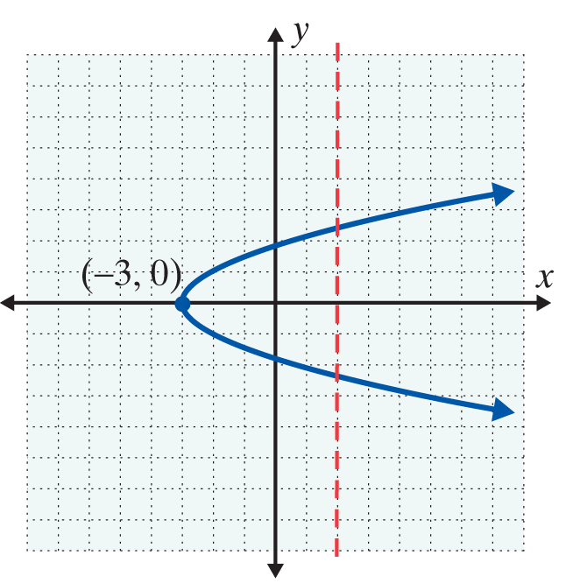
Example 3: Vertical Line Test (cont.)
c.
Solution:
The relation is not a function. At least one vertical line (drawn) intersects the graph at more than one point.
D = [−3,∞) and R = (−∞, ∞).

Slide 15
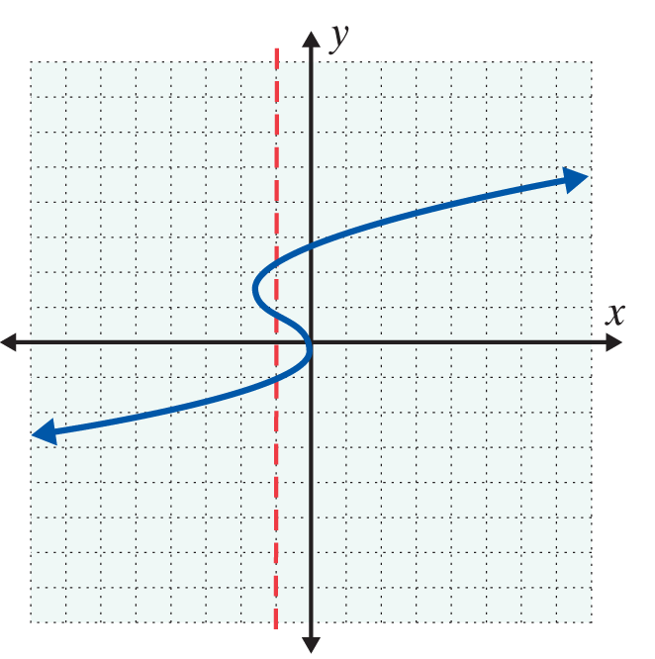
Example 3: Vertical Line Test (cont.)
d.
Solution:
The relation is not a function. At least one vertical line intersects the graph at more than one point.
D = (−∞, ∞) and R = (−∞, ∞).

Slide 16
Linear Functions
Linear Functions
A linear function is a function represented by an equation of the form
y = mx + b
The domain of a linear function is the set of all real numbers: D = [−∞, ∞).

Slide 17
Linear Functions
NOTES
In determining the domain of a function, two facts about real numbers are particularly important at this stage:
1. No denominator can equal 0, and
2. Square roots of negative numbers are not real numbers.

Slide 18
Example 4: Domain
Find the domain of each of the following functions.
Solution: The domain is all real numbers for which the expression is defined. Thus D = (−∞, 5)∪(5, ∞), because the denominator is 0 when x = 5.
Note: Here interval notation tells us that x can be any real number except 5.

Slide 19
Example 4: Domain (cont.)
Solution: For to be a real number, the expression under the square root sign must be non-negative. So we have
Thus D = [2, ∞).

Slide 20
Example 5: Function Evaluation
For the function g(x) = 4x + 5, find:
a. g(2)
Solution:
b. g(−1)
Solution:
c. g(0)
Solution:
g(2)
= 4 ⋅ (2) + 5
= 13
g(−1)
= 4 ⋅ (−1) + 5
= 1
g(0)
= 4 ⋅ (0) + 5
= 5

Slide 21
Example 6: Nonlinear Function Evaluation
For the function h(x) = x² − 3x + 2, find:
a. h(4)
Solution:
b. h(0)
Solution:
c. h(−3)
Solution:
h(4)
= (4)² − 3 ⋅ (4) + 2
= 16 − 12 + 2
= 6
h(0)
= (0)² − 3 ⋅ (0) + 2
= 0 − 0 + 2
= 2
h(−3)
= (−3)² − 3 ⋅ (−3) + 2
= 9 + 9 + 2
= 20

Slide 22
Practice Problems
1. State the domain and range of the relation {(5, 6), (7, 8), (9, 0.5), (11, 0.3)}. Is the relation a function? Explain briefly.
2. State the domain of the linear function f(x) = 5x − 2.
3. State the domain of the function
4. State the domain of the function

Slide 23
Practice Problem Answers
1. D = {5, 7, 9, 11}; R = {0.3, 0.5, 6, 8}. Yes, the relation is a function because each x-coordinate appears only once.
2. D = (−∞, ∞)
3. D = [−3, ∞)
4. D = (−∞,−6) ∪ (−6, ∞) or x ≠ −6

Slide 24
Example 7: Graphing Functions with a TI-84 Plus
Use a TI-84 Plus graphing calculator to find the graphs of each of the following functions. Use the CALC key to find the point where each graph intersects the x-axis. Changing the WINDOW may help you get a “better” or “more complete” picture of the function. This is a judgment call on your part.
a. 3x + y = −1
Solution:
To have the calculator graph a nonvertical straight line, you must first solve the equation for y. Solving for y gives,

Slide 25

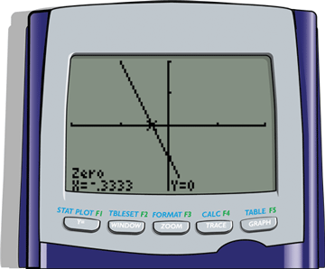
Example 7: Graphing Functions with a TI-84 Plus (cont.)
y = −3x – 1.
[It is important that the key be used to indicate the negative sign in front of 3x. This is not the same as the subtraction key.]
Note: Vertical lines are not functions and cannot be graphed by the calculator in function mode.

Slide 26


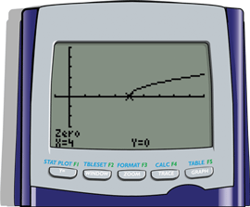
Example 7: Graphing Functions with a TI-84 Plus (cont.)
Solution: To graph a square root equation, we enter the
sign by selecting
Note: Be sure to include the expression “( x −4 )” in parentheses after the sign.

Slide 27
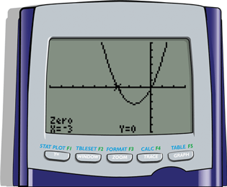
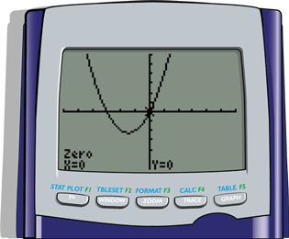
Example 7: Graphing Functions with a TI-84 Plus (cont.)
c. y = x² + 3x
Solution: Since the graph of this function has two x-intercepts, we have shown the graph twice. Each graph shows the coordinates of a distinct x-intercept.

Slide 28
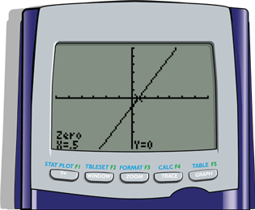
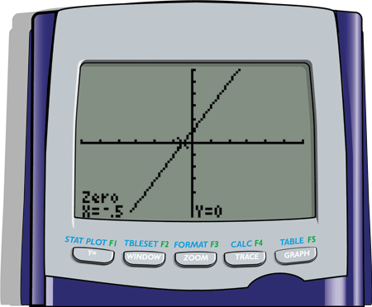
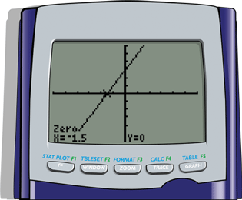
Example 7: Graphing Functions with a TI-84 Plus (cont.)
d. y = 2x − 1; y = 2x + 1; y = 2x + 3
Solution:
y = 2x − 1
y = 2x + 1
y = 2x + 3

Slide 29
Some Basics about the TI-84 Plus
NOTES
The standard window shows 96 pixels across the window and 64 pixels up and down the window. This gives a ratio of 3 to 2 and can give a slightly distorted view of the actual graph because the vertical pixels are squeezed into a smaller space. For Example 7d, the graphs of all three functions are in the standard window.

Slide 30
Some Basics about the TI-84 Plus
NOTES (cont.)
Experiment by changing the window to a square window, say −9 to 9 for x and −6 to 6 for y. Then graph the functions and notice the slight differences (and better representation) in the appearances on the display. DO THIS!

