Slide 1
Section 3.1
Systems of Linear Equations in Two Variables

Slide 2
Objectives
Solve systems of linear equations in two variables using three methods:
graphing,
substitution, and
addition.

Slide 3
Solutions by Graphing
To Solve a System of Linear Equations by Graphing
1. Graph both linear equations on the same set of axes.
2. Observe the point of intersection (if there is one).
a. If the slopes of the two lines are different, then the lines intersect in one and only one point. The system is consistent and has a single point solution.

Slide 4
Solutions by Graphing
To Solve a System of Linear Equations by Graphing (cont.)
b. If the lines are distinct and have the same slope, then the lines are parallel and the system is inconsistent. The system will have no solution.
c. If the lines are the same line, the system is dependent and all the points on the line constitute the solution.

Slide 5
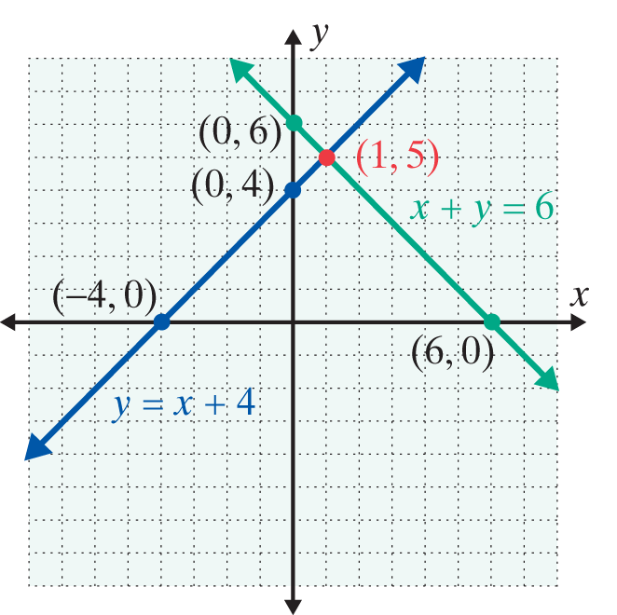
Example 1: A Consistent System
Solve the following system of linear equations by
graphing:
Solution:
The two lines intersect at the
point (1, 5). The system is
consistent and the solution
is x = 1 and y = 5.

Slide 6
Example 1: A Consistent System (cont.)
Check:
Substitution shows that (1, 5) satisfies both of the equations in the system.

Slide 7
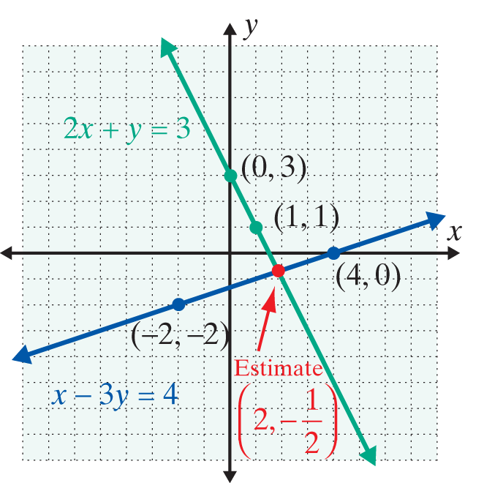
Example 2: A Consistent System with Estimation
Solve the following system of linear equations by
graphing:
Solution:

Slide 8
Example 2: A Consistent System with Estimation
The two lines intersect at one point, making this system consistent. However, we can only estimate the point of
intersection as In this situation be aware that,
although graphing gives a good “estimate,” finding exact solutions to the system is not likely.

Slide 9
Example 2: A Consistent System with Estimation (cont.)
Check: Substituting x = 2 and gives:
and

Slide 10
Example 2: A Consistent System with Estimation (cont.)
Thus, checking shows that the estimated solution
does not satisfy either equation. The
estimated point of intersection is just that – an estimate. The following discussion develops an algebraic technique that gives the exact solution as

Slide 11
Solutions by Substitution
To Solve a System of Linear Equations by Substitution
1. Solve one of the equations for one of the variables.
2. Substitute the resulting expression into the other equation.
3. Solve this new equation, if possible, and then substitute back into one of the original equations to find the value of the other variable. (This is known as back substitution.)
4. Check the solution in both of the original equations.

Slide 12
Example 3: A Consistent System
Use the method of substitution to solve the system:
Solution:
Note that this is the same problem we tried to solve by graphing in Example 2, but needed to estimate the solution.

Slide 13
Example 3: A Consistent System (cont.)

Slide 14
Example 3: A Consistent System (cont.)
To find x, we “back substitute” for y in one of the original equations.
OR

Slide 15
Example 3: A Consistent System (cont.)
The system is consistent, and the solution is
In this example, the second equation could have been solved for y and the substitution made into the first equation. The solution would have been the same. (As a thorough check, substitute the solution in both of the original equations.)

Slide 16
Solutions by Substitution
Notes
In Example 3, we could have solved either equation for either variable and then substituted the result into the other equation. For simplicity, we generally solve for the variable that has a coefficient of 1 if there is such a variable.

Slide 17
Example 4: An Inconsistent System
Solve the following system by substitution:
Solution:

Slide 18
Example 4: An Inconsistent System (cont.)
The variable x is eliminated, and this last equation is never true.
Therefore, the system is inconsistent.
There is no solution to this system of equations. (The lines are parallel.)

Slide 19
Solutions by Addition
To Solve a System of Linear Equations by Addition
1. Write the equations one under the other so that like terms are aligned.
2. Multiply all terms of one equation by a constant (and possibly all terms of the other equation by another constant) so that two like terms have opposite coefficients.

Slide 20
Solutions by Addition
To Solve a System of Linear Equations by Addition (cont.)
3. Add the two equations by combining like terms and solve the resulting equation, if possible. Then, back substitute into one of the original equations to find the value of the other variable.
4. Check the solution in both of the original equations.

Slide 21
Example 5: A Consistent System
Use the method of addition to solve the following
system:
Solution:
Multiply each term in the first equation by 2 and each term in the second equation by −5. The y-coefficients will be opposites. Add the two equations by combining like terms which will eliminate y. Solve for x.

Slide 22
Example 5: A Consistent System (cont.)

Slide 23
Example 5: A Consistent System (cont.)
Substitute x = −1 into one of the original equations.
The solution is x = −1 and y = 0, or (−1, 0).

Slide 24
Solutions by Addition
Notes
In Example 5, we could have multiplied the terms in the first equation by 7 and the terms in the second equation by 3 and eliminated x instead of y. The solution would be the same.

Slide 25
Example 6: A Dependent System
Solve the following system by using the method of
addition:
Solution: Multiply the first equation by −2 so that the y-coefficients will be opposites.

Slide 26
Example 6: A Dependent System (cont.)
Because this last equation, 0 = 0, is always true, the system is dependent. The solution consists of all points that satisfy the equation 6x − y = 12. Solving for y gives y = 6x −12, and we can write the solution in the general
form (x, 6x − 12). [Or, solving for x, The
solution can be written in the form ]

Slide 27
Practice Problems
Solve each of the following systems of linear equations algebraically.

Slide 28
Practice Problem Answers

