Slide 1
Section 3.4
Matrices and Gaussian Elimination

Slide 2
Objectives
Write a system of equations as a coefficient matrix and an augmented matrix.
Transform a matrix into triangular form by using elementary row operations.
Solve systems of linear equations by using the Gaussian elimination method.

Slide 3
Elementary Row Operations
Elementary Row Operations
1. Interchange two rows.
2. Multiply a row by a nonzero constant.
3. Add a multiple of a row to another row.
If any elementary row operation is applied to a matrix, the new matrix is said to be row-equivalent to the original matrix.

Slide 4
Example 1: Coefficient and Augmented Matrices
a. For the system
write the corresponding coefficient matrix and the corresponding augmented matrix.

Slide 5
Example 1: Coefficient and Augmented Matrices (cont.)
Solution:
Coefficient Matrix Augmented Matrix

Slide 6
Example 1: Coefficient and Augmented Matrices (cont.)
b. In the augmented matrix in Example 1a, interchange
rows 1 and 2 and multiply row 3 by
Solution:

Slide 7
Example 1: Three Variables (Consistent System) (cont.)
c. For the system write the
corresponding coefficient matrix and the
corresponding augmented matrix.
Solution:
Coefficient Matrix Augmented Matrix

Slide 8
Example 1: Three Variables (Consistent System) (cont.)
d. In the augmented matrix in Example 1c, add −3 times row 1 to row 2.
(Note that row 1 is unchanged in the resulting matrix. Only row 2 is changed.)
Solution:

Slide 9
General Notation for a Matrix and a System of Equations
Notes
We will see in dealing with polynomials later that can be read simply as “a sub eleven.” However, with matrices, we need to indicate the row and column corresponding to the entry. If there are more than nine rows or columns, then commas are used to separate the numbers as You will see the commas in use on your calculator.

Slide 10
Gaussian Elimination
Strategy for Gaussian Elimination
1. Write the augmented matrix for the system.
2. Use elementary row operations to transform the matrix into row echelon form.
3. Solve the corresponding system of equations by using back substitution.

Slide 11
Example 2: Gaussian Elimination
Solve the following system of linear equations by using the Gaussian elimination method with back substitution.
Solution:
Step 1: Write the augmented matrix.
[The following steps show how to use elementary row operations to get the matrix in row echelon form with 0 in the lower left corner.]

Slide 12
Example 2: Gaussian Elimination (cont.)
Step 2: Multiply row 1 by so that the entry in the
upper left corner will be 1. This will help to get 0 below the 1 in the next step.

Slide 13
Example 2: Gaussian Elimination (cont.)
Step 3: To get 0 in the lower left corner, add −5 times row 1 to row 2.
Step 4: Now multiply row 2 by

Slide 14
Example 2: Gaussian Elimination (cont.)
Step 5: The last triangular matrix in Step 4 represents the following system of linear equations.
The last equation gives y = −2.
Back substitute to find the value for x.
Thus the solution is x = 1 and y = −2. Or we can write (1, −2).

Slide 15
Example 3: Gaussian Elimination
Solve the following system of linear equations by using the Gaussian elimination method with back substitution.
Solution:
Step 1: Write the augmented matrix.

Slide 16
Example 3: Gaussian Elimination (cont.)
Step 2: Exchange row 1 and row 3 so that the entry in the upper left corner will be 1.

Slide 17
Example 3: Gaussian Elimination (cont.)
Step 3: To get a 0 under the 1 in Column 1, add row 1 to row 2.

Slide 18
Example 3: Gaussian Elimination (cont.)
Step 4: To get to be 0, add −2 times row 1 to row 3.
Step 5: Add row 2 to row 3 to arrive at triangular form.

Slide 19
Example 3: Gaussian Elimination (cont.)
Step 6: Then multiply row 3 by

Slide 20
Example 3: Gaussian Elimination (cont.)
Step 7: The triangular matrix in Step 6 represents the following system of linear equations.
From the last equation, we have z = 6.
Back substitution into the equation y + 3z = 20 gives:

Slide 21
Example 3: Gaussian Elimination (cont.)
Back substitution into the equation x − y + 2z = 14 gives:
Thus the solution is x = 4, y = 2, and z = 6. Or, as an ordered triple, (4, 2, 6).

Slide 22
Example 4: Gaussian Elimination (cont.)
Use a TI-84 Plus calculator to solve the following system of linear equations.

Slide 23


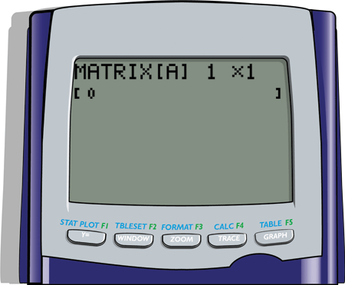
Example 4: Gaussian Elimination (cont.)
Solution:
Step 1: Press > MATRIX and move to the EDIT menu.
Press The following display will appear.

Slide 24


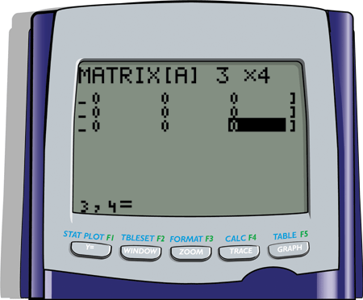
Example 4: Gaussian Elimination (cont.)
Step 2: The augmented matrix is a 3 × 4 matrix. So, in
the top line enter 3, press , enter 4, press
and the display will appear as follows.
(Note: If other numbers are already present on the display, just type over them. The calculator will adjust automatically.)

Slide 25

Example 4: Gaussian Elimination (cont.)
Step 3: Move the cursor to the upper left entry position and enter the coefficients and constants in the matrix. As you enter each number press and the cursor will automatically move to the next position in the matrix. Note that the double subscripts appear at the bottom of the display as each number is entered. The final display for matrix [A] should appear as follows.

Slide 26
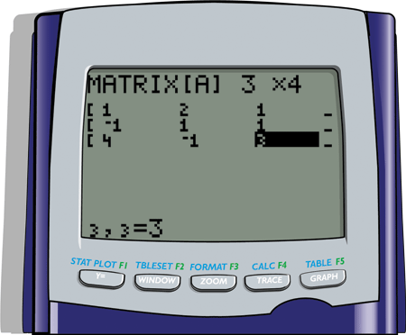

Example 4: Gaussian Elimination (cont.)

Slide 27


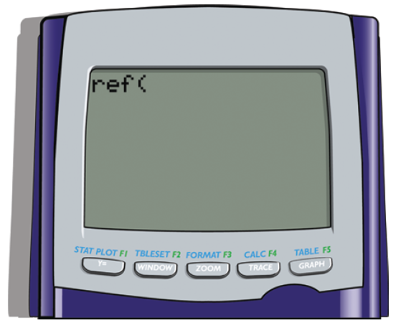
Example 4: Gaussian Elimination (cont.)
Step 4: Press > QUIT, press > MATRIX again, go to MATH; move the cursor down to A:ref
(; press The display will appear as follows.

Slide 28


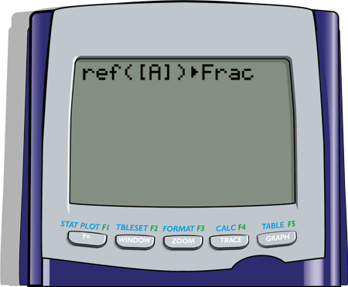
Example 4: Gaussian Elimination (cont.)
Step 5: Press > MATRIX again; press ( this selects the matrix A); enter a right parenthesis ) ; press the MATH key; and choose 1:> Frac by pressing . The display will appear as follows.
[Note: You must select the matrix from the matrix menu. The calculator will not recognize the matrix if you manually type in [A].]

Slide 29
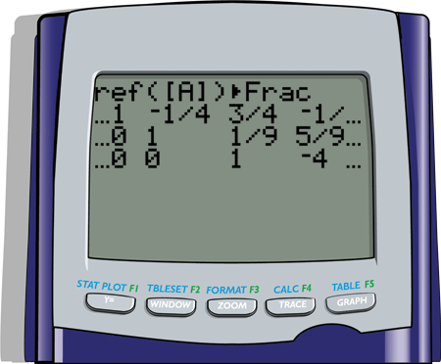
Example 4: Gaussian Elimination (cont.)
Step 6: Press and the row echelon form of matrix
will appear as follows.
With back substitution we get the following solution:
x = 3, y = 1, z = −4.

Slide 30
Practice Problems
Solve the following system of linear equations by using the Gaussian elimination method with back substitution.

Slide 31
Practice Problem Answers

