Slide 1
Section 3.5
Determinants

Slide 2
Objectives
Evaluate 2 × 2 and 3 × 3 determinants.
Solve equations involving determinants.

Slide 3
Determinants
Determinant
A determinant is a real number associated with a square array of real numbers and is indicated by enclosing the array between two vertical bars. For a matrix A, the corresponding determinant is designated as det(A) and is read “determinant of A.”

Slide 4
Determinants
Value of a 2×2 Determinant

Slide 5
Example 1: 2×2 Determinant
Evaluate the following 2 × 2 determinants.

Slide 6
Determinants
Value of a 3×3 Determinant

Slide 7
Determinants
NOTES
CAUTION: The negative sign in the middle term of the expansion (representing −1 times a₁₂) is a critical part of the method and is a source of error for many students. Be careful.

Slide 8
Determinants
NOTES
There are methods other than expanding by minors for evaluating 3 × 3 determinants. Your instructor may wish to show you some of these, but they will not be discussed in the text. The advantage of learning to expand by minors is that this method can be used for evaluating higher-order determinants.

Slide 9
Example 2: 3×3 Determinant
Evaluate the following 3 × 3 determinants.
Solution:
Using Row 1, mentally delete the shaded regions.

Slide 10
Example 2: 3×3 Determinant (cont.)

Slide 11
Example 2: 3×3 Determinant (cont.)
Solution:
After some practice, many of these steps can be done mentally.

Slide 12
Example 3: Equations with Determinants
Solve the following equation for x:
Solution: First, evaluate the determinant.

Slide 13
Example 3: Equations with Determinants (cont.)
Now solve the equation.

Slide 14
Example 4: Evaluating Determinants with a Calculator
Use a TI-84 Plus calculator to find the value of det(A) for the matrix

Slide 15

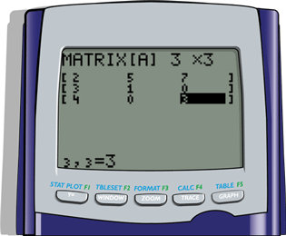
Example 4: Evaluating Determinants with a Calculator
Solution:
Step 1: Press > MATRIX, go to the EDIT menu and enter the appropriate dimensions and numbers in the matrix A. The display should appear as follows.

Slide 16

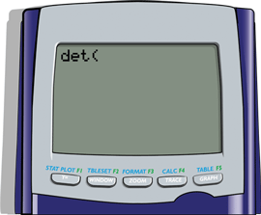
Example 4: Evaluating Determinants with a Calculator (cont.)
Step 2: Press > QUIT then > MATRIX again and go to the MATH menu. On the MATH menu choose 1: det( and press . The display should appear as follows.

Slide 17
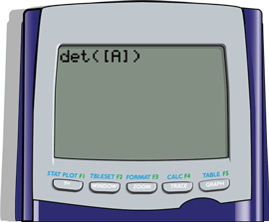
Example 4: Evaluating Determinants with a Calculator (cont.)
Step 3: Press > MATRIX again and on the NAMES menu choose 1:[A]3×3. Press and type a right parenthesis ). The display should appear as follows.

Slide 18
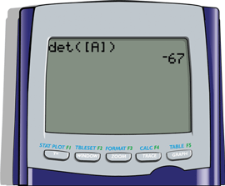
Example 4: Evaluating Determinants with a Calculator (cont.)
Step 4: Press and the display should appear as follows with the answer.

Slide 19
Practice Problems
Evaluate each of the following determinants.

Slide 20
Practice Problems (cont.)
Use a graphing calculator to find the value of the determinant.
Use the method for evaluating determinants to solve the equation.

Slide 21
Practice Problem Answers
1. −29
2. 0
3. −26
4. 92
5. 16

