Slide 1
Section 4.1
Exponents and Scientific Notation

Slide 2
Objectives
Simplify expressions by using the properties of integer exponents
Write decimal numbers in scientific notation.
Write numbers given in scientific notation as decimal numbers.

Slide 3
The Product Rule
Product Rule for Exponents
If a is a nonzero real number and m and n are integers, then

Slide 4
Example 1: The Product Rule for Exponents
Use the Product Rule for Exponents to simplify each expression.

Slide 5
The Product Rule
The Exponent 0
If a is a nonzero real number, then
a⁰ = 1.
Note: the expression 0⁰ is undefined.

Slide 6
The Product Rule
Notes
Throughout this text, unless specifically stated otherwise, we will assume that the bases of exponents are nonzero.

Slide 7
Example 2: The Exponent 0
Find the value of each expression.

Slide 8
The Quotient Rule
Quotient Rule for Exponents
If a is a nonzero real number and m and n are integers, then

Slide 9
Example 3: The Quotient Rule for Exponents
Use the Quotient Rule for Exponents to simplify each expression.
Solution:
Solution:

Slide 10
Example 3: The Quotient Rule for Exponents (cont.)
Solution:
Solution:

Slide 11
Negative Exponents
Rule for Negative Exponents
If a is a nonzero real number and n is an integer, then
In words, a negative exponent indicates the reciprocal of the base.

Slide 12
Negative Exponents
Notes
There is nothing wrong with negative exponents. In fact, negative exponents are preferred in some courses in mathematics and science. However, so that all answers are the same, in this course we will consider expressions to be simplified if:
1. all exponents are positive, and
2. each base appears only once.

Slide 13
Example 4: Negative Exponents
Use the rules for exponents that apply and simplify each expression so that it contains only positive exponents.
Solution:

Slide 14
Example 4: Negative Exponents
Solution:

Slide 15
Example 4: Negative Exponents (cont.)
Solution:

Slide 16
Example 4: Negative Exponents (cont.)
Solution:

Slide 17
Negative Exponents
Notes
Special Note about Using the Quotient Rule:
Regardless of the size of the exponents or whether they are positive or negative, the following single subtraction policy can be used with the Quotient Rule.
(numerator exponent) − (denominator exponent)
This subtraction will always lead to the correct answer.

Slide 18
Power Rules for Exponents
Power Rule for Exponents
If a and b are nonzero real numbers and m and n are integers:
1. Power Rule:
To raise a power to a power, multiply the exponents.
2. Power Rule for Products:
To raise a product to a power, raise each factor to that power.

Slide 19
Power Rules for Exponents
Power Rule for Exponents (cont.)
3. Power Rule for Fractions:
To raise a fraction to a power, raise the numerator and denominator to that power.

Slide 20
Power Rules for Exponents
Notes
Special Note about Negative Numbers and Exponents:
In an expression such as –x² we know that –1 is understood to be the coefficient of x² . That is,
The same is true for expressions with numbers such as −4². That is,

Slide 21
Power Rules for Exponents
Notes (cont.)
We see that the exponent refers to 4 and not to –4. For the exponent to refer to –4 as the base, –4 must be in parentheses as follows:
As another example,

Slide 22
Example 5: Using Combinations of the Rules for Exponents
Simplify each expression by using the power rules and any other appropriate rules for exponents. (There may be more than one correct sequence of steps to arrive at the correct answer.)
Solution:

Slide 23
Example 5: Using Combinations of the Rules for Exponents (cont.)
Solution:

Slide 24
Example 5: Using Combinations of the Rules for Exponents (cont.)
Solution:
Option 1: Simplify within the parentheses first.

Slide 25
Example 5: Using Combinations of the Rules for Exponents (cont.)
Option 2: Apply the Power Rule for Fractions first.

Slide 26
Power Rules for Exponents
Notes
In effect there are two basic shortcuts with negative exponents and fractions:
1. Taking the reciprocal of a fraction changes the sign of any exponent in the fraction.
2. Moving any term from the numerator to the denominator, or vice versa, changes the sign of the corresponding exponent.

Slide 27
Example 6: Two Approaches with Fractional Expressions and Negative Exponents
Simplify
Solution: Option 1: Use the idea of reciprocal first.
Option 2: Apply the Power Rule for Fractions first.

Slide 28
Example 7: A More Complex Example
This example involves the application of a variety of steps. Study it carefully and see if you can get the same result by following a different sequence of steps.
Simplify
Solution:

Slide 29
Example 7: A More Complex Example (cont.)

Slide 30
Example 7: A More Complex Example (cont.)

Slide 31
Power Rules for Exponents
Summary of Properties and Rules for Exponents
If a and b are nonzero real numbers and m and n are integers:
1. The Exponent 1:
2. The Exponent 0:
3. Product Rule:
4. Quotient Rule:

Slide 32
Power Rules for Exponents
Summary of Properties and Rules for Exponents (cont.)
5. Negative Exponents:
6. Power Rule:
7. Power of a Product: The Power Rules
8. Power of a Quotient:

Slide 33
Scientific Notation and Calculators
Scientific Notation
If N is a decimal number, then in scientific notation
where 1 ≤ a < 10 and n is an integer.

Slide 34
Example 8: Decimals in Scientific Notation
Write the following decimal numbers in scientific notation.
a. 867,000,000,000
Solution:
b. 420,000
Solution:

Slide 35
Example 8: Decimals in Scientific Notation (cont.)
c. 0.0036
Solution:
d. 0.000 000 025
Solution:

Slide 36
Example 9: Using Scientific Notation and the Properties of Exponents
Simplify the following expressions by first writing the decimal numbers in scientific notation and then using the properties of exponents.
Solution:

Slide 37
Example 9: Using Scientific Notation and the Properties of Exponents (cont.)

Slide 38
Example 9: Using Scientific Notation and the Properties of Exponents (cont.)
Solution:

Slide 39
Example 9: Using Scientific Notation and the Properties of Exponents (cont.)
c. Light travels approximately meters per second. How many meters per minute does light travel?
Solution:
Since there are 60 seconds in one minute, multiply by 60.
Thus light travels meters per minute.

Slide 40

Example 10: Scientific Notation and Calculators
a. Use a TI-84 Plus graphing calculator to evaluate the
expression Leave the answer in
scientific notation.
[Note: The caret key is used to indicate an exponent.]

Slide 41

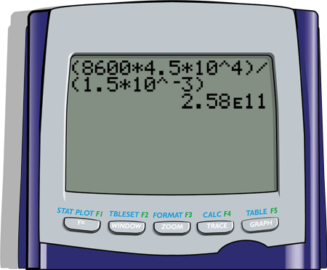
Example 10: Scientific Notation and Calculators
Solution:
With a TI-84 Plus calculator (set in scientific notation mode by pressing the key and selecting SCI) the display should appear as shown below:

Slide 42

Example 10: Scientific Notation and Calculators (cont.)
The E on the display indicates an exponent with base 10. Thus,
Note that the numerator and denominator must be set in parentheses and be sure to use the key on the bottom row for −3.

Slide 43
Example 10: Scientific Notation and Calculators (cont.)
b. Use a calculator to find the number of miles that light travels in one year (a light-year) if light travels 186,000 miles per second.
Solution: We know

Slide 44
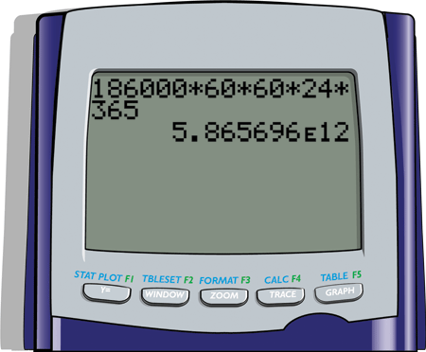
Example 10: Scientific Notation and Calculators (cont.)
Multiplication should give the following display on your calculator:
Thus a light-year is 5,865,696,000,000 miles (or approximately miles.

Slide 45
Practice Problems
Use the properties of exponents to simplify each expression.

Slide 46
Practice Problems (cont.)
7. Write the following expression in decimal notation:
8. Write the number 186,000 in scientific notation. This is the speed of light in miles per second.

Slide 47
Practice Problem Answers

