Slide 1
Section 4.8
Polynomial Equations and Applications

Slide 2
Objectives
Solve equations by factoring.
Write equations given the roots.
Solve problems related to consecutive integers.
Solve problems related to the Pythagorean Theorem.

Slide 3
Solving Equations by Factoring
Quadratic Equations
Quadratic equations are equations of the form
ax² + bx + c = 0 where a, b, and c are constants and a ≠ 0.

Slide 4
Solving Equations by Factoring
Zero-Factor Property
If a product is 0, then at least one of the factors must be 0. That is, for real numbers a and b,
if a ∙ b = 0, then a = 0 or b = 0 or both.

Slide 5
Example 1: Solving Factored Equations
Use the zero-factor property to solve each equation.
Solution:
The quadratic on the left of the equation is already in factored form and the product is 0. Set each factor equal to 0. This process yields two linear equations, which can, in turn, be solved.

Slide 6
Example 1: Solving Factored Equations (cont.)
The solutions can be checked by substituting them, one at a time, for x in the equation. That is, there will be two “checks.”
Substituting x = 5 gives

Slide 7
Example 1: Solving Factored Equations (cont.)
Substituting gives

Slide 8
Example 1: Solving Factored Equations (cont.)
Solution:
Again the polynomial is factored. But, in this case there are three factors and there are three solutions. Setting each factor equal to 0 and solving gives the three solutions (or roots):

Slide 9
Example 1: Solving Factored Equations (cont.)
The three solutions are −3, 2, and
(These can be checked in the original equation.)

Slide 10
Example 2: Solving Equations By Factoring
Solve each polynomial equation by factoring.
The solutions are −3 and 9.

Slide 11
Example 2: Solving Equations By Factoring (cont.)

Slide 12
Example 2: Solving Equations By Factoring (cont.)
Because (x + 1) is a double factor, the solution −1 is called a double root or a root of multiplicity two. (Note that the constant factor 5 does not affect the solution.)

Slide 13
Example 2: Solving Equations By Factoring (cont.)

Slide 14
Example 2: Solving Equations By Factoring (cont.)
The solutions are and 2.

Slide 15
Example 2: Solving Equations By Factoring (cont.)

Slide 16
Example 2: Solving Equations By Factoring (cont.)
The solutions are 0, −5, and 5.

Slide 17
Solving Equations by Factoring
Notes
All of the polynomial equations in this section can be solved by factoring. That is, all of the polynomials are factorable. However, as we have seen in some of the previous sections not all polynomials are factorable. In Chapter 7 we will develop techniques (other than factoring) for solving quadratic equations whether the quadratic polynomial is factorable or not.

Slide 18
Solving Equations by Factoring
Notes
COMMON ERROR
A common error is to divide both sides of an equation by the variable x. This error can be illustrated by using the equation in Example 2d.

Slide 19
Solving Equations by Factoring
Notes (cont.)
Factoring is the method to use. By factoring, you will find all solutions shown in the previous examples.
INCORRECT
Do not divide by x because you lose the solution x = 0.

Slide 20
Finding an Equation Given the Roots
Factor Theorem
If x = c is a root of a polynomial equation in the form P(x) = 0, then x − c is a factor of the polynomial P(x).
Proof:
The division algorithm says that
But, because c is a root we must have P(c) = 0.

Slide 21
Finding an Equation Given the Roots
Factor Theorem (cont.)
We also know that
Now, since P(c) = 0 and P(c) = r, this gives the result that r = 0. Thus when c is a root of P(x),
and (x – c) is a factor of P(x).

Slide 22
Example 3: Using the Factor Theorem to Find Equations with Given Roots
Find a polynomial equation with integer coefficients that has the given roots:
Solution: Form the linear equations and then the product of the factors.

Slide 23
Example 3: Using the Factor Theorem to Find Equations with Given Roots (cont.)
Form the equation by setting the product of the factors equal to 0 and simplifying.

Slide 24
Consecutive Integers
Consecutive Integers
Integers are consecutive if each is 1 more than the previous integer.
Three consecutive integers can be represented as n, n + 1, and n + 2.
For example: 5, 6, 7

Slide 25
Consecutive Integers
Consecutive Even Integers
Even integers are consecutive if each is 2 more than the previous even integer.
Three consecutive even integers can be represented as n, n + 2, and n + 4.
For example: 24, 26, 28

Slide 26
Consecutive Integers
Consecutive Odd Integers
Odd integers are consecutive if each is 2 more than the previous odd integer.
Three consecutive odd integers can be represented as n, n + 2, and n + 4.
For example: 41, 43, 45

Slide 27
Example 4: Consecutive Integers
a. Find two consecutive positive integers such that the sum of their squares is 265.
Solution:
Let n = first integer
n + 1 = next consecutive integer
Set up and solve the related equation.

Slide 28
Example 4: Consecutive Integers (cont.)

Slide 29
Example 4: Consecutive Integers (cont.)
Consider the solution n = −12. The next consecutive integer, n + 1, is −11. While it is true that the sum of their squares is 265, we must remember that the problem calls for positive consecutive integers. Therefore, we can only consider positive solutions. Hence, the two integers are 11 and 12.

Slide 30
Example 4: Consecutive Integers (cont.)
b. Find three consecutive odd integers such that the product of the first and second is 68 more than the third.
Solution:
Let n = first odd integer
and n + 2 = second consecutive odd integer
and n + 4 = third consecutive odd integer.
Set up and solve the related equation.

Slide 31
Example 4: Consecutive Integers (cont.)

Slide 32
Example 4: Consecutive Integers (cont.)
The three consecutive odd integers are −9, −7, and −5. Note that 8, 10 and 12 are even and therefore cannot be considered a solution to the problem.

Slide 33
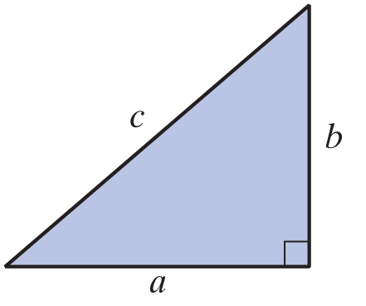
The Pythagorean Theorem
The Pythagorean Theorem
In a right triangle, the square of the hypotenuse is equal to the sum of the squares of the legs.

Slide 34
Example 5: The Pythagorean Theorem
A support wire is 25 feet long and stretches from a tree to a point on the ground. The point of attachment on the tree is 5 feet higher than the distance from the base of the tree to the point on the ground. How far up the tree is the point of attachment?
Solution:
Let x = distance from base of tree to point on ground (see diagram), then x + 5 = height of point of attachment.

Slide 35
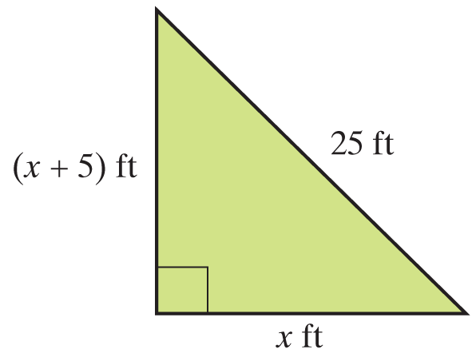
Example 5: The Pythagorean Theorem (cont.)
By the Pythagorean Theorem, we have:

Slide 36
Example 5: The Pythagorean Theorem (cont.)
Because distance is positive, −20 is not a possible solution.
The solution is
Thus the point of attachment is 20 feet up the tree.

Slide 37
Practice Problems
Solve the following equations by factoring.
1. y² − 4y = 21 2. 3x² − 16x + 5 = 0
3. z² + 6z = −9 4. x³ = 25x
5. Find a quadratic equation with integer coefficients
that has the roots

Slide 38
Practice Problem Answers
1. y = 7, y = −3
2.
3. z = −3
4. x = 0, x = 5, x = −5
5. 6x² − 7x + 2 = 0

