Slide 1
Section 4.9
Using a Graphing Calculator to Solve Equations

Slide 2
Objectives
Use a TI-84 Plus graphing calculator to solve (or estimate the solutions of) polynomial equations by using one of the following strategies:
a. graph one function and find the zeros of the function, or
b. graph two functions and find the points of intersection of the functions.
Use a TI-84 Plus graphing calculator to solve absolute value equations and inequalities.

Slide 3
Using a Graphing Calculator to Solve Equations
Notes
When a polynomial is second-degree or higher, the same factor may occur multiple times. This means that the corresponding zero may appear more than once. That is, if a binomial factor is squared, then the corresponding zero is said to be of multiplicity 2. If the factor is cubed, then the corresponding zero is of multiplicity 3, and so on. For example, P(x) = x³ – 3x² − 24x + 80 = (x + 5)(x – 4)² and there are technically three zeros, −5, 4, and 4.

Slide 4
Using a Graphing Calculator to Solve Equations
Notes (cont.)
But 4 appears twice, so 4 is a zero of multiplicity 2 and the only distinct zeros are −5 and 4. As we will see, this has a major effect on the nature of the corresponding graph of the function.

Slide 5
Using a Graphing Calculator to Solve Equations
Zeros of Polynomial Functions
1. Nonconstant linear functions have 1 zero. (The graph crosses the x-axis once.)
2. Quadratic functions have 2 zeros or none. (The graph crosses the x-axis twice, just touches the x-axis, or doesn’t cross at all.)
3. Cubic functions have 3 zeros or 1 zero. (The graph crosses the x-axis three times, crosses once and just touches once, or crosses just once.)
Note: A zero of multiplicity n is considered to be n zeros.

Slide 6
Using a Graphing Calculator to Solve Equations
Notes
Important Note about the Graphs of Polynomial Functions:
The graph of every polynomial function is a smooth continuous graph. (That is, there are no holes, jumps from one point to another, or sharp points in the graph of a polynomial function.)

Slide 7
Example 1: Using One Graph to Solve a Polynomial Equation
Use a TI-84 Plus graphing calculator to solve the equation
Solution:
Strategy: Manipulate the equation so that one side is 0. Graph the indicated function on the nonzero side. The zeros of this function are the roots of the original equation.

Slide 8
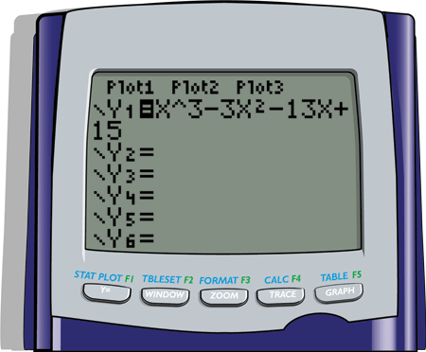
Example 1: Using One Graph to Solve a Polynomial Equation (cont.)
Enter the function as follows:

Slide 9
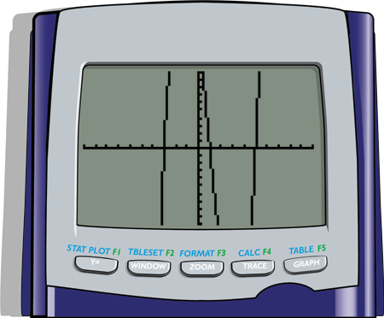
Example 1: Using One Graph to Solve a Polynomial Equation (cont.)
With the standard window the graph will appear as follows:
Note: You may want to increase the y-values on the window to see a more complete graph. This will not change the zeros.

Slide 10

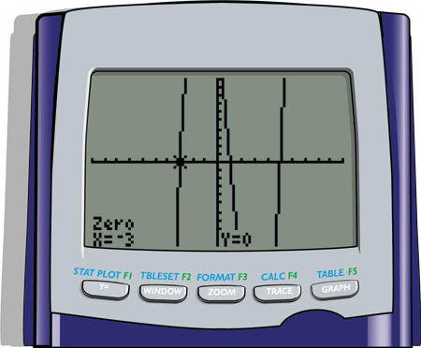
Example 1: Using One Graph to Solve a Polynomial Equation (cont.)
With the > CALC > 2:zero sequence of commands you will find the following zeros (and therefore solutions to the equation):
x = −3, x = 1, and x = 5.

Slide 11

Example 1: Using One Graph to Solve a Polynomial Equation (cont.)
[Note: See Section 2.4 for a more in-depth explanation of the zero function. With the command you will find only approximations of the zeros.]

Slide 12
Example 2 : Using Two Graphs to Solve a Polynomial Equation
Solve the polynomial equation
Solution:
Strategy: Graph the function indicated on each side of the equation. Find the points of intersection of these two graphs. The x-values of these points are the roots of the original equation.

Slide 13
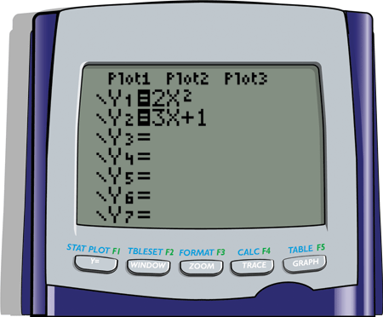
Example 2 : Using Two Graphs to Solve a Polynomial Equation (cont.)
Enter the functions as follows:

Slide 14
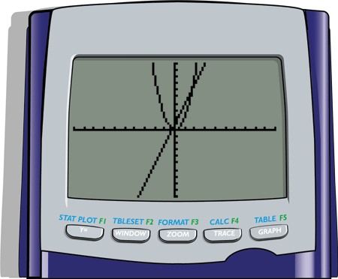
Example 2 : Using Two Graphs to Solve a Polynomial Equation (cont.)
With the standard window the graphs will appear as follows:

Slide 15
Example 2 : Using Two Graphs to Solve a Polynomial Equation (cont.)
With the > CALC > 5:intersect sequence of commands you will find the following approximate x-values of the points of intersection (and therefore approximate solutions to the equation):
x ≈ −.28 and x ≈ 1.78 (accurate to two decimal places).

Slide 16
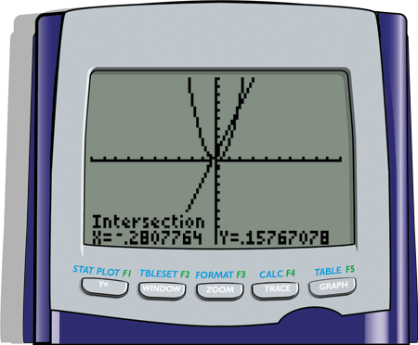
Example 2 : Using Two Graphs to Solve a Polynomial Equation (cont.)
[Note: See Section 3.1 for an explanation of the intersect function.]

Slide 17

Example 3: Using Two Graphs to Solve an Absolute Value Equation
Solve the equation
Solution:
Strategy: Graph the functions indicated on each side of the equation. This includes the constant function. Find the points of intersection of these two graphs. The x-values of these points are the roots of the original equation. Remember that the absolute value command can be found in the > NUM menu.

Slide 18
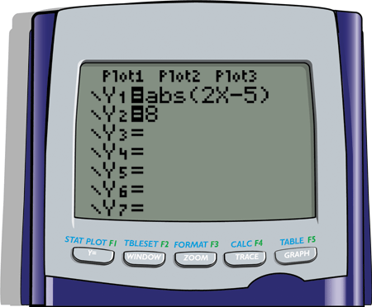
Example 3: Using Two Graphs to Solve an Absolute Value Equation (cont.)
Enter the functions as follows:

Slide 19

Example 3: Using Two Graphs to Solve an Absolute Value Equation (cont.)
With the standard window the graphs will appear as follows:

Slide 20
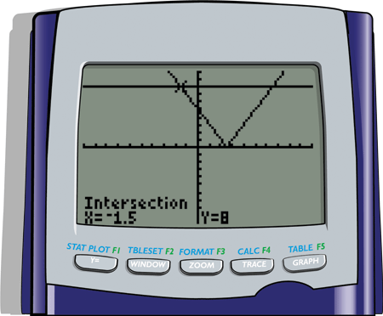
Example 3: Using Two Graphs to Solve an Absolute Value Equation (cont.)
With the > CALC > 5:intersect sequence of commands you will find the following x-values at the points of intersection (and therefore the solutions to the equation):
x = −1.5 and x = 6.5

Slide 21
Example 3: Using Two Graphs to Solve an Absolute Value Equation (cont.)
[Note: These values of x are exact. The command will not give these exact values.]

Slide 22
Example 4: Using a Graphing Calculator to Solve Absolute Value Inequalities
Use a graphing calculator to solve the inequalities:
Both inequalities can be solved by using the graphs from Example 3.
Solution:
We change the window for a clearer view: Use the interval [−10, 10] for x and the interval [−1, 15] for y.

Slide 23
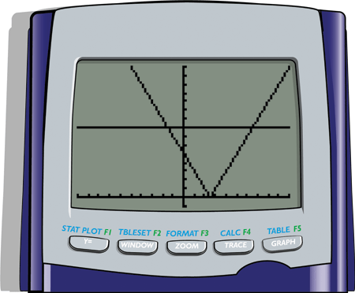
Example 4: Using a Graphing Calculator to Solve Absolute Value Inequalities (cont.)
This gives:

Slide 24
Example 4: Using a Graphing Calculator to Solve Absolute Value Inequalities (cont.)
a. From Example 3, we know that the intersections occur at x = −1.5 and x = 6.5. Looking at the graph we see that the graph of the absolute value is below the line y = 8 on the interval (−1.5, 6.5). Thus the interval (−1.5, 6.5) is the solution set for
b. Looking at the graph we see that the graph of the absolute value is above the line y = 8 on the intervals (−∞, −1.5) and (6.5, ∞). Thus the solution set is (−∞, −1.5)∪(6.5, ∞) for

