Slide 1
Section 5.5
Applications

Slide 2
Objectives
Solve applied problems related to fractions.
Solve applied problems related to work.
Solve applications involving distance, rate, and time.

Slide 3
Applications
Strategy for Solving Word Problems
1. Read the problem carefully. Read it several times if necessary.
2. Decide what is asked for and assign a variable to the unknown quantity.
3. Draw a diagram or set up a chart whenever possible as a visual aid.
4. Form an equation that relates the information provided.

Slide 4
Applications
Strategy for Solving Word Problems (cont.)
5. Solve the equation.
6. Check your solution with the wording of the problem to be sure it makes sense.

Slide 5
Example 1: Fractions
The denominator of a fraction is 8 more than the numerator. If both the numerator and denominator are
increased by 3, the new fraction is equal to Find the original fraction.
Solution:
Reread the problem to be sure that you understand all terminology used. Assign variables to the unknown quantities.

Slide 6
Example 1: Fractions (cont.)

Slide 7
Example 1: Fractions (cont.)
Check:
The original fraction is

Slide 8
Example 2: Work Problems
a. A carpenter can build a certain type of patio cover in 6 hours. His partner takes 8 hours to build the same cover. How long would it take them working together to build this type of patio cover?
Solution:
Let x = number of hours to build the cover working together.

Slide 9
Example 2: Work Problems (cont.)
Person(s) | Time of Work (in Hours) | Part of Work Done in 1 Hour
Carpenter | 6
Partner | 8
Together | x

Slide 10
Example 2: Work Problems (cont.)

Slide 11
Example 2: Work Problems (cont.)
Together, they can build the patio cover in hours, or
hours.
(Note that this answer is reasonable because the time is less than either person would take working alone.)

Slide 12
Example 2: Work Problems (cont.)
b. A man can wax his car three times faster than his daughter can. Together they can do the job in 4 hours. How long would it take each of them working alone?
Solution:
Let t = number of hours for man alone to wax the car and
3t = number of hours for daughter alone to wax the car.

Slide 13
Example 2: Work Problems (cont.)
Person(s) | Time of Work (in Hours) | Part of Work Done in 1 Hour
Man | t
Daughter | 3t
Together | 4

Slide 14
Example 2: Work Problems (cont.)
Multiply each term on both sides by 12t, the LCM of the denominators.

Slide 15
Example 2: Work Problems (cont.)
Check: Man’s part in 1 hr
Daughter’s part in 1 hr

Slide 16

Example 2: Work Problems (cont.)
Man’s part in 4 hr
Daughter’s part in 4 hr
car waxed in 4 hours.
Working alone, the man takes hours, or 5 hours 20 minutes, and his daughter takes 16 hours.

Slide 17
Example 2: Work Problems (cont.)
c. A man was told that his new whirlpool would fill through an inlet valve in 3 hours. He knew something was wrong when the pool took 8 hours to fill. He found he had left the drain valve open. How long will it take to drain the pool once it is completely filled and only the drain valve is open?
Solution: Let t = time to drain pool with only the drain valve open. [Note: We use the information gained when the pool was filled with both valves open. In that situation, the inlet and outlet valves worked against each other.]

Slide 18
Example 2: Work Problems (cont.)
Valves | Hours to Fill or Drain | Part Filled or Drained in 1 Hour
Inlet | 3
Outlet | t
Together | 8

Slide 19
Example 2: Work Problems (cont.)

Slide 20
Example 2: Work Problems (cont.)
The pool will drain in hours, or 4 hours, 48 minutes.
(Note that this is more time than the inlet valve would take to fill the pool. If the outlet valve worked faster than the inlet valve, then the pool would never have filled in the first place.)

Slide 21
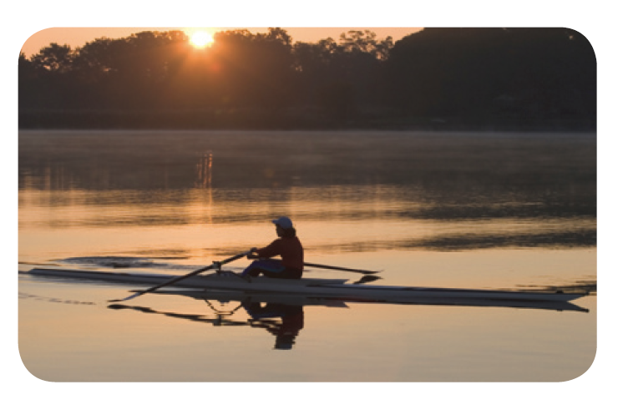
Example 3: Distance-Rate-Time
a. On Lake Itasca a man can row his boat 5 miles per hour. On the nearby Mississippi River it takes him the same time to row 5 miles downstream as it does to row 3 miles upstream. What is the speed of the river current in miles per hour?

Slide 22
Example 3: Distance-Rate-Time (cont.)
Solution:
Let c = the speed of the current.
Distance and rate are represented first in the table below. Then the time going downstream and coming back upstream is represented in terms of distance and rate. Since the rate is in miles per hour, the distance is in miles and the time is in hours.

Slide 23
Example 3: Distance-Rate-Time (cont.)
 | Distance d | Rate r
Downstream | 5 | 5 + c
Upstream | 3 | 5 − c

Slide 24
Example 3: Distance-Rate-Time (cont.)

Slide 25
Example 3: Distance-Rate-Time (cont.)
The times are equal. The rate of the river current is mph, or mph.

Slide 26
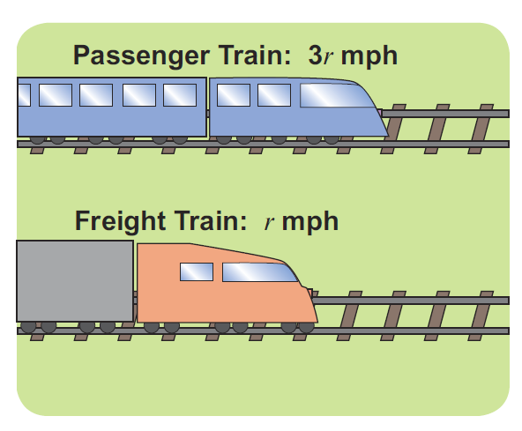
Example 3: Distance-Rate-Time (cont.)
b. If a passenger train travels three
times as fast as a freight train, and
the freight train takes 4 hours
longer to travel 210 miles, what is
the speed of each train?
Solution:
Let r = rate of freight train in miles per hour
3r = rate of passenger train in miles per hour

Slide 27
Example 3: Distance-Rate-Time (cont.)
 | Distance d | Rate r
Freight | 210 | r
Passenger | 210 | 3r
(Note: If the rate is faster, then the time is shorter. Thus the fraction is smaller than the fraction )

Slide 28
Example 3: Distance-Rate-Time (cont.)

Slide 29
Example 3: Distance-Rate-Time (cont.)
Check:
Time for freight train
Time for passenger train
6 − 2 = 4 hours difference in time
The freight train travels 35 mph, and the passenger train travels 105 mph.

