Slide 1
Section 5.6
Variation

Slide 2
Objectives
Solve problems related to direct variation.
Solve problems related to inverse variation.
Solve problems involving combined variation.

Slide 3
Direct Variation
Direct Variation
A variable quantity y varies directly as (or is directly proportional to) a variable x if there is a constant k such that
The constant k is called the constant of variation.

Slide 4
Example 1: Direct Variation
If y varies directly as x, and y = 6 when x = 2, find y if
x = 6.
Solution:
So y = 3x.
Thus, if x = 6, then y = 3 ⋅ 6 = 18.

Slide 5
Example 2: Direct Variation
A spring will stretch a greater distance as more weight is placed on the end of the spring. The distance, d, the spring stretches varies directly as the weight, w, placed at the end of the spring. This is a property of springs studied in physics and is known as Hooke’s Law. If a weight of 10 g stretches a certain spring 6 cm, how far will the spring stretch with a weight of 15 g?
[Note: We assume that the weight is not so great as to break the spring.]

Slide 6
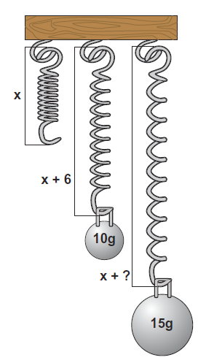
Example 2: Direct Variation (cont.)
Solution: Because the two variables are directly proportional, the relationship can be indicated with the formula
where d = distance spring stretches in cm,
w = weight in g,
and k = constant of variation.
First, substitute the given information to find the value for k. (The value of k will depend on the particular spring. Springs made of different material or which are wound more tightly, will have different values for k.)

Slide 7
Example 2: Direct Variation (cont.)
If w = 15, we have
The spring will stretch 9 cm if a weight of 15 g is placed at its end.

Slide 8
Inverse Variation
Inverse Variation
A variable quantity y varies inversely as (or is inversely proportional to) a variable x if there is a constant k such that
The constant k is called the constant of variation.

Slide 9
Example 3: Inverse Variation
If y varies inversely as the cube of x, and y = −1 when
x = 3, find y if x = −3.
Solution:

Slide 10
Example 3: Inverse Variation (cont.)

Slide 11
Example 4: Inverse Variation
The gravitational force, F, between an object and the Earth is inversely proportional to the square of the distance, d, from the object to the center of the Earth.
Hence we have the formula
(As the distance of an object from the Earth becomes larger, the gravitational force exerted by the Earth on the object becomes smaller.)

Slide 12
Example 4: Inverse Variation (cont.)
If an astronaut weighs 200 pounds on the surface of the Earth, what will he weigh 100 miles above the Earth? Assume that the radius of the Earth is 4000 miles.
Solution:
We know F = 200 = 2 × 10² pounds
when d = 4000 = 4 × 103 miles.
Use scientific notation to make values simpler to work with in the calculations.

Slide 13

Example 4: Inverse Variation (cont.)
When the astronaut is 100 miles above the Earth,
d = 4100 = 4.1 × 103 miles. Then,
That is, 100 miles above the Earth the astronaut will weigh 190 pounds.

Slide 14
Example 5: Variation
a. If y is directly proportional to x², and y = 9 when
x = 2, what is y when x = 4?
Solution:

Slide 15
Example 5: Variation (cont.)
b. The distance an object falls varies directly as the square of the time it falls (until it hits the ground and assuming little or no air resistance). If an object fell 64 feet in two seconds, how far would it have fallen by the end of 3 seconds?
Solution:

Slide 16
Example 5: Variation (cont.)
The object would have fallen 144 feet in 3 seconds.

Slide 17
Example 5: Variation (cont.)
c. The volume of a gas in a container varies inversely as the pressure on the gas. If a gas has a volume of 200 cubic inches under pressure of 5 pounds per square inch, what will be its volume if the pressure is increased to 8 pounds per square inch?
Solution:

Slide 18
Example 5: Variation (cont.)
The volume will be 125 cubic inches.

Slide 19
Example 5: Variation (cont.)
d. The illumination (in foot-candles, fc) of a light source varies directly as the intensity (in candelas, cd) of the source and inversely as the square of the distance from the source. If a certain light source with intensity of 300 cd provides an illumination of 10 fc at a distance of 20 feet, what is the illumination at a distance of 40 feet? [Note: This is an illustration of combined variation.]

Slide 20
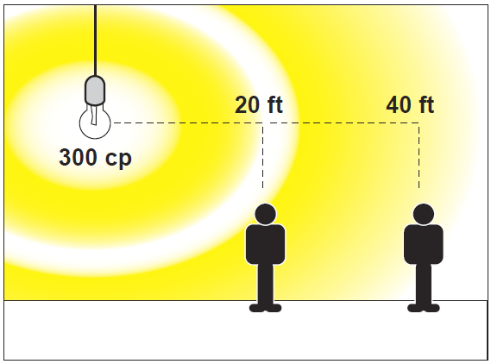
Example 5: Variation (cont.)
Solution:

Slide 21
Example 5: Variation (cont.)
The illumination at 40 feet is 2.5 fc.

Slide 22
Practice Problems
1. The length that a hanging spring stretches varies directly as the weight placed on the end of the spring. If a weight of 5 mg stretches a certain spring 3 cm, how far will the spring stretch with a weight of 6 mg?
2. The volume of propane in a container varies inversely to the pressure on the gas. If the propane has a volume of 200 in.³ under a pressure of 4 lbs per in.², what will be its volume if the pressure is increased to 5 lbs per in.²?

Slide 23
Practice Problem Answers

