Slide 1
Section 6.1
Roots and Radicals

Slide 2
Objectives
Evaluate square roots and cube roots.
Simplify expressions with square roots and cube roots.

Slide 3
Perfect Squares and Square Roots
Radical Terminology
The symbol is called a radical sign.
The number under the radical sign is called the radicand.
The complete expression, such as is called a radical or radical expression.

Slide 4
Perfect Squares and Square Roots
Square Root
If a is a nonnegative real number and b is a real number such that
b² = a, then b is called a square root of a.
If b is nonnegative, then we write

Slide 5
Example 1: Evaluating Square Roots
a. 64 has two square roots, one positive and one
negative. The sign is understood to represent the positive square root or the principal square root. Therefore,

Slide 6
Example 1: Evaluating Square Roots (cont.)
[Note: As these examples illustrate, the radicand may be a nonnegative integer, fraction, or decimal number.]
Note that the sum under the radical sign is found first. Then the square root is found. In this situation, the radical sign is similar to parentheses.
In this case the square roots are evaluated before addition.

Slide 7
Perfect Squares and Square Roots
Notes
Note that, as illustrated in Examples 1e and 1f, in general,

Slide 8
Perfect Squares and Square Roots
Notes
The square roots of negative real numbers are not real numbers. (There is no real number whose square is negative.) Thus is not a real number and is not a real number. Such numbers are called imaginary numbers or nonreal complex numbers. These numbers and their properties will be studied later in Sections 6.6 and 6.7.

Slide 9
Example 2: Evaluating Radical Expressions with a Calculator
In each of the following examples the steps (or keys to press) are shown. Although your calculator will probably display the answer to 9 decimal places, your instructor may ask you to round these calculations to fewer than nine places. The answers here are rounded to 4 decimal places.
Solution: Press the keys in the following sequence.

Slide 10


Example 2: Evaluating Radical Expressions with a Calculator (cont.)
Note: To get the square root symbol on the TI-84 Plus, press then the key. When the
symbol appears, it will appear with a left-hand parenthesis. You should press the right-hand parenthesis key to close the square root operation.

Slide 11
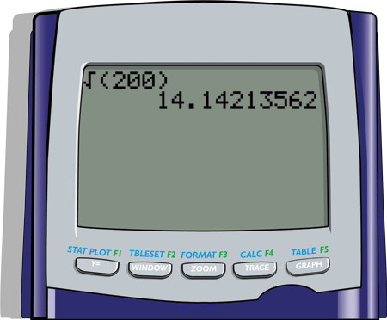
Example 2: Evaluating Radical Expressions with a Calculator (cont.)
The display will appear as follows.

Slide 12

Example 2: Evaluating Radical Expressions with a Calculator (cont.)
Solution:
Press the keys in the following sequence.

Slide 13
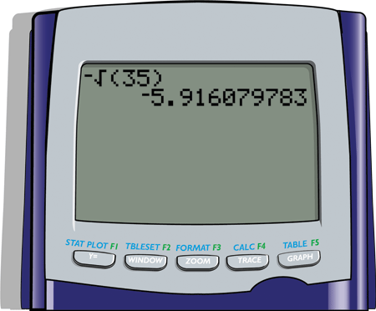
Example 2: Evaluating Radical Expressions with a Calculator (cont.)
The display will appear as follows.

Slide 14
Simplifying Algebraic Expressions with Square Roots
Properties of Square Roots
If a and b are positive real numbers, then

Slide 15
Simplifying Algebraic Expressions with Square Roots
Simplest Form
A square root is considered to be in simplest form when the radicand has no perfect square as a factor.

Slide 16
Simplifying Algebraic Expressions with Square Roots
Notes
Of these three approaches, the second appears to be the easiest because it has the fewest steps. However, “seeing” the largest perfect square factor may be difficult. If you do not immediately see a perfect square factor, proceed by finding other factors or prime factors as illustrated.

Slide 17
Example 3: Simplifying Numerical Expressions with Square Roots
Simplify each numerical expression so that there are no perfect square numbers in the radicand.

Slide 18
Example 3: Simplifying Numerical Expressions with Square Roots (cont.)

Slide 19
Example 4: Simplifying Radical Expressions
Simplify each radical expression.
Solutions:
Method 1: Simplify and factor the numerator.
2

Slide 20
Example 4: Simplifying Radical Expressions (cont.)
Method 2: Simplify the numerator and divide each term by the denominator.
Note that these answers may look different but they are equivalent. Both are correct, just in different forms.

Slide 21
Example 4: Simplifying Radical Expressions (cont.)
Solutions:
Method 1: Simplify and factor the numerator.

Slide 22
Example 4: Simplifying Radical Expressions (cont.)
Method 2: Simplify the numerator and divide each term by the denominator.

Slide 23
Simplifying Algebraic Expressions with Square Roots
Square Root of x²

Slide 24
Example 5: Simplifying Square Roots with Variables
Simplify each of the following radical expressions. Assume that all variables represent positive numbers. (Note that, by making this assumption, we need not be concerned about the absolute value sign.)

Slide 25
Example 5: Simplifying Square Roots with Variables (cont.)

Slide 26
Simplifying Algebraic Expressions with Square Roots
Square Roots of Expressions with Even and Odd Exponents
For any nonnegative real number x and positive integer m,
Note: For any integer m, 2m is even and 2m + 1 is odd.

Slide 27
Example 6: Simplifying Square Roots
Simplify each of the following radical expressions. Look for perfect square factors and even powers of the variables. Assume that all variables represent positive numbers.

Slide 28
Example 6: Simplifying Square Roots (cont.)

Slide 29
Perfect Cubes and Cube Roots
Cube Root
If a and b are real numbers such that

Slide 30
Perfect Cubes and Cube Roots
Notes

Slide 31
Example 7: Evaluating Cube Roots

Slide 32

Example 7: Evaluating Cube Roots (cont.)
Solution:
500 is not a perfect cube. The value of can be estimated using the TI-84 Plus calculator by pressing keys in the following sequence.
[Note: The sequence selects from the math menu.]

Slide 33
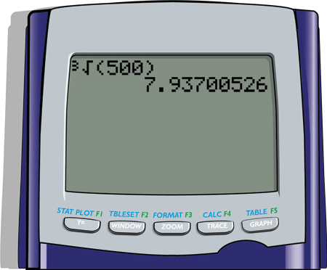
Example 7: Evaluating Cube Roots (cont.)
The display should appear as follows.

Slide 34
Simplifying Algebraic Expressions with Cube Roots
Simplest Form
A cube root is considered to be in simplest form when the radicand has no perfect cube as a factor.

Slide 35
Example 8: Simplifying Expressions with Cube Roots
Simplify each of the following radical expressions. Look for perfect cube factors and powers of the variables that are multiples of 3.

Slide 36
Example 8: Simplifying Expressions with Cube Roots (cont.)

Slide 37
Practice Problems
Simplify the following radical expressions. Assume that all variables represent positive numbers.
Use a calculator to find the value of each number accurate to four decimal places.

Slide 38
Practice Problem Answers

