Slide 1
Section 6.5
Functions with Radicals

Slide 2
Objectives
Recognize radical functions.
Evaluate radical functions.
Find the domain and range of radical functions.
Graph radical functions.

Slide 3
Review of Functions and Function Notation
Relation, Domain, and Range
A relation is a set of ordered pairs of real numbers.
The domain, D, of a relation is the set of all first coordinates in the relation.
The range, R, of a relation is the set of all second coordinates in the relation.

Slide 4
Review of Functions and Function Notation
Function
A function is a relation in which each domain element has exactly one corresponding range element.

Slide 5
Review of Functions and Function Notation
Vertical Line Test
If any vertical line intersects the graph of a relation at more than one point, then the relation graphed is not a function.

Slide 6
Evaluating Radical Functions
Radical Function
A radical function is a function of the form
in which the radicand contains a variable expression.
The domain of such a function depends on the index, n:
1. If n is an even number, the domain is the set of all x such that g(x) ≥ 0.
2. If n is an odd number, the domain is the set of all real numbers, (−∞, ∞).

Slide 7
Example 1: Finding the Domain of a Radical Function
Determine the domain of each radical function.
Solution:
Because the index is 2 (understood), the radicand must be nonnegative. (That is, the expression under the radical sign cannot be negative.) Thus we must have

Slide 8
Example 1: Finding the Domain of a Radical Function (cont.)
Solution:
Because the index is 3, an odd number, the radicand may be any real number.
Thus the domain is the entire interval of real numbers (−∞, ∞).

Slide 9
Example 2: Evaluating Radical Functions
Complete each table by finding the corresponding f(x) values for the given values of x.
Solution:
x | f(x)
0 | ?
4 | ?
6 | ?
x | f(x)
0
4
6

Slide 10
Example 2: Evaluating Radical Functions (cont.)
Solution:
x | y
7 | ?
6 | ?
−1 | ?
x | y
7
6
−1

Slide 11
Example 3: Graphing a Radical Function
Graph the function
Solution: For the domain we have
x | y
−5 | 0
−4 | 1
−3
0
4 | 3
To see the nature of the graph
we select a few values for x in
the domain and find the corresponding values of y.

Slide 12
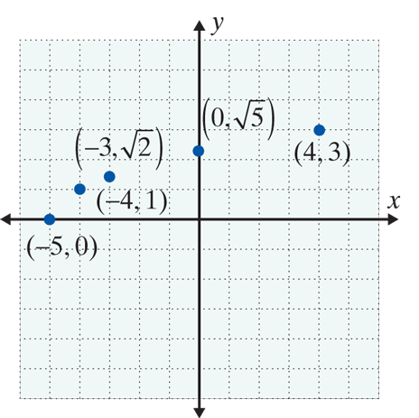
Example 3: Graphing a Radical Function (cont.)
Now we plot these points on a graph.

Slide 13
Example 3: Graphing a Radical Function (cont.)
Note that is the principal square root. This means that y ≥ 0. Thus, the point (−5, 0) is on the x-axis and the remaining points on the graph are above the x-­axis. So, we can complete the graph by drawing a smooth curve that passes through the selected points. The graph of the function is shown on next slide.

Slide 14
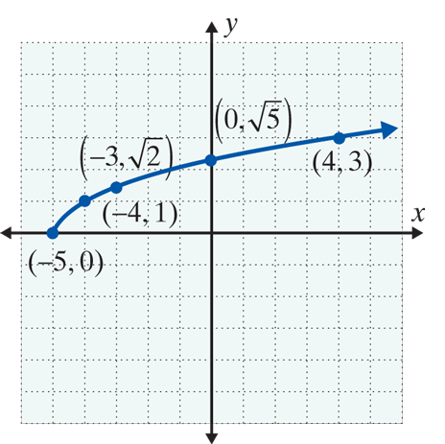
Example 3: Graphing a Radical Function (cont.)
We see that the domain is [−5, ∞) and the range is [0, ∞).

Slide 15

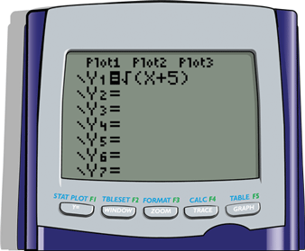
Example 3: Graphing a Radical Function (cont.)
To use a TI-84 Plus graphing calculator to graph this function,
Step 1: Press and enter the function as follows.

Slide 16


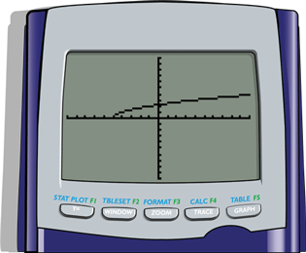
Example 3: Graphing a Radical Function (cont.)
Step 2: Press . (You may need to adjust the
.)
The result will be the graph as shown here.

Slide 17


Example 4: Using a TI-84 Plus to Graph a Radical Function
a. Use the TABLE feature of a TI-84 Plus graphing calculator to locate many points on the graph of the function
Solution: Using the TABLE feature of a TI-84 Plus:
Step 1: Press and enter the function as follows:
1. Press .
2. Choose 4:
3. Enter 2x – 3) and press .

Slide 18


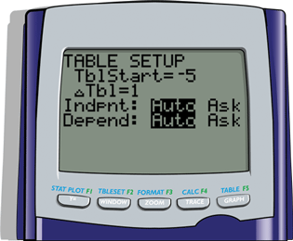
Example 4: Using a TI-84 Plus to Graph a Radical Function (cont.)
Step 2: Press TBLSET (which is ) and set the display as shown here.

Slide 19
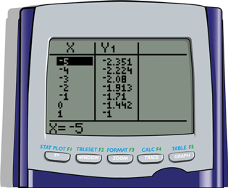
Example 4: Using a TI-84 Plus to Graph a Radical Function (cont.)
Step 3: Press TABLE (which is ) and the display will appear as follows.

Slide 20
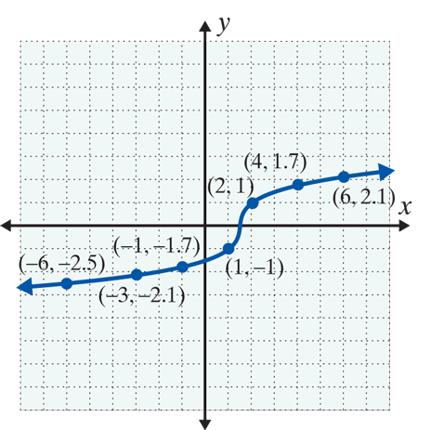
Example 4: Using a TI-84 Plus to Graph a Radical Function (cont.)
b. Plot several points (approximately) on a graph and then connect them with a smooth curve.
Solution:
You may scroll up and down the
display to find as many points as
you like. A few are shown here to
see the nature of the graph.

Slide 21
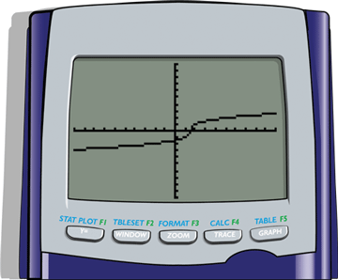
Example 4: Using a TI-84 Plus to Graph a Radical Function (cont.)
c. Use a TI-84 Plus graphing calculator to graph the function.
Solution: Press and the display will appear with the curve as follows.

Slide 22
Practice Problems
Find the indicated value of the function.

Slide 23
Practice Problems (cont.)
Use a calculator to estimate the value of the function accurate to 4 decimal places.

Slide 24
Practice Problem Answers
1.
2. 1
3. −2
4. 2.6458
5. 2.1544

