Slide 1
Section 7.3
Applications

Slide 2
Objectives
Use quadratic equations to solve applied problems.

Slide 3
Applications
Strategy for Solving Word Problems
1. Understand the problem.
a. Read the problem carefully. (Read it several times if necessary.)
b. If it helps, restate the problem in your own words.
2. Devise a plan.
a. Decide what is asked for; assign a variable to the unknown quantity. Label this variable so you know exactly what it represents.

Slide 4
Applications
Strategy for Solving Word Problems (cont.)
b. Draw a diagram or set up a chart whenever possible.
c. Write an equation that relates the information provided.
3. Carry out the plan.
a. Study your picture or diagram for insight into the solution.
b. Solve the equation.

Slide 5
Applications
Strategy for Solving Word Problems (cont.)
4. Look back over the results.
a. Does your solution make sense in terms of the wording of the problem?
b. Check your solution in the equation.

Slide 6
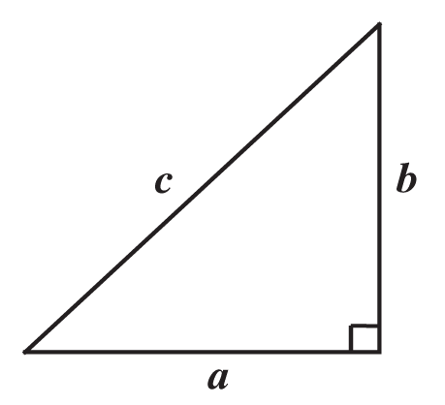
The Pythagorean Theorem
The Pythagorean Theorem
In a right triangle, the square of the hypotenuse is equal to the sum of the squares of the legs.

Slide 7
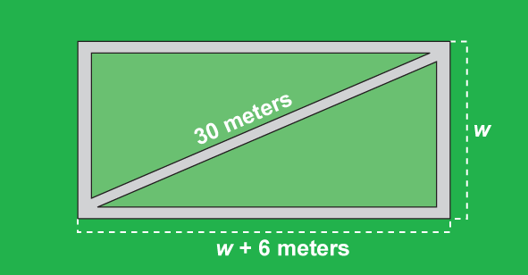
Example 1: The Pythagorean Theorem
The length of a rectangular field is 6 meters longer than its width. If a diagonal foot path stretching from one corner of the field to the opposite corner is 30 meters long, what are the dimensions of the field?

Slide 8
Example 1: The Pythagorean Theorem (cont.)
Solution:
Use the Pythagorean Theorem.
A negative number does not fit the conditions of the problem.

Slide 9
Example 1: The Pythagorean Theorem (cont.)
The length is 24 meters and the width is 18 meters.

Slide 10
Example 2: Projectiles
A bullet is fired straight up from ground level with a muzzle velocity of 320 feet per second.
a. When will the bullet hit the ground?
b. When will the bullet be 1200 feet above the ground?
Solution:

Slide 11
Example 2: Projectiles (cont.)
a. The bullet hits the ground when h = 0.
The bullet hits the ground in 20 seconds. The solution t = 0 confirms the fact that the bullet was fired from the ground.

Slide 12
Example 2: Projectiles (cont.)
b. Let h = 1200.
Both solutions are meaningful. The bullet is at a height of 1200 feet twice; once at 5 seconds while going up and once at 15 seconds while coming down.

Slide 13
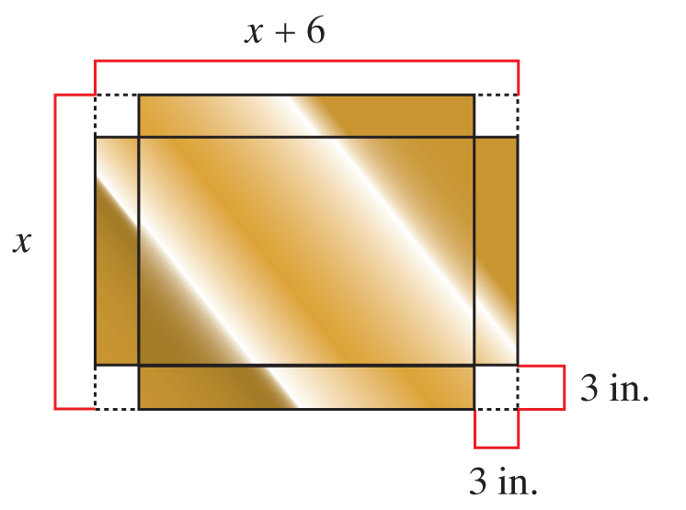
Example 3: Geometry
A rectangular sheet of copper was 6 in. longer than it was wide. Three inch by three inch squares were cut from each corner and the sides were folded up to form an open box. If the box has a volume of 336 in.³, what were the dimensions of the original sheet of copper?

Slide 14
Example 3: Geometry (cont.)
Solution:

Slide 15
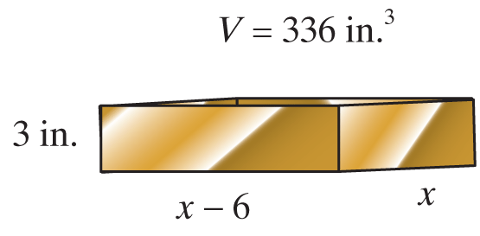
Example 3: Geometry (cont.)

Slide 16
Example 3: Geometry (cont.)
The length of the sheet was 20 in. and the width was 14 in.

Slide 17
Example 4: Cost Per Person
The members of a bowling club were going to fly commercially to a tournament at a total cost of $2420, which was to be divided equally among the members. At the last minute, two of the members decided to fly their own private planes. The cost to the remaining members increased $11 each. How many members flew commercially?
Solution:

Slide 18
Example 4: Cost Per Person (cont.)

Slide 19
Example 4: Cost Per Person (cont.)
−20 does not fit the conditions. That is, the number of people in a club is a positive number.

Slide 20
Example 4: Cost Per Person (cont.)

