Slide 1
Section 7.6
Solving Quadratic and Rational Inequalities

Slide 2
Objectives
Solve quadratic inequalities.
Solve higher-degree inequalities.
Solve rational inequalities.
Graph the solutions of inequalities on real number lines.
Use a graphing calculator as an aid in solving quadratic inequalities.

Slide 3
Quadratic Inequalities: Solved Algebraically
To Solve a Polynomial Inequality Algebraically
1. Arrange the terms so that one side of the inequality is 0.
2. Factor the algebraic expression, if possible, and find the points where each factor is 0. (Use the quadratic formula, if necessary.)
3. Mark each of these points on a number line. These are the interval endpoints.

Slide 4
Quadratic Inequalities: Solved Algebraically
To Solve a Polynomial Inequality Algebraically (cont.)
4. Test one point from each interval to determine the sign of the polynomial expression for all points in that interval.
5. The solution consists of those intervals where the test points satisfy the original inequality.
6. Mark a bracket for an endpoint that is included and a parenthesis for an endpoint that is not included.

Slide 5
Example 1: Solving Polynomial Inequalities by Factoring
Solve the following inequalities by factoring and by using a number line. Graph the solution set on a number line.

Slide 6
Example 1: Solving Polynomial Inequalities by Factoring (cont.)
Set each factor equal to 0 to locate the interval endpoints.
Mark these points on a number line and test one point from each of the intervals formed.

Slide 7
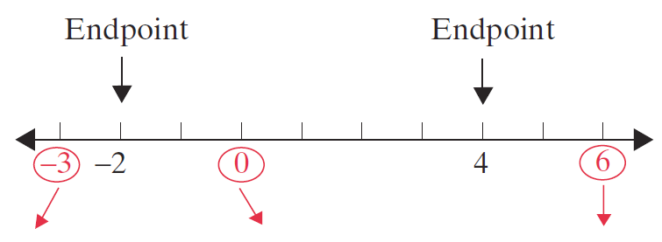
Example 1: Solving Polynomial Inequalities by Factoring (cont.)

Slide 8
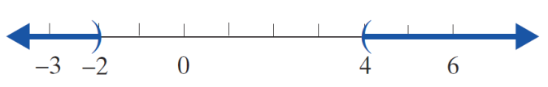
Example 1: Solving Polynomial Inequalities by Factoring (cont.)
Graphically,
The solution is:

Slide 9
Example 1: Solving Polynomial Inequalities by Factoring (cont.)
Set each factor equal to 0 to locate the interval endpoints.

Slide 10
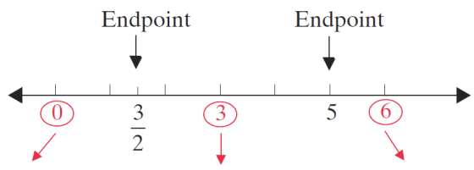
Example 1: Solving Polynomial Inequalities by Factoring (cont.)
Test one point from each interval formed.

Slide 11
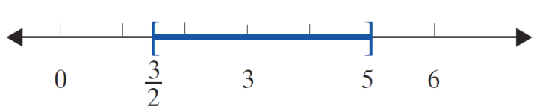
Example 1: Solving Polynomial Inequalities by Factoring (cont.)
The solution includes both endpoints since the inequality ( ≤ ) includes 0:
The solution is:

Slide 12
Example 1: Solving Polynomial Inequalities by Factoring (cont.)
Set each factor equal to 0 to locate the interval endpoints.

Slide 13
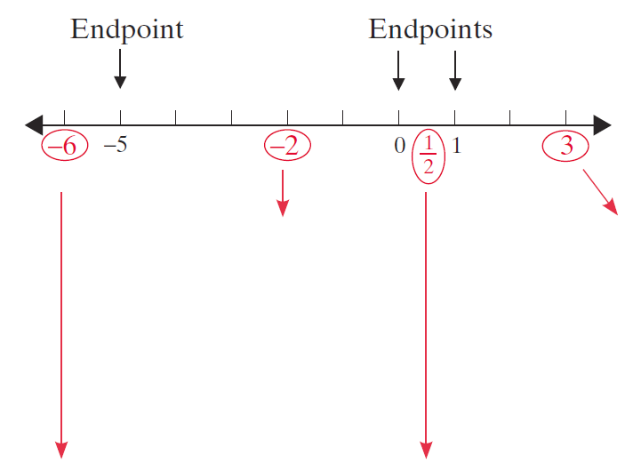
Example 1: Solving Polynomial Inequalities by Factoring (cont.)
Test one point from each interval formed.

Slide 14
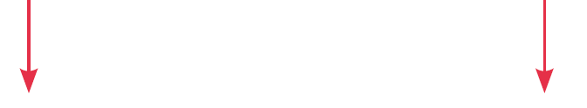
Example 1: Solving Polynomial Inequalities by Factoring (cont.)

Slide 15
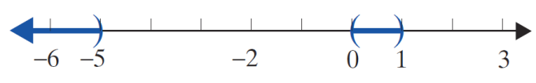
Example 1: Solving Polynomial Inequalities by Factoring (cont.)
The solution is:

Slide 16
Example 2: Solving Polynomial Inequalities Using the Quadratic Formula
Solve the following inequalities using the quadratic formula and a number line. Graph the solution set on a number line.
a. x² – 2x – 1 > 0
Solution:
The quadratic expression x² – 2x – 1 will not factor with integer coefficients. Use the quadratic formula and find the roots of the equation x² – 2x – 1 = 0. Then use these roots as endpoints for the intervals. The test points can themselves be integers.

Slide 17
Example 2: Solving Polynomial Inequalities Using the Quadratic Formula (cont.)

Slide 18
Example 2: Solving Polynomial Inequalities Using the Quadratic Formula (cont.)
Test one point from each interval formed.

Slide 19
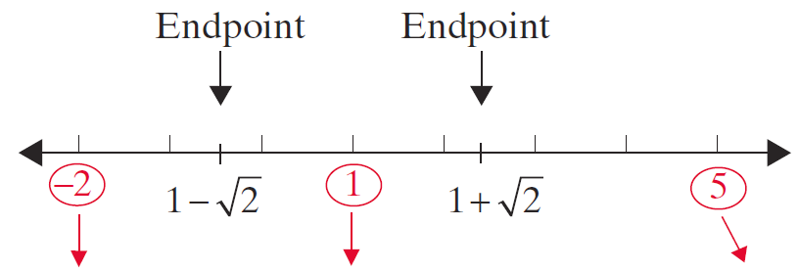
Example 2: Solving Polynomial Inequalities Using the Quadratic Formula (cont.)

Slide 20
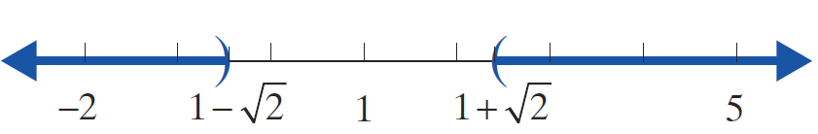
Example 2: Solving Polynomial Inequalities Using the Quadratic Formula (cont.)
The solution is:

Slide 21
Example 2: Solving Polynomial Inequalities Using the Quadratic Formula (cont.)

Slide 22
Example 2: Solving Polynomial Inequalities Using the Quadratic Formula (cont.)
Since these values are nonreal, the polynomial is either always positive or always negative for real values of x. Therefore, we only need to test one point. If that point satisfies the inequality, then the solution is all real numbers. If it does not, then there is no solution. In this example, we test x = 0 because the polynomial is easy to evaluate for x = 0.

Slide 23

Example 2: Solving Polynomial Inequalities Using the Quadratic Formula (cont.)
Since the real number 0 satisfies the inequality, the solution is all real numbers. In interval notation we write (−∞, ∞) and in algebraic notation we write ○. Graphically,

Slide 24
Solving Rational Inequalities
To Solve a Polynomial Inequality with Rational Expressions
1. Simplify the inequality so that one side is 0 and the other side has a single fraction with both the numerator and denominator in factored form.
2. Find the points that cause the factors in the numerator or in the denominator to be 0.
3. Mark each of these points on a number line. These are the interval endpoints.

Slide 25
Solving Rational Inequalities
To Solve a Polynomial Inequality with Rational Expressions (cont.)
4. Test one point from each interval to determine the sign of the polynomial expression for all points in that interval.
5. The solution consists of those intervals where the test points satisfy the original inequality.
6. Mark a bracket for an endpoint that is included and a parenthesis for an endpoint that is not included. Remember that no denominator can be 0.

Slide 26
Example 3: Solving Rational Inequalities
Solve and graph the following rational inequalities.
Solution: Set each factor in the numerator and the denominator equal to 0 to locate the interval endpoints.
Mark each of these points on a number line and test one point from each of the intervals formed. (Consider these points as endpoints of intervals.)

Slide 27
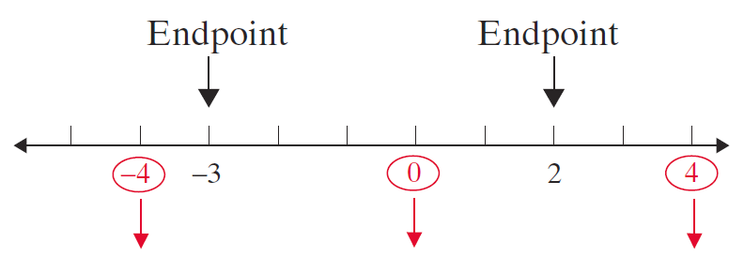
Example 3: Solving Rational Inequalities (cont.)

Slide 28
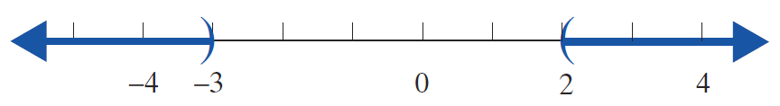
Example 3: Solving Rational Inequalities (cont.)
Graphically,
The solution is:

Slide 29
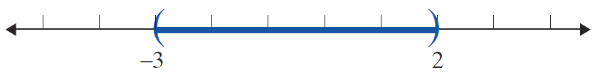
Example 3: Solving Rational Inequalities (cont.)
Solution: Using the graph and test points from
Example 2a, we know that
Graphically,

Slide 30
Example 3: Solving Rational Inequalities (cont.)
The solution is:

Slide 31
Example 4: Solving Rational Inequalities
Solve the following rational inequality.
Solution:

Slide 32
Example 4: Solving Rational Inequalities (cont.)
Set each linear expression equal to 0 to find the interval endpoints.
Test a value from each of the intervals:

Slide 33
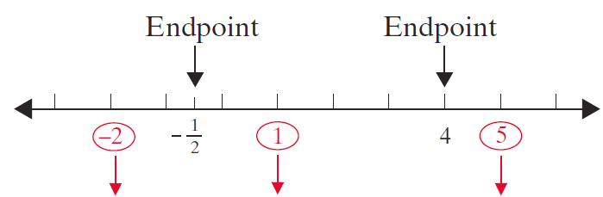
Example 4: Solving Rational Inequalities (cont.)

Slide 34
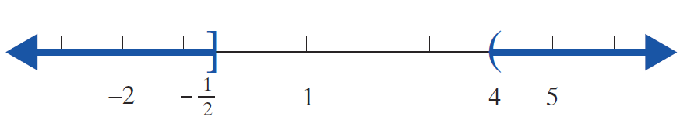
Example 4: Solving Rational Inequalities (cont.)
The solution includes the endpoint since the
inequality (≤) includes 0. However, the endpoint 4 is not included in the solution because the rational inequality is undefined (the denominator equals 0) when x = 4.
Graphically,

Slide 35
Example 4: Solving Rational Inequalities (cont.)
The solution is:

Slide 36
Solving Rational Inequalities
Notes
Notice that in the first step, we do not multiply by the denominator x − 4. The reason is that the variable expression is positive for some values of x and negative for other values of x. Therefore, if we did multiply by x − 4, we would not be able to determine whether the inequality should stay as ≥ or be reversed to ≤.

Slide 37
Solving Quadratic Inequalities Using a Graphing Calculator
To Solve a Polynomial Inequality Using a Graphing Calculator
1. Arrange the terms so that one side of the inequality is 0.
2. Form a function by letting y = [the polynomial], and graph the function.
Be sure to set the WINDOW so that all of the zeros are easily seen. This may be difficult if large numbers are involved.

Slide 38


Solving Quadratic Inequalities Using a Graphing Calculator
To Solve a Polynomial Inequality Using a Graphing Calculator (cont.)
3. Use the CALC key ( ) and select 2:(zero) to find (or approximate) the real zeros of the function, if there are any.
a. The values of x for which the y-values are above the x-axis satisfy y > 0.
b. The values of x for which the y-values are below the x-axis satisfy y < 0.

Slide 39
Solving Quadratic Inequalities Using a Graphing Calculator
To Solve a Polynomial Inequality Using a Graphing Calculator (cont.)
4. Endpoints of intervals are included if the inequality includes 0, as in y ≥ 0 or y ≤ 0.

Slide 40
Example 5: Solving a Quadratic Inequality Using a Graphing Calculator
Solve the following quadratic inequalities using a graphing calculator. Graph the solution set on a real number line.
a. x² – 2x > 8
Solution:
This inequality was solved algebraically in Example 1a. We repeat the solution here using a graphing calculator to show how the two methods are related.

Slide 41


Example 5: Solving a Quadratic Inequality Using a Graphing Calculator (cont.)
Manipulate the inequality so that one side is 0.
Press and enter the function:
Press to graph the function.

Slide 42
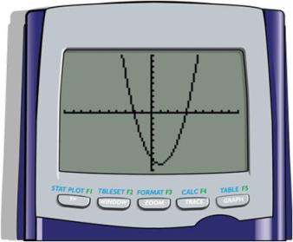
Example 5: Solving a Quadratic Inequality Using a Graphing Calculator (cont.)
The graph will appear as illustrated here. (In this case the graph is a parabola.)

Slide 43

Example 5: Solving a Quadratic Inequality Using a Graphing Calculator (cont.)
Find the zeros (or estimate the zeros) as follows:
Step 1: Press CALC ( ).
Step 2: Press or choose 2: zero.
Step 3: Follow the directions for moving the cursor to Left Bound?, Right Bound?, and Guess? for each point.
(Press each time.)

Slide 44
Example 5: Solving a Quadratic Inequality Using a Graphing Calculator (cont.)
[Note: If there are no real zeros, then the graph will be entirely above or entirely below the x-axis. The solution is then dependent on the nature of the inequality. It will be either the empty set (no solution) or the entire set of real numbers (−∞, ∞).]
In this case, the zeros are x = −2 and x = 4 (just as we found in Example 1a). Because we want to know where y > 0 , we look at the graph and choose the intervals for x where the curve is above the x-axis. [Note: Endpoints are not included because the inequality does not include 0.]

Slide 45
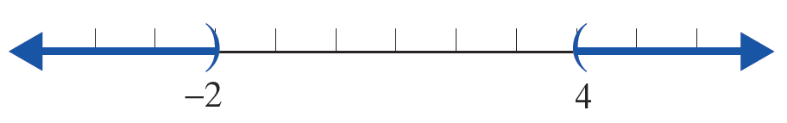
Example 5: Solving a Quadratic Inequality Using a Graphing Calculator (cont.)
Thus the solution consists of the union of two intervals:

Slide 46
Example 5: Solving a Quadratic Inequality Using a Graphing Calculator (cont.)
Solution:
Press and enter the function:
Press to graph the function.

Slide 47
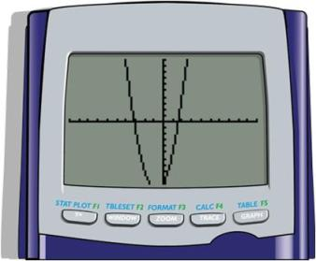
Example 5: Solving a Quadratic Inequality Using a Graphing Calculator (cont.)
The graph will appear as illustrated here. (In this case the graph is a parabola.)

Slide 48
Example 5: Solving a Quadratic Inequality Using a Graphing Calculator (cont.)
Find the zeros (or estimate the zeros) as follows:
Step 1: Press CALC ( ).
Step 2: Press or choose 2: zero.
Step 3: Follow the directions for moving the cursor to Left Bound?, Right Bound?, and Guess? for each point.
(Press each time.)
In this case the zeros are estimates:
x ≈ −3.1085 and x ≈ 1.6085.

Slide 49
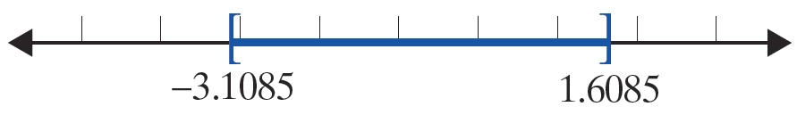
Example 5: Solving a Quadratic Inequality Using a Graphing Calculator (cont.)
Because we want to know where y ≤ 0, we look at the graph and choose the intervals for x where the curve is below the x-axis and include the endpoints because 0 is included in the inequality.
Thus the solution is the closed interval

Slide 50
Example 6: Solving a Higher-Degree Polynomial Inequality Using a Graphing Calculator
Solve the following 3rd-degree polynomial inequality using a graphing calculator:
Solution:
Press and enter the function:
Press to graph the function.

Slide 51
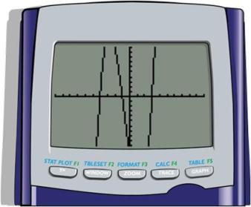
Example 6: Solving a Higher-Degree Polynomial Inequality Using a Graphing Calculator (cont.)
The graph will appear as illustrated here. (In this case the graph is not a parabola.)

Slide 52
Example 6: Solving a Higher-Degree Polynomial Inequality Using a Graphing Calculator (cont.)
Find the zeros (or estimate the zeros) as follows:
Step 1: Press CALC ( ).
Step 2: Press or choose 2: zero.
Step 3: Follow the directions for moving the cursor to Left Bound?, Right Bound?, and Guess? for each point.
(Press each time.)
In this case there are three zeros:
x = −4 , x = −1, and x = 3.

Slide 53
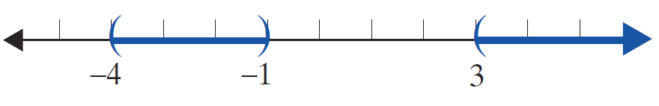
Example 6: Solving a Higher-Degree Polynomial Inequality Using a Graphing Calculator (cont.)
Because we want to know where y > 0, we look at the graph and choose the intervals for x where the curve is above the x-axis. Do not include the endpoints because 0 is not included in the inequality.
Thus the solution is the union of two intervals:

Slide 54
Practice Problems
Solve each of the following inequalities algebraically. Graph each solution set on a real number line. Write the answers in interval notation.
Use a graphing calculator to solve the following inequalities. Write the answers in interval notation.

Slide 55



Practice Problem Answers
1.
2.
3.

