Slide 1
Section 9.3
Distance Formula and Circles

Slide 2
Objectives
Find the distance between any two points in a plane.
Write the equation of a circle given its center and radius.
Graph circles centered at the point (h, k).

Slide 3
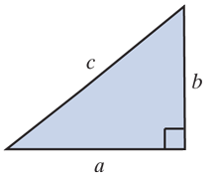
Distance Between Two Points
The Pythagorean Theorem
In a right triangle, the square of the hypotenuse is equal to the sum of the squares of the legs.

Slide 4
Distance Between Two Points
The Distance Formula
For two points in a plane, the
distance between the points is

Slide 5
Example 1: The Distance Formula
a. Find the distance between the two points (3, 4) and (−2, 7).
Solution:

Slide 6
Example 1: The Distance Formula (cont.)
b. Use the distance formula (3 times) and the Pythagorean Theorem to determine whether or not the triangle with vertices at A(−5, −1), B(2, 1), and C(0, 7) is a right triangle.
Solution:
Find the lengths of the three line segments
and decide whether or not the Pythagorean Theorem is satisfied.

Slide 7
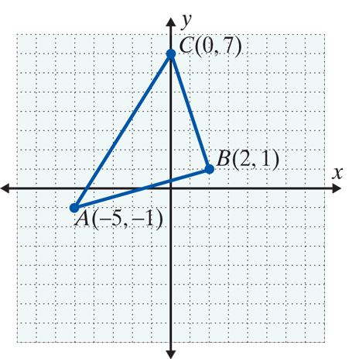
Example 1: The Distance Formula (cont.)

Slide 8
Example 1: The Distance Formula (cont.)
The triangle is not a right triangle since

Slide 9
Equations of Circles
Circle, Center, Radius, and Diameter
A circle is the set of all points in a plane that are a fixed distance from a fixed point.
The fixed point is called the center of the circle.
The distance from the center to any point on the circle is called the radius of the circle.

Slide 10
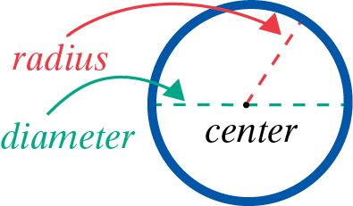
Equations of Circles
Circle, Center, Radius, and Diameter (cont.)
The distance from one point on the circle to another point on the circle measured through the center is called the diameter of the circle.
Note: The diameter is twice the length of the radius.

Slide 11
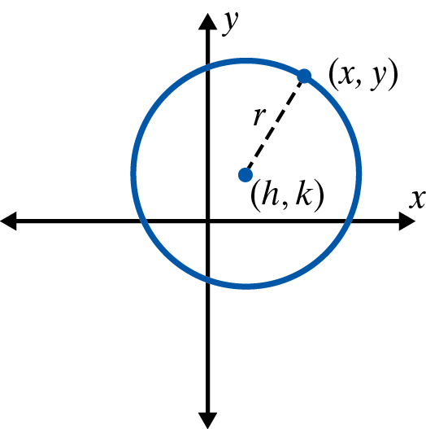
Equations of Circles
Equation of a Circle
The equation of a circle with radius r
and center at (h, k) is
If the center is at the origin,
(0, 0), the equation simplifies to

Slide 12
Example 2: Equations of Circles
a. Find the equation of the circle with its center at the origin and radius Are the points
on the circle?
Solution: The equation of the circle is
To determine whether or not the points
are on the circle, substitute each of these points into the equation.

Slide 13
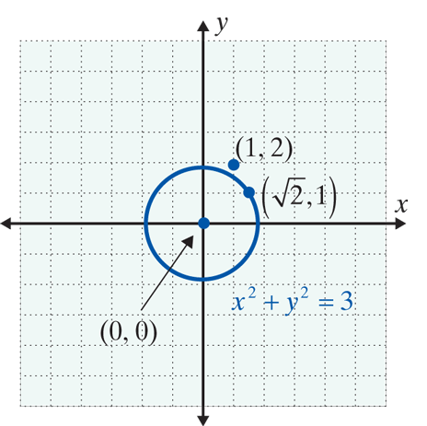
Example 2: Equations of Circles (cont.)
Therefore, is on
the circle, but (1, 2) is not on the circle.

Slide 14
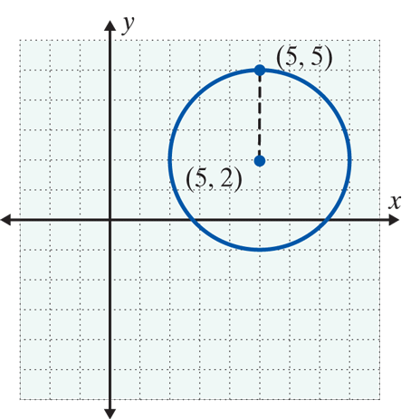
Example 2: Equations of Circles (cont.)
b. Find the equation of the circle with center at (5, 2) and radius 3. Is the point (5, 5) on the circle?
Solution:

Slide 15
Example 2: Equations of Circles (cont.)
c. Show that represents a circle. Find its center and radius. Then graph the circle.
Solution: Rearrange the terms and complete the square for
Add 16 and 1 to both sides.
Completes the square

Slide 16
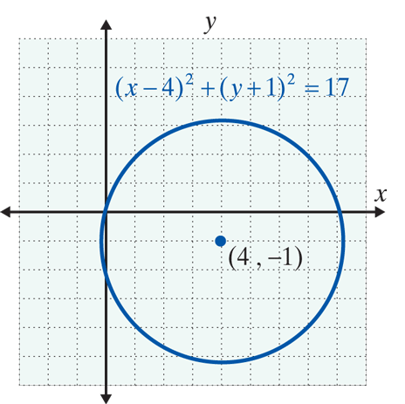
Example 2: Equations of Circles (cont.)
Standard form for the equation of a circle

Slide 17

Example 3: Using a Graphing Calculator
Use a graphing calculator with a “square window” to graph the circle
Solution: Set the scales to −6 and 6 for Xmin and Xmax and −4 and 4 for Ymin and Ymax, respectively.

Slide 18
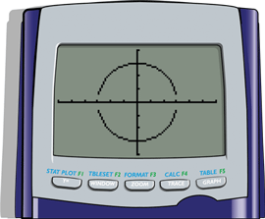
Example 3: Using a Graphing Calculator (cont.)
Graphing both y₁ and y₂ gives the following graph of the circle.

Slide 19
Practice Problems
1. Find the equation of the circle with center at (−2, 3) and radius 6.
2. Write the equation in standard form and find the center and radius for the circle with equation
3. Find the distance between the two points (5, 3) and (−1, −3).

Slide 20
Practice Problems

