Slide 1
Section 0.1
Real Numbers

Slide 2
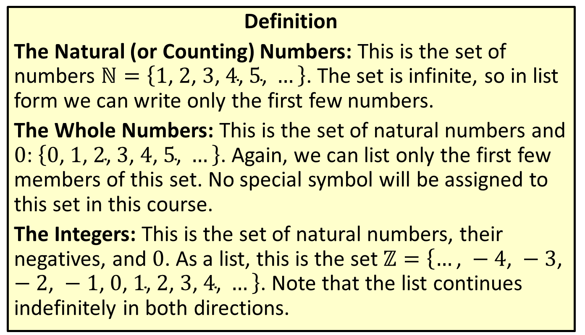
Types of Real Numbers
Definition
The Natural (or Counting) Numbers: This is the set of numbers $ℕ=\left\{1\text{, }2\text{, }3\text{, }4\text{, }5\text{, }…\right\}$. The set is infinite, so in list form we can write only the first few numbers.
The Whole Numbers: This is the set of natural numbers and 0: $\left\{0\text{, }1\text{, }2\text{, }3\text{, }4\text{, }5\text{, }…\right\}$. Again, we can list only the first few members of this set. No special symbol will be assigned to this set in this course.
The Integers: This is the set of natural numbers, their negatives, and 0. As a list, this is the set $ℤ=\left\{…\text{, }−4\text{, }−3\text{, }−2\text{, }−1\text{, }0\text{, }1\text{, }2\text{, }3\text{, }4\text{, }…\right\}$. Note that the list continues indefinitely in both directions.

Slide 3
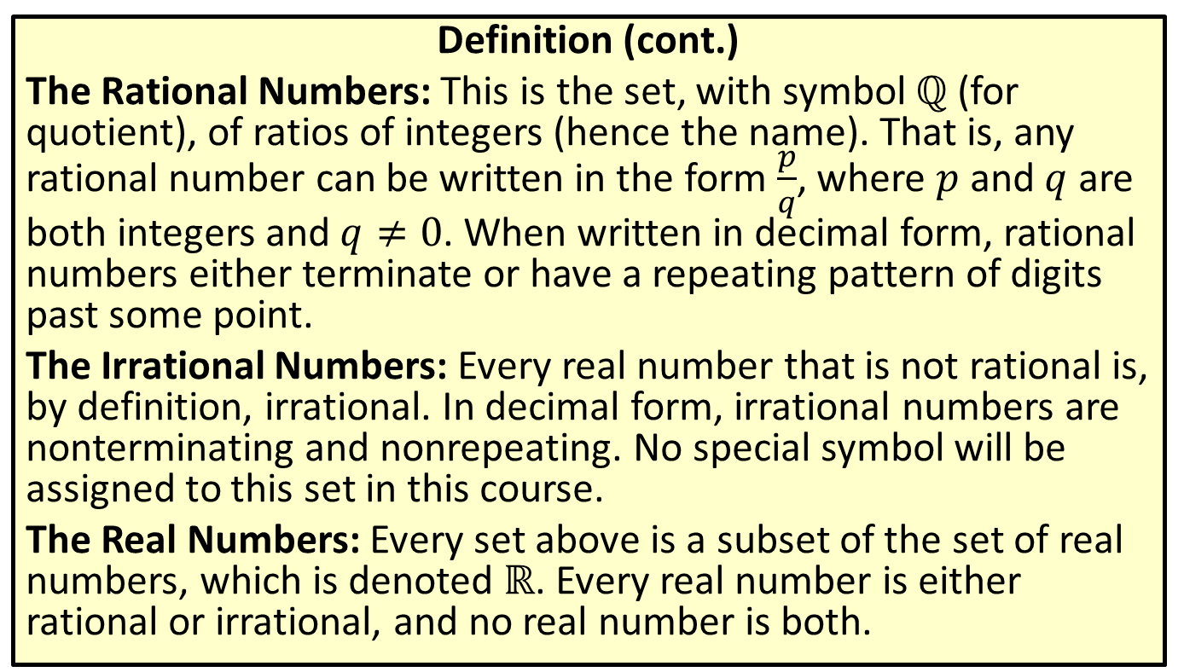
Types of Real Numbers
Definition (cont.)
The Rational Numbers: This is the set, with symbol $ℚ$ (for quotient), of ratios of integers (hence the name). That is, any rational number can be written in the form $\frac{p}{q}$, where $p$ and $q$ are both integers and $q≠0$. When written in decimal form, rational numbers either terminate or have a repeating pattern of digits past some point.
The Irrational Numbers: Every real number that is not rational is, by definition, irrational. In decimal form, irrational numbers are nonterminating and nonrepeating. No special symbol will be assigned to this set in this course.
The Real Numbers: Every set above is a subset of the set of real numbers, which is denoted $ℝ$. Every real number is either rational or irrational, and no real number is both.

Slide 4
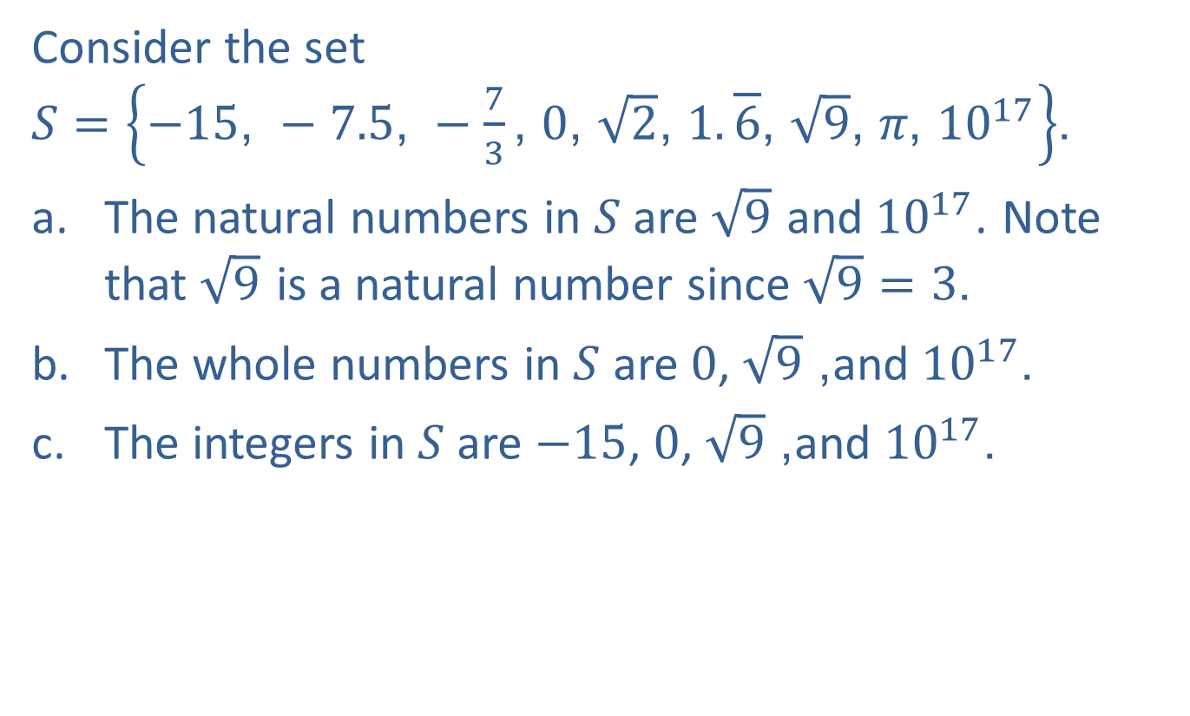
EXAMPLE 1: Types of Real Numbers
Consider the set $S=\left\{−15\text{, }−7.5\text{, }−\frac{7}{3}\text{, }0\text{, }\sqrt{2}\text{, }1.\overline{6}\text{, }\sqrt{9}\text{, }π\text{, }{10}^{17}\right\}$.
​The natural numbers in $S$ are $\sqrt{9}$ and ${10}^{17}$. Note that $\sqrt{9}$ is a natural number since $\sqrt{9}=3$.
​The whole numbers in $S$ are 0, $\sqrt{9}$, and ${10}^{17}$.
​The integers in $S$ are $−15$, 0, $\sqrt{9}$, and ${10}^{17}$.

Slide 5
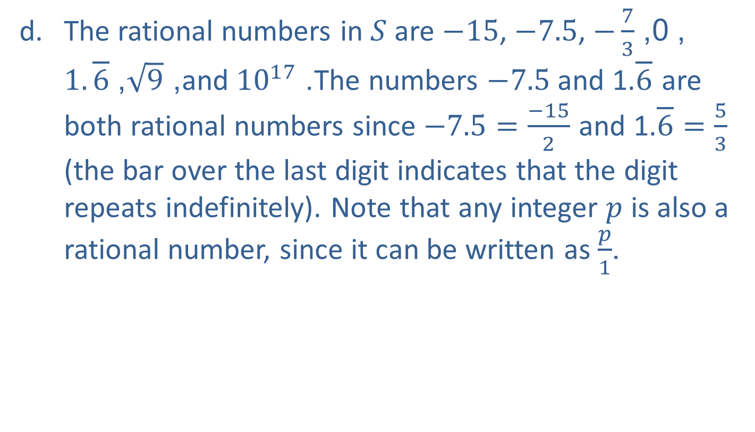
EXAMPLE 1: Types of Real Numbers (cont.)
​The rational numbers in $S$ are $−15$, $−7.5$, $−\frac{7}{3}$, 0, $1.\overline{6}$, $\sqrt{9}$, and ${10}^{17}$. The numbers $−7.5$ and 1.$\overline{6}$ are both rational numbers since $−7.5=\frac{−15}{2}$ and 1.$\overline{6}=\frac{5}{3}$ (the bar over the last digit indicates that the digit repeats indefinitely). Note that any integer $p$ is also a rational number, since it can be written as $\frac{p}{1}$.

Slide 6

EXAMPLE 1: Types of Real Numbers (cont.)
​The only irrational numbers in $S$ are $\sqrt{2}$ and $π$. Although well known now, the irrationality of $\sqrt{2}$ came as a bit of a surprise to the early Greek mathematicians who discovered this fact. The irrationality of $π$ was not proven until 1767.

Slide 7
EXAMPLE 2: Drawing the Real Number Line
We choose which portion of the real number line to show and the physical length that represents one unit based on the numbers that we wish to plot.
​If we want to plot the numbers 101, 106, and 107, we might construct the graph below.
​

Slide 8
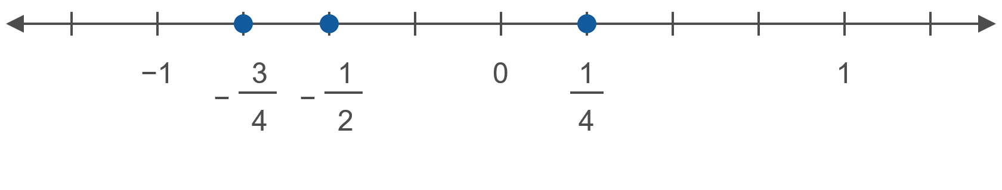

EXAMPLE 2: Drawing the Real Number Line (cont.)
​If we want to plot the numbers $−\frac{3}{4}$, $−\frac{1}{2}$, and $\frac{1}{4}$, we might make the unit interval longer.
​

Slide 9
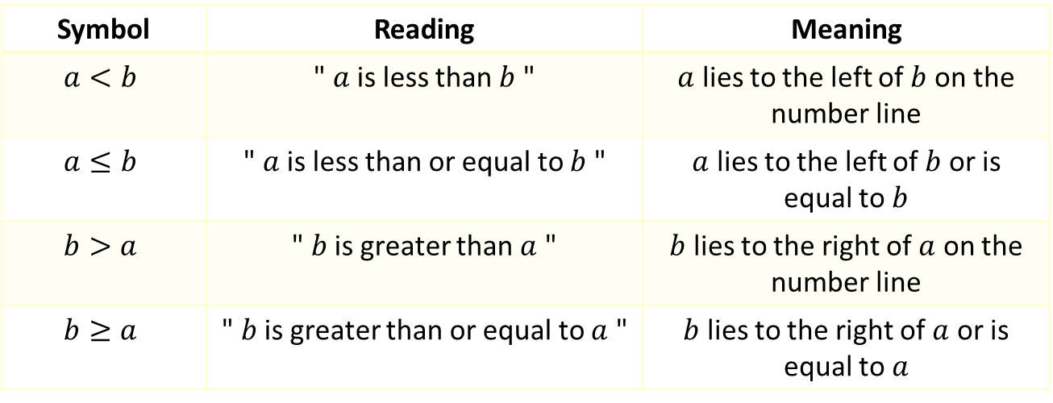
Inequality Symbols (Order)
The two symbols < and > are called strict inequality signs, while the symbols ≤ and ≥ are nonstrict inequality signs.
Symbol | Reading | Meaning
$$a<b$$ | " $a$ is less than $b$ " | $a$ lies to the left of $b$ on the number line
$$a≤b$$ | " $a$ is less than or equal to $b$ " | $a$ lies to the left of $b$ or is equal to $b$
$$b>a$$ | " $b$ is greater than $a$ " | $b$ lies to the right of $a$ on the number line
$$b≥a$$ | " $b$ is greater than or equal to $a$ " | $b$ lies to the right of $a$ or is equal to $a$

Slide 10
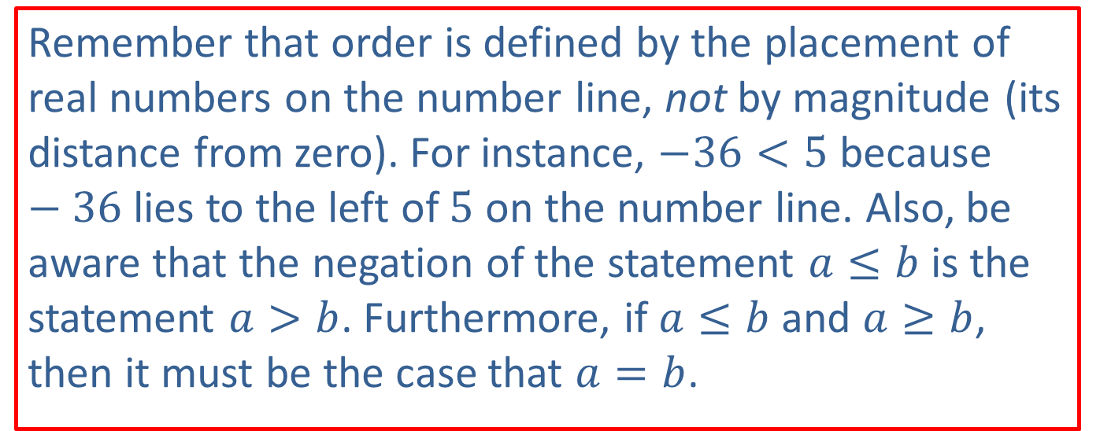
CAUTION!
Remember that order is defined by the placement of real numbers on the number line, not by magnitude (its distance from zero). For instance, $−36<5$ because $−36$ lies to the left of 5 on the number line. Also, be aware that the negation of the statement $a≤b$ is the statement $a>b$. Furthermore, if $a≤b$ and $a≥b$, then it must be the case that $a=b$.

Slide 11
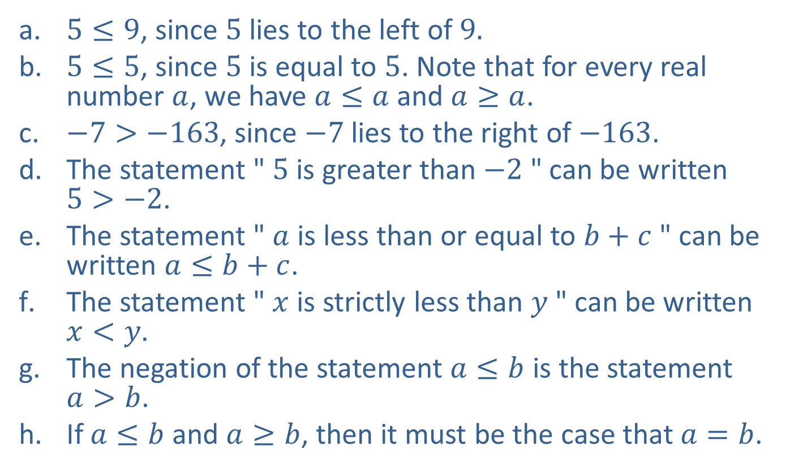
EXAMPLE 3: Working with Order
​$5≤9$, since 5 lies to the left of 9.
​$5≤5$, since 5 is equal to 5. Note that for every real number $a$, we have $a≤a$ and $a≥a$.
​$−7>−163$, since $−7$ lies to the right of $−163$.
​The statement " 5 is greater than $−2$ " can be written $5>−2$.
​The statement " $a$ is less than or equal to $b+c$ " can be written $a≤b+c$.
​The statement " $x$ is strictly less than $y$ " can be written $x<y$.
​The negation of the statement $a≤b$ is the statement $a>b$.
​If $a≤b$ and $a≥b$, then it must be the case that $a=b$.

Slide 12
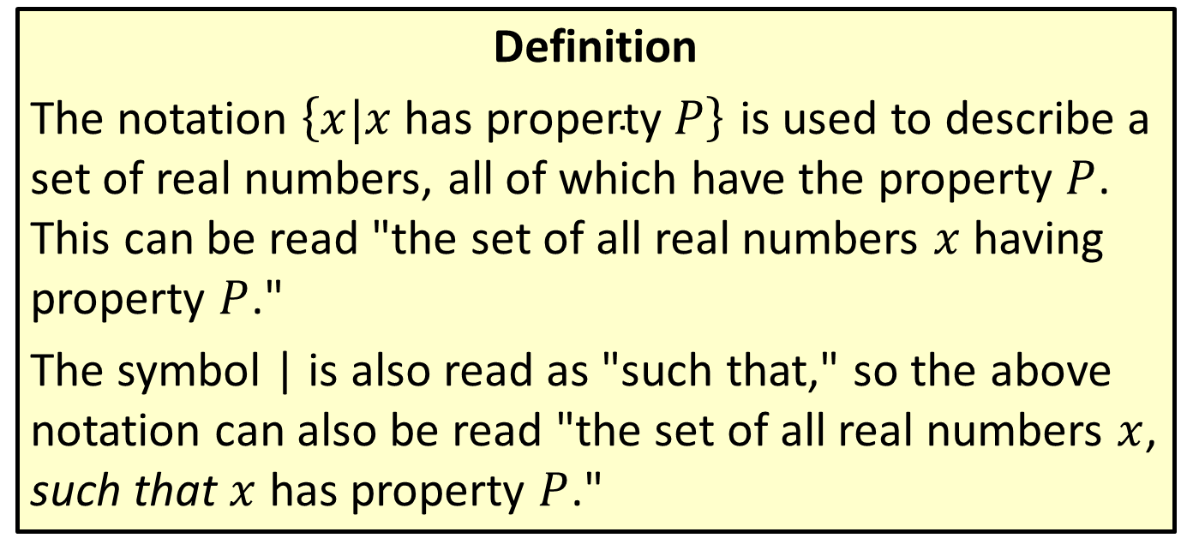
Set-Builder Notation
Definition
The notation $\left\{x|x \text{has} \text{property} P\right\}$ is used to describe a set of real numbers, all of which have the property $P$. This can be read "the set of all real numbers $x$ having property $P$."
The symbol | is also read as "such that," so the above notation can also be read "the set of all real numbers $x$, such that $x$ has property $P$."

Slide 13
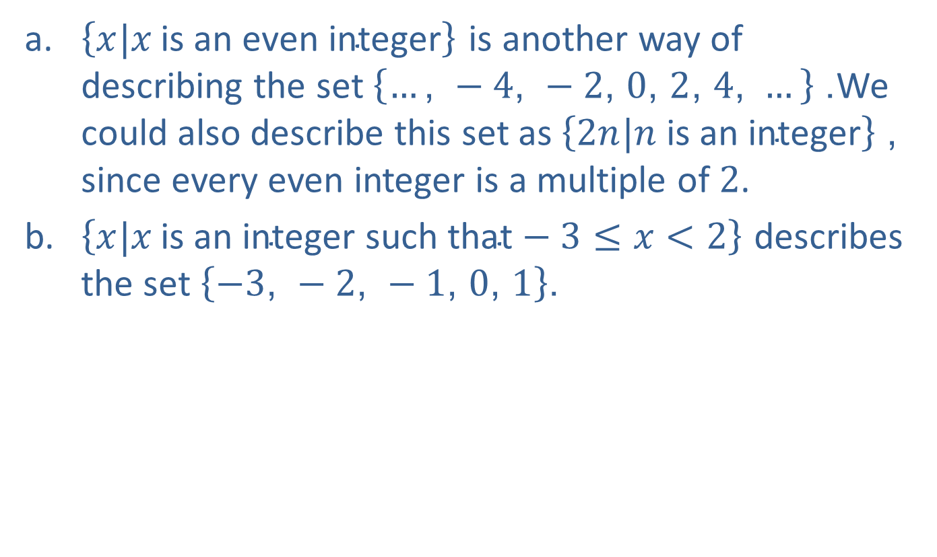
EXAMPLE 4: Set-Builder Notation
​$\left\{x|x \text{is} \text{an} \text{even} \text{integer}\right\}$ is another way of describing the set $\left\{…\text{, }−4\text{, }−2\text{, }0\text{, }2\text{, }4\text{, }…\right\}$. We could also describe this set as $\left\{2n|n \text{is} \text{an} \text{integer}\right\}$, since every even integer is a multiple of 2.
​$\left\{x|x \text{is} \text{an} \text{integer} \text{such} \text{that}−3≤x<2\right\}$ describes the set $\left\{−3\text{, }−2\text{, }−1\text{, }0\text{, }1\right\}$.

Slide 14
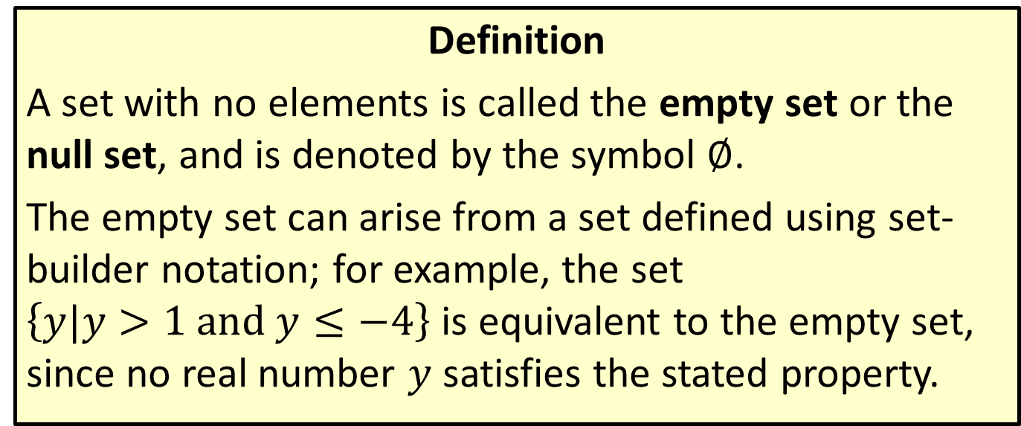
The Empty Set
Definition
A set with no elements is called the empty set or the null set, and is denoted by the symbol $∅$.
The empty set can arise from a set defined using set-builder notation; for example, the set $\left\{y|y>1 and y≤−4\right\}$ is equivalent to the empty set, since no real number $y$ satisfies the stated property.

Slide 15
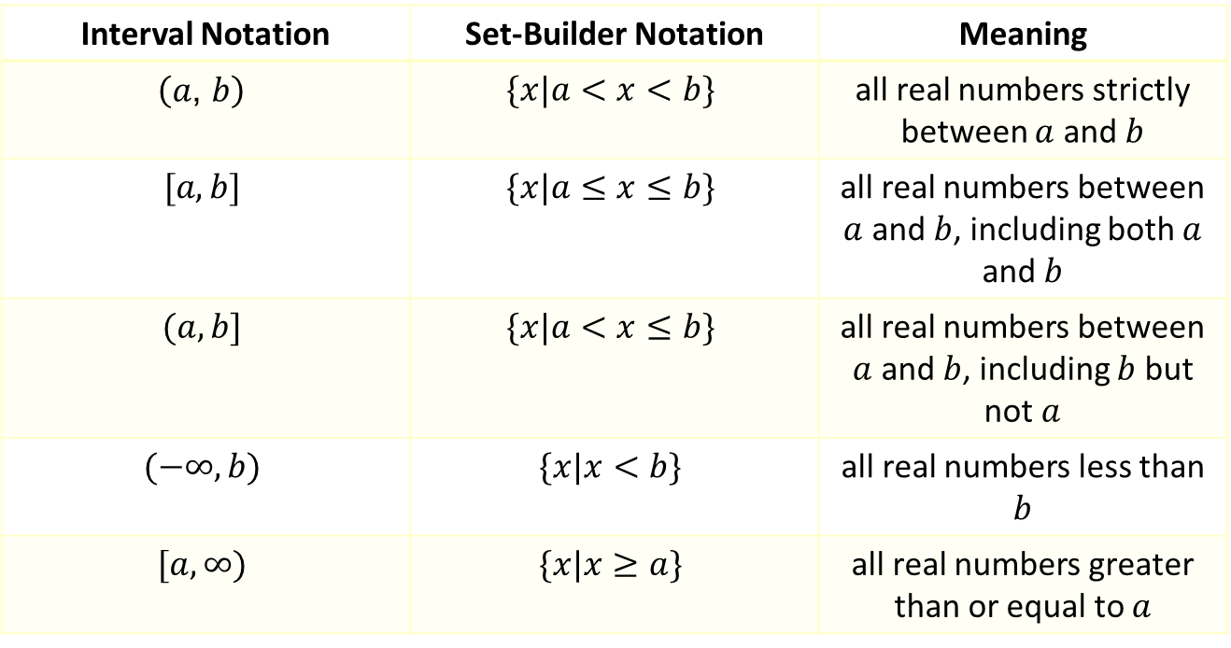
Interval Notation
Definition
Interval Notation | Set-Builder Notation | Meaning
$$\left(a\text{, }b\right)$$ | $$\{x|a<x<b\}$$ | all real numbers strictly between $a$ and $b$
$$[a,b]$$ | $$\{x|a≤x≤b\}$$ | all real numbers between $a$ and $b$, including both $a$ and $b$
$$(a,b]$$ | $$\{x|a<x≤b\}$$ | all real numbers between $a$ and $b$, including $b$ but not $a$
$$(−∞,b)$$ | $$\{x|x<b\}$$ | all real numbers less than $b$
$$[a,∞)$$ | $$\{x|x≥a\}$$ | all real numbers greater than or equal to $a$

Slide 16
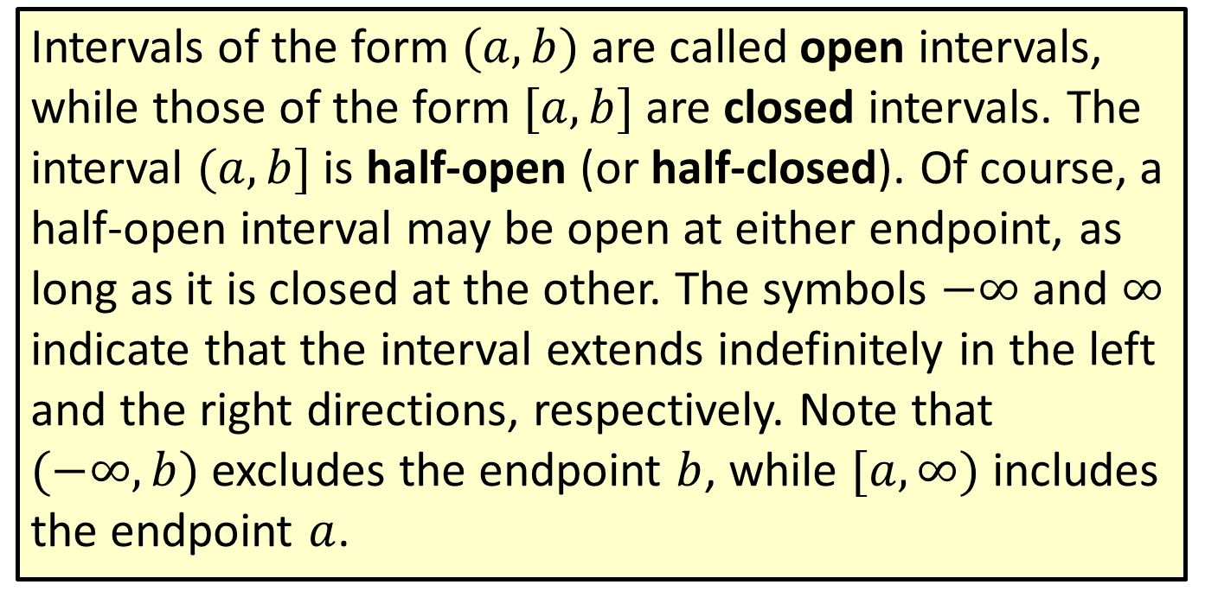
Interval Notation (cont.)
Intervals of the form $(a,b)$ are called open intervals, while those of the form $[a,b]$ are closed intervals. The interval $(a,b]$ is half-open (or half-closed). Of course, a half-open interval may be open at either endpoint, as long as it is closed at the other. The symbols $−∞$ and $∞$ indicate that the interval extends indefinitely in the left and the right directions, respectively. Note that $(−∞,b)$ excludes the endpoint $b$, while $[a,∞)$ includes the endpoint $a$.

Slide 17
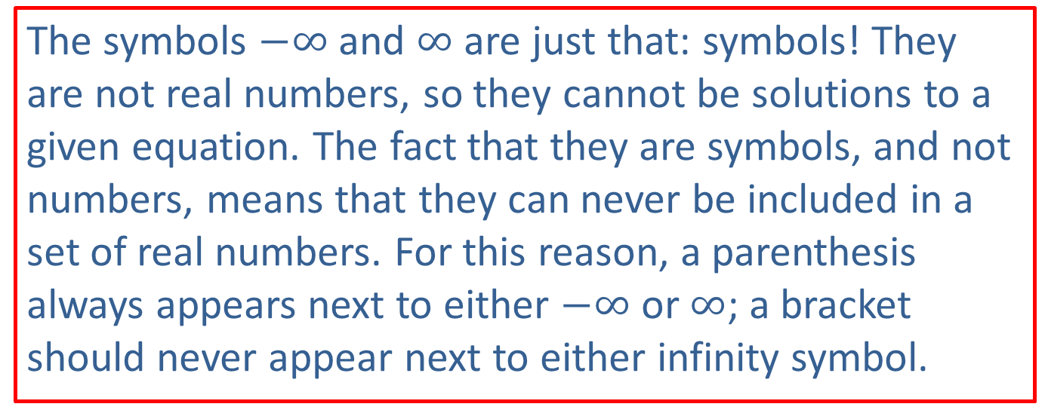
CAUTION!
The symbols $−∞$ and $∞$ are just that: symbols! They are not real numbers, so they cannot be solutions to a given equation. The fact that they are symbols, and not numbers, means that they can never be included in a set of real numbers. For this reason, a parenthesis always appears next to either $−∞$ or $∞$; a bracket should never appear next to either infinity symbol.

Slide 18
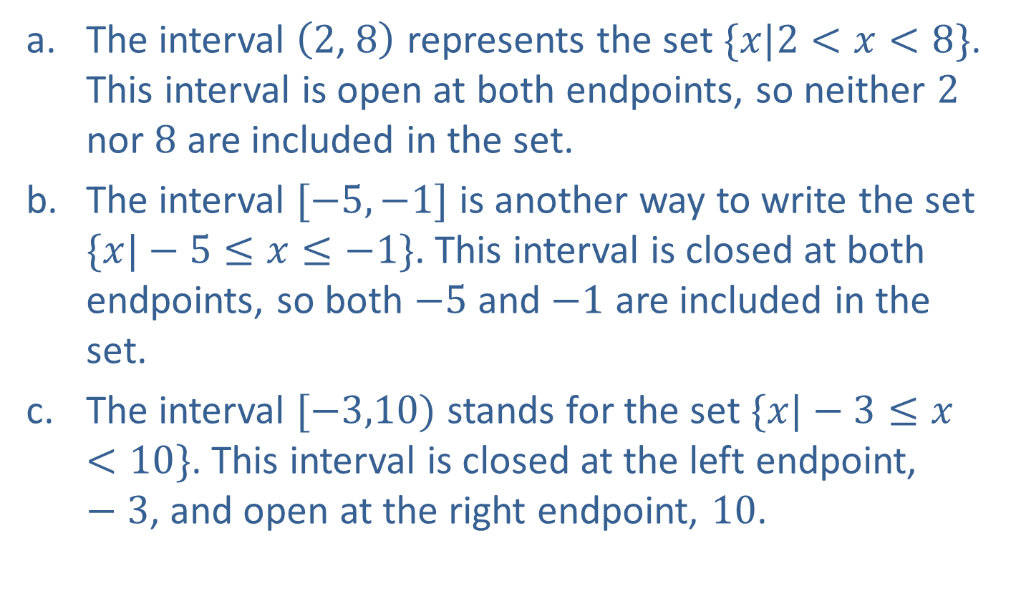
EXAMPLE 5: Intervals of Real Numbers
​The interval $\left(2\text{, }8\right)$ represents the set $\{x|2<x<8\}$. This interval is open at both endpoints, so neither 2 nor 8 are included in the set.
​The interval $[−5,−1]$ is another way to write the set $\{x|−5≤x≤−1\}$. This interval is closed at both endpoints, so both $−5$ and $−1$ are included in the set.
​The interval $[−3,10)$ stands for the set $\{x|−3≤x<10\}$. This interval is closed at the left endpoint, $−3$, and open at the right endpoint, 10.

Slide 19
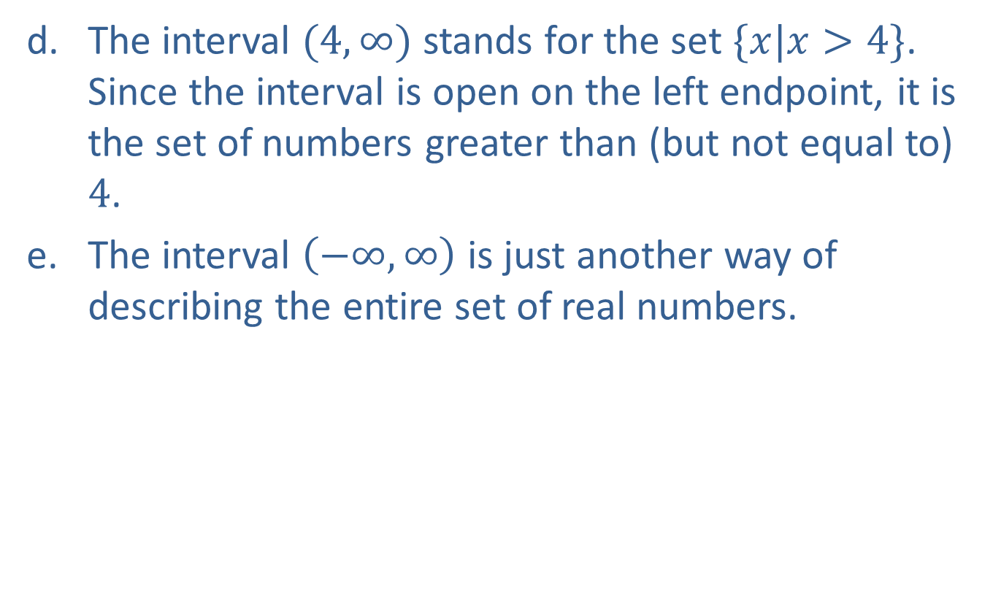
EXAMPLE 5: Intervals of Real Numbers (cont.)
​The interval $(4,∞)$ stands for the set $\{x|x>4\}$. Since the interval is open on the left endpoint, it is the set of numbers greater than (but not equal to) 4.
​The interval $\left(−∞,∞\right)$ is just another way of describing the entire set of real numbers.

Slide 20
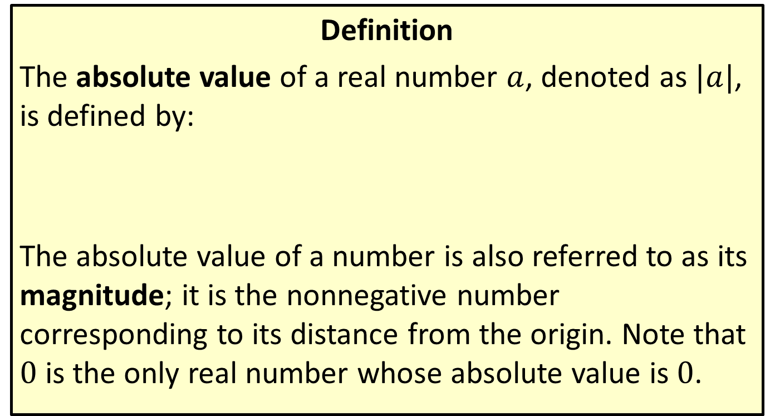
Absolute Value
Definition
The absolute value of a real number $a$, denoted as $|a|$, is defined by:
The absolute value of a number is also referred to as its magnitude; it is the nonnegative number corresponding to its distance from the origin. Note that 0 is the only real number whose absolute value is 0.

Slide 21
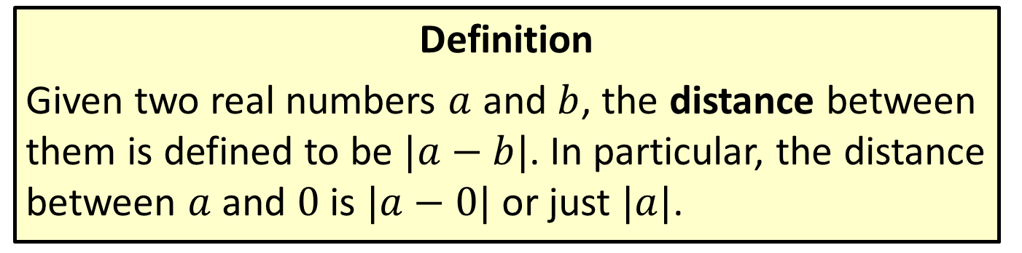
Distance on the Real Number Line
Definition
Given two real numbers $a$ and $b$, the distance between them is defined to be $|a−b|$. In particular, the distance between $a$ and 0 is $|a−0|$ or just $|a|$.

Slide 22

EXAMPLE 6: Absolute Value
​ $|17−3|=|3−17|=14$. That is, 17 and 3 are 14 units apart.
​ $|−π|=|π|=π$. Both $−π$ and $π$ are $π$ units from 0.
​ $\frac{|7|}{7}=\frac{7}{7}=1$
​ $\frac{|−7|}{−7}=\frac{7}{−7}=−1$

Slide 23
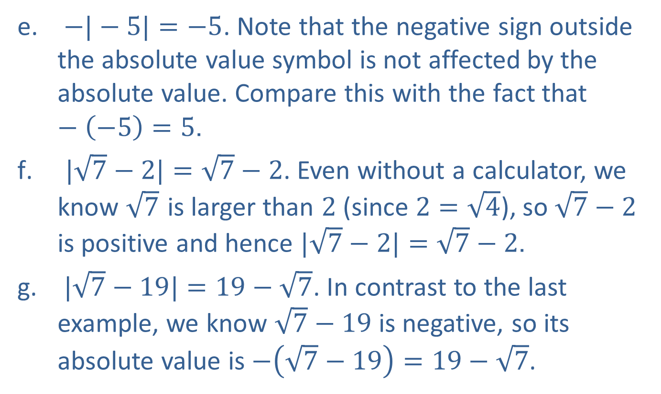
EXAMPLE 6: Absolute Value (cont.)
​ $−|−5|=−5$. Note that the negative sign outside the absolute value symbol is not affected by the absolute value. Compare this with the fact that $−\left(−5\right)=5$.
​ $|\sqrt{7}−2|=\sqrt{7}−2$. Even without a calculator, we know $\sqrt{7}$ is larger than 2 (since $2=\sqrt{4}$), so $\sqrt{7}−2$ is positive and hence $|\sqrt{7}−2|=\sqrt{7}−2$.
​ $|\sqrt{7}−19|=19−\sqrt{7}$. In contrast to the last example, we know $\sqrt{7}−19$ is negative, so its absolute value is $−\left(\sqrt{7}−19\right)=19−\sqrt{7}$.

Slide 24
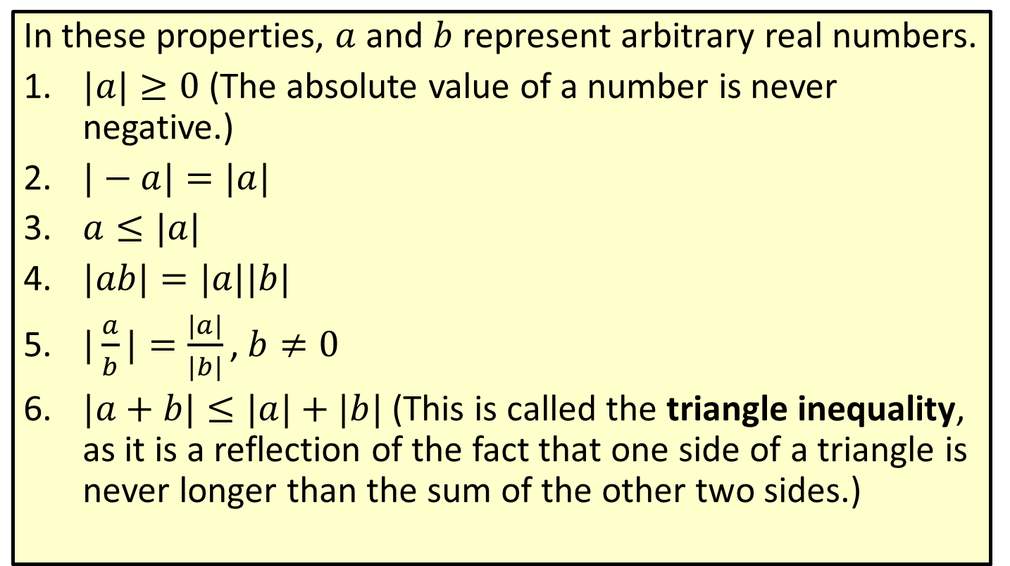
Properties of Absolute Value
In these properties, $a$ and $b$ represent arbitrary real numbers.
​$|a|≥0$ (The absolute value of a number is never negative.)
​$|−a|=|a|$
​$a≤|a|$
​$|ab|=|a||b|$
​$|\frac{a}{b}|=\frac{|a|}{|b|}\text{,} b≠0$
​$|a+b|≤|a|+|b|$ (This is called the triangle inequality, as it is a reflection of the fact that one side of a triangle is never longer than the sum of the other two sides.)

Slide 25

EXAMPLE 7: Using Absolute Value Properties
​$|\left(−3\right)\left(5\right)|=|−15|=15=|−3||5|$
​$1=|−3+4|≤|−3|+|4|=7$
​$7=|−3−4|≤|−3|+|−4|=7$
​$|\frac{−3}{7}|=\frac{|−3|}{|7|}=\frac{3}{7}$

