Slide 1
Section 0.2
The Arithmetic of Algebraic Expressions

Slide 2
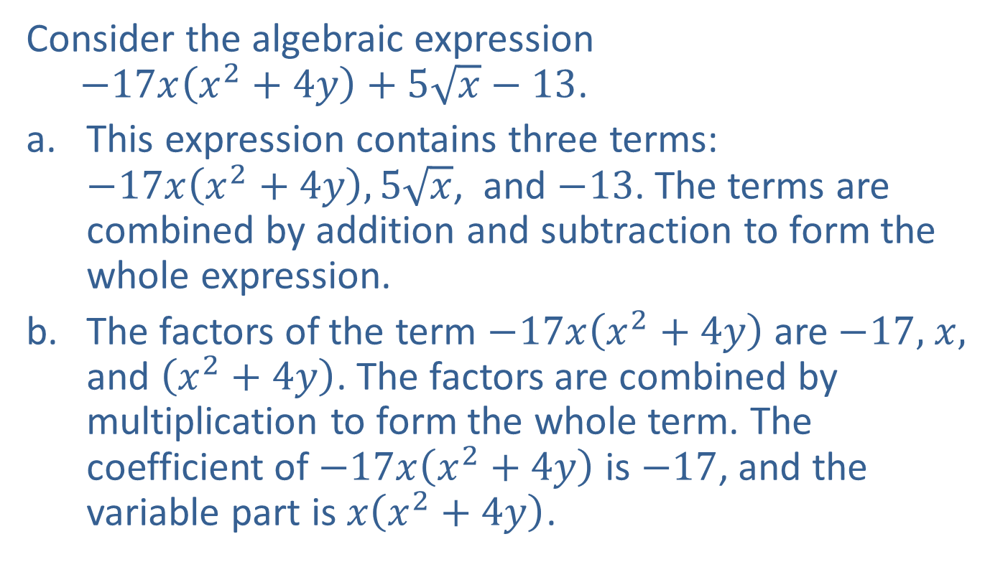
Example 1: Terminology of Algebraic Expressions
Consider the algebraic expression
$−17x\left(x^{2}+4y\right)+5\sqrt{x}−13$.
This expression contains three terms:
$−17x\left(x^{2}+4y\right),5\sqrt{x}$, and $−13$. The terms are combined by addition and subtraction to form the whole expression.
The factors of the term $−17x\left(x^{2}+4y\right)$are $−17,$ $x,$ and $\left(x^{2}+4y\right)$. The factors are combined by multiplication to form the whole term. The coefficient of $−17x\left(x^{2}+4y\right)$is $−17$, and the variable part is $x\left(x^{2}+4y\right)$.

Slide 3

Example 1: Terminology of Algebraic Expressions (cont.)
The factor $\left(x^{2}+4y\right)$ itself consists of the two terms $x^{2}$and $4y$, but these two terms are not terms of the original algebraic expression $−17x\left(x^{2}+4y\right)+5\sqrt{x}−13$.

Slide 4

Example 2: Evaluating Algebraic Expressions
Evaluate the following algebraic expressions.
${5x}^{3}−16$ for $x=4$
${−3x}^{2}−2\left(x+y\right)$ for $x=2$and $y=3$

Slide 5
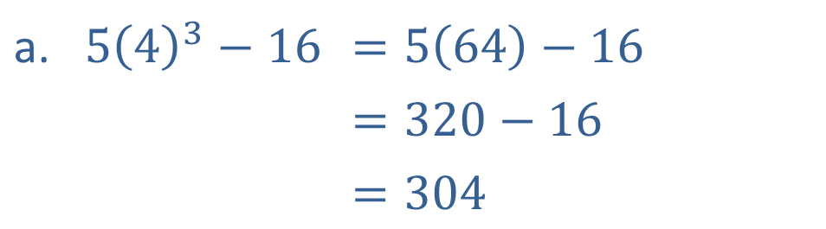
Example 2: Evaluating Algebraic Expressions (cont.)
Solution
In both cases, we simply "plug in" the given values for each variable, then simplify.
a. | $$5{\left(4\right)}^{3}−16$$ | $$=5\left(64\right)−16$$
 |  | $$=320−16$$
 |  | $$=304$$

Slide 6
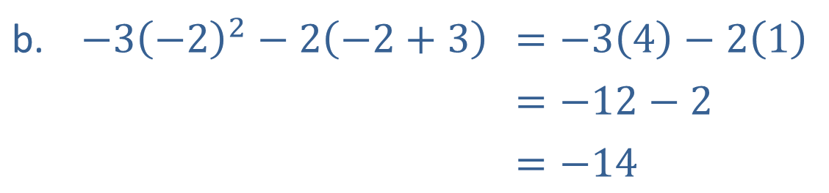
Example 2: Evaluating Algebraic Expressions (cont.)
b. | $$−3{\left(−2\right)}^{2}−2\left(−2+3\right)$$ | $$=−3\left(4\right)−2\left(1\right)$$
 |  | $$=−12−2$$
 |  | $$=−14$$

Slide 7
The Field Properties and Their Use in Algebra
Field Properties
In these properties, a, b, and c represent arbitrary real numbers. The first five properties apply to addition and multiplication, while the last combines the two.
Name of Property | Additive Version | Multiplicative Version
Closure | a + b is a real number | ab is a real number
Commutative | a + b = b + a | ab = ba

Slide 8
The Field Properties and Their Use in Algebra
Field Properties (cont.)
Name of Property | Additive Version | Multiplicative Version
Associative | a + (b + c) = (a + b) + c | a(bc) = (ab)c
Identity | a + 0 = 0 + a = a | a ⋅ 1 = 1 ⋅ a = a
Inverse | a + (−a) = 0
Distributive | a(b + c) = ab + ac

Slide 9
Example 3: Applying the Field Properties
a. 3(2 + (−8)) = 3 ⋅ (−6) = −18 and
3 ⋅ 2 + 3 ⋅ (−8) = 6 − 24 = −18. This demonstrates the distributive property: 3(2 + (−8)) = 3 ⋅ 2 + 3 ⋅ (−8).
b. 3 − 4 = 3 + (−4) = −4 + 3 = −1. While subtraction is not commutative, we can rewrite any difference as a sum (with the sign changed on the second term) and then apply the commutative property.

Slide 10
Example 3: Applying the Field Properties (cont.)
Division can be restated
as multiplication by the reciprocal of the denominator, and multiplication is commutative.
d. provided that x² + y ≠ 0. Any
nonzero expression, when multiplied by its reciprocal, yields the multiplicative identity 1. The
expression is the multiplicative inverse of
x² + y.

Slide 11
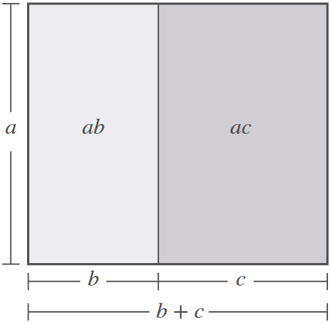

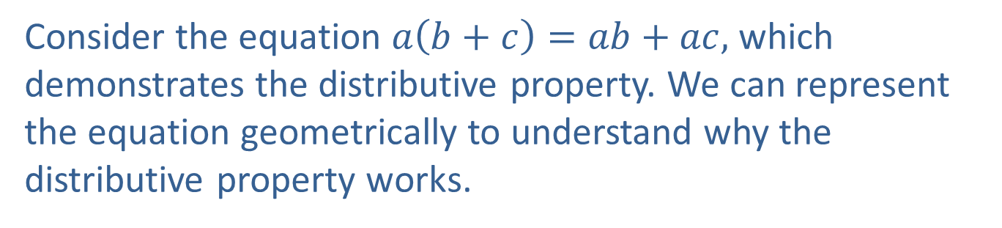
Example 4: Visualizing the Distributive Property
Consider the equation $a\left(b+c\right)=ab+ac,$ which demonstrates the distributive property. We can represent the equation geometrically to understand why the distributive property works.
Figure 1 shows that the area of
the shaded region represents
the product $a\left(b+c\right)$, and that
total area is the sum of two
smaller areas that represent
the products $ab$ and $ac$.
Figure 1

Slide 12
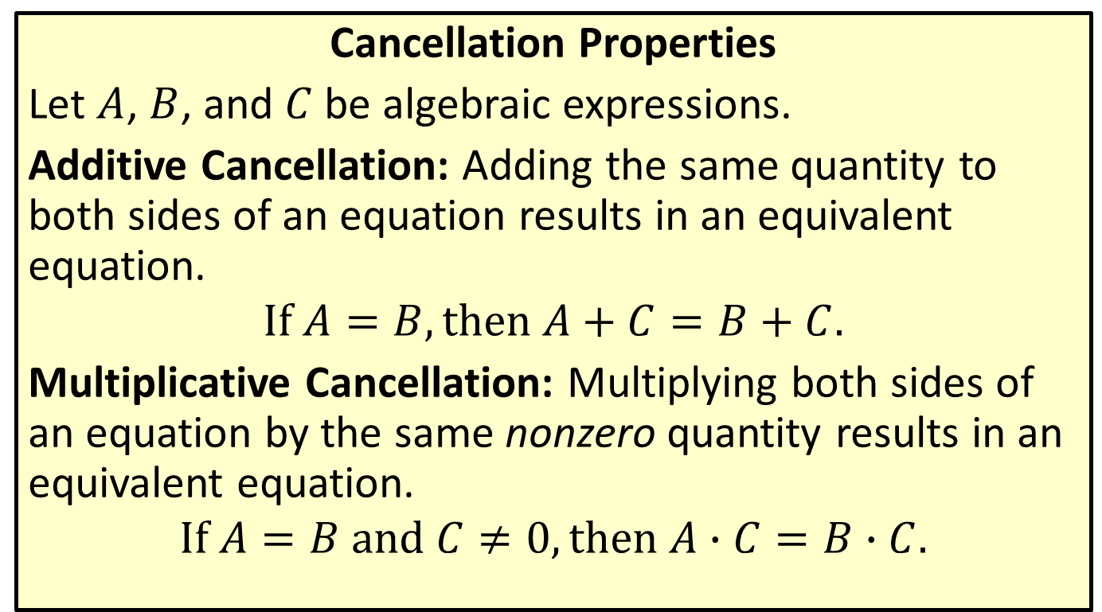
The Field Properties and Their Use in Algebra
Cancellation Properties
Let $A$, $B$, and $C$ be algebraic expressions.
Additive Cancellation: Adding the same quantity to both sides of an equation results in an equivalent equation.
$$If A=B, then A+C=B+C.$$
Multiplicative Cancellation: Multiplying both sides of an equation by the same nonzero quantity results in an equivalent equation.
$$If A=B and C≠0, then A∙C=B∙C.$$

Slide 13
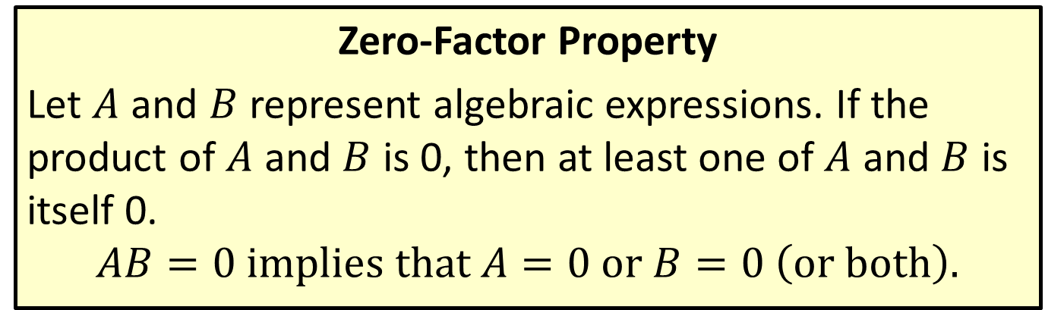
The Field Properties and Their Use in Algebra
Zero-Factor Property
Let $A$ and $B$ represent algebraic expressions. If the product of $A$ and $B$ is 0, then at least one of $A$ and $B$ is itself 0.
$$AB=0 implies that A=0 or B=0 \left(or both\right).$$

Slide 14
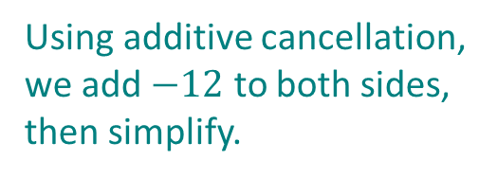

Example 5: Properties of Real Numbers
$\begin{matrix}y+12=18 \\ y+12+\left(−12\right)=18+\left(−12\right) \\ y=6\end{matrix}$
This shows that the equation $y+12=18$ is equivalent to the equation $y=6$.
Using additive cancellation, we add $−12$ to both sides, then simplify.

Slide 15
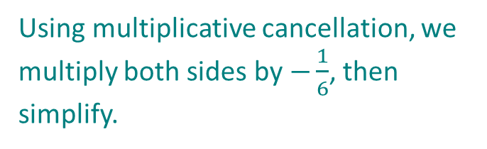
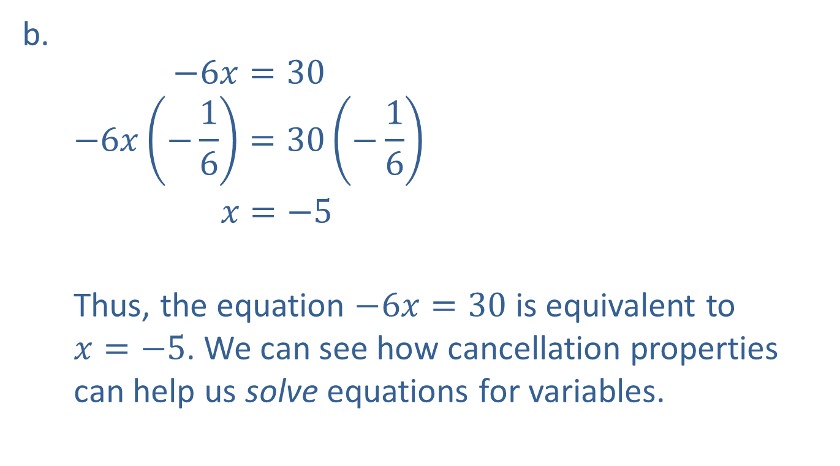
Example 5: Properties of Real Numbers (cont.)
$$\begin{matrix}−6x=30 \\ −6x\left(−\frac{1}{6}\right)=30\left(−\frac{1}{6}\right) \\ x=−5\end{matrix}$$
Thus, the equation $−6x=30$ is equivalent to
$x=−5$. We can see how cancellation properties can help us solve equations for variables.
Using multiplicative cancellation, we multiply both sides by $−\frac{1}{6}$, then simplify.

Slide 16
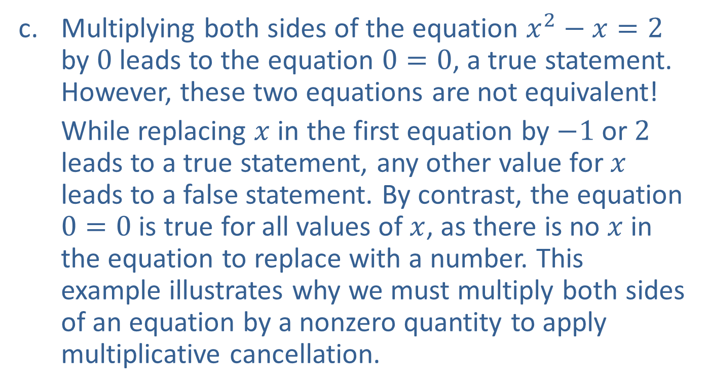
Example 5: Properties of Real Numbers (cont.)
Multiplying both sides of the equation $x^{2}−x=2$ by $0$ leads to the equation $0=0$, a true statement. However, these two equations are not equivalent!
While replacing $x$ in the first equation by $−1$ or $2$ leads to a true statement, any other value for $x$ leads to a false statement. By contrast, the equation $0=0$ is true for all values of $x$, as there is no $x$ in the equation to replace with a number. This example illustrates why we must multiply both sides of an equation by a nonzero quantity to apply multiplicative cancellation.

Slide 17
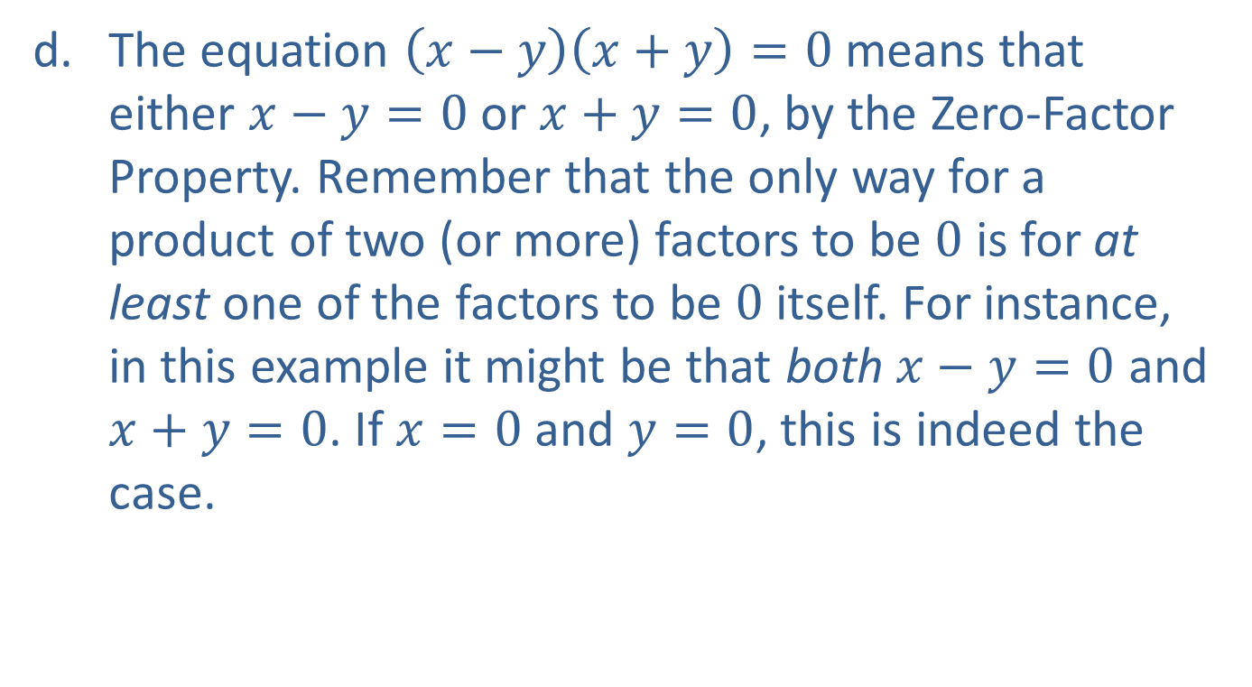
Example 5: Properties of Real Numbers (cont.)
The equation $\left(x−y\right)\left(x+y\right)=0$ means that either $x−y=0$ or $x+y=0$, by the Zero-Factor Property. Remember that the only way for a product of two (or more) factors to be $0$ is for at least one of the factors to be $0$ itself. For instance, in this example it might be that both $x−y=0$ and $x+y=0$. If $x=0$ and $y=0$, this is indeed the case.

Slide 18
Order of Mathematical Operations
Order of Operations
Step 1: If the expression is a fraction, simplify the numerator and denominator individually, according to the guidelines in the following steps.
Step 2: Parentheses, braces, and brackets are all used as grouping symbols. Simplify expressions within each set of grouping symbols, if any are present, working from the innermost outward.
Step 3: Simplify all powers (exponents) and roots.

Slide 19
Order of Mathematical Operations
Order of Operations (cont.)
Step 4: Perform all multiplications and divisions in the expression in the order they occur, working from left to right.
Step 5: Perform all additions and subtractions in the expression in the order they occur, working from left to right.

Slide 20

Example 6: Order of Operations
Simplify the following expressions using the correct order of operations.
$4−\frac{6}{2}$
$−3^{2}$
$\frac{3−\left(3\sqrt{4}−2^{2}\right)\left(\frac{6}{−2}\right)}{3+2(−2)}$

Slide 21
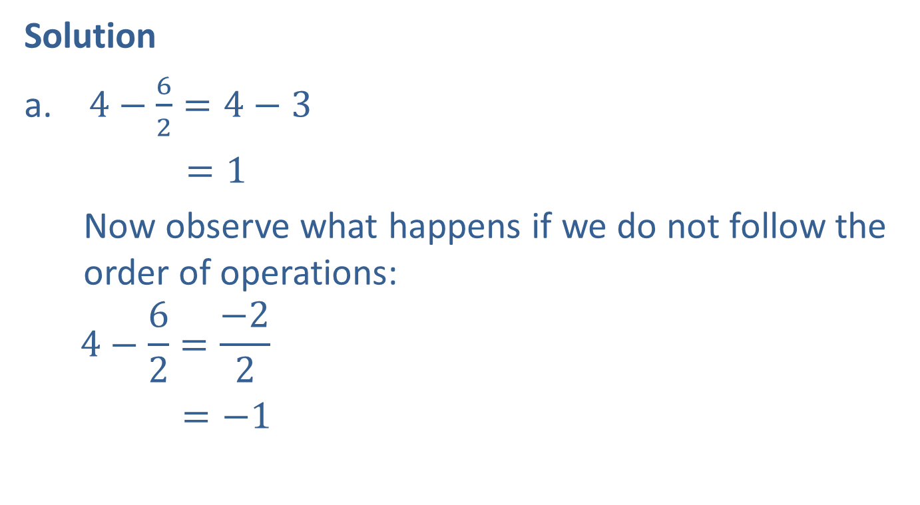
Example 6: Order of Operations (cont.)
Solution
$4−\frac{6}{2}=4−3$
$=1$
Now observe what happens if we do not follow the order of operations:
$$4−\frac{6}{2}=\frac{−2}{2}$$
$=−1$
Perform the division first.
Then subtract.
We subtract first, against order of operations. The result is now incorrect.

Slide 22


Example 6: Order of Operations (cont.)
$−3^{2} =\left(−1\right)\left(3^{2}\right)$
$$=\left(−1\right)\left(6\right) \\ =−9$$
We simplify the power before multiplying by $−1$.

Slide 23

Example 6: Order of Operations (cont.)
$$\frac{3−\left(3\sqrt{4}−2^{2}\right)\left(\frac{6}{−2}\right)}{3+2(−2)} \\ =\frac{3−(3∙2−4)(−3)}{3−4} \\ =\frac{3−(2)(−3)}{−1} \\ =\frac{3+6}{−1} \\ =−9$$
We simplify within each grouping symbol, following order of operations.
Recall that fractions also act as a grouping symbol.

Slide 24
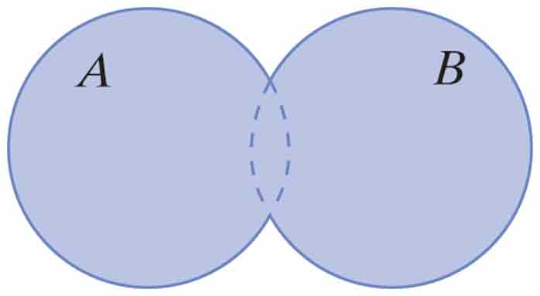
Basic Set Operations and Venn Diagrams
Union
In this definition, A and B denote two sets, and are represented in the Venn diagram by circles. The operation of union is depicted in the diagram by shading.
The union of A and B, denoted A ∪ B, is the set {x|x ∈ A or x ∈ B}. That is, an element x is in A ∪ B if it is in the set A, the set B, or both. Note that the union of A and B contains both individual sets.

Slide 25
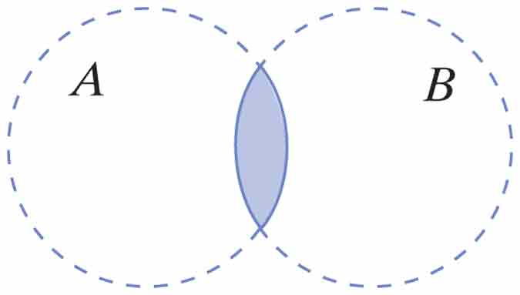
Basic Set Operations and Venn Diagrams
Intersection
In this definition, A and B denote two sets, and are represented in the Venn diagram by circles. The operation of intersection is depicted in the diagram by shading.
The intersection of A and B, denoted A ∩ B, is the set {x|x ∈ A and x ∈ B}. That is, an element x is in A ∩ B if it is in both A and B. Note that the intersection of A and B is contained in each individual set.

Slide 26
Example 7: Union and Intersection of Intervals
Simplify the following unions and intersections of intervals.

Slide 27
Example 7: Union and Intersection of Intervals (cont.)
Solutions
Since these two intervals overlap, their union is described with a single interval.
This intersection of two intervals can also be described with a single interval.
These two intervals have no elements in common, and their intersection is the empty set.
The union of these two intervals is the entire set of real numbers.
= ∅

Slide 28
Example 8: Union and Intersection
Simplify each of the following set expressions.

Slide 29
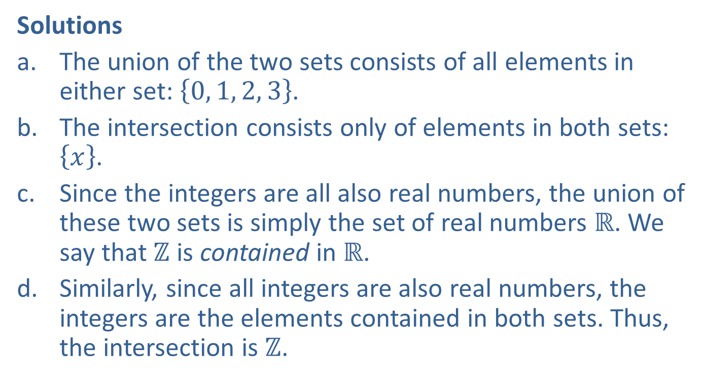
Example 8: Union and Intersection (cont.)
Solutions
The union of the two sets consists of all elements in either set: $\left\{0, 1, 2, 3\right\}$.
The intersection consists only of elements in both sets: $\left\{x\right\}$.
Since the integers are all also real numbers, the union of these two sets is simply the set of real numbers $ℝ$. We say that $ℤ$ is contained in $ℝ$.
Similarly, since all integers are also real numbers, the integers are the elements contained in both sets. Thus, the intersection is $ℤ$.

