Slide 1
Section 0.3
Integer Exponents

Slide 2
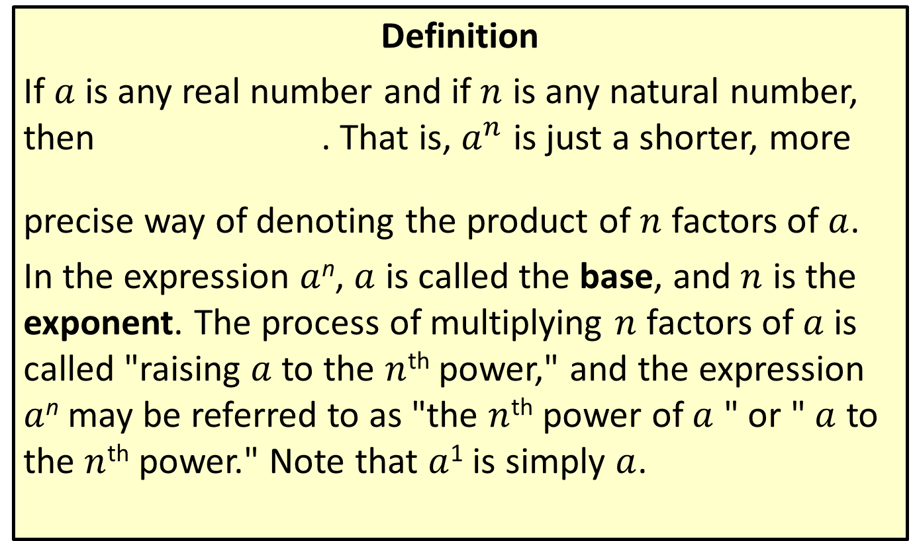
Natural Number Exponents
Definition
If $a$ is any real number and if $n$ is any natural number, then . That is, $a^{n}$ is just a shorter, more
precise way of denoting the product of $n$ factors of $a$.
In the expression $a$^{n}, $a$ is called the base, and $n$ is the exponent. The process of multiplying $n$ factors of $a$ is called "raising $a$ to the $n$^{th} power," and the expression $a$^{n} may be referred to as "the $n$^{th} power of $a$ " or " $a$ to the $n$^{th} power." Note that $a$¹ is simply $a$.

Slide 3
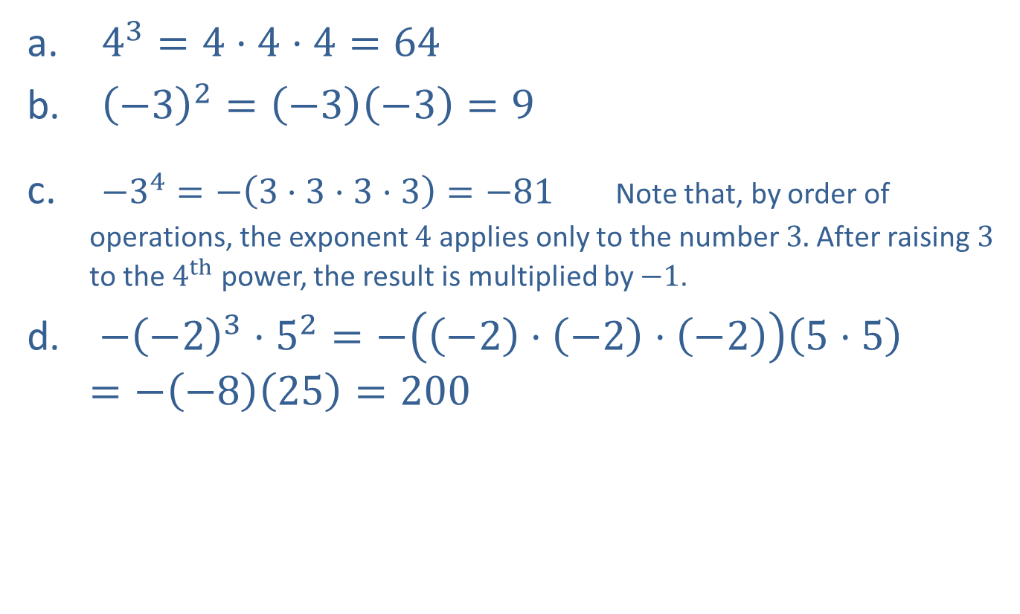
EXAMPLE 1: Natural Number Exponents
​ $4^{3}=4⋅4⋅4=64$
​ ${\left(−3\right)}^{2}=\left(−3\right)\left(−3\right)=9$
​ $−3^{4}=−\left(3⋅3⋅3⋅3\right)=−81$ Note that, by order of operations, the exponent 4 applies only to the number 3. After raising 3 to the $4^{th}$ power, the result is multiplied by $−1$.
​ $−{\left(−2\right)}^{3}⋅5^{2}=−\left(\left(−2\right)⋅\left(−2\right)⋅\left(−2\right)\right)\left(5⋅5\right)=−\left(−8\right)\left(25\right)=200$

Slide 4
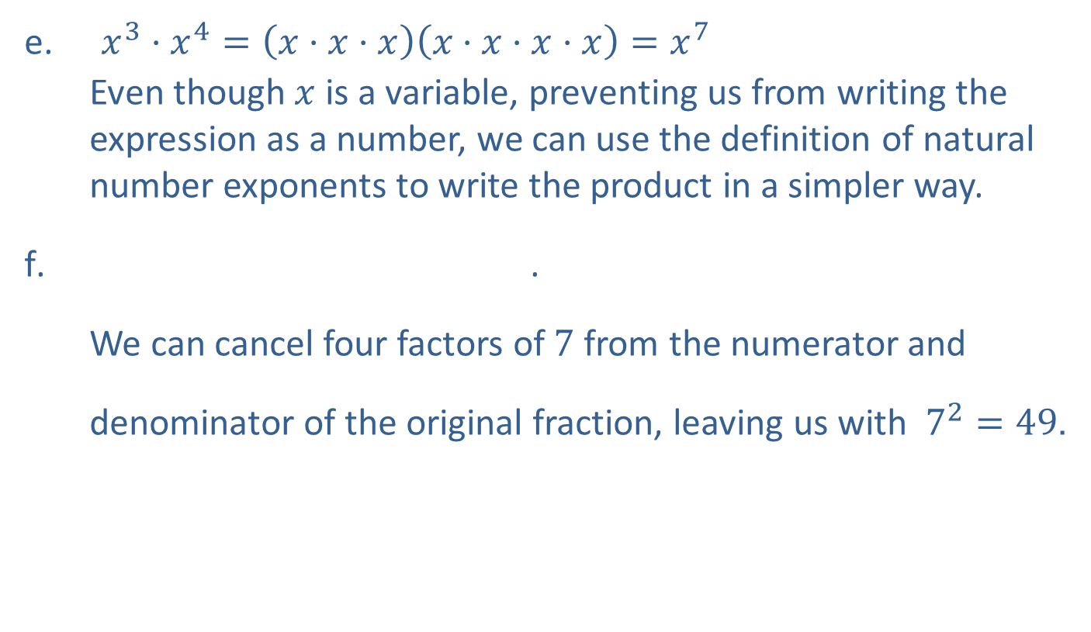
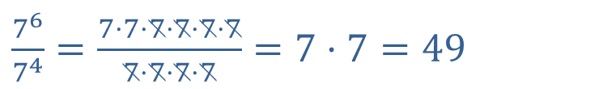
EXAMPLE 1: Natural Number Exponents (cont.)
​ $x^{3}⋅x^{4}=\left(x⋅x⋅x\right)\left(x⋅x⋅x⋅x\right)=x^{7}$
Even though $x$ is a variable, preventing us from writing the expression as a number, we can use the definition of natural number exponents to write the product in a simpler way.
.
We can cancel four factors of 7 from the numerator and denominator of the original fraction, leaving us with $7^{2}=49$.
$\frac{7^{6}}{7^{4}}=\frac{7⋅7⋅7⋅7⋅7⋅7}{7⋅7⋅7⋅7}=7⋅7=49$

Slide 5
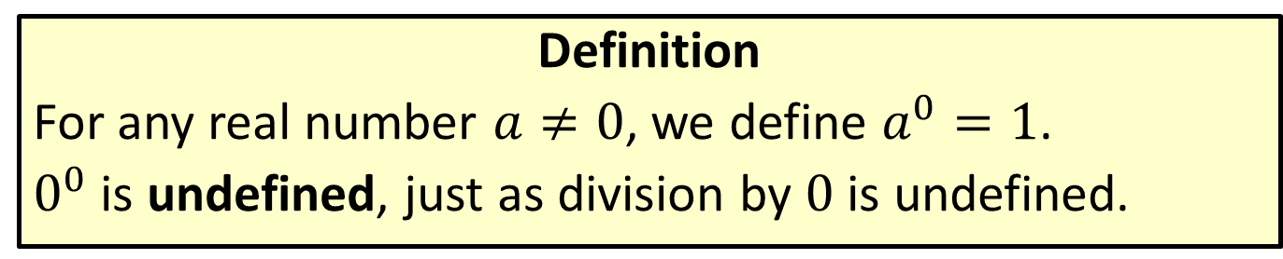
0 as an Exponent
Definition
For any real number $a≠0$, we define $a^{0}=1$.
$0^{0}$ is undefined, just as division by 0 is undefined.

Slide 6
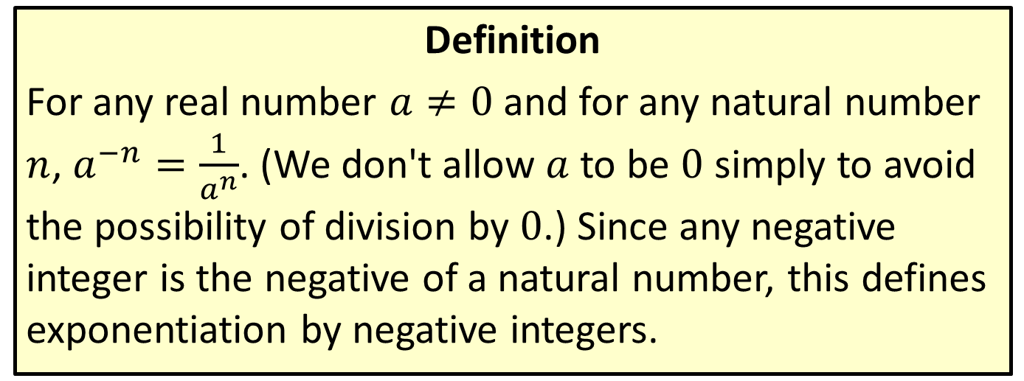
Negative Integer Exponents
Definition
For any real number $a≠0$ and for any natural number $n$, $a^{−n}=\frac{1}{a^{n}}$. (We don't allow $a$ to be 0 simply to avoid the possibility of division by 0.) Since any negative integer is the negative of a natural number, this defines exponentiation by negative integers.

Slide 7
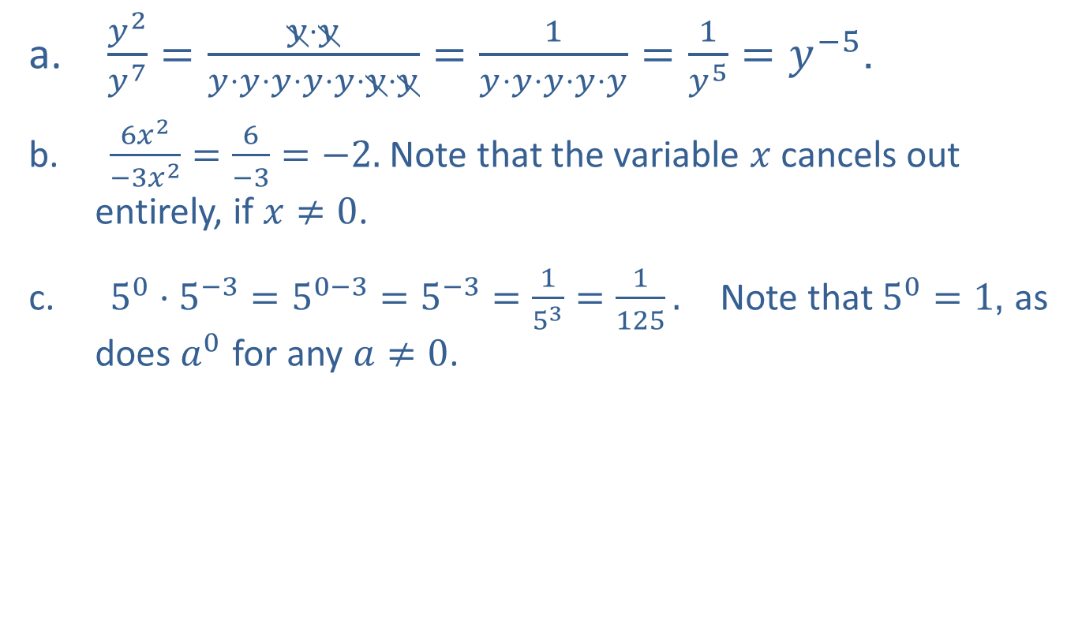
EXAMPLE 2: Simplifying Exponents
​ $\frac{y^{2}}{y^{7}}=\frac{y⋅y}{y⋅y⋅y⋅y⋅y⋅y⋅y}=\frac{1}{y⋅y⋅y⋅y⋅y}=\frac{1}{y^{5}}=y^{−5}$.
​ $\frac{6x^{2}}{−3x^{2}}=\frac{6}{−3}=−2.$ Note that the variable $x$ cancels out entirely, if $x≠0$.
​ $5^{0}⋅5^{−3}=5^{0−3}=5^{−3}=\frac{1}{5^{3}}=\frac{1}{125}.$ Note that $5^{0}=1$, as does $a^{0}$ for any $a≠0$.

Slide 8

EXAMPLE 2: Simplifying Exponents (cont.)
​ $\frac{1}{t^{−3}}=\frac{1}{\frac{1}{t^{3}}}=1⋅\frac{t^{3}}{1}=t^{3}$.
​ ${\left(x^{2}y\right)}^{3}=\left(x^{2}y\right)\left(x^{2}y\right)\left(x^{2}y\right)=x^{2}⋅x^{2}⋅x^{2}⋅y⋅y⋅y=x^{6}y^{3}$.

Slide 9
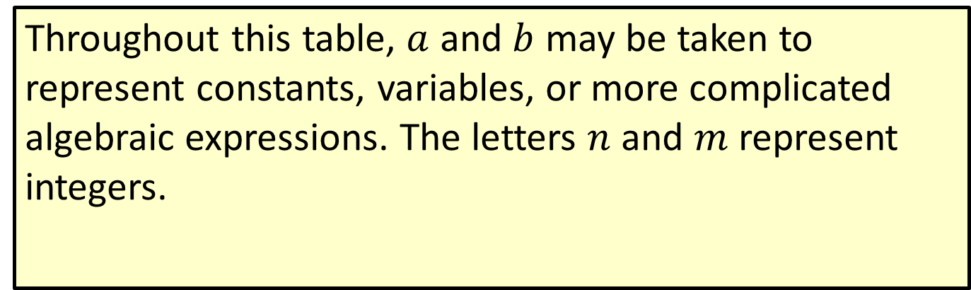
Properties of Exponents
Throughout this table, $a$ and $b$ may be taken to represent constants, variables, or more complicated algebraic expressions. The letters $n$ and $m$ represent integers.

Slide 10
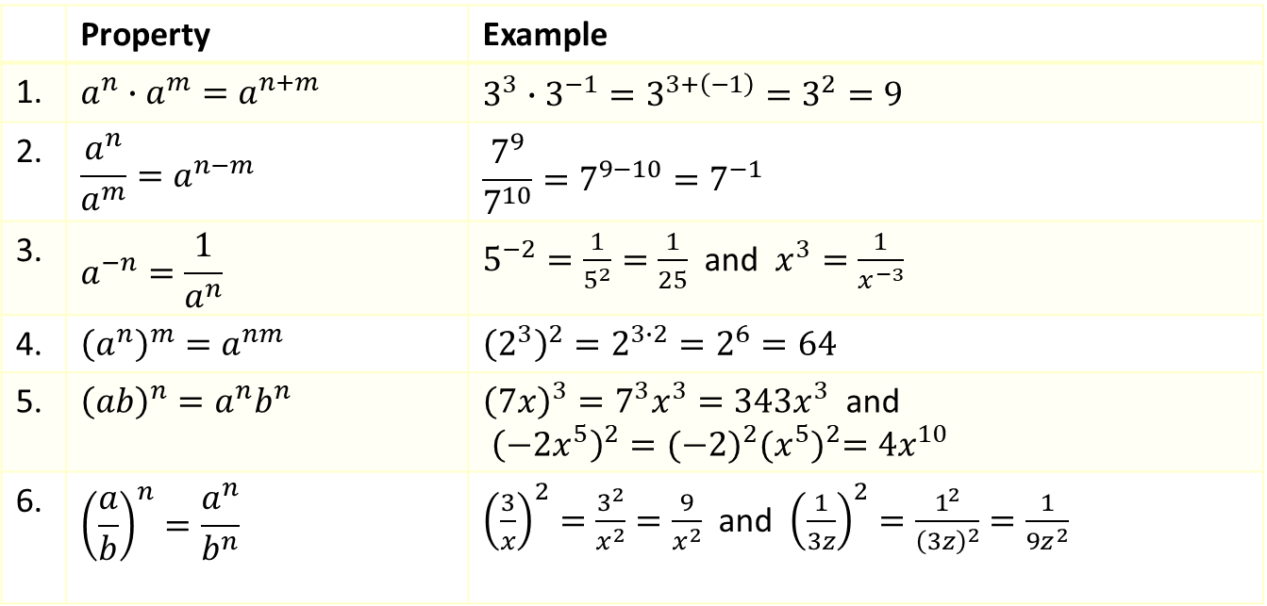
Properties of Exponents (cont.)
 | Property | Example
1. | $$a^{n}∙a^{m}=a^{n+m}$$ | $$3^{3}∙3^{−1}=3^{3+\left(−1\right)}=3^{2}=9$$
2. | $$\frac{a^{n}}{a^{m}}=a^{n−m}$$ | $$\frac{7^{9}}{7^{10}}=7^{9−10}=7^{−1}$$
3. | $$a^{−n}=\frac{1}{a^{n}}$$ | $5^{−2}=\frac{1}{5^{2}}=\frac{1}{25}$ and $x^{3}=\frac{1}{x^{−3}}$
4. | $${\left(a^{n}\right)}^{m}=a^{nm}$$ | $${\left(2^{3}\right)}^{2}=2^{3∙2}=2^{6}=64$$
5. | $${\left(ab\right)}^{n}=a^{n}b^{n}$$ | ${\left(7x\right)}^{3}=7^{3}x^{3}=343x^{3}$ and ${\left(−2x^{5}\right)}^{2}={(−2)}^{2}{(x^{5})}^{2}=4x^{10}$
6. | $${\left(\frac{a}{b}\right)}^{n}=\frac{a^{n}}{b^{n}}$$ | ${\left(\frac{3}{x}\right)}^{2}=\frac{3^{2}}{x^{2}}=\frac{9}{x^{2}}$ and ${\left(\frac{1}{3z}\right)}^{2}=\frac{1^{2}}{{\left(3z\right)}^{2}}=\frac{1}{9z^{2}}$

Slide 11
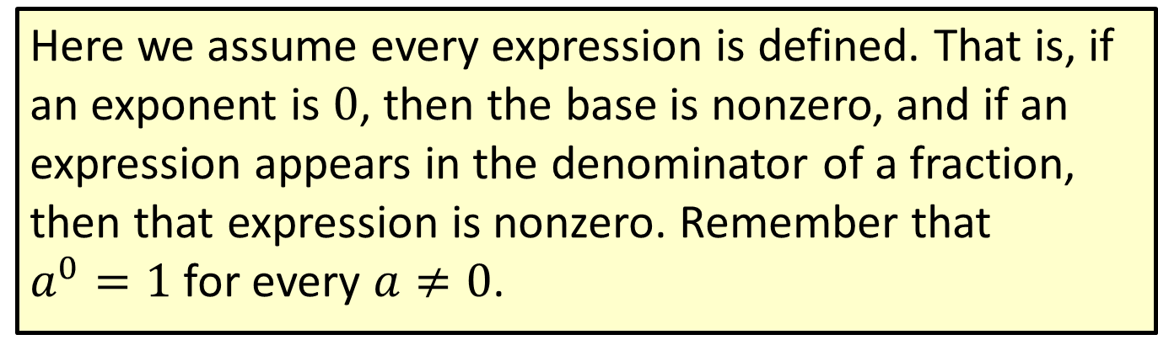
Properties of Exponents (cont.)
Here we assume every expression is defined. That is, if an exponent is 0, then the base is nonzero, and if an expression appears in the denominator of a fraction, then that expression is nonzero. Remember that
$a^{0}=1$ for every $a≠0$.

Slide 12
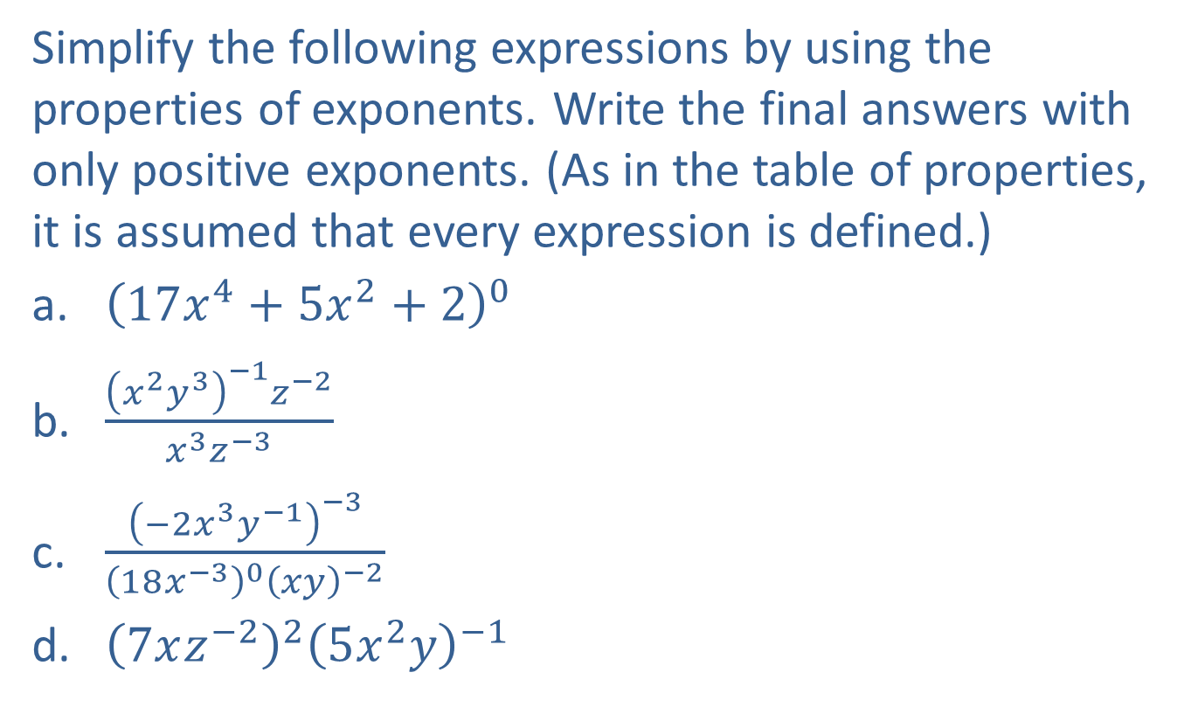
EXAMPLE 3: Properties of Exponents
Simplify the following expressions by using the properties of exponents. Write the final answers with only positive exponents. (As in the table of properties, it is assumed that every expression is defined.)
​${\left(17x^{4}+5x^{2}+2\right)}^{0}$
​$\frac{{\left(x^{2}y^{3}\right)}^{−1}z^{−2}}{x^{3}z^{−3}}$
​$\frac{{\left(−2x^{3}y^{−1}\right)}^{−3}}{{\left(18x^{−3}\right)}^{0}{\left(xy\right)}^{−2}}$
​${\left(7xz^{−2}\right)}^{2}{\left(5x^{2}y\right)}^{−1}$

Slide 13
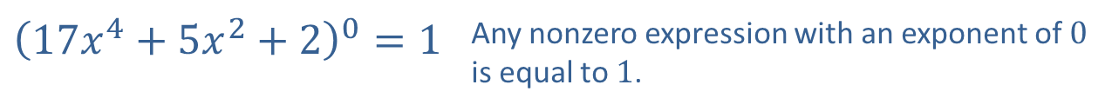
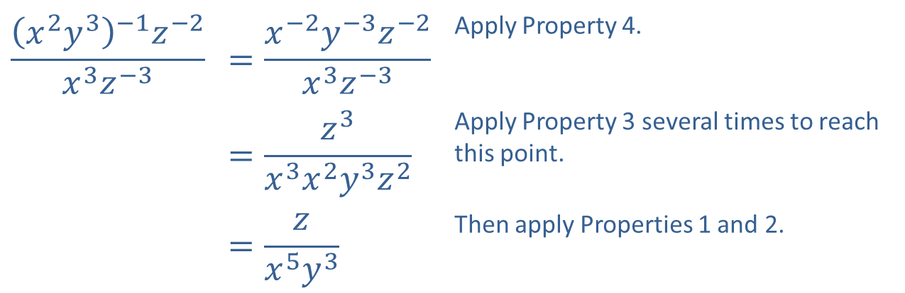
EXAMPLE 3: Properties of Exponents (cont.)
Solution
​
$${\left(17x^{4}+5x^{2}+2\right)}^{0}=1$$ | Any nonzero expression with an exponent of 0 is equal to 1.
$$\frac{{\left(x^{2}y^{3}\right)}^{−1}z^{−2}}{x^{3}z^{−3}}$$ | $$=\frac{x^{−2}y^{−3}z^{−2}}{x^{3}z^{−3}}$$ | Apply Property 4.
 | $$=\frac{z^{3}}{x^{3}x^{2}y^{3}z^{2}}$$ | Apply Property 3 several times to reach this point.
 | $$=\frac{z}{x^{5}y^{3}}$$ | Then apply Properties 1 and 2.

Slide 14
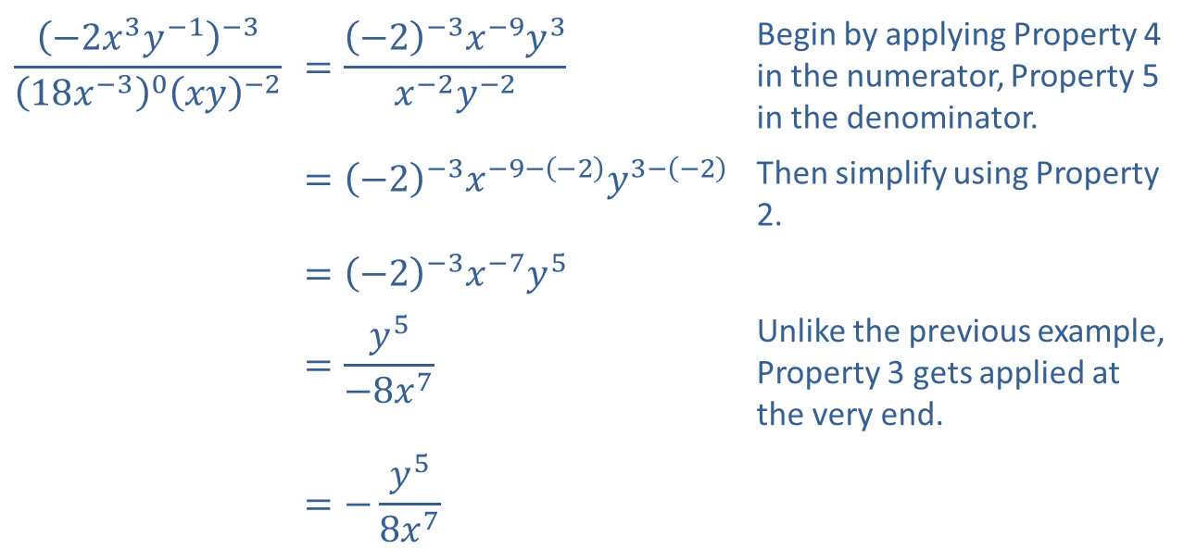
EXAMPLE 3: Properties of Exponents (cont.)
​
$$\frac{{\left(−2x^{3}y^{−1}\right)}^{−3}}{{\left(18x^{−3}\right)}^{0}{\left(xy\right)}^{−2}}$$ | $$=\frac{{\left(−2\right)}^{−3}x^{−9}y^{3}}{x^{−2}y^{−2}}$$ | Begin by applying Property 4 in the numerator, Property 5 in the denominator.
 | $$={\left(−2\right)}^{−3}x^{−9−\left(−2\right)}y^{3−\left(−2\right)}$$ | Then simplify using Property 2.
 | $$={\left(−2\right)}^{−3}x^{−7}y^{5}$$
 | $$=\frac{y^{5}}{{−8x}^{7}}$$ | Unlike the previous example, Property 3 gets applied at the very end.
 | $$=−\frac{y^{5}}{{8x}^{7}}$$

Slide 15
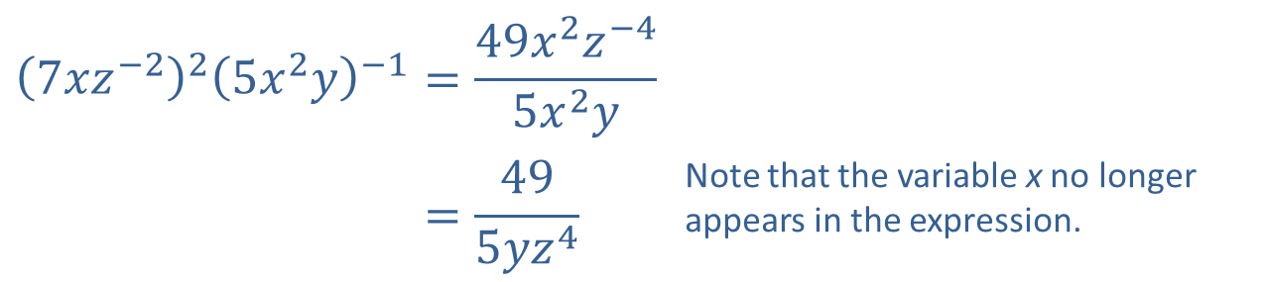
EXAMPLE 3: Properties of Exponents (cont.)
​
$${\left(7xz^{−2}\right)}^{2}{\left(5x^{2}y\right)}^{−1}$$ | $$=\frac{49x^{2}z^{−4}}{5x^{2}y}$$
 | $$=\frac{49}{5yz^{4}}$$ | Note that the variable x no longer appears in the expression.

Slide 16
Note:
There are often many ways to simplify an expression; the order in which you apply the properties of exponents will not change the result.

Slide 17
CAUTION!
Many errors can be made in applying the properties of exponents as a result of forgetting the exact form of the properties. The first column contains examples of some common errors. The second column contains the corrected statements.

Slide 18
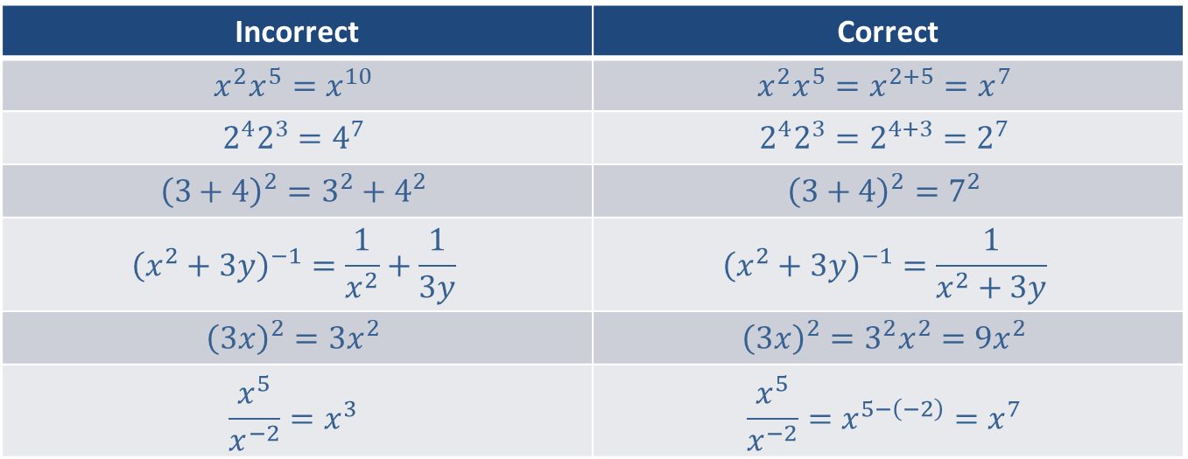
CAUTION! (cont.)
Incorrect | Correct
$$x^{2}x^{5}=x^{10}$$ | $$x^{2}x^{5}=x^{2+5}=x^{7}$$
$$2^{4}2^{3}=4^{7}$$ | $$2^{4}2^{3}=2^{4+3}=2^{7}$$
$${\left(3+4\right)}^{2}=3^{2}+4^{2}$$ | $${\left(3+4\right)}^{2}=7^{2}$$
$${\left(x^{2}+3y\right)}^{−1}=\frac{1}{x^{2}}+\frac{1}{3y}$$ | $${\left(x^{2}+3y\right)}^{−1}=\frac{1}{x^{2}+3y}$$
$${\left(3x\right)}^{2}=3x^{2}$$ | $${\left(3x\right)}^{2}=3^{2}x^{2}=9x^{2}$$
$$\frac{x^{5}}{x^{−2}}=x^{3}$$ | $$\frac{x^{5}}{x^{−2}}=x^{5−\left(−2\right)}=x^{7}$$

