Slide 1
Section 0.4
Radicals

Slide 2
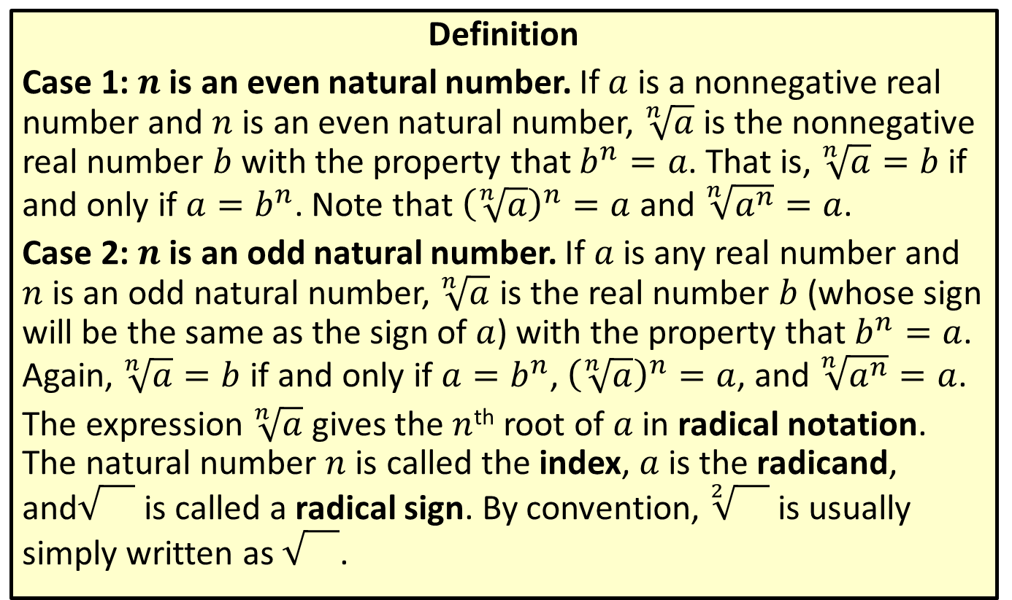
Radical Notation
Definition
Case 1: $n$ is an even natural number. If $a$ is a nonnegative real number and $n$ is an even natural number, $\sqrt[n]{a}$ is the nonnegative real number $b$ with the property that $b^{n}=a$. That is, $\sqrt[n]{a}=b$ if and only if $a=b^{n}$. Note that ${\left(\sqrt[n]{a}\right)}^{n}=a$ and $\sqrt[n]{a^{n}}=a$.
Case 2: $n$ is an odd natural number. If $a$ is any real number and $n$ is an odd natural number, $\sqrt[n]{a}$ is the real number $b$ (whose sign will be the same as the sign of $a$) with the property that $b^{n}=a$. Again, $\sqrt[n]{a}=b$ if and only if $a=b^{n}$, ${\left(\sqrt[n]{a}\right)}^{n}=a$, and $\sqrt[n]{a^{n}}=a$.
The expression $\sqrt[n]{a}$ gives the $n$^{th} root of $a$ in radical notation. The natural number $n$ is called the index, $a$ is the radicand, and is called a radical sign. By convention, $\sqrt[2]{}$ is usually simply written as .

Slide 3
Perfect Powers
Definition
A perfect square is an integer equal to the square of another integer. The square root of a perfect square is always an integer.
A perfect cube is an integer equal to the cube of another integer. The cube root of a perfect cube is always an integer.

Slide 4
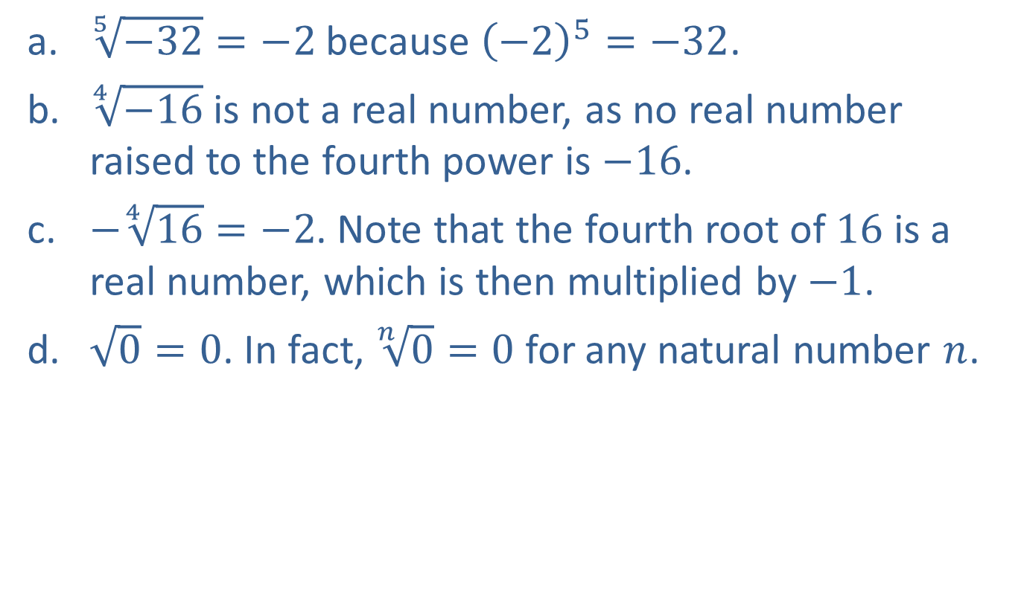
EXAMPLE 1: Radical Notation
​$\sqrt[5]{−32}=−2$ because ${\left(−2\right)}^{5}=−32$.
​$\sqrt[4]{−16}$ is not a real number, as no real number raised to the fourth power is $−16$.
​$−\sqrt[4]{16}=−2$. Note that the fourth root of 16 is a real number, which is then multiplied by $−1$.
​$\sqrt{0}=0$. In fact, $\sqrt[n]{0}=0$ for any natural number $n$.

Slide 5
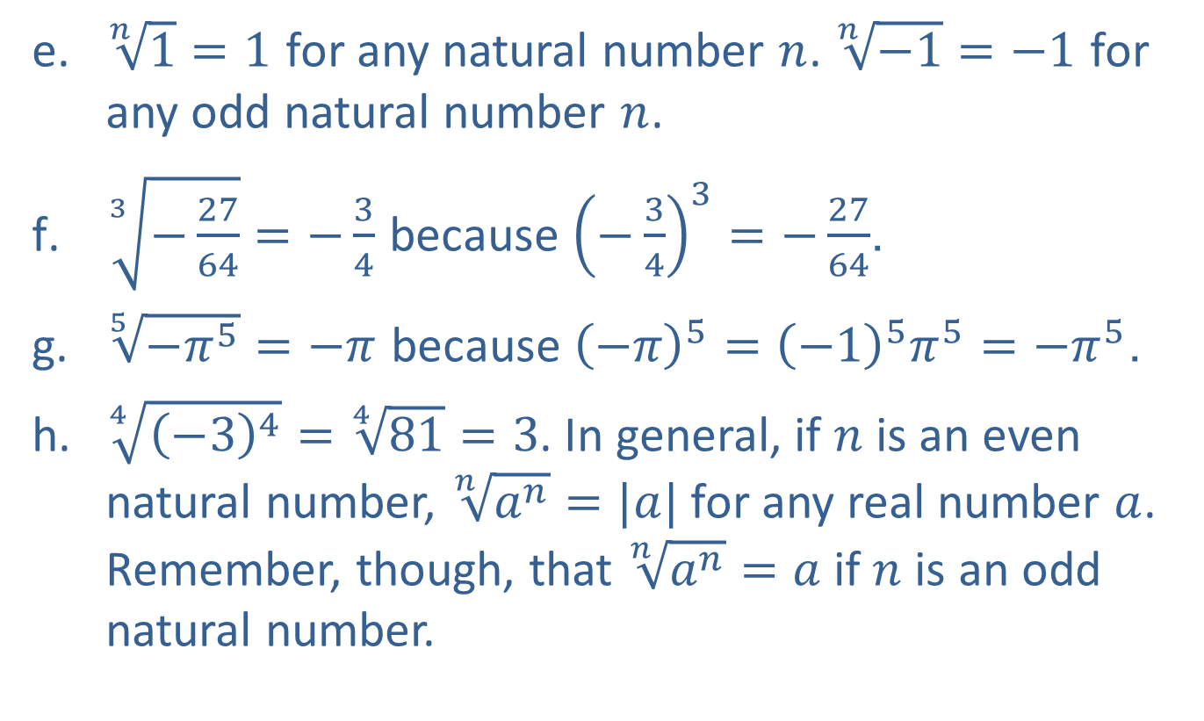
EXAMPLE 1: Radical Notation (cont.)
​$\sqrt[n]{1}=1$ for any natural number $n$. $\sqrt[n]{−1}=−1$ for any odd natural number $n$.
​$\sqrt[3]{−\frac{27}{64}}=−\frac{3}{4}$ because ${\left(−\frac{3}{4}\right)}^{3}=−\frac{27}{64}$.
​$\sqrt[5]{−π^{5}}=−π$ because ${\left(−π\right)}^{5}={\left(−1\right)}^{5}π^{5}=−π^{5}$.
​$\sqrt[4]{{\left(−3\right)}^{4}}=\sqrt[4]{81}=3$. In general, if $n$ is an even natural number, $\sqrt[n]{a^{n}}=|a|$ for any real number $a$. Remember, though, that $\sqrt[n]{a^{n}}=a$ if $n$ is an odd natural number.

Slide 6
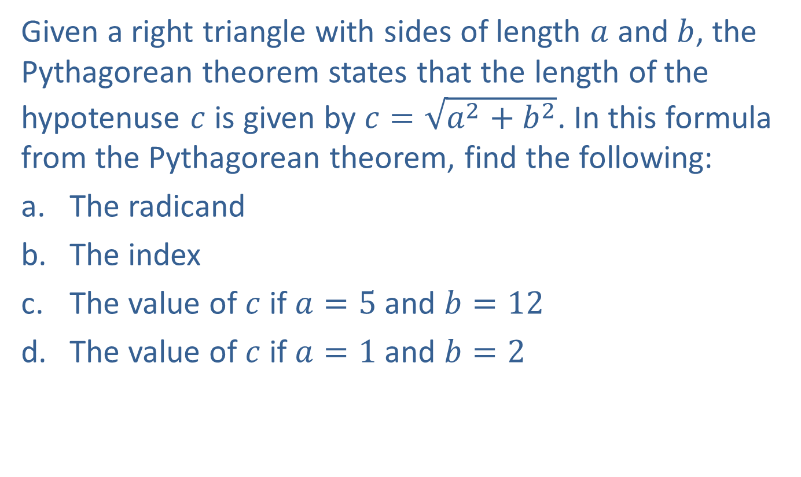
EXAMPLE 2: The Pythagorean Theorem
Given a right triangle with sides of length $a$ and $b$, the Pythagorean theorem states that the length of the hypotenuse $c$ is given by $c=\sqrt{a^{2}+b^{2}}$. In this formula from the Pythagorean theorem, find the following:
​The radicand
​The index
​The value of $c$ if $a=5$ and $b=12$
​The value of $c$ if $a=1$ and $b=2$

Slide 7

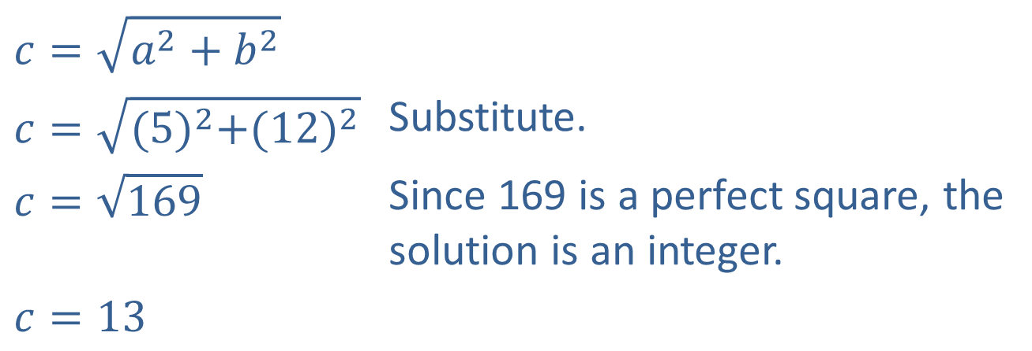
EXAMPLE 2: The Pythagorean Theorem (cont.)
Solution
​The radicand is the quantity beneath the radical sign, $a^{2}+b^{2}$.
​Because no index is indicated, the index is 2.
​
$$c=\sqrt{a^{2}+b^{2}}$$
$$c=\sqrt{{(5)}^{2}+({12)}^{2}}$$ | Substitute.
$$c=\sqrt{169}$$ | Since 169 is a perfect square, the solution is an integer.
$$c=13$$

Slide 8
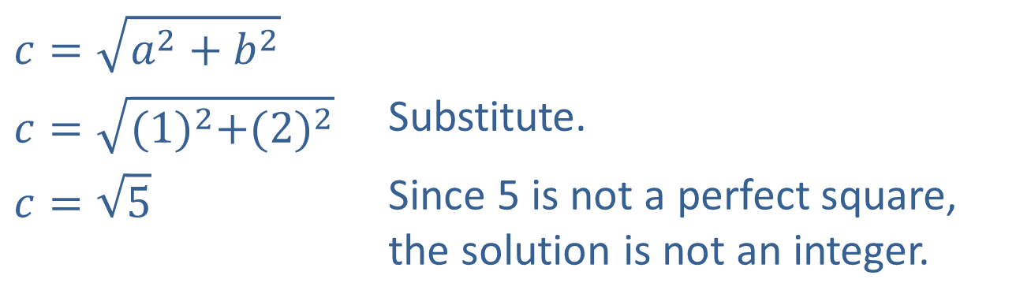
EXAMPLE 2: The Pythagorean Theorem (cont.)
$$c=\sqrt{a^{2}+b^{2}}$$
$$c=\sqrt{{(1)}^{2}+({2)}^{2}}$$ | Substitute.
$$c=\sqrt{5}$$ | Since 5 is not a perfect square, the solution is not an integer.
​

Slide 9
Simplified Form of Radical Expressions
A radical expression is in simplified form when the following conditions are met:
​The radicand contains no factor with an exponent greater than or equal to the index of the radical.
​The radicand contains no fractions.
​The denominator, if there is one, contains no radical.
​The greatest common factor of the index and any exponent occurring in the radicand is 1. That is, the index and any exponent in the radicand have no common factor other than 1.

Slide 10
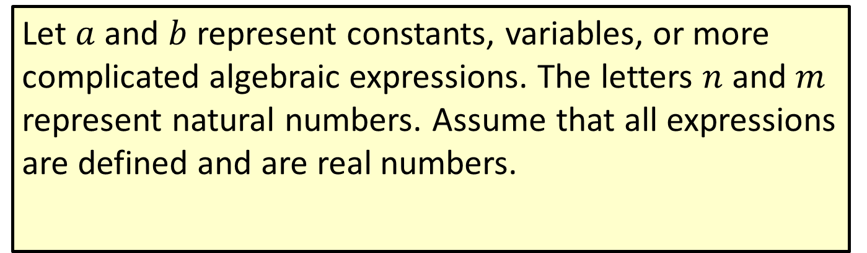
Properties of Radicals
Let $a$ and $b$ represent constants, variables, or more complicated algebraic expressions. The letters $n$ and $m$ represent natural numbers. Assume that all expressions are defined and are real numbers.

Slide 11
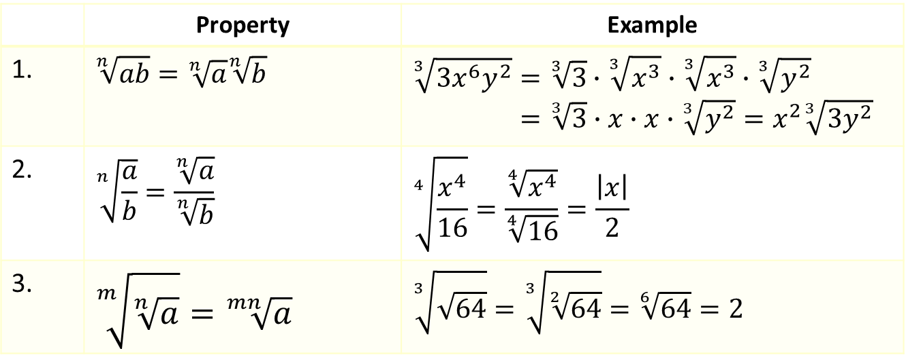
Properties of Radicals (cont.)
 | Property | Example
1. | $$\sqrt[n]{ab}=\sqrt[n]{a}\sqrt[n]{b}$$ | $$\sqrt[3]{3x^{6}y^{2}}=\sqrt[3]{3}∙\sqrt[3]{x^{3}}∙\sqrt[3]{x^{3}}∙\sqrt[3]{y^{2}}$$ $=\sqrt[3]{3}∙x∙x∙\sqrt[3]{y^{2}}=x^{2}\sqrt[3]{3y^{2}}$
2. | $$\sqrt[n]{\frac{a}{b}}=\frac{\sqrt[n]{a}}{\sqrt[n]{b}}$$ | $$\sqrt[4]{\frac{x^{4}}{16}}=\frac{\sqrt[4]{x^{4}}}{\sqrt[4]{16}}=\frac{\left|x\right|}{2}$$
3. | $$\sqrt[m]{\sqrt[n]{a}}=\sqrt[mn]{a}$$ | $$\sqrt[3]{\sqrt{64}}=\sqrt[3]{\sqrt[2]{64}}=\sqrt[6]{64}=2$$

Slide 12

EXAMPLE 3: Simplifying Radical Expressions
Simplify the following radical expressions:
​$\sqrt[3]{−16x^{8}y^{4}}$
​$\sqrt{8z^{6}}$
​$\sqrt[3]{\frac{72x^{2}}{y^{3}}}$

Slide 13
Note:
Begin by factoring the radicand, looking for perfect powers that match the index. This makes it easier to recognize what terms can be "pulled out" of the radical.

Slide 14
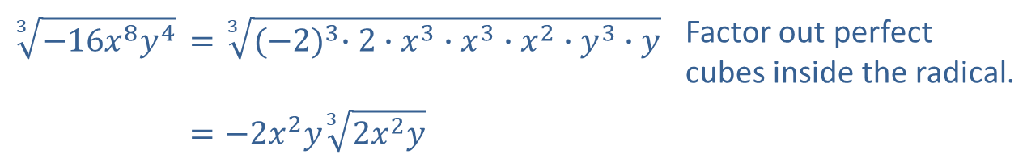
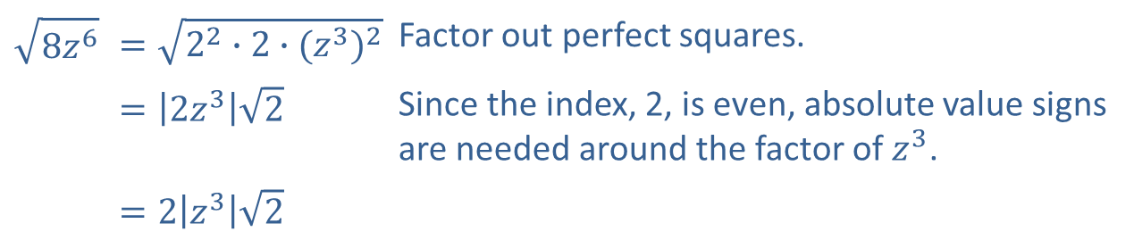
EXAMPLE 3: Simplifying Radical Expressions (cont.)
Solution
​
$$\sqrt[3]{−16x^{8}y^{4}}$$ | $$=\sqrt[3]{{(−2)}^{3}∙2∙x^{3}∙x^{3}∙x^{2}∙y^{3}∙y}$$ | Factor out perfect cubes inside the radical.
 | $$=−2x^{2}y\sqrt[3]{{2x}^{2}y}$$
$$\sqrt{8z^{6}}$$ | $$=\sqrt{2^{2}∙2∙{(z^{3})}^{2}}$$ | Factor out perfect squares.
 | $$=\left|2z^{3}\right|\sqrt{2}$$ | Since the index, 2, is even, absolute value signs are needed around the factor of $z^{3}$.
 | $$=2\left|z^{3}\right|\sqrt{2}$$

Slide 15
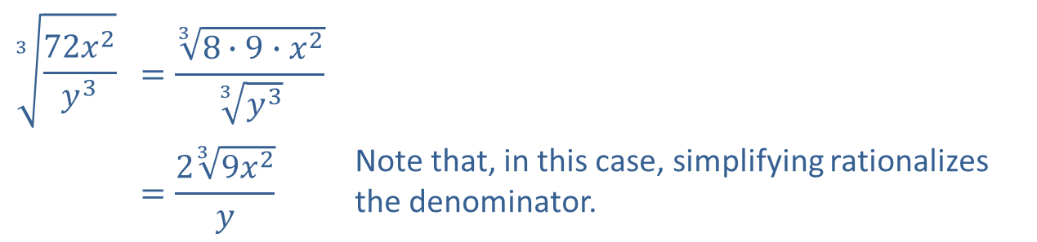
EXAMPLE 3: Simplifying Radical Expressions (cont.)
Solution
$$\sqrt[3]{\frac{72x^{2}}{y^{3}}}$$ | $$=\frac{\sqrt[3]{8∙9∙x^{2}}}{\sqrt[3]{y^{3}}}$$
 | $$=\frac{2\sqrt[3]{9x^{2}}}{y}$$ | Note that, in this case, simplifying rationalizes the denominator.

Slide 16
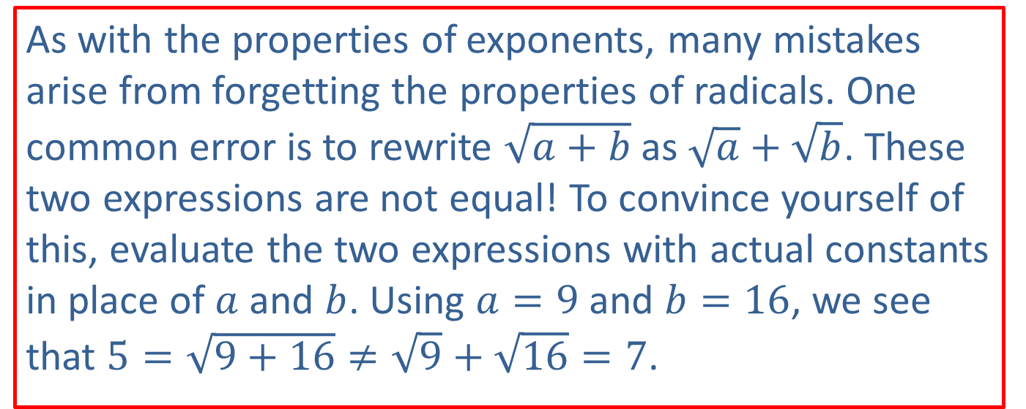
CAUTION!
As with the properties of exponents, many mistakes arise from forgetting the properties of radicals. One common error is to rewrite $\sqrt{a+b}$ as $\sqrt{a}+\sqrt{b}$. These two expressions are not equal! To convince yourself of this, evaluate the two expressions with actual constants in place of $a$ and $b$. Using $a=9$ and $b=16$, we see that $5=\sqrt{9+16}≠\sqrt{9}+\sqrt{16}=7$.

Slide 17

EXAMPLE 4: Rationalizing the Denominator
Simplify the following radical expressions:
​$\frac{1}{\sqrt{x}}$
​$\sqrt[5]{\frac{−4x^{6}}{8y^{2}}}$
​$\frac{4}{\sqrt{7}+\sqrt{3}}$
​$\frac{−\sqrt{5x}}{5−\sqrt{x}}$

Slide 18
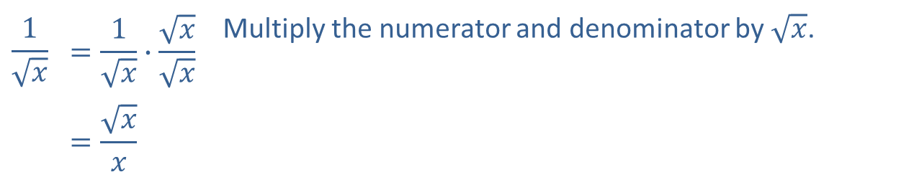
EXAMPLE 4: Rationalizing the Denominator (cont.)
Solution
​
$$\frac{1}{\sqrt{x}}$$ | $$=\frac{1}{\sqrt{x}}∙\frac{\sqrt{x}}{\sqrt{x}}$$ | Multiply the numerator and denominator by $\sqrt{x}$.
 | $$=\frac{\sqrt{x}}{x}$$

Slide 19
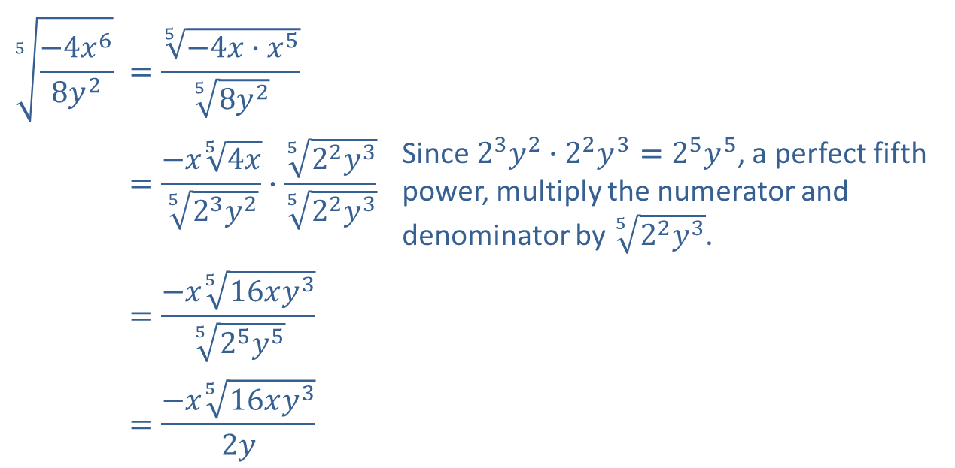
EXAMPLE 4: Rationalizing the Denominator (cont.)
$$\sqrt[5]{\frac{−4x^{6}}{8y^{2}}}$$ | $$=\frac{\sqrt[5]{−4x∙x^{5}}}{\sqrt[5]{8y^{2}}}$$
 | $$=\frac{−x\sqrt[5]{4x}}{\sqrt[5]{2^{3}y^{2}}}∙\frac{\sqrt[5]{2^{2}y^{3}}}{\sqrt[5]{2^{2}y^{3}}}$$ | Since $2^{3}y^{2}∙2^{2}y^{3}=2^{5}y^{5}$, a perfect fifth power, multiply the numerator and denominator by $\sqrt[5]{2^{2}y^{3}}$.
 | $$=\frac{−x\sqrt[5]{16xy^{3}}}{\sqrt[5]{2^{5}y^{5}}}$$
 | $$=\frac{−x\sqrt[5]{16xy^{3}}}{2y}$$
​

Slide 20
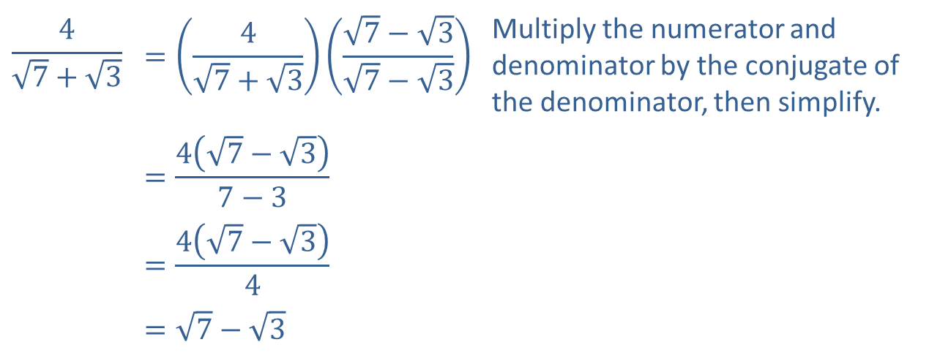
EXAMPLE 4: Rationalizing the Denominator (cont.)
$$\frac{4}{\sqrt{7}+\sqrt{3}}$$ | $$=\left(\frac{4}{\sqrt{7}+\sqrt{3}}\right)\left(\frac{\sqrt{7}−\sqrt{3}}{\sqrt{7}−\sqrt{3}}\right)$$ | Multiply the numerator and denominator by the conjugate of the denominator, then simplify.
 | $$=\frac{4\left(\sqrt{7}−\sqrt{3}\right)}{7−3}$$
 | $$=\frac{4\left(\sqrt{7}−\sqrt{3}\right)}{4}$$
 | $$=\sqrt{7}−\sqrt{3}$$
​

Slide 21
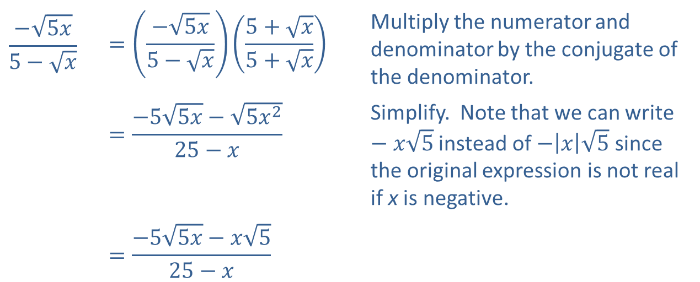
EXAMPLE 4: Rationalizing the Denominator (cont.)
$$\frac{−\sqrt{5x}}{5−\sqrt{x}}$$ | $$=\left(\frac{−\sqrt{5x}}{5−\sqrt{x}}\right)\left(\frac{5+\sqrt{x}}{5+\sqrt{x}}\right)$$ | Multiply the numerator and denominator by the conjugate of the denominator.
 | $$=\frac{−5\sqrt{5x}−\sqrt{5x^{2}}}{25−x}$$ | Simplify. Note that we can write $−x\sqrt{5}$ instead of $−\left|x\right|\sqrt{5}$ since the original expression is not real if x is negative.
 | $$=\frac{−5\sqrt{5x}−x\sqrt{5}}{25−x}$$
​

Slide 22

EXAMPLE 5: Rationalizing the Numerator
Rationalize the numerator of the fraction $\frac{\sqrt{4x}−\sqrt{6y}}{2x−3y}$.

Slide 23
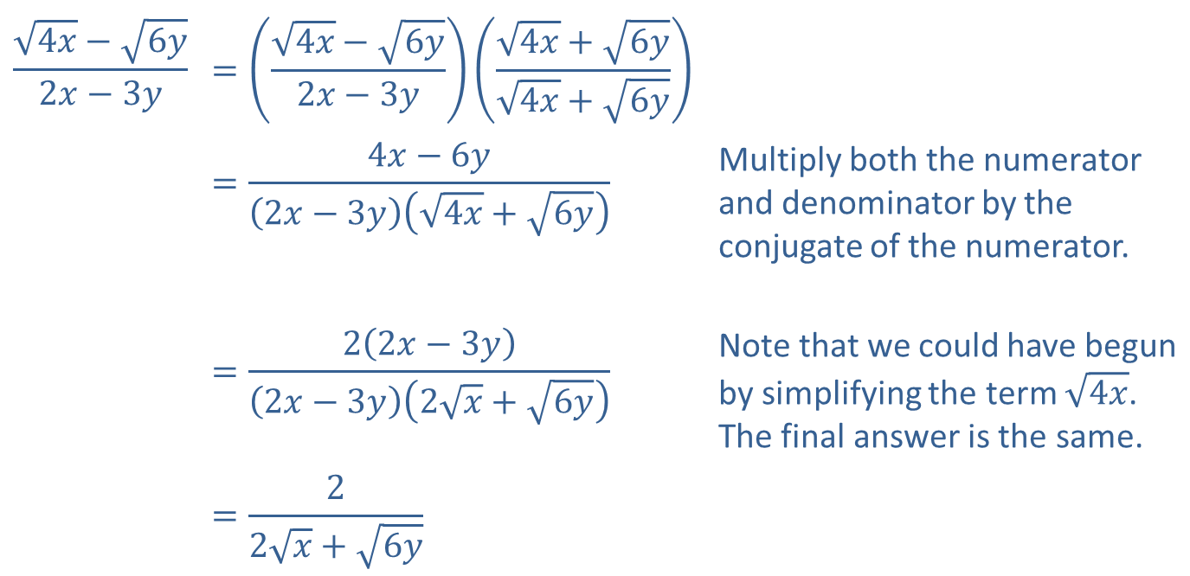
EXAMPLE 5: Rationalizing the Numerator (cont.)
Solution
$$\frac{\sqrt{4x}−\sqrt{6y}}{2x−3y}$$ | $$=\left(\frac{\sqrt{4x}−\sqrt{6y}}{2x−3y}\right)\left(\frac{\sqrt{4x}+\sqrt{6y}}{\sqrt{4x}+\sqrt{6y}}\right)$$
 | $$=\frac{4x−6y}{\left(2x−3y\right)\left(\sqrt{4x}+\sqrt{6y}\right)}$$ | Multiply both the numerator and denominator by the conjugate of the numerator.
 | $$=\frac{2\left(2x−3y\right)}{\left(2x−3y\right)\left(2\sqrt{x}+\sqrt{6y}\right)}$$ | Note that we could have begun by simplifying the term $\sqrt{4x}$. The final answer is the same.
 | $$=\frac{2}{2\sqrt{x}+\sqrt{6y}}$$

