Slide 1
Section 0.5
Rational Exponents

Slide 2

Example 1: Combining Radical Expressions
Combine the radical expressions, if possible.
​$−3\sqrt{8x^{5}}+\sqrt{18x}$
​$\sqrt[3]{54x^{3}}+\sqrt{50x^{2}}$
​$\sqrt{\frac{1}{12}}−\sqrt{\frac{25}{48}}$

Slide 3
Example 1: Combining Radical Expressions (cont.)
Solution
​
Simplify each radical separately.
Now we can see that the radicals have the same index and radicand.
The radicands are the same, but the indices are not, so the terms cannot be combined.

Slide 4
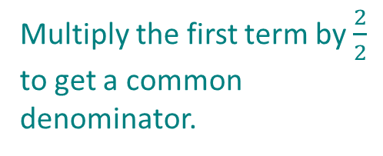
EXAMPLE 1: Combining Radicals (cont.)
​
Simplify the radicals.
Rationalize denominators.
Multiply the first term by $\frac{2}{2}$ to get a common denominator.

Slide 5
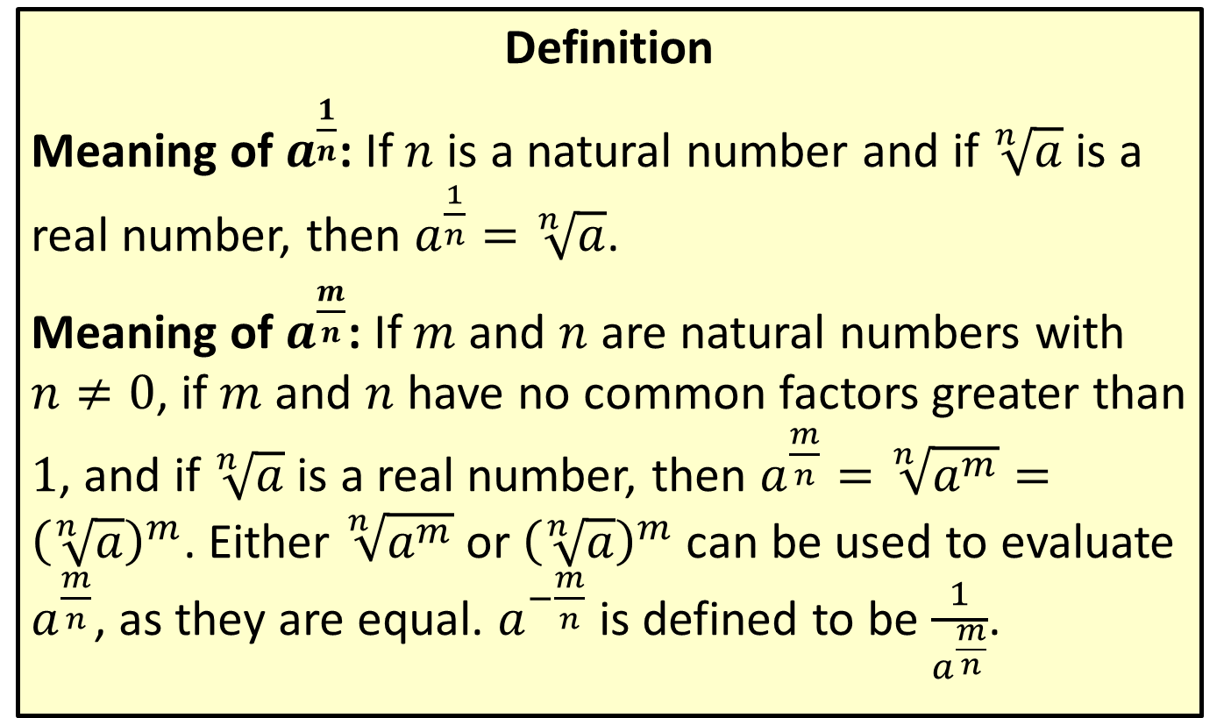
Rational Number Exponents
Definition
Meaning of $a^{\frac{1}{n}}$: If $n$ is a natural number and if $\sqrt[n]{a}$ is a real number, then $a^{\frac{1}{n}}=\sqrt[n]{a}$.
Meaning of $a^{\frac{m}{n}}$: If $m$ and $n$ are natural numbers with $n≠0$, if $m$ and $n$ have no common factors greater than 1, and if $\sqrt[n]{a}$ is a real number, then $a^{\frac{m}{n}}=\sqrt[n]{a^{m}}={\left(\sqrt[n]{a}\right)}^{m}$. Either $\sqrt[n]{a^{m}}$ or ${\left(\sqrt[n]{a}\right)}^{m}$ can be used to evaluate $a^{\frac{m}{n}}$, as they are equal. $a^{−\frac{m}{n}}$ is defined to be $\frac{1}{a^{\frac{m}{n}}}$.

Slide 6
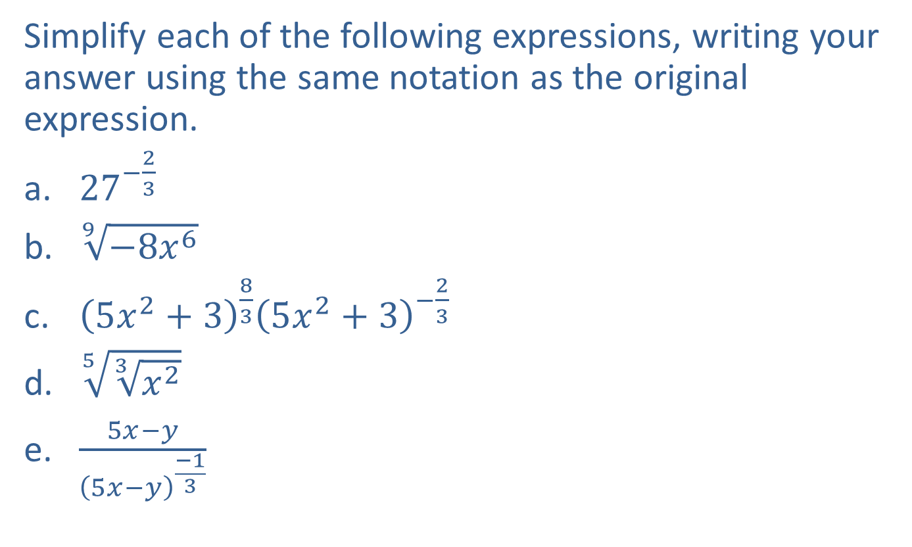
Example 2: Simplifying Expressions
Simplify each of the following expressions, writing your answer using the same notation as the original expression.
​${27}^{−\frac{2}{3}}$
​$\sqrt[9]{−8x^{6}}$
​${\left(5x^{2}+3\right)}^{\frac{8}{3}}{\left(5x^{2}+3\right)}^{−\frac{2}{3}}$
​$\sqrt[5]{\sqrt[3]{x^{2}}}$
​$\frac{5x−y}{{\left(5x−y\right)}^{\frac{−1}{3}}}$

Slide 7
Note:
When simplifying, it is good practice to write the final answer in the same form as the original expression. However, it is often useful to convert between notations to make available a particular method of simplification. The first two examples exhibit this type of strategy.

Slide 8
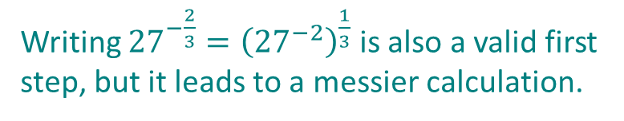

Example 2: Simplifying Expressions (cont.)
Solution
${27}^{−\frac{2}{3}}={\left({27}^{\frac{1}{3}}\right)}^{−2}$
$=3^{−2}$
$$=\frac{1}{3^{2}}$$
$$=\frac{1}{9}$$
Writing ${27}^{−\frac{2}{3}}={\left({27}^{−2}\right)}^{\frac{1}{3}}$ is also a valid first step, but it leads to a messier calculation.

Slide 9
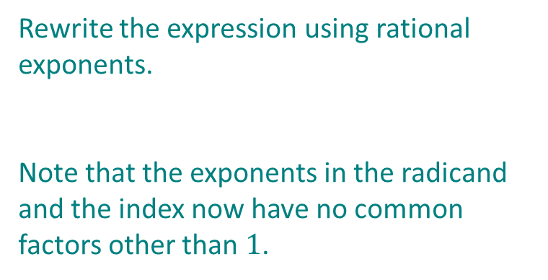

Example 2: Simplifying Expressions (cont.)
$\sqrt[9]{−8x^{6}}=−\sqrt[9]{2^{3}x^{6}}$
$=−2^{\frac{3}{9}}x^{\frac{6}{9}}$
$$=−2^{\frac{1}{3}}x^{\frac{2}{3}}$$
$$=−\sqrt[3]{2x^{2}}$$
Rewrite the expression using rational exponents.
Note that the exponents in the radicand and the index now have no common factors other than $1$.

Slide 10

Example 2: Simplifying Expressions (cont.)
${\left(5x^{2}+3\right)}^{\frac{8}{3}}{\left(5x^{2}+3\right)}^{−\frac{2}{3}}$
$={\left(5x^{2}+3\right)}^{\left(\frac{8}{3}\right)+\left(−\frac{2}{3}\right)}$
$={\left(5x^{2}+3\right)}^{\frac{6}{3}}$
$$={\left(5x^{2}+3\right)}^{2}$$
$\sqrt[5]{\sqrt[3]{x^{2}}}=\sqrt[15]{x^{2}}$ Apply the property $\sqrt[m]{\sqrt[n]{a}}=\sqrt[mn]{a}.$
The bases are the same, so we add the exponents.

Slide 11
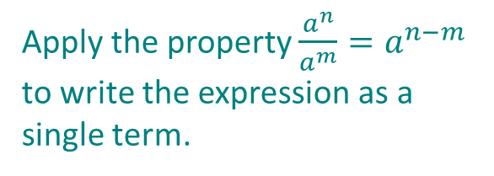

Example 2: Simplifying Expressions (cont.)
$\frac{5x−y}{{\left(5x−y\right)}^{\frac{−1}{3}}}={\left(5x−y\right)}^{1−\left(\frac{−1}{3}\right)}$
$={\left(5x−y\right)}^{\frac{4}{3}}$
Apply the property $\frac{a^{n}}{a^{m}}=a^{n−m}$ to write the expression as a single term.

Slide 12

Example 3: Simplifying Radical Expressions
​Simplify the expression $\sqrt[4]{x^{2}}$.
​Write $\sqrt[3]{2}⋅\sqrt{3}$ as a single radical.

Slide 13
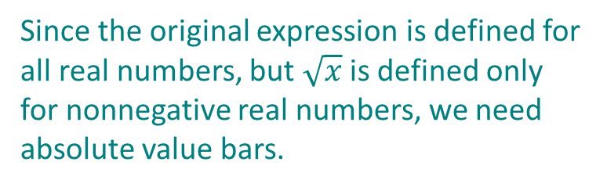

Example 3: Simplifying Radical Expressions (cont.)
Solution
​$\sqrt[4]{x^{2}}={\left(x^{2}\right)}^{\frac{1}{4}}$
$={\left|x\right|}^{\frac{1}{2}}$
$=\sqrt{\left|x\right|}$
Since the original expression is defined for all real numbers, but $\sqrt{x}$ is defined only for nonnegative real numbers, we need absolute value bars.

Slide 14


Example 3: Simplifying Radical Expressions (cont.)
​$\sqrt[3]{2}∙\sqrt{3}=2^{\frac{1}{3}}∙3^{\frac{1}{2}}$
$=$ $2^{\frac{2}{6}}∙3^{\frac{3}{6}}$
$={\left(2^{2}\right)}^{\frac{1}{6}}{\left(3^{3}\right)}^{\frac{1}{6}}$
$=4^{\frac{1}{6}}∙{27}^{\frac{1}{6}}$
$={108}^{\frac{1}{6}}$
$=\sqrt[6]{108}$
Rewrite the expression using rational exponents.
Write the two exponents with a common denominator.
By applying $a^{nm}={\left(a^{n}\right)}^{m}$we can give both terms the same exponent.
This allows us to combine the terms using the property $a^{n}b^{n}={\left(ab\right)}^{n}$.

Slide 15
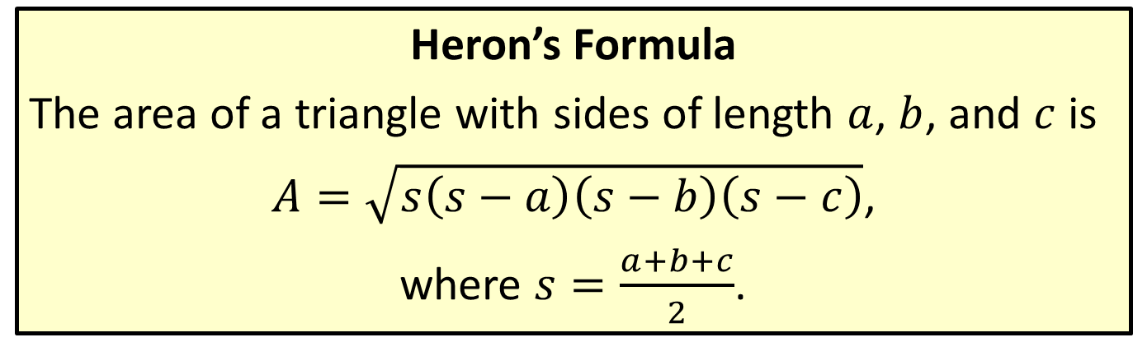
Heron’s Formula for Area of a Triangle
Heron’s Formula
The area of a triangle with sides of length $a$, $b$, and $c$ is
$A=\sqrt{s\left(s−a\right)\left(s−b\right)\left(s−c\right)}$,
where $s=\frac{a+b+c}{2}$.

Slide 16

Example 4: Finding Areas with Heron’s Formula
A regular hexagon is a six-sided plane figure whose sides are all the same length and whose interior angles are all the same. Use Heron’s formula to derive a formula for the area of a regular hexagon with side-length $d$.

Slide 17
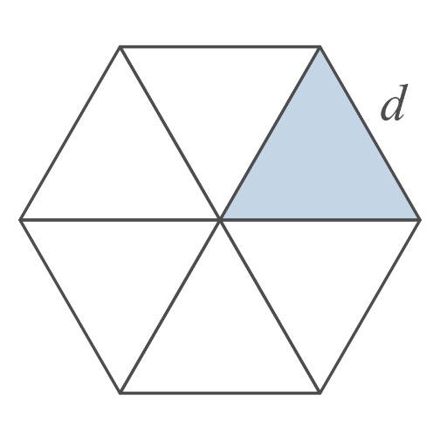
Example 4: Finding Areas with Heron’s Formula (cont.)
Solution

Slide 18
Example 4: Finding Areas with Heron’s Formula (cont.)
Begin by drawing three line segments joining each vertex to the vertex diagonally opposite it. The sum of the six angles meeting in the middle must be 360 degrees and all of the angles are equal, so each one must be a 60 degree angle. By symmetry, each of the six triangles making up the hexagon is isosceles, so each of the remaining two angles in any one triangle must measure 60 degrees as well. Thus each triangle is equilateral (equal sides and equal angles).

Slide 19
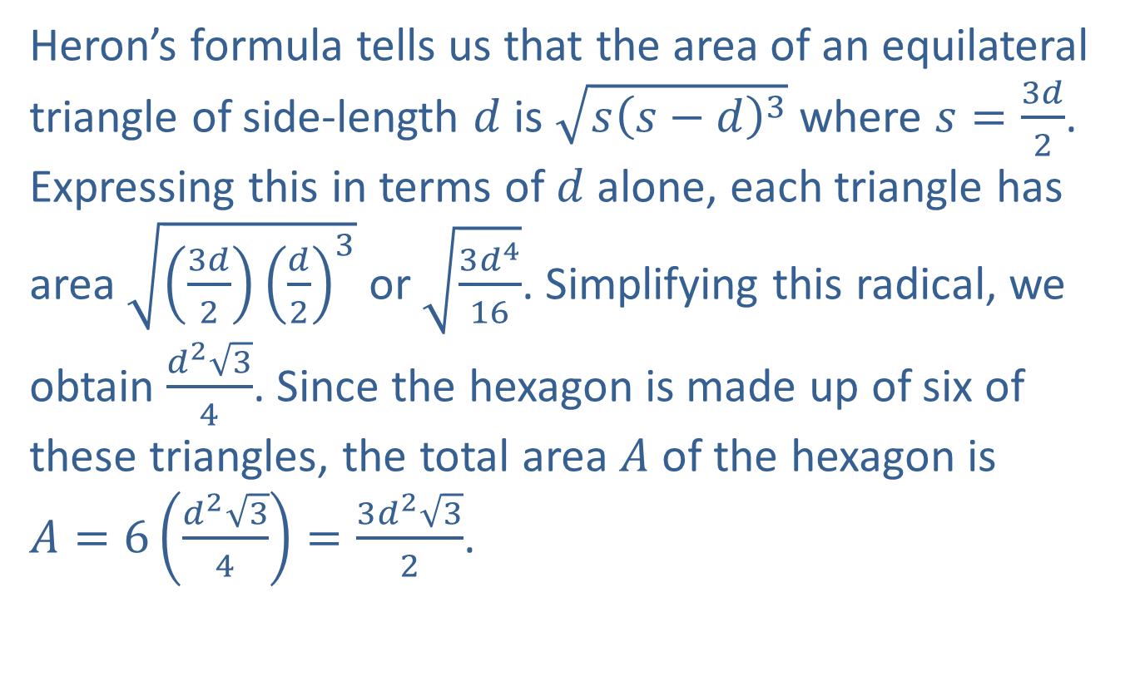
Example 4: Finding Areas with Heron’s Formula (cont.)
Heron’s formula tells us that the area of an equilateral triangle of side-length $d$ is $\sqrt{s{\left(s−d\right)}^{3}}$ where $s=\frac{3d}{2}$. Expressing this in terms of $d$ alone, each triangle has area $\sqrt{\left(\frac{3d}{2}\right){\left(\frac{d}{2}\right)}^{3}}$ or $\sqrt{\frac{3d^{4}}{16}}$. Simplifying this radical, we obtain $\frac{d^{2}\sqrt{3}}{4}$. Since the hexagon is made up of six of these triangles, the total area $A$ of the hexagon is
$A=6\left(\frac{d^{2}\sqrt{3}}{4}\right)=\frac{3d^{2}\sqrt{3}}{2}$.

