Slide 1
Section 1.1
Linear Equations in One Variable

Slide 2
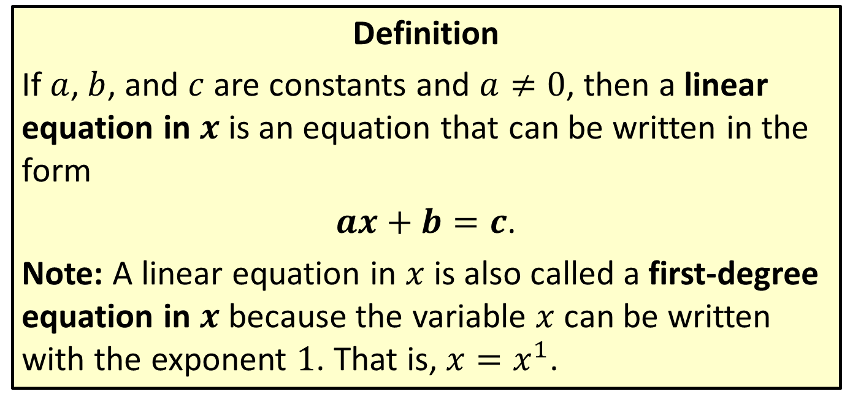

Linear Equations in $x$
Definition
If $a$, $b$, and $c$ are constants and $a≠0$, then a linear equation in $x$ is an equation that can be written in the form
$ax+b=c$.
Note: A linear equation in $x$ is also called a first-degree equation in $x$ because the variable $x$ can be written with the exponent 1. That is, $x=x^{1}$.

Slide 3
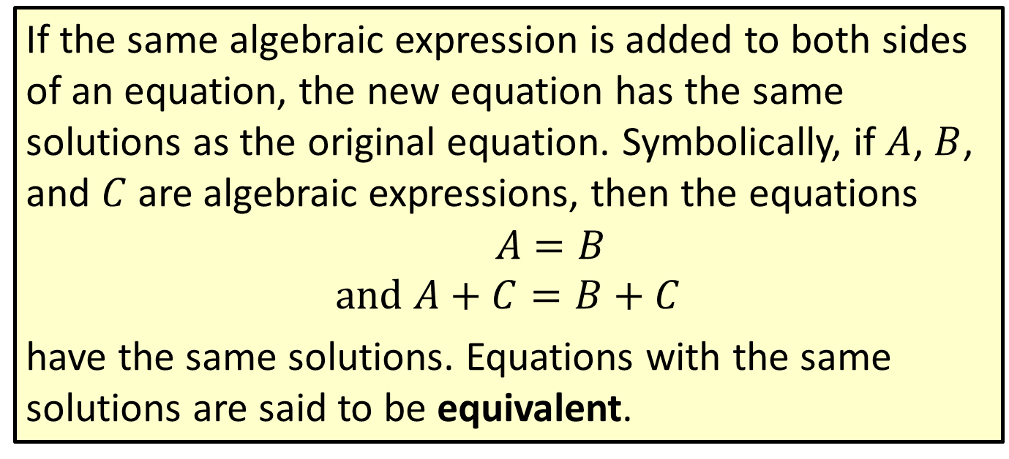
Addition Property of Equality
If the same algebraic expression is added to both sides of an equation, the new equation has the same solutions as the original equation. Symbolically, if $A$, $B$, and $C$ are algebraic expressions, then the equations
$$A=B \\ and A+C=B+C$$
have the same solutions. Equations with the same solutions are said to be equivalent.

Slide 4
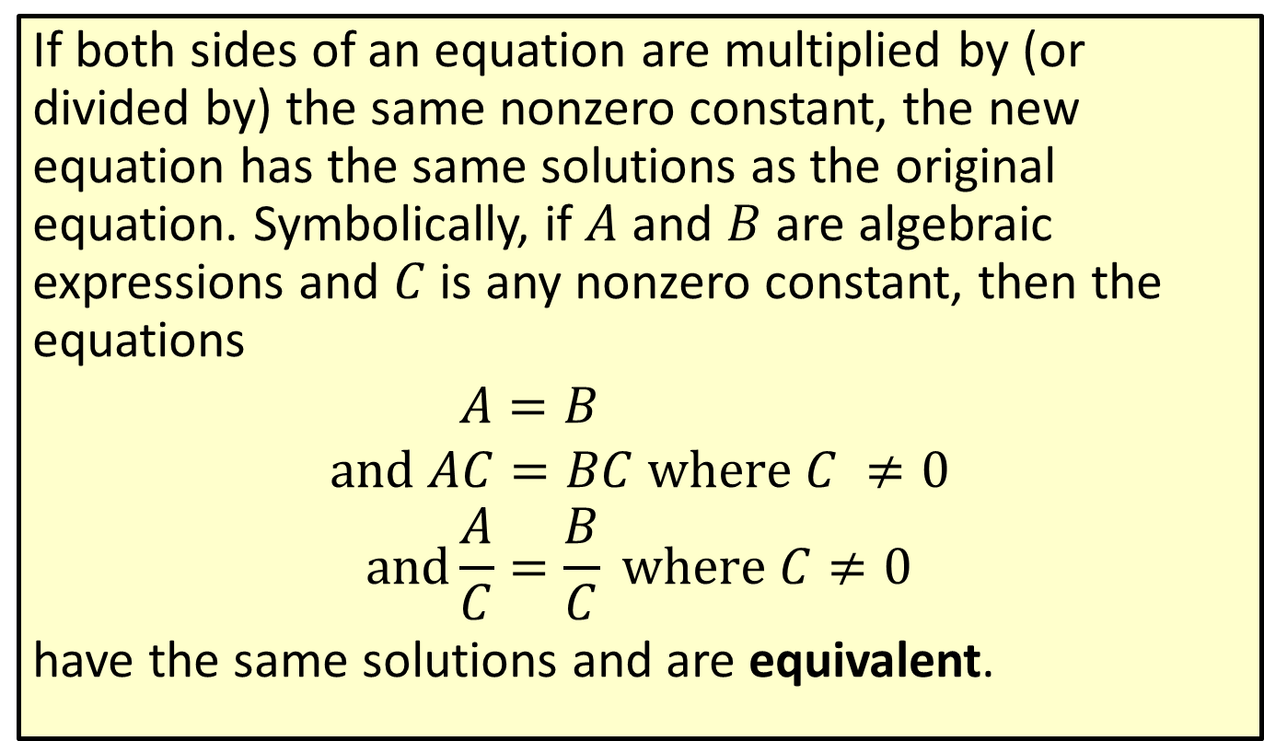
Multiplication (or Division) Property of Equality
If both sides of an equation are multiplied by (or divided by) the same nonzero constant, the new equation has the same solutions as the original equation. Symbolically, if $A$ and $B$ are algebraic expressions and $C$ is any nonzero constant, then the equations
$$A=B \\ and AC=BC where C ≠0 \\ and\frac{A}{C}=\frac{B}{C} where C≠0$$
have the same solutions and are equivalent.

Slide 5
Solving Linear Equations
​Simplify each side of the equation by removing any grouping symbols and combining like terms. (In some cases, you may want to multiply both sides of the equation by a constant to clear fractional or decimal coefficients.)
​Use the addition property of equality to add the opposites of constants or variable expressions so that variable expressions are on one side of the equation and constants on the other.

Slide 6
Solving Linear Equations (cont.)
​Use the multiplication property of equality to multiply both sides by the reciprocal of the coefficient of the variable (that is, divide both sides by the coefficient) so that the new coefficient is 1.
​Check your answer by substituting it into the original equation.

Slide 7

Example 1: Solving a Linear Equation
Solve the linear equation $5+8x−4−3x+2=−8+1$.

Slide 8
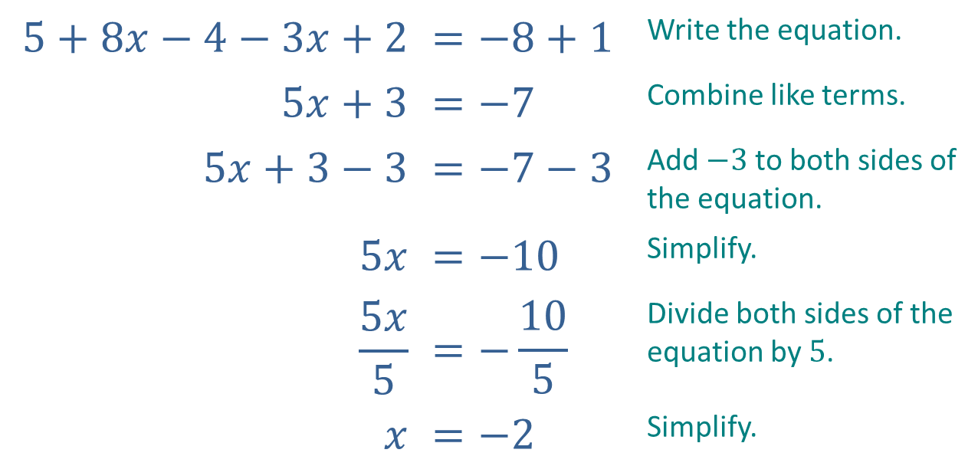
Example 1: Solving a Linear Equation (cont.)
Solution
$$5+8x−4−3x+2$$ | $$=−8+1$$ | Write the equation.
$$5x+3$$ | $$=−7$$ | Combine like terms.
$$5x+3−3$$ | $$=−7−3$$ | Add $−3$ to both sides of the equation.
$$5x$$ | $$=−10$$ | Simplify.
$$\frac{5x}{5}$$ | $$=−\frac{10}{5}$$ | Divide both sides of the equation by $5$.
$$x$$ | $$=−2$$ | Simplify.

Slide 9
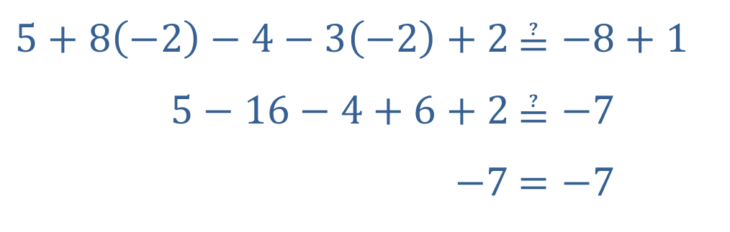
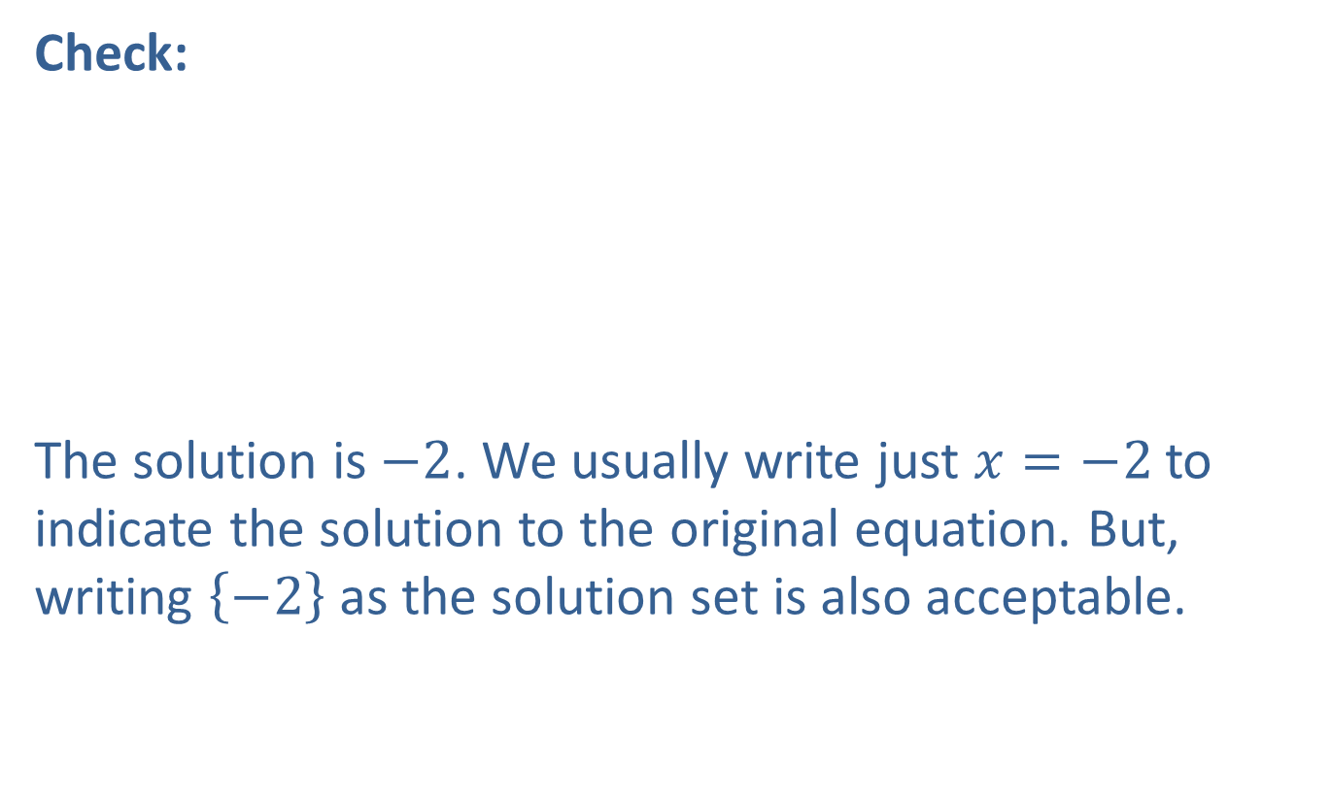
Example 1: Solving a Linear Equation (cont.)
Check:
​
The solution is $−2$. We usually write just $x=−2$ to indicate the solution to the original equation. But, writing $\left\{−2\right\}$ as the solution set is also acceptable.
​$5+8\left(−2\right)−4−3\left(−2\right)+2$ | ​$≟−8+1$
​$5−16−4+6+2$ | ​$≟−7$
​$−7$ | ​$=−7$

Slide 10
Note
To avoid errors and to help make your work easy to read and understand, try to align the = signs in a vertical format so that each new equation is directly below the previous equation.

Slide 11

Example 2: Solving a Linear Equation
Solve $2\left(y−7\right)=4\left(y+1\right)−26$.

Slide 12
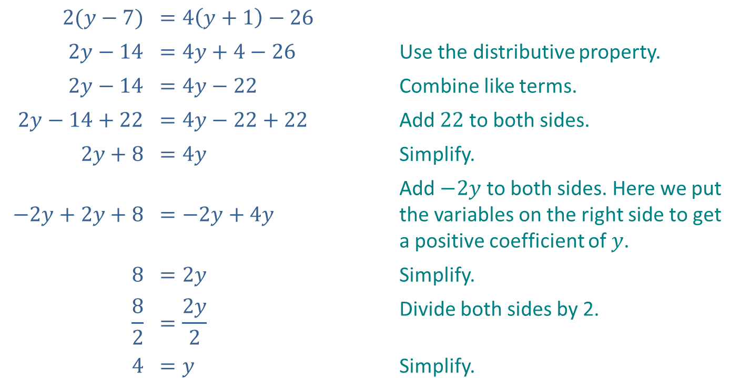
Example 2: Solving a Linear Equation (cont.)
Solution
$$2(y−7)$$ | $$=4\left(y+1\right)−26$$
$$2y−14$$ | $$=4y+4−26$$ | Use the distributive property.
$$2y−14$$ | $$=4y−22$$ | Combine like terms.
$$2y−14+22$$ | $$=4y−22+22$$ | Add $22$ to both sides.
$$2y+8$$ | $$=4y$$ | Simplify.
$$−2y+2y+8$$ | $$=−2y+4y$$ | Add $−2y$ to both sides. Here we put the variables on the right side to get a positive coefficient of $y$.
$$8$$ | $$=2y$$ | Simplify.
$$\frac{8}{2}$$ | $$=\frac{2y}{2}$$ | Divide both sides by 2.
$$4$$ | $$=y$$ | Simplify.

Slide 13
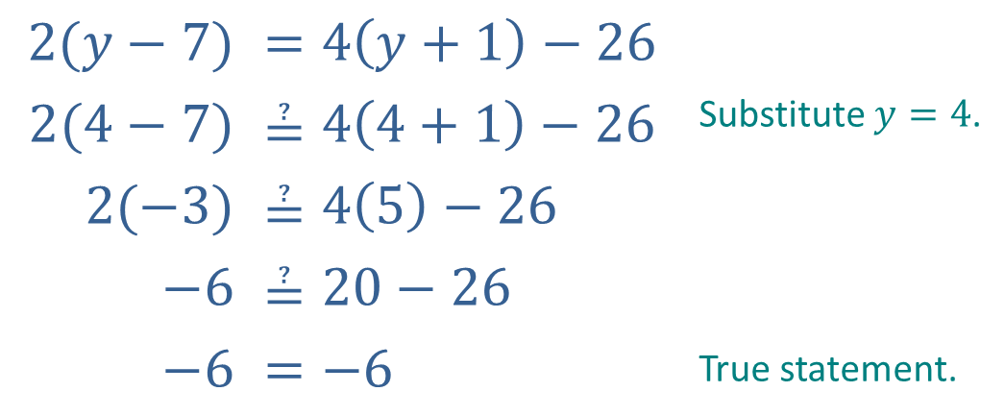

Example 2: Solving a Linear Equation (cont.)
Check:
Thus, the solution to $2\left(y−7\right)=4\left(y+1\right)−26$ is $y=4$.
$$2(y−7)$$ | $$=4\left(y+1\right)−26$$
$$2(4−7)$$ | $$≟4\left(4+1\right)−26$$ | Substitute $y=4$.
$$2(−3)$$ | $$≟4\left(5\right)−26$$
$$−6$$ | $$≟20−26$$
$$−6$$ | $$=−6$$ | True statement.

Slide 14

Example 3: Solving a Linear Equation
Solve $\frac{x−4}{10}+\frac{7}{2}=\frac{x+1}{5}$.

Slide 15
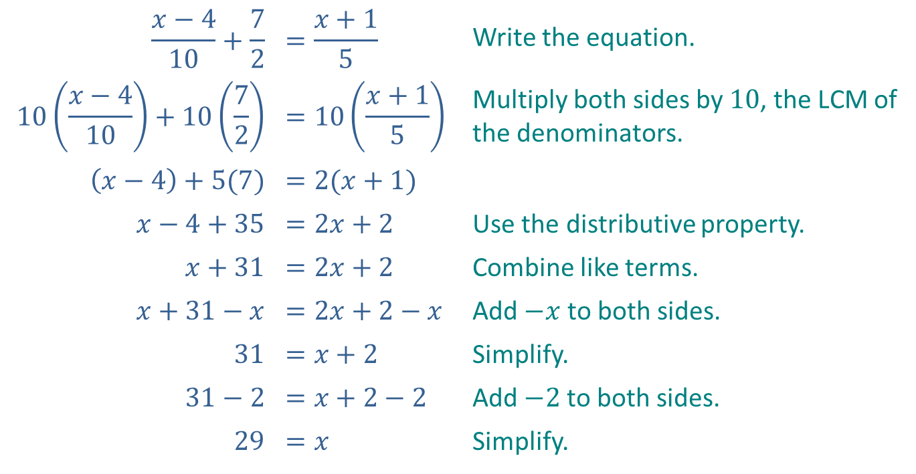
Example 3: Solving a Linear Equation (cont.)
Solution
​
$$\frac{x−4}{10}+\frac{7}{2}$$ | $$=\frac{x+1}{5}$$ | Write the equation.
$$10\left(\frac{x−4}{10}\right)+10\left(\frac{7}{2}\right)$$ | $$=10\left(\frac{x+1}{5}\right)$$ | Multiply both sides by $10$, the LCM of the denominators.
$$\left(x−4\right)+5(7)$$ | $$=2(x+1)$$
$$x−4+35$$ | $$=2x+2$$ | Use the distributive property.
$$x+31$$ | $$=2x+2$$ | Combine like terms.
$$x+31−x$$ | $$=2x+2−x$$ | Add $−x$ to both sides.
$$31$$ | $$=x+2$$ | Simplify.
$$31−2$$ | $$=x+2−2$$ | Add $−2$ to both sides.
$$29$$ | $$=x$$ | Simplify.

Slide 16
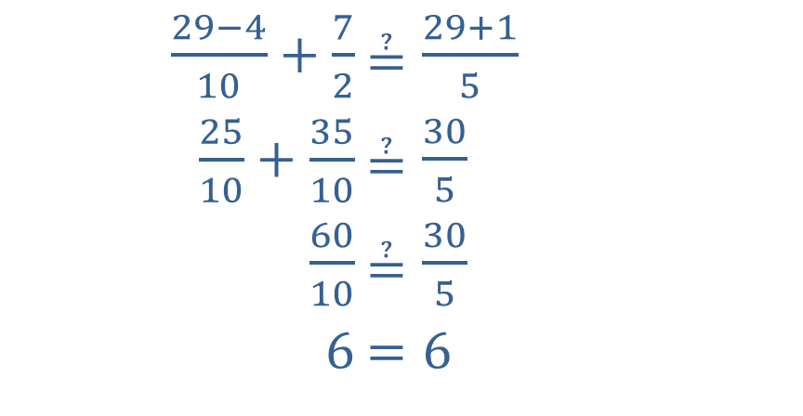
Example 3: Solving a Linear Equation (cont.)
Check:
​
​$\frac{29−4}{10}+\frac{7}{2}$ | ​$≟\frac{29+1}{5}$
​$\frac{25}{10}+\frac{35}{10}$ | ​$≟\frac{30}{5}$
​$\frac{60}{10}$ | ​$≟\frac{30}{5}$
​$6$ | ​$=6$

Slide 17

Example 4: Solving a Linear Equation
Solve $16.53−18.2z=7.43$.

Slide 18
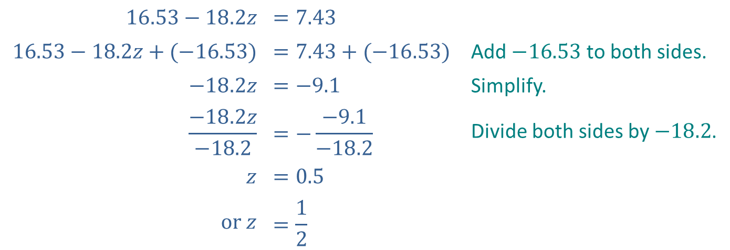
Example 4: Solving a Linear Equation (cont.)
Solution
$$16.53−18.2z$$ | $$=7.43$$
$$16.53−18.2z+(−16.53)$$ | $$=7.43+(−16.53)$$ | Add $−16.53$ to both sides.
$$−18.2z$$ | $$=−9.1$$ | Simplify.
$$\frac{−18.2z}{−18.2}$$ | $$=−\frac{−9.1}{−18.2}$$ | Divide both sides by $−18.2$.
$$z$$ | $$=0.5$$
$$or z$$ | $$=\frac{1}{2}$$

Slide 19
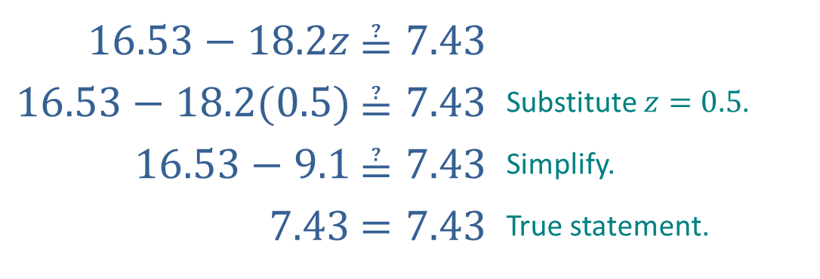

Example 4: Solving a Linear Equation (cont.)
Check:
Thus, the solution to $16.53−18.2z=7.43$ is $z=0.5$.
​$16.53−18.2z$ | ​$≟7.43$
​$16.53−18.2(0.5)$ | ​$≟7.43$ | Substitute $z=0.5$.
​$16.53−9.1$ | ​$≟7.43$ | Simplify.
​$7.43$ | ​$=7.43$ | True statement.

Slide 20
Note
Checking can be quite time-consuming and need not be done for every problem. This is particularly important on exams. You should check only if you have time after the entire exam is completed.

Slide 21
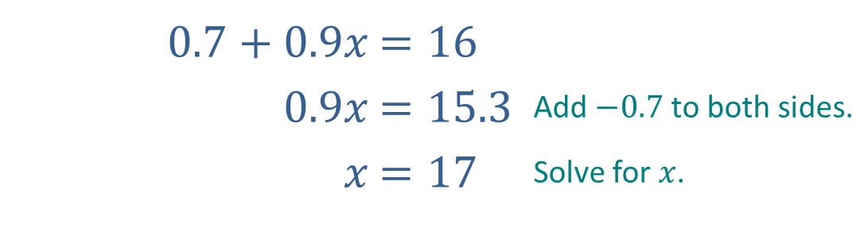
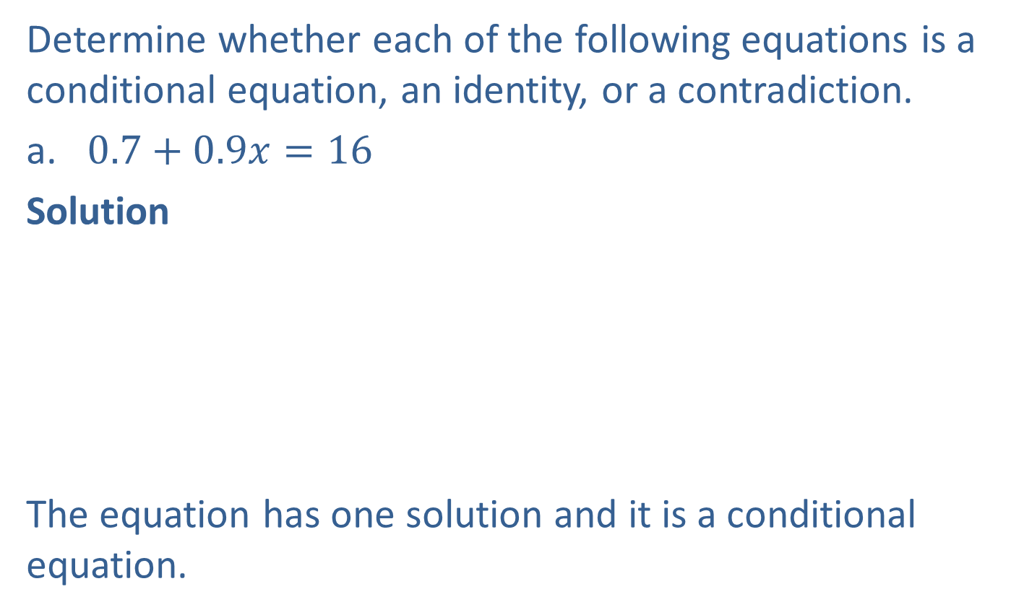
Example 5: Solutions of Equations
Determine whether each of the following equations is a conditional equation, an identity, or a contradiction.
​$0.7+0.9x=16$
​Solution
​The equation has one solution and it is a conditional equation.
​$0.7+0.9x$ | ​$=16$
​$0.9x$ | ​$=15.3$ | Add $−0.7$ to both sides.
​$x$ | ​$=17$ | Solve for $x$.

Slide 22
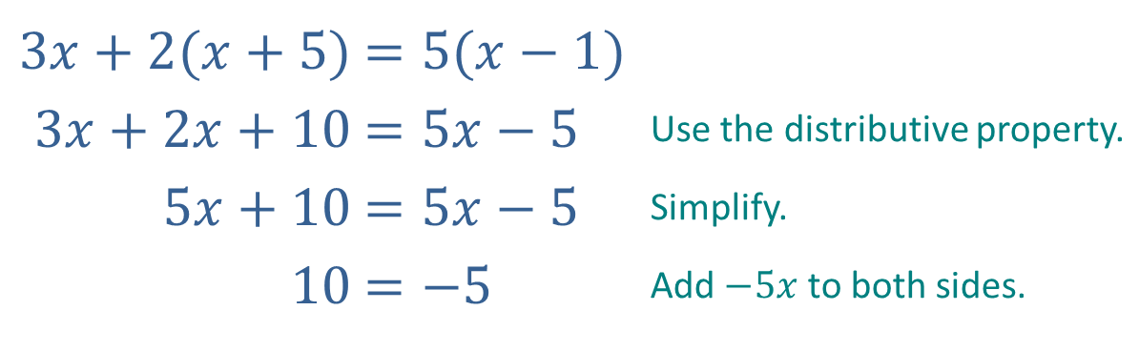

Example 5: Solutions of Equations (cont.)
​$3x+2\left(x+5\right)=5\left(x−1\right)$
​Solution
​The last equation is never true. Therefore, the original equation is a contradiction and has no solution.
​$3x+2(x+5)$ | ​$=5(x−1)$
​$3x+2x+10$ | ​$=5x−5$ | Use the distributive property.
​$5x+10$ | ​$=5x−5$ | Simplify.
​$10$ | ​$=−5$ | Add $−5x$ to both sides.

Slide 23
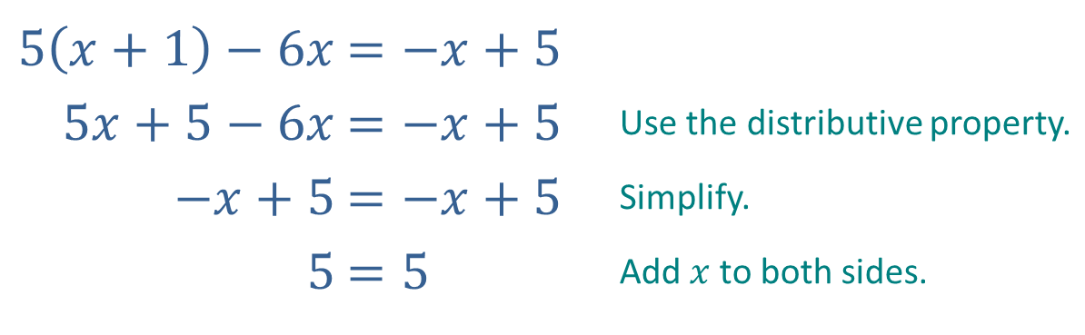

Example 5: Solutions of Equations (cont.)
​$5\left(x+1\right)−6x=−x+5$
​Solution
​The last equation is always true. Therefore, the original equation is an identity and has an infinite number of solutions. Every real number is a solution.
​$5\left(x+1\right)−6x$ | ​$=−x+5$
​$5x+5−6x$ | ​$=−x+5$ | Use the distributive property.
​$−x+5$ | ​$=−x+5$ | Simplify.
​$5$ | ​$=5$ | Add $x$ to both sides.

