Slide 1
Section 1.2
Applications of Linear Equations in One Variable

Slide 2
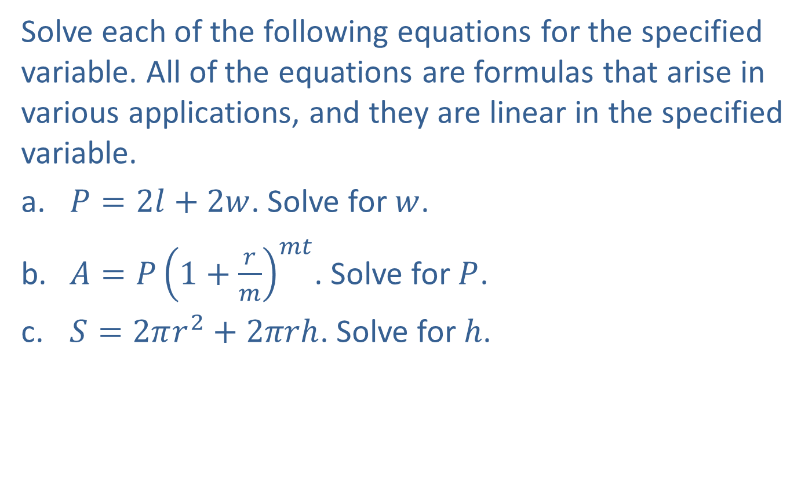
Example 1: Solving Linear Equations for One Variable
Solve each of the following equations for the specified variable. All of the equations are formulas that arise in various applications, and they are linear in the specified variable.
​$P=2l+2w$. Solve for $w$.
​$A=P{\left(1+\frac{r}{m}\right)}^{mt}$. Solve for $P$.
​$S=2πr^{2}+2πrh$. Solve for $h$.

Slide 3
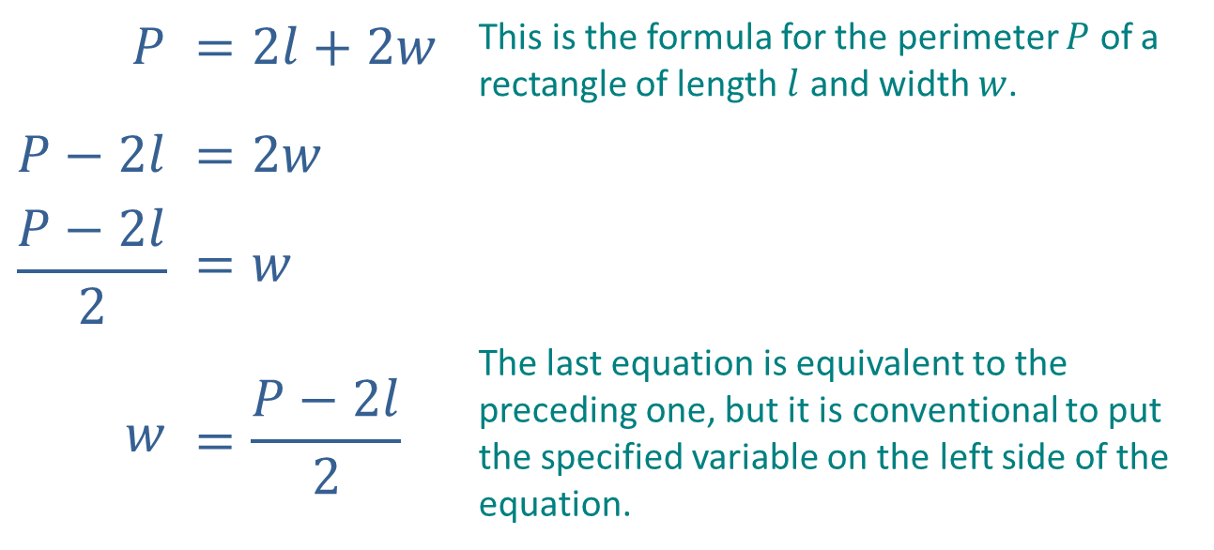
Example 1: Solving Linear Equations for One Variable (cont.)
Solution
​
$$P$$ | $$=2l+2w$$ | This is the formula for the perimeter $P$ of a rectangle of length $l$ and width $w$.
$$P−2l$$ | $$=2w$$
$$\frac{P−2l}{2}$$ | $$=w$$
$$w$$ | $$=\frac{P−2l}{2}$$ | The last equation is equivalent to the preceding one, but it is conventional to put the specified variable on the left side of the equation.

Slide 4
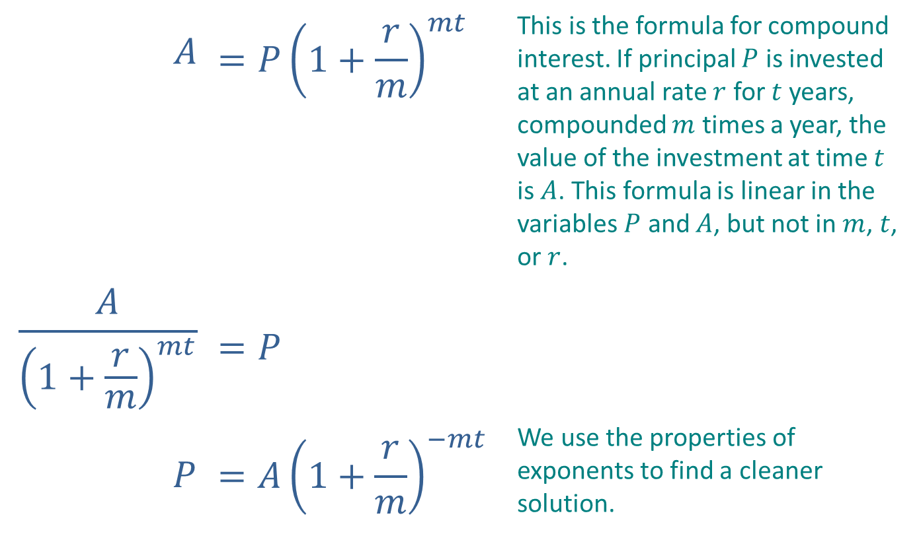
Example 1: Solving Linear Equations for One Variable (cont.)
​
$$A$$ | $$=P{\left(1+\frac{r}{m}\right)}^{mt}$$ | This is the formula for compound interest. If principal $P$ is invested at an annual rate $r$ for $t$ years, compounded $m$ times a year, the value of the investment at time $t$ is $A$. This formula is linear in the variables $P$ and $A$, but not in $m$, $t$, or $r$.
$$\frac{A}{{\left(1+\frac{r}{m}\right)}^{mt}}$$ | $$=P$$
$$P$$ | $$=A{\left(1+\frac{r}{m}\right)}^{−mt}$$ | We use the properties of exponents to find a cleaner solution.

Slide 5
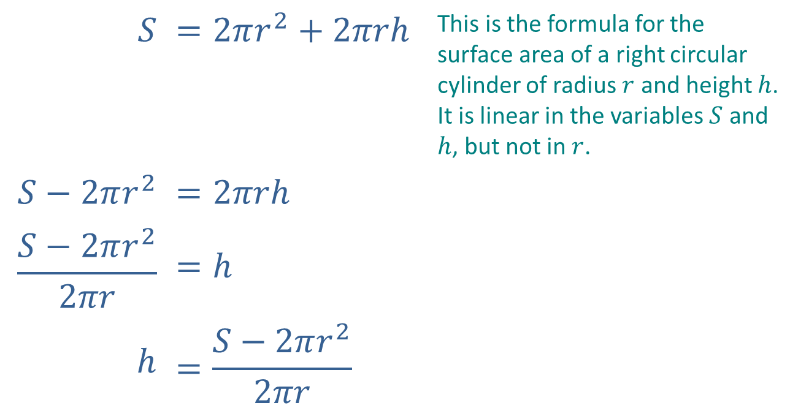
Example 1: Solving Linear Equations for One Variable (cont.)
​
$$S$$ | $$=2πr^{2}+2πrh$$ | This is the formula for the surface area of a right circular cylinder of radius $r$ and height $h$. It is linear in the variables $S$ and $h$, but not in $r$.
$$S−2πr^{2}$$ | $$=2πrh$$
$$\frac{S−2πr^{2}}{2πr}$$ | $$=h$$
$$h$$ | $$=\frac{S−2πr^{2}}{2πr}$$

Slide 6
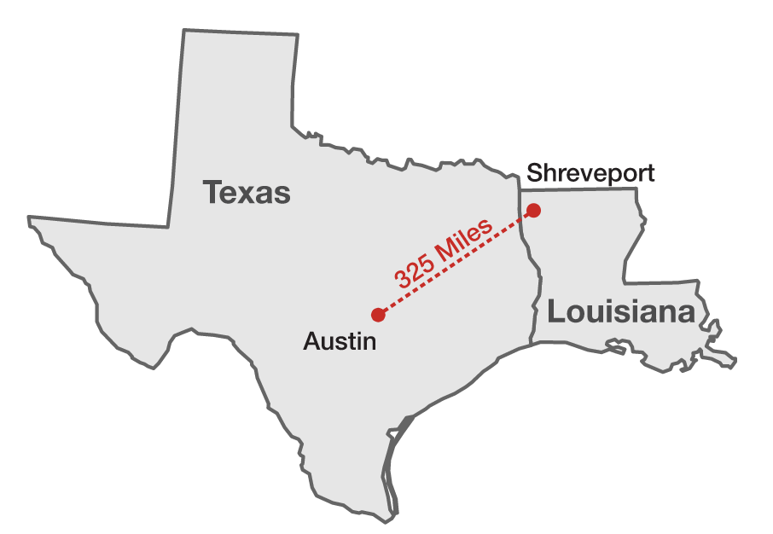
Example 2: Calculating Average Speed
The distance from Shreveport, LA to Austin, TX by one route is 325 miles. If Kevin made the trip in five and a half hours, what was his average speed?

Slide 7
Note
With application or mathematical modeling problems, it often helps to list the variables in the problem. As you read through the problem statement, fill in this list and determine which variable to solve for.

Slide 8
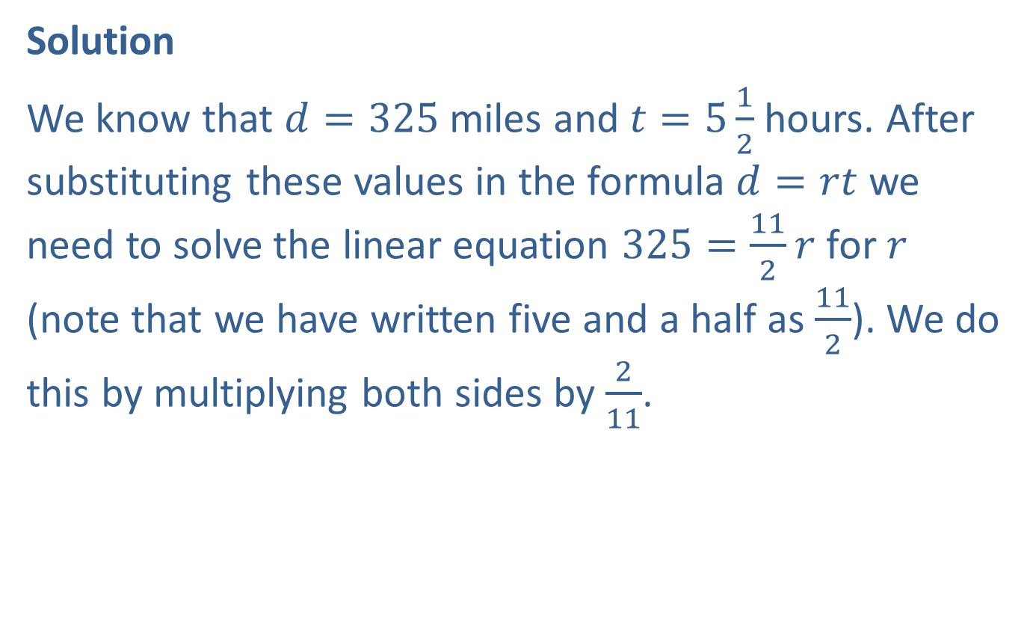
Example 2: Calculating Distance (cont.)
Solution
We know that $d=325$ miles and $t=5\frac{1}{2}$ hours. After substituting these values in the formula $d=rt$ we need to solve the linear equation $325=\frac{11}{2}r$ for $r$ (note that we have written five and a half as $\frac{11}{2}$). We do this by multiplying both sides by $\frac{2}{11}$.

Slide 9
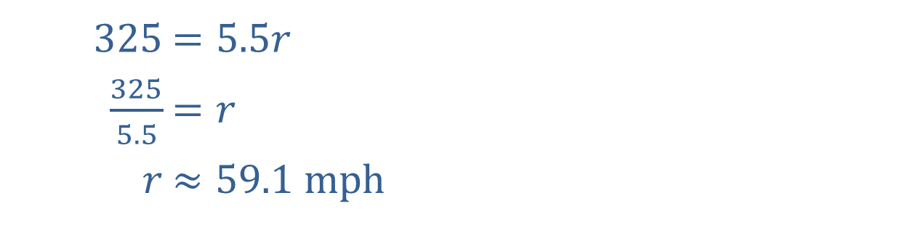
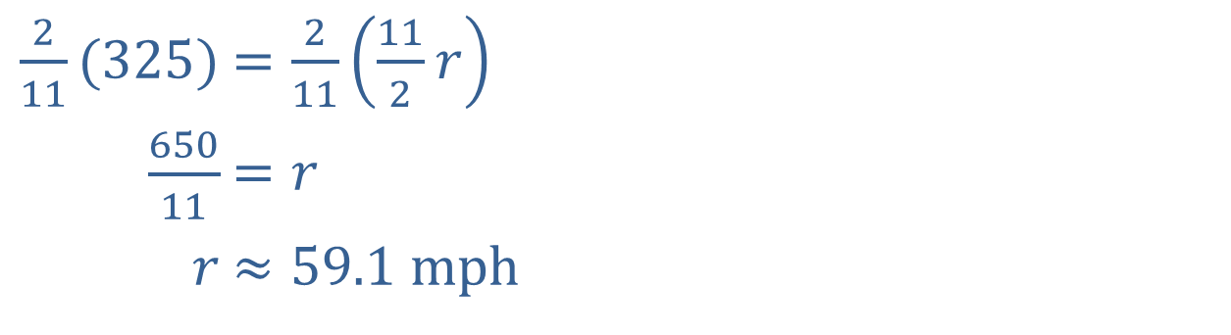
Example 2: Calculating Distance (cont.)
Alternatively, the time can be expressed in decimal form as 5.5 hours.
​$\frac{2}{11}(325)$ | ​$=\frac{2}{11}\left(\frac{11}{2}r\right)$
​$\frac{650}{11}$ | ​$=r$
​$r$ | ​$≈\text{59.1 }\text{mph}$
​$325$ | ​$=5.5r$
​$\frac{325}{5.5}$ | ​$=r$
​$r$ | ​$≈\text{59.1 }\text{mph}$

Slide 10
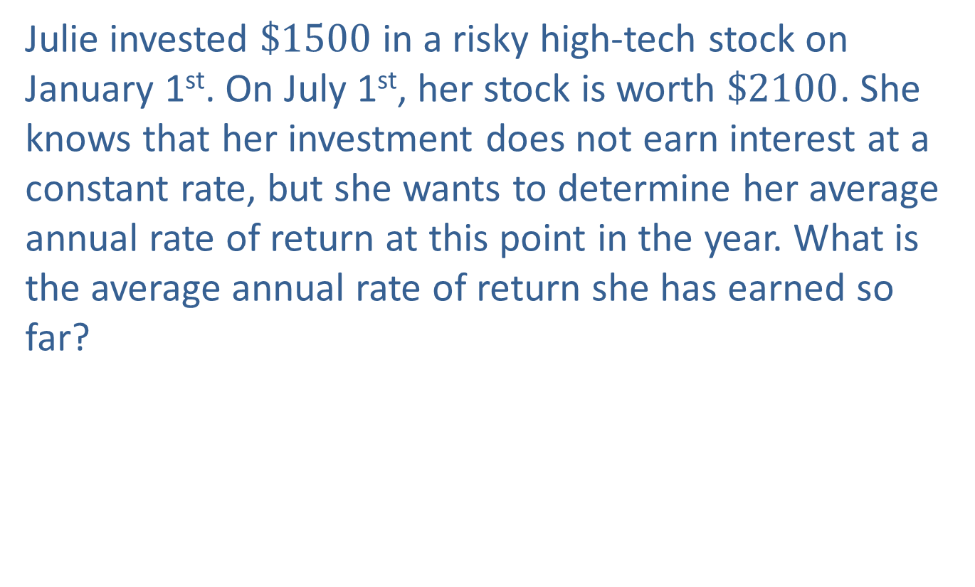
Example 3: Calculating Average Interest Rate
Julie invested $\$1500$ in a risky high-tech stock on January 1st. On July 1st, her stock is worth $\$2100$. She knows that her investment does not earn interest at a constant rate, but she wants to determine her average annual rate of return at this point in the year. What is the average annual rate of return she has earned so far?

Slide 11
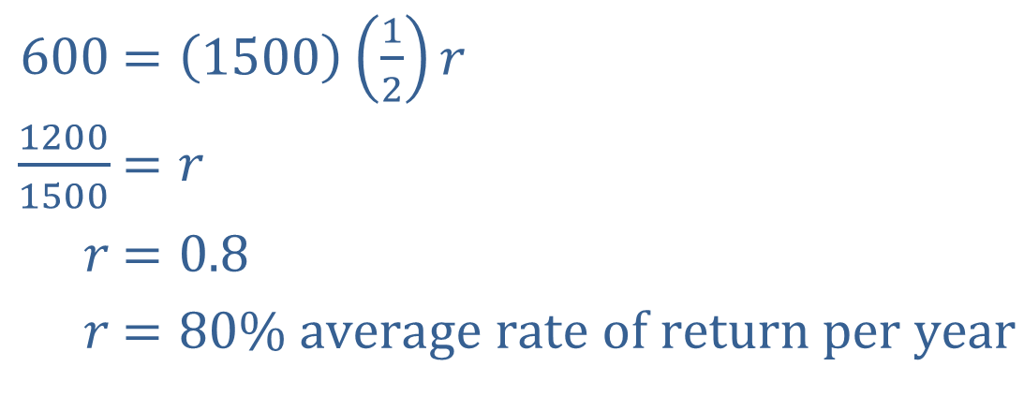

Example 3: Calculating Average Interest Rate (cont.)
Solution
The interest that Julie has earned in half a year is $\$600$ (or $\$2100−\$1500$). Replacing $P$ with 1500, $t$ with $\frac{1}{2}$, and $I$ with 600 in the formula $I=Prt$, we have:
​
​$600$ | ​$=\left(1500\right)\left(\frac{1}{2}\right)r$
​$\frac{1200}{1500}$ | ​$=r$
​$r$ | ​$=0.8$
​$r$ | ​$=80\% \text{average} \text{rate} \text{of} \text{return} \text{per} \text{year}$

